Slide 1
Season 2, Lecture 12 (S2,L12):
Thermal Physics and Quantum Technology

Slide 2
Quantum Memory (QM)
Stationary QuBit
i.e QUANTUM MEMORY
(Eg Quantum atomic gas)
Flying QuBit
(Eg a photon)
Flying QuBit
(Eg a photon)
storage
read-out
LIGHT
LIGHT
ATOM + LIGHT
POLARITON
RESEARCH
WORK
Says Quantum gas

Slide 3
Interesting experiment by Prof. Ashkin and his team
Atom
Stream of Photons
Atoms got deflected by laser beam ………………………..HOW?
Effect was very directional

Slide 4
Resonances in systems
Simple Pendulum
Spring mass system
LCR Systems
ATOMIC SYSTEMS

Slide 5
Possibility of Cooling of atoms by Light?
v
v
LIGHT interacts with ATOMS
Radiation Pressure from Light
Atom
Stream of Photons

Slide 6
Model using 2 level system

Slide 7
Two level atom interacting with Light
Atom
Stream of Photons
What are the possible phenomena’s?
Stimulated Absorption
Stimulated Emission
Spontaneous Emission

Slide 8
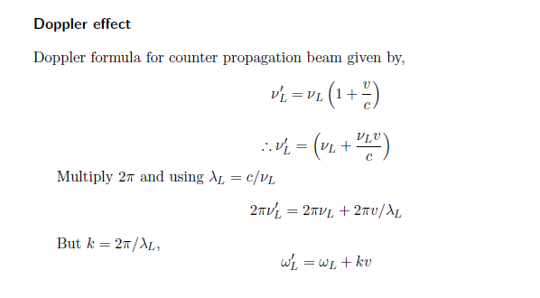
Doppler Effect

Slide 9
Doppler effect in radiation pressure
Laser cooling in 1-D
v
e
δ
ω_{L}- kv
ω_{L}+ kv
ω_{L}
ω_{o}
ω_{L}
g

Slide 10
Atoms decelerate

Slide 11
Laser cooling in 3-D

Slide 12
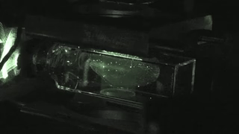

Slide 13
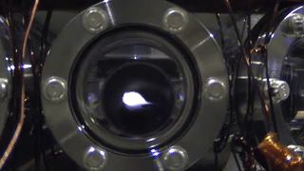

Slide 14
Name | L9 | L10 | L11 | L12
"2201ph34_dolly" <2201ph34_dolly@iitp.ac.in>; | p | P | p | A
"Adhila Aslam" <2201ph01_adhila@iitp.ac.in>; | p | P | p | p
"Aditi Baghel" <2201ph31_aditi@iitp.ac.in>; | p | P | p | p
"Aditya Kumar" <2201ph02_aditya@iitp.ac.in>; | p | A | A | A
"Aditya Singh" <2201ph03_aditya@iitp.ac.in>; | p | P | p | p
"Anil Ram" <2201ph04_anil@iitp.ac.in>; | a | A | A | A
"Animesh Sharma" <2201ph05_animesh@iitp.ac.in>; | p | P | p | p
"Arun Mishra" <2201ph06_arun@iitp.ac.in>; | a | P | p | p
"Aryan Raj" <2201ph32_aryan@iitp.ac.in>; | p | P | p | p
"Ayush Gautam" <2201ph07_ayush@iitp.ac.in>; | a | P | a | A
"Boda Vishnuwardhan" <2201ph08_boda@iitp.ac.in>; | p | A | A | p
"Chanchal Tolani" <2201ph09_chanchal@iitp.ac.in>; | p | P | p | p
"Devansh Srivastava" <2201ph33_devansh@iitp.ac.in>; | a | A | A | A
"Gaurav Verma" <2201ph10_gaurav@iitp.ac.in>; | p | P | p | A

Slide 15
Name | L9 | L10 | L11 | L12
"Gourav Jha" <2201ph11_gourav@iitp.ac.in>; | a | P | p | p
"Gurinder Dhillon" <2201ph12_gurinder@iitp.ac.in>; | p | P | A | A
"Harsh Joshi" <2201ph13_harsh@iitp.ac.in>; | p | P | p | p
"Himanshu Patel" <2201ph35_himanshu@iitp.ac.in>; | p | P | p | A
"Jigyasa Agrawal" <2201ph36_jigyasa@iitp.ac.in>; | a | A | A | A
"Khushal Yadav" <2201ph14_khushal@iitp.ac.in>; | p | P | p | A
"Krishnakant Chourey" <2201ph15_krishnakant@iitp.ac.in>; | p | A | A | p
"Manas Gupta" <2201ph16_manas@iitp.ac.in>; | a | P | p | A
"Mohit Saini" <2201ph17_mohit@iitp.ac.in>; | a | P | p | p
"Mude Naik" <2201ph18_mude@iitp.ac.in>; | p | P | p | p
"Murari Kumar" <2201ph19_murari@iitp.ac.in>; | p | P | A | p
"Nishant Yadav" <2201ph20_nishant@iitp.ac.in>; | p | P | A | p
"Pranitha Moluguri" <2201ph21_pranitha@iitp.ac.in>; | p | P | p | p

Slide 16
Name | L9 | L10 | L11 | L12
"Premanandh Sigamala" <2201ph22_premanandh@iitp.ac.in>; | p | P | A | p
"Ruchi Thakur" <2201ph23_ruchi@iitp.ac.in>; | p | P | p | p
"Satyam Sahoo" <2201ph25_satyam@iitp.ac.in>; | p | P | p | p
"Satyam Shandilya" <2201ph24_satyam@iitp.ac.in>; | p | P | A | p
"Shyam Hembram" <2201ph26_shyam@iitp.ac.in>; “ | p | P | p | p
Sougata Saha" <2201ph27_sougata@iitp.ac.in>; | a | A | A | A
"Sumit Rajpoot" <2201ph28_sumit@iitp.ac.in>; | p | P | p | p
"Suprajit Dewanji" <2201ph29_suprajit@iitp.ac.in>; | a | P | p | p
"Yepuri Subhash" <2201ph30_yepuri@iitp.ac.in> | p | A | A | A
Attendance: 75% mandatory

