Slide 1
Season 3, Lecture 6 (S3,L6):
Tutorial 1 continued
EP2104 Thermal physics with engineering applications
3-1-0-4

Slide 8
Roll No. | Name | L1 | L2 | L3 | L4 | L5 | l6 | l7
2301PH01 | Aditya Chandra | p | P | p | p | P | p | a
2301PH02 | Aditya Mittal | p | P | a | p | P | p | p
2301PH03 | Aditya Prakash Gupta | p | P | p | p | P | p | p
2301PH04 | Amit Kumar | a | P | p | p | P | p | p
2301PH05 | Angaanba Ningthoujam | p | P | p | p | P | p | p
2301PH06 | Arunvishal Palanisamy | p | P | p | p | P | p | p
2301PH07 | Ashmit Verma | p | P | p | p | P | p | p
2301PH08 | Azariah Peter | a | A | p | p | P | p | p
2301PH09 | Deveshsingh Kuldeepsingh Tomar | p | P | p | p | P | p | c

Slide 9
 |  | L1 | L2 | L3 | L4 |  |  | l7
2301PH10 | Muskan Singh | p | P | a | p | P | p | p
2301PH11 | Naveen Saini | a | P | p | p | P | p | p
2301PH12 | Nishanth Kumaran | p | P | p | a | P | p | a
2301PH13 | Nived Krishna M | p | P | p | p | P | p | p
2301PH14 | Ratan Deep Prasad | p | P | p | p | P | p | p
2301PH15 | Ritesh | p | P | p | p | P | p | c
2301PH16 | Shivam Kumar Kannojia | p | P | p | p | P | p | p
2301PH17 | Shivang Rayat | p | P | p | p | P | p | p
2301PH18 | Yashraj Singh Thakur | p | P | p | p | P | p | p
2301PH19 | Aekampreet Singh Dhir | p | P | p | p | P | p | p
2301PH20 | Banoth Naveen | a | A | a | a | A | a | a

Slide 10
 |  | L1 | L2 | L3 | L4 |  |  | l7
2301PH21 | Neerati Pranay | p | P | p | p | P | p | p
2301PH22 | Tanish Dhankhar | p | P | p | p | P | p | p
2301PH23 | Farhan Farhan | p | P | p | a | P | p | p
2301PH24 | Utpal Raj Ambastha | p | P | p | p | P | p | p
2301PH25 | Riya Singh | p | P | p | p | P | p | p
2301PH26 | Aakarsh Sinha | a | P | p | p | P | p | c
2301PH27 | Rahul Katravath | a | A | p | p | P | p | p
2301PH28 | Shivani | p | P | p | p | P | p | p
2301PH29 | Rakesh Bairwa | p | P | a | p | P | p | p
2301PH30 | Nikhil Pratap Singh | a | P | p | p | P | p | p
2301PH31 | Sridutt Rugada | a | P | p | p | P | p | p
2301PH32 | Anmisha Jadi | p | P | p | p | P | p | p
Attendance: 75% mandatory

Slide 13
Maxwell-Boltzmann Distribution: Kinetic Theory
y
Random motion in all directions
N molecules
V container volume
x
z
How many molecules are moving between velocities v and v + dv?

Slide 14
For convenience
Position space to Velocity space

Slide 15
Let us consider a small region of space

Slide 16
Let us consider a small infinitesimal region of space
“N” molecules
in container
how many molecules are moving between
velocities v and v + dv?

Slide 17
Maxwell’s velocity distribution function and assumption’s

Slide 18
Maxwell’s velocity distribution function and assumption’s
A

Slide 21
2

Slide 22
Recollect eqn (1)
3

Slide 23
Laplace’s method of undetermined multiplier (Mathematics)

Slide 24
Recollecting (A) and substituting

Slide 25
A
B

Slide 28
Maxwell’s distribution law

Slide 30
Maxwell Boltzmann
distribution law

Slide 31
Tutorial 1

Slide 32
Problem 1

Slide 33
Solution

Slide 39
Using Law of Equipartition of energy

Slide 40
Distribution function
Maxwell Boltzmann speed distribution

Slide 41
Problem 2

Slide 42
Distribution function
Maxwell Boltzmann speed distribution

Slide 43
Problem 2

Slide 44
(a) Complete Analysis of distribution function

Slide 45
Complete Analysis of distribution function

Slide 46
(b) With temperature

Slide 47
(c) Most Probable speed
Most probable speed

Slide 48
Complete Analysis of distribution function

Slide 49
Average speed
(d)
Root mean square speed (RMS)

Slide 50
(e) A comparison

Slide 51
Problem 3

Slide 52
Solution:

Slide 53
Solution:

Slide 54
Problem 4

Slide 55
Solution

Slide 57
Problem 5

Slide 58
Solution
1

Slide 59
Solution

Slide 61
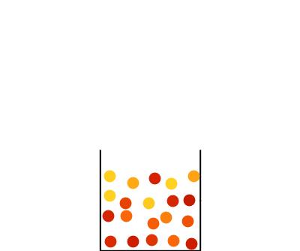

Slide 62
Problem 6

Slide 63
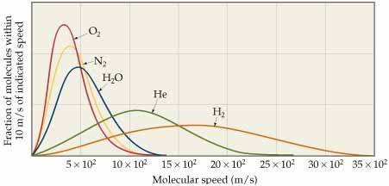
Solution

