Slide 1
Experiment Sequence (MOT)

Slide 2
 |  |  | L13 | L14
1 | 1921PH19 | SAUMYASHREE BARAL | p | p
2 | 2321PH02 | ARYA KUMAR SIDDHARTH | p | p
3 | 2321PH07 | NAINCY SHRIVASTAVA | p | p
4 | 2321PH09 | PRITAM SAMANTA | p | p
5 | 2321PH10 | REETU SAINI | p | p
6 | 2321PH13 | SOUBHIK MUKHERJEE | p | p
7 | 2321PH14 | NEHA CHOUDHARY | p | p
8 | 2321PH15 | RABI DAS | p | a
9 | 2321PH19 | SHRUTI SARSWAT | p | p
10 | 2212PH02 | AMAN KUMAR | p | p
11 | 2212PH10 | BINAYAK ROUT | p | p
12 | 2212PH11 | DARPAN SARKAR | p | p
13 | 2212PH13 | GAURAV JAISWAL | a | p
14 | 2212PH17 | KAUSHIP SAHA | p | p
15 | 2212PH20 | NEELLOHIT KARMAKAR | p | p
16 | 2212PH23 | RITIK PAL | p | p
17 | 2212PH26 | SOUMIK KARMAKAR | p | p
18 | 2212PH32 | KAUSTAB BHARASA | p | a

Slide 3
Doppler
Cooling
MOT
Laser
Power
ω₀-kv_{d}
Laser
frequency
ω₀ - ω_{zeeman} + kv
Magnetic
field

Slide 4
Cooling phases
Doppler
Cooling
MOT
Atomic is density
Increased
Temperature decreased
Magnetic Trapping
Need
Multi-Level
Treatment.
2 level model fails…
Quantum nature of atoms observed
Evaporative Cooling

Slide 5
Force equation in a MOT

Slide 6
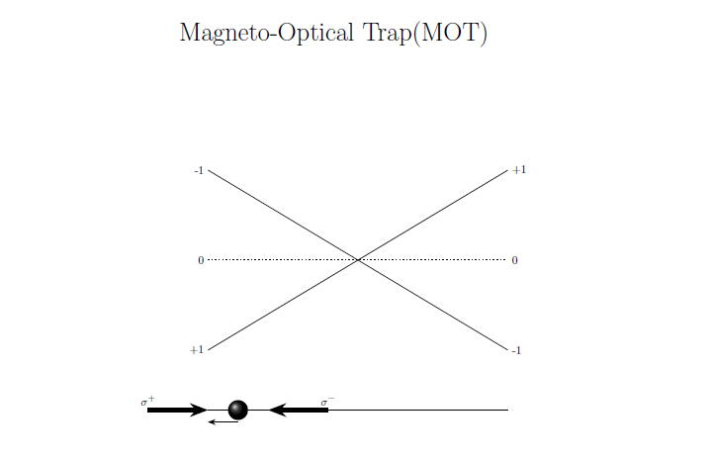
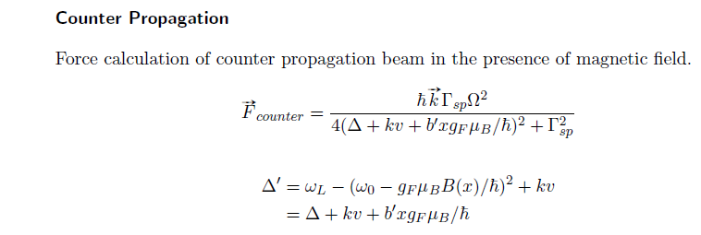

Slide 7
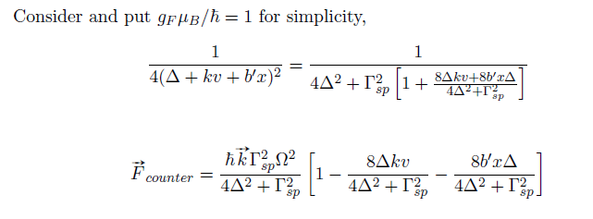
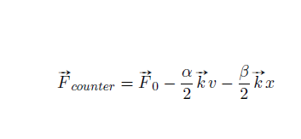

Slide 8
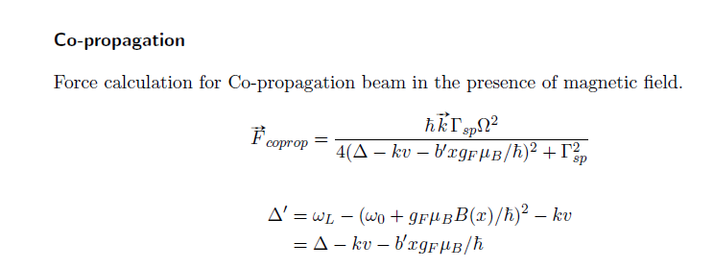
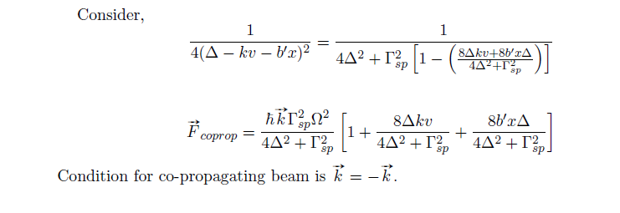

Slide 13
Multi-Level atom – A case study on Rb

Slide 14
Rb
Two ISOTOPES 85 AND 87
Mass number = 85
Mass number = no of protons +no of nuetrons
37 protons + 48 nuetrons = 85
Mass number = 87
Mass number = no of protons +no of nuetrons
37 protons + 50 nuetrons = 87
Number of electrons = 37
[…………………] 5S¹

Slide 15
Is it a Bosonic Atom or Fermionic Atom?

Slide 16
Atomic Spin of Rb⁸⁵
= [Proton spin + Neutron spin + Electron spin]X$\frac{1}{2}$
=[37(odd) + 48(even)+37(odd)] X$\frac{1}{2}$
= Even number, Hence Boson……
What about Rb⁸⁷?

Slide 17
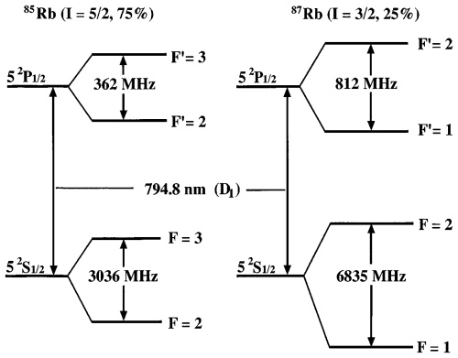
Hyperfine splitting

Slide 18
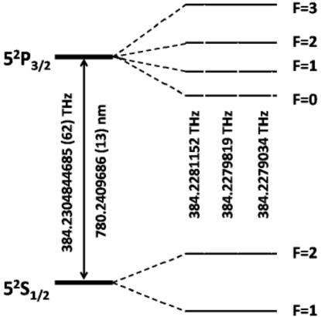
Hyperfine splitting

Slide 19
Laser Cooling in Rb87
Cooling
repump

Slide 20
MOT for Rb

Slide 21
MOT
-B Location
-2
+2
For emission
ΔmF = 0, +/-1
ΔF=0, +/-1
Repump,
Π POLARIZED
+2
+1
mF
σ+Light, ΔmF = +1
-1
+1

Slide 22
MOT
+B
VICE VERSA

Slide 23
MAGNETIC TRAPPING
A conservative Trap/ Potential for laser cooled atoms
No Laser Cooling Lights, they are off

Slide 24
Doppler
Cooling
MOT
Laser
Power
ω₀-kv_{d}
Laser
Frequency
Cooling+
Repump
ω₀ - ω_{zeeman} + kv
Magnetic
field

Slide 25
Rb
Two ISOTOPES 85 AND 87
Mass number = 85
Mass number = no of protons +no of nuetrons
37 protons + 48 nuetrons = 85
Mass number = 87
Mass number = no of protons +no of nuetrons
37 protons + 50 nuetrons = 87
Number of electrons = 37
[…………………] 5S¹

Slide 26
Is it a Bosonic Atom or Fermionic Atom?

Slide 27
Atomic Spin of Rb⁸⁵
= [Proton spin + Neutron spin + Electron spin]X$\frac{1}{2}$
=[37(odd) + 48(even)+37(odd)] X$\frac{1}{2}$
= Even number, Hence Boson……
What about Rb⁸⁷?

Slide 28
Hyperfine splitting

Slide 31
Hyperfine splitting

Slide 32
MOT
-B Location
-2
+2
For emission
ΔmF = 0, +/-1
ΔF=0, +/-1
+2
+1
mF
σ+Light, ΔmF = +1
-1
+1

Slide 33
MOT
-B Location
-2
+2
For emission
ΔmF = 0, +/-1
ΔF=0, +/-1
Repump,
Π POLARIZED
+2
+1
mF
σ+Light, ΔmF = +1
-1
+1

Slide 34
MOT
+B
VICE VERSA

Slide 35
Cooling phases
Doppler
Cooling
Milli Kelvin range
MOT
Atomic density
Increased
Cooling is limited
Upto Doppler Temp due to light
Magnetic Trapping
Need
Multi-Level
Treatment.
2 level model fails…
Cooling Beyond Doppler Limit
Quantum nature of atoms observed
Evaporative Cooling

Slide 36
MAGNETIC TRAPPING
A conservative Trap/ Potential for laser cooled atoms
No Laser Cooling Lights, they are off

