Slide 1
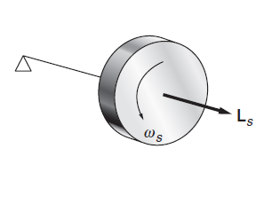
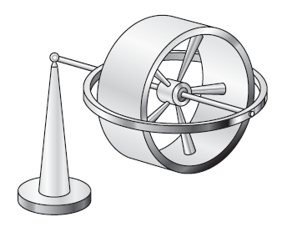
Recap
Gyroscope

Slide 2
$$Ωy$$
L_{y} = I_{yy}$Ωy$
L_{s}+$∆L_{Z}$
$∆L_{Z}$ = $∆L_{s}$
x
L_{s}
Apply an Impulse in y
z
Torque in z
$\frac{∆L_{Z}}{∆t}=\frac{∆L_{s}}{∆t}=Ωy×$L_{s}
τ_{z} =

Slide 3
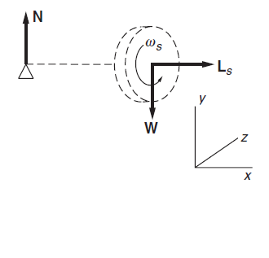
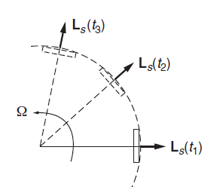
Gyroscope Precision
l
Z
Ω_{y}
Direction is tangential
X
There must be a torque on the gyroscope to account for the change in L_{s}

Slide 4
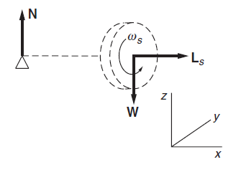
Gyroscope Precision
l

Slide 5
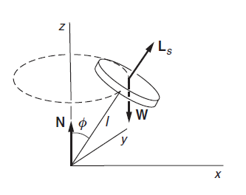
Gyroscope Precision
y
Consider a gyroscope in uniform precession with its axle at angle φ with vertical
The horizontal component of angular momentum is L_{s}sin φ
z
The precessional velocity is independent of φ

Slide 6
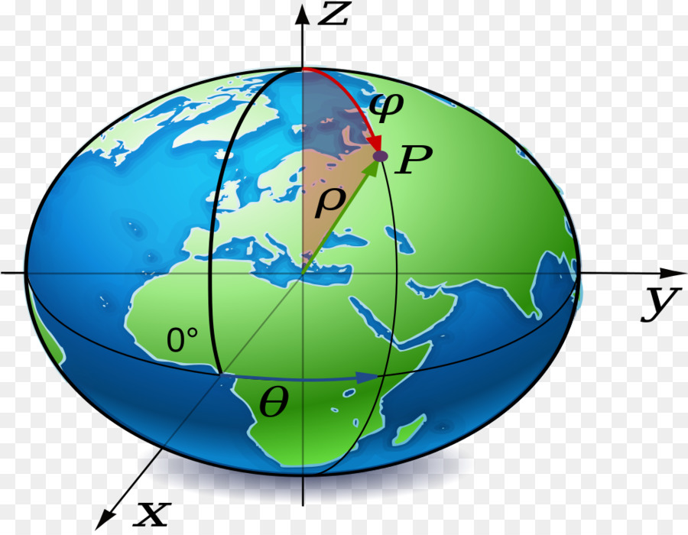
North Pole star
Precession of the equinoxes
The spin axis precesses (With a period 25810 years)

Slide 7
EULER’S EQUATION OF MOTION

Slide 8
What is Euler’s Equation about?
Euler’s equation derivation- A geometrical approach
Euler’s equation derivation- A mathematical approach

Slide 9
What is Euler’s equation about?
COMPLETE ANALYSIS FOR STABILITY OF A RIGID BODY IN MOTION
SOLUTION OF EULER’S EQUATION GIVES WHETHER MOTION OF RIGID BODY IS BOUND OR UNBOUND
BOUND MOTION = STABLE
UNBOUND MOTION = UNSTABLE

Slide 10
A thought experiment! To understand and derive Euler equations
A GEOMETRICAL APPROACH…….
‘ROTATION OF A CYLINDER’

Slide 11
A SIMPLIFIED VERSION WITH ADDED DEMO

Slide 12
Another thought experiment!
Initial Conditions…
3
2
In the time interval Δt, the principal axes rotate away from the 1, 2, 3 axes.
1
What are the changes in angular momentum in 1,2 and 3 axis?
ΔL₁, ΔL₂ and ΔL₃?

Slide 13
ΔL₁ due to rotation along ‘1’ axis
3
2
1

Slide 14
ΔL₁ due to rotation along ‘2’ axis
3
2
1

Slide 15
ΔL₁ due to rotation along ‘2’ axis
L₃
L₂
This will not contribute!
L₁

Slide 16
ΔL₁ due to rotation along ‘3’ axis
3
2
1

Slide 17
ΔL₁ due to rotation along ‘3’ axis
L₃
L₂
This will not contribute!
L₁

Slide 18
Equation of motion of a Rigid body: Euler’s equation
3
Dividing by and taking the limit
2
1

Slide 19
Equation of motion of a Rigid body: Euler’s equation
3
2
1

Slide 20
Equation of motion of a Rigid body: Euler’s equation
3
2
1
Euler’s Equations of rigid body motion

Slide 21
A MATHEMATICAL APPROACH!

Slide 22
Lab frame Vs Body frame
3
2
1

Slide 23
Euler’s equation: Mathematical approach
L can change due to two reasons
Changes in the body frame
Rotation of the body relative to lab frame

Slide 24
Euler’s equation: Mathematical approach
REARRANGING L.H.S AND R.H.S WE GET EULER’S EQUATIONS

Slide 25
Euler’s equation: Mathematical approach

Slide 26
How Euler’s equations are related to stability?
APPLICATION
Will learn through some Examples………

Slide 27
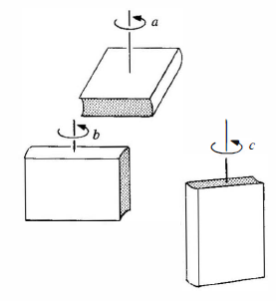
Example1
Stability of a book under rotation through its different axis

Slide 28
Book under rotation….
Book is rotated in one of its axis by applying a torque and quickly released. Lets say it has
A small perturbation is given …..
Stability of motion is analyzed by
Applying Euler’s equation
Guess which of the above configuration will be stable ??

Slide 29
Stability of Rotational motion
1
2
3
Too small……
Since equations 2 and 3 are coupled, we take second derivative of eqn 2 to get equation
of motion

Slide 30
Stability of Rotational motion
Stable
Unstable
Stable
I₁ is largest or smallest
UnStable
I₁ is intermediate

