Slide 1
Co-ordinate Systems
Introduction to Vector Operators
Work , Energy and Conservation laws
Rigid body in motion
Oscillations and Waves
Quantum Physics

Slide 2
Quantum Physics

Slide 3
Important points
Expectation value
of position
Probability
Position operator
Eigen value eqn
Momentum operator and Eigen
Value eqn
Expectation value
of momentum
Energy operator

Slide 4
RECAP
In Quantum Physics position x and momentum p are not accurately measurable.
All information of the system is encoded in wave function ψ(x).
ψ(x) is obtained by solving Schrödinger Equation.
Expectation or average values of observables x, p etc are obtained using ψ(x).

Slide 5
Important points
How to find ψ(x)?
Classical
Quantum Mechanical
Schrödinger’s Equation (1-D)

Slide 6
Ref. Arthur Beiser, P. 168

Slide 7
Schrodinger equation when V is time Independant

Slide 8
For any schrödinger equation with potential time independent, the time part will be the same.

Slide 9
Following the previous procedure as in free particle, we get
Recall same as in free particle
For any schrödinger equation with potential time independent, the time part will be the same.

Slide 10
Time dependent Schrödinger equation.
Time independent Schrödinger equation.

Slide 11
Time independent Schrödinger equation.

Slide 12
Practice problems
TODAY’S PLAN
Application of Schrödinger equation on physical system

Slide 13
How to Solve Problems?
Step1: Write down the Schrodinger Equation
Step2: Solve it and get Wave function $φ$(x)
Step3: Normalize
Once you get $φ$(x), you get everything you want!
Step 4: Depending on problem, Look for limits of Integration
any boundary conditions then, easily you can evaluate
Probability, Expectation Values, Eigen Values for Energy, Momentum
Etc
ALMOST EVERYTHING!!!!

Slide 14
2
Particle in an impenetrable box
Are you kidding?

Slide 15
Consider a quantum mechanical particle trapped inside an impenetrable box of length L.
(a) Write the schrödinger equation for the system.
(b) Obtain the energy from boundary condition .
(c) Plot the energy diagram.
(d) Obtain the wavefunction by solving the Schrodinger equation.
(e)Normalize the wavefunction and plot the ψ(x) and |ψ(x)|².

Slide 16
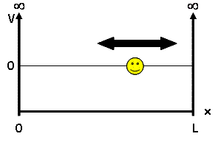
Solve the Schrödinger’s equation subjected to Boundary Conditions

Slide 17
Apply the Boundary Condition-1
Apply the Boundary Condition-2

Slide 18
n=1,2,3,….

Slide 19
(c) Plot the energy diagram.

Slide 20
Quantized energy levels

Slide 21
n=1,2,3,….

Slide 22
(d) Plot the wavefunction

Slide 23
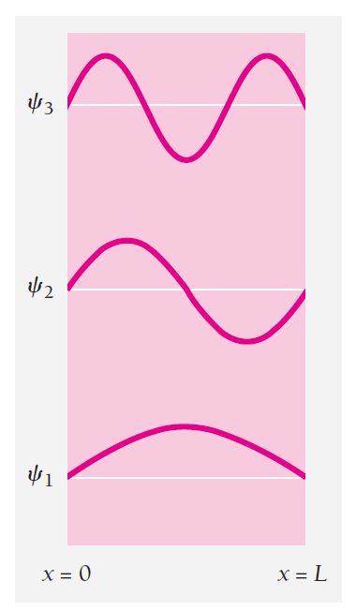

Slide 24
(e) Normalize and Plot the probability density

Slide 25
Normalize the ψ(x)
C²
=1
C²
=1

Slide 26
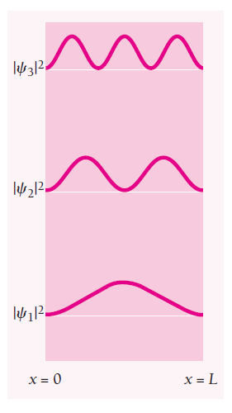

Slide 27
Expectation value of position

Slide 28
Expectation value of momentum
Guess why?

Slide 29
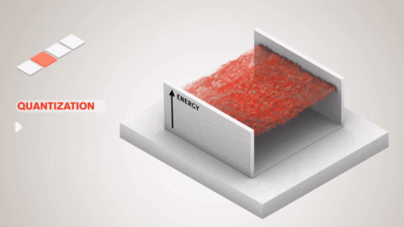
Particle in a box

Slide 30
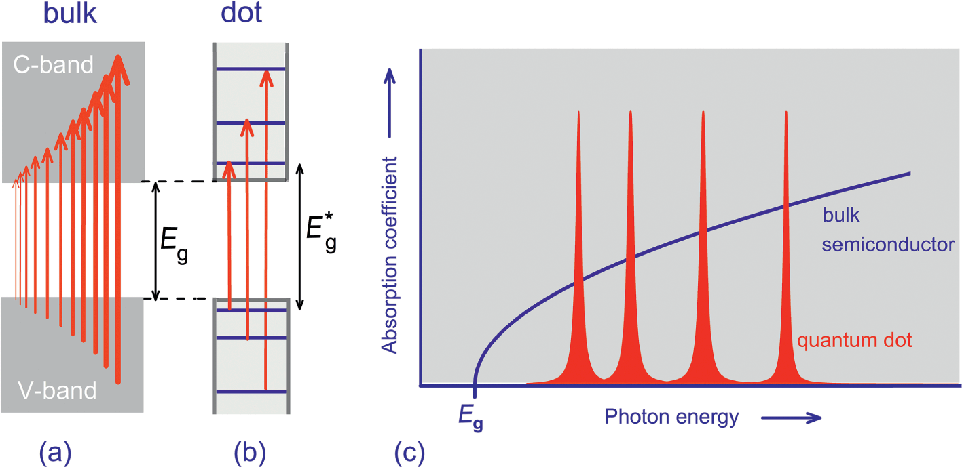
Electron confinement effects in semiconductor

