Slide 1
PH608
Atomic Collision Physics

Slide 2
Low-energy scattering by a deep attractive square well
V(r)
r
r=a
V(r)=- V₀

Slide 6
If κ changes rapidly , then Γ_{l} and therefore phase shift also changes rapidly.

Slide 7
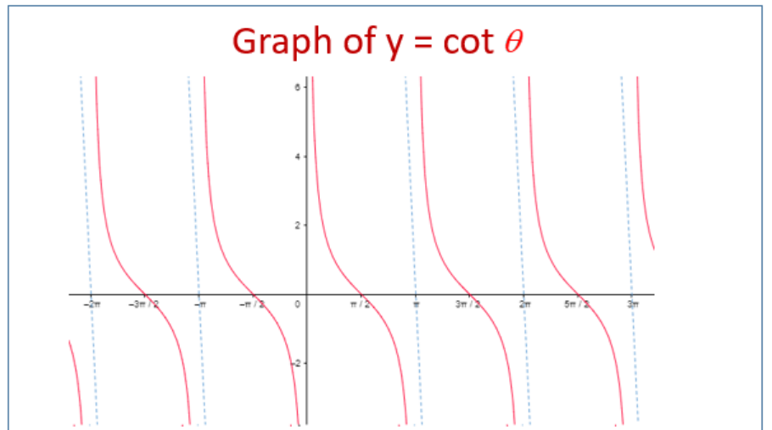
Asymptote of the cotangent functions are at

Slide 9
D is the energy difference between
two resonances

Slide 10
In Short….

Slide 11
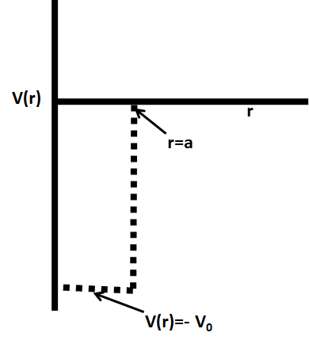
In Short….

Slide 12
In Short….

Slide 14
At resonance
(κ²= κ _{r}²)

Slide 15
Recap
At resonance
(κ²= κ _{r}²)

Slide 16
Expand the about the resonance

Slide 18
$$b_{l}≃\left.\frac{∂}{∂κ^{2}}\left(aκ\cot{(}κa)\right)\right|$$

Slide 20
Resonant phase shift

Slide 21
$$3π/4$$
$$π/2$$
$$π/4$$
E_{r}-γ/2
E_{r}
E_{r}+γ/2

Slide 22
Width of the resonance and spacing between two resonance are comparable?

Slide 24
Width of the resonance is far less than spacing between two resonance
Let’s express the scattering amplitude in terms of the resonance…..

Slide 28
Let us analyse only the resonant part for now!

Slide 30
But these are pure sonant cross-section!
What about non-resonant part ???

Slide 34
Pure background
Pure resonance
Interreference term

Slide 35
Fano parameterization

