Slide 1
Season 2, Lecture 22 (S2,L22):
Maxwell relations, Chemical Potential and Gibbs Duhem relations
Mid Sem Solutions

Slide 2
Mid Sem Exam Solutions with step wise marks

Slide 3
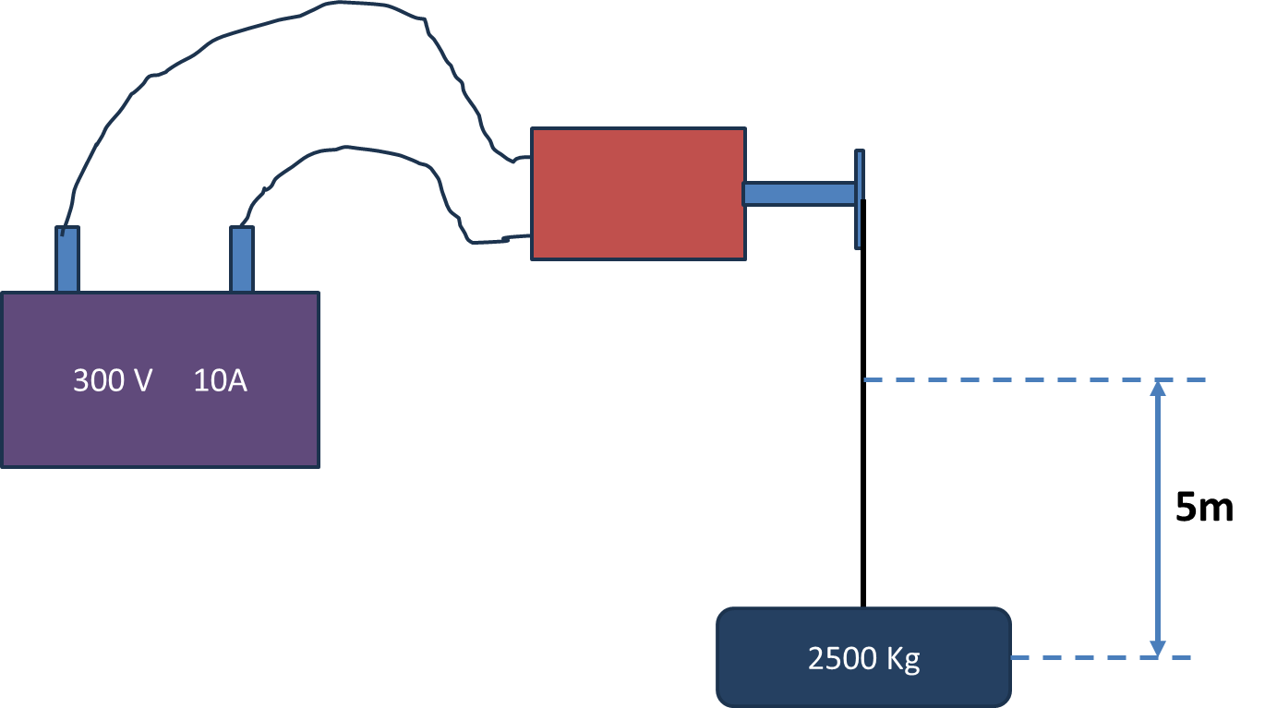
A DC electrical motor is used to operate a hoist mechanism (which does lifting of objects) in a crane. The motor is supplied with 300 V and 10 Ampere from a DC source for a period of 2 min. The torque provided by the motor to the hoist shaft is 250 Nm at 50 rpm. The hoist mechanism lifts a mass of 2500 Kg through a height of 5m. Calculate the work interaction for the DC source, motor, hoist and the mass

Slide 4
2 Marks

Slide 5
2 Marks

Slide 6
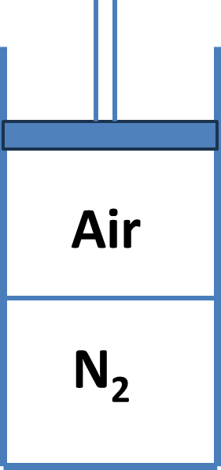
Air and N₂ are contained in an insulated piston cylinder apparatus as shown in the figure. The thin rigid wall that separates the two chambers is perfectly thermally conducting. Initially, the air is at 500kPa and 473K and N₂ is at 1500 kPa and they each occupy 0.01 m³. The air is now compressed slowly till the pressure of N₂ reaches 1580 kPa. Determine the work and heat interaction for the air and its final temperature. For air and N₂, pv = 288T, C_{V}=742 J/Kg K, where p is in N/m², v is in m³/Kg and T is in K. Neglect any internal energy changes in the partition wall.
Given
4 marks
pv = 288T, C_{V}=742 J/Kg K

Slide 7
1 Mark

Slide 8
1 Mark

Slide 9
1 Mark
1 Mark

Slide 10
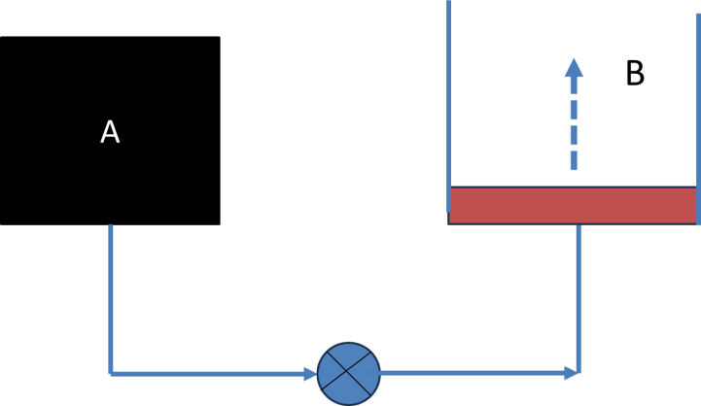
Tank A and a piston-cylinder arrangement B are connected through pipes as shown. The piston is frictionless. Tank A contains Nitrogen at 300 kPa and its volume is 0.4 m³. It requires 150 kPa to lift the piston. As the connecting valve opens, Nitrogen flows into the piston – cylinder arrangement B and attains a steady state after some time. What is the final pressure and work interaction for Nitrogen if the initial and final states are related by pV=C, where p and V represent pressure and volume of the gas and C represents a constant
4 Marks
Marks 2
Marks 2

Slide 11
A heat engine operates between a hot reservoir at 500 K and a cold reservoir at 300 K. It absorbs 3500 J and rejects 2500 J of heat. Calculate the work done, efficiency and the maximum possible efficiency. 4 Marks
Marks 2
Marks 2

Slide 12
A sheet of steel 1.5 mm thick has nitrogen atmospheres on both sides at 1200ºC and is permitted to achieve a steady state diffusion condition. The diffusion coefficient for Nitrogen in steel at this temperature is 6 X 10⁻¹¹ m²/s, and the diffusion flux is found to be 1.2 X 10⁻⁷ Kg/m².s. Also it is known that the concentration of Nitrogen in the steel at the high pressure side is 4 Kg/m³. How far into the sheet from this high-pressure side will the concentration be 2 Kg/m³(for convenience choose starting position as x=0)? Assume a linear concentration profile.
4 marks

Slide 13
Last 3 Questions solutions already available in Lecture ppt’s

Slide 14
Name | L21
"2201ph34_dolly" <2201ph34_dolly@iitp.ac.in>; | p | p
"Adhila Aslam" <2201ph01_adhila@iitp.ac.in>; | p | p
"Aditi Baghel" <2201ph31_aditi@iitp.ac.in>; | p | p
"Aditya Kumar" <2201ph02_aditya@iitp.ac.in>; | a | a
"Aditya Singh" <2201ph03_aditya@iitp.ac.in>; | p | p
"Animesh Sharma" <2201ph05_animesh@iitp.ac.in>; | p | p
"Arun Mishra" <2201ph06_arun@iitp.ac.in>; | a | p
"Aryan Raj" <2201ph32_aryan@iitp.ac.in>; | p | p
"Boda Vishnuwardhan" <2201ph08_boda@iitp.ac.in>; | p | p
"Chanchal Tolani" <2201ph09_chanchal@iitp.ac.in>; | p | p
"Gaurav Verma" <2201ph10_gaurav@iitp.ac.in>; | a | p

Slide 15
Name | L21
"Gourav Jha" <2201ph11_gourav@iitp.ac.in>; | p | p
"Gurinder Dhillon" <2201ph12_gurinder@iitp.ac.in>; | p | p
"Harsh Joshi" <2201ph13_harsh@iitp.ac.in>; | p | p
"Himanshu Patel" <2201ph35_himanshu@iitp.ac.in>; | a | a
"Khushal Yadav" <2201ph14_khushal@iitp.ac.in>; | a | p
"Krishnakant Chourey" <2201ph15_krishnakant@iitp.ac.in>; | p | a
"Manas Gupta" <2201ph16_manas@iitp.ac.in>; | p | a
"Mohit Saini" <2201ph17_mohit@iitp.ac.in>; | p | a
"Mude Naik" <2201ph18_mude@iitp.ac.in>; | a | p
"Murari Kumar" <2201ph19_murari@iitp.ac.in>; | p | p
"Nishant Yadav" <2201ph20_nishant@iitp.ac.in>; | p | p
"Pranitha Moluguri" <2201ph21_pranitha@iitp.ac.in>; | p | p

Slide 16
Name | L21
"Premanandh Sigamala" <2201ph22_premanandh@iitp.ac.in>; | a | p
"Ruchi Thakur" <2201ph23_ruchi@iitp.ac.in>; | p | p
"Satyam Sahoo" <2201ph25_satyam@iitp.ac.in>; | p | p
"Satyam Shandilya" <2201ph24_satyam@iitp.ac.in>; | a | a
"Shyam Hembram" <2201ph26_shyam@iitp.ac.in>; “ | p | p
Sougata Saha" <2201ph27_sougata@iitp.ac.in>; | p | p
"Sumit Rajpoot" <2201ph28_sumit@iitp.ac.in>; | p | p
"Suprajit Dewanji" <2201ph29_suprajit@iitp.ac.in>; | p | p
Attendance: 75% mandatory

Slide 17
Introduction to Thermodynamics Functions and Maxwell’s relations

Slide 18
Combining First Law and Entropy

Slide 20
Conjugate Variables

Slide 21
We need to conduct experiment at different Entropy and
find Temperature in those conditions
Cumbersome

Slide 22
Similarly

Slide 23
We need to conduct experiment at different volumes and
find Pressures in those conditions
Cumbersome

Slide 25
Now, we define new thermodynamic functions
which depend on T and P, first mathematically
using “Legendre Transformations”
These new Thermodynamic functions turns out to be Gibbs Free Energy G

Slide 26
Legendre Transformation

Slide 27
Legendre Transformation

Slide 29
Thermodynamic Functions

Slide 31
Maxwell’s Relations
In Thermal Physics
Condition for an Exact differential

Slide 32
Maxwell’s Relations
In Thermal Physics

Slide 34
N
N+1

Slide 35
Chemical Potential
N
N+1

Slide 36
N

Slide 37
New variable “N”

Slide 38
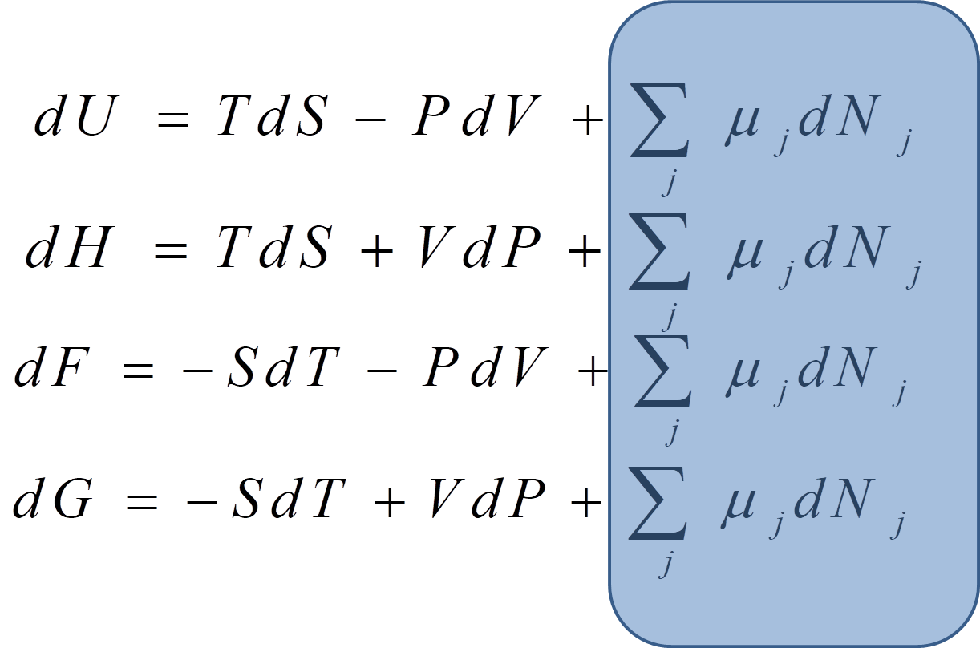

Slide 39
Can we write like
?
Answer is we cannot

Slide 40
Extensive and Intensive variables
3 pairs of variables we formed
Conjugate variables
T
P
V
S
Intensive
variables
Extensive variable (depends on quantity of the substance)

Slide 41
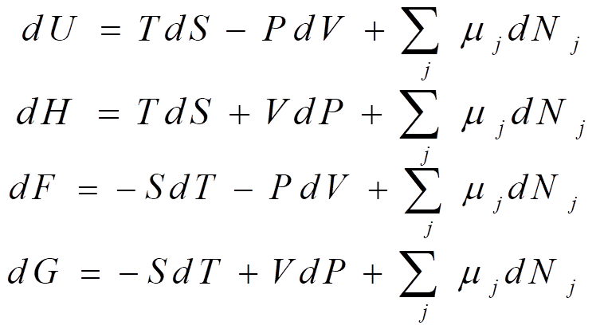
At least one extensive variable was present

Slide 43
Can we write like
?
All are intensive variables
System specification is incomplete

Slide 44
We cannot define such Thermodynamic function
Gibbs -Duhem relation

Slide 46
Using Gibbs Duhem relation we could find an absolute value of U

Slide 47
Thermal energy
Mechanical energy
chemical energy

Slide 48
Finding other thermodynamic functions using this relation

