Slide 1
Chapter 6 Quantum Physics

Slide 2
RECAP: Quantum Physics
To get full knowledge of a problem POSITION and MOMENTUM need to be known
For QUANTUM particles its Uncertain
First Postulate Introduce a parameter called ψ(x)
This is obtained as Solution of Master Equation known as SCHRODINGER EQUATION, which give FULL INFORMATION

Slide 3
RECAP: Quantum Physics
Postulate2: ψ*(x)ψ(x) is the probability density
For Quantum particles probability gives full information
Probability that the particle can be found in the interval dx

Slide 4
RECAP: Quantum Physics
A given wave function of the form ψ(x) =Af(x) needs to get normalized such that total Probability = 1, using the condition for NORMALIZATION
Suitable A is obtained
Dimension analysis of wavefunction in 1-D is always

Slide 5
Postulate 3
Linearity and Superposition
Let ψ₁(x) and ψ₂(x) represents the two wavefunctions of a quantum system, then the linear superposition will also be a valid wavefunction for the same quantum system.

Slide 6
Today’s Plan
Invention of a equation of motion for Wavefunction ψ:
Schrodinger Equation
Try one practice problem..

Slide 7
Postulate 4
Expectation Value
OR
Average value

Slide 8
Postulate 4
Expectation values
Let ψ (x) describe the wavefunction of a quantum system, average value of the position (x) is given by the expectation value integral:
Note the difference in two expressions above, difference in representation will be clear
soon
Lets see some examples……

Slide 9
Expectation or average: no of students v/s height
20
No of students
10
5
4
4.5
5
Height

Slide 10
Expectation or average position
Probability
0.6
0.4
1m
2m
Distance (x)

Slide 11
Expectation value of position of a quantum particle
Probability that the particle can be found in the interval dx
What is the expectation value of the position of the particle ?

Slide 12
Postulate 4
Let ψ (x) describe the wavefunction of a quantum system, average value of the position (x) is given by the expectation value integral:
Expectation values

Slide 13
A particle is limited to the x axis has the wave function ψ(x) =Ax between x=0 and x=1, ψ(x) =0 elsewhere. Find the expectation value <x> of the particle’s position.
Recollect

Slide 14
Postulate 5
OPERATORS

Slide 15
Postulate 5
How to extract meaningful information from wavefunction?
To every measurable quantity (Observable) in classical mechanics there corresponds an OPERATOR in quantum mechanics.
Result of the measurement
Analogous to measurement
Eigen value equation

Slide 16
Lets see some simple examples of operator’s

Slide 17
Expectation value of general
Observable <A>

Slide 18
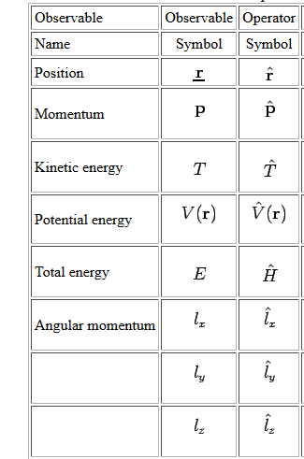
Operators
r

Slide 19
Introducing position operator

Slide 20
Expectation value of position

Slide 21
Introducing momentum operator

Slide 22
Introducing Energy operator

Slide 23
IMPORTANT GOAL
Invent a differential equation, whose solution is ψ(x,t)!
Similar to wave equation!

Slide 24
Inventing a differential equation which will solve the wavefunction ψ (x)!
Classical
Quantum Mechanical

Slide 25
Inventing a differential equation which will solve the wavefunction ψ (x,t)!
Schrodinger’s Equation (1-D)

Slide 26
Ref. Arthur Beiser, P. 168

Slide 27
Important points
Expectation value
of position
Probability
Position operator
Eigen value eqn
Momentum operator and Eigen
Value eqn
Expectation value
of momentum
Energy operator

Slide 28
Practice problems
Application of Schrödinger equation on physical system

Slide 29
How to Solve Problems?
Step1: Write down the Schrodinger Equation
Step2: Solve it and get Wave function ψ(x)
Step3: Normalize
Once you get ψ(x), you get everything you want!
Step 4: Depending on problem, Look for limits of Integration
any boundary conditions then, easily you can evaluate
Probability, Expectation Values, Eigen Values for Energy, Momentum
Etc
ALMOST EVERYTHING!!!!

Slide 30
Practice Problem no.1
Free particle
I am free!!
free!!

Slide 31
Consider a quantum mechanical free particle (Particle moving without any external potential) in 1-Dimension in +x direction towards right.
Find the wave-function of the free particle.
Find the eigen value of the energy and momentum operator for right going direction.
What is your intuition about the uncertainity in position and momentum?

Slide 32
For a free particle
………………. (1)
Apply variable separable method:
………………. (2)
Substitute (2) in (1) and dividing by α(x)β(t)
………………. (3)

Slide 33
Integrate in the limit 0 to t
Similar to Harmonic oscillator

Slide 34
Recollect the general solution of a wave equation
from Chapter 5:
For the present case, C=0 for the right going wave.

Slide 35
(b) Find the eigen-value of the energy operator.

Slide 36
(b) Find the eigen-value of momentum operator.
(c) What is your intuition about the uncertainty in position and momentum?

