Slide 1
The damped harmonic oscillator
RECAP

Slide 2
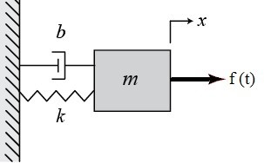
Problem 3
Write the equation of motion for a spring mass system connected to a damper as shown in figure. In the figure, b is the damping coefficient.
Find the solution of the damped harmonic oscillator. Use the trial solution

Slide 3
The damped harmonic oscillator
Trial solution

Slide 4
Solution of damped harmonic oscillator

Slide 5
Analysis of damped harmonic oscillator

Slide 6
The damped harmonic oscillator
Case 1:
(Underdamping)
Case 2:
(Critical damping)
Case 3:
(Over damping)

Slide 7
The damped harmonic oscillator
Case 1:
(Underdamping)
Light damping

Slide 8
(Underdamping)
Mathematically this gives a complex solution!
A and B also could be complex!
But position x(t) cannot be complex!
Is there any real solution?
Solution can be made real by choosing
appropriate constants

Slide 9
How to do it?
We know
Let’s Choose A and B as

Slide 10
REAL SOLUTION

Slide 11
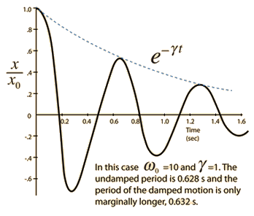
Problem 4
(a) Plot the solution of a damped harmonic oscillator with x(0) =C with φ=0.

Slide 12
Problem 4
(b) Provided T is the time period and γ is the damping factor, show that in
two successive periods of oscillations, the amplitude falls as

Slide 13
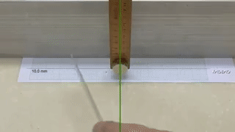
(Underdamping)

Slide 14
Underdamping Recap
(Underdamping)

Slide 15
Solution can be made real by choosing
appropriate constants

Slide 17
Analysis of Critically damped oscillator

Slide 18
The damped harmonic oscillator
Case 2:
(Critical damping)
Under critical damping

Slide 20
Problem 4
(a) Show that a critically damped oscillator can cross the equilibrium position at most once.
At what will happen???
The system will cross equilibrium.
However, negative time is not acceptable since x(-t) is invalid.
For the oscillator to cross equilibrium at finite time (>0), A or B has to be negative.

Slide 21
(b) Using the initial conditions, find at what time the system will cross equilibrium.
How to control A and B?

Slide 22
Plots of

Slide 23
Plot 1
Given

Slide 24
Zero crossing:
For the oscillator to cross equilibrium at finite time t >0, A or B has to be negative.
A = 10, B = 4, t_{c} is negative, hence system
will not cross equilibrium in positive value of t

Slide 25
Maxima /Minima:
Maximum

Slide 26
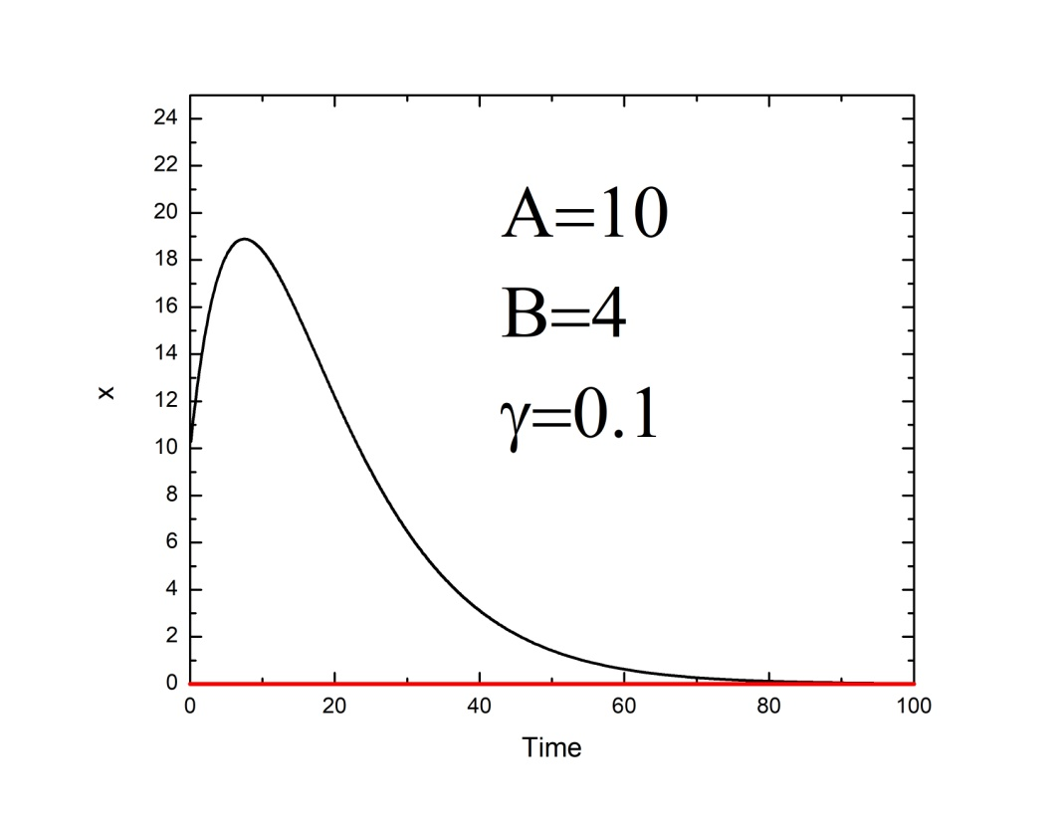
Maximum at 7.6s

Slide 27
Plot2

Slide 28
Zero crossing:
For the oscillator to cross equilibrium at finite time, A or B has to be negative.
A = -10, B = 2, t_{c} is positive, hence system
will cross equilibrium in positive value of t

Slide 29
Maxima /Minima:
Maximum

Slide 30
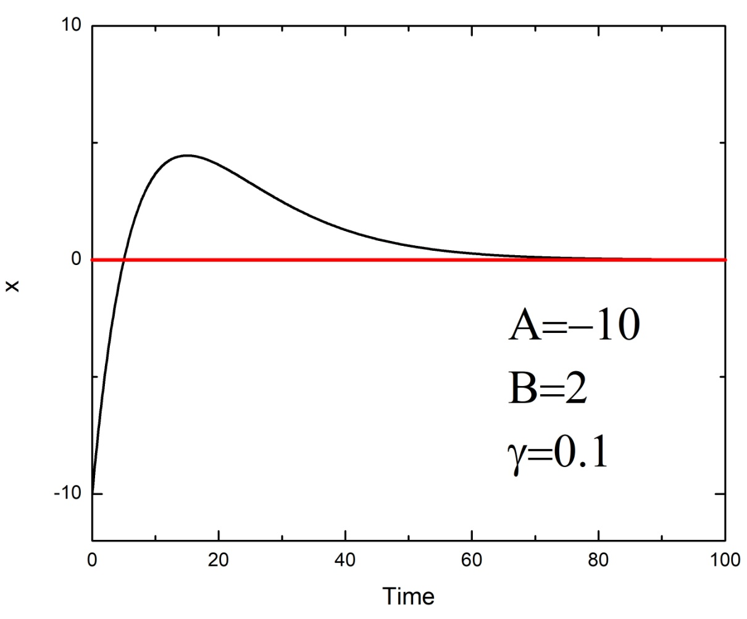
Maximum at 15s

Slide 31
Plot 3

Slide 32
A = -40, B = -1, t_{c} is negative, hence system
will not cross equilibrium in positive value of t
Zero crossing:
Maxima/Minima:

Slide 33
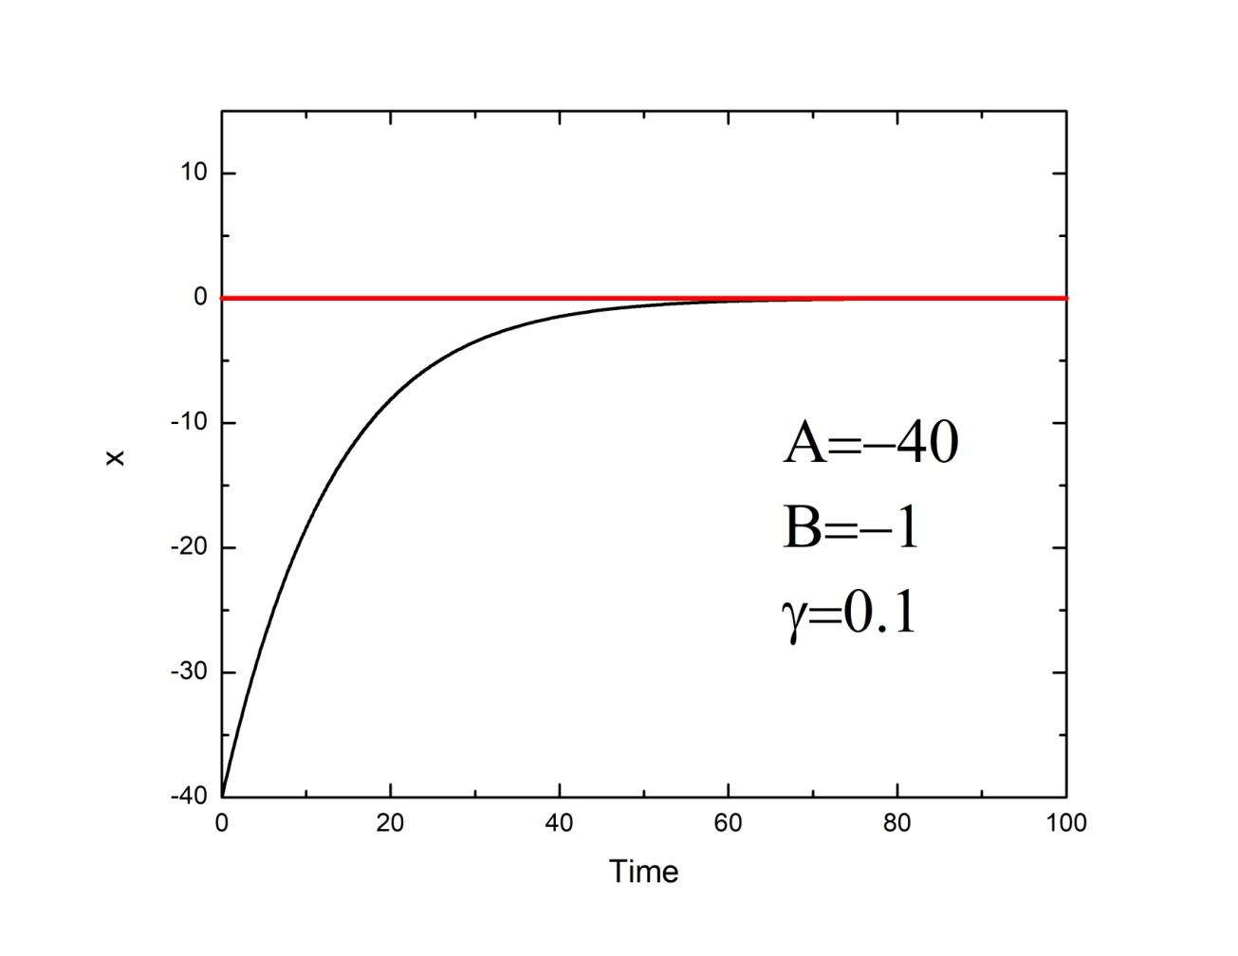

Slide 34
Plot 4

Slide 35
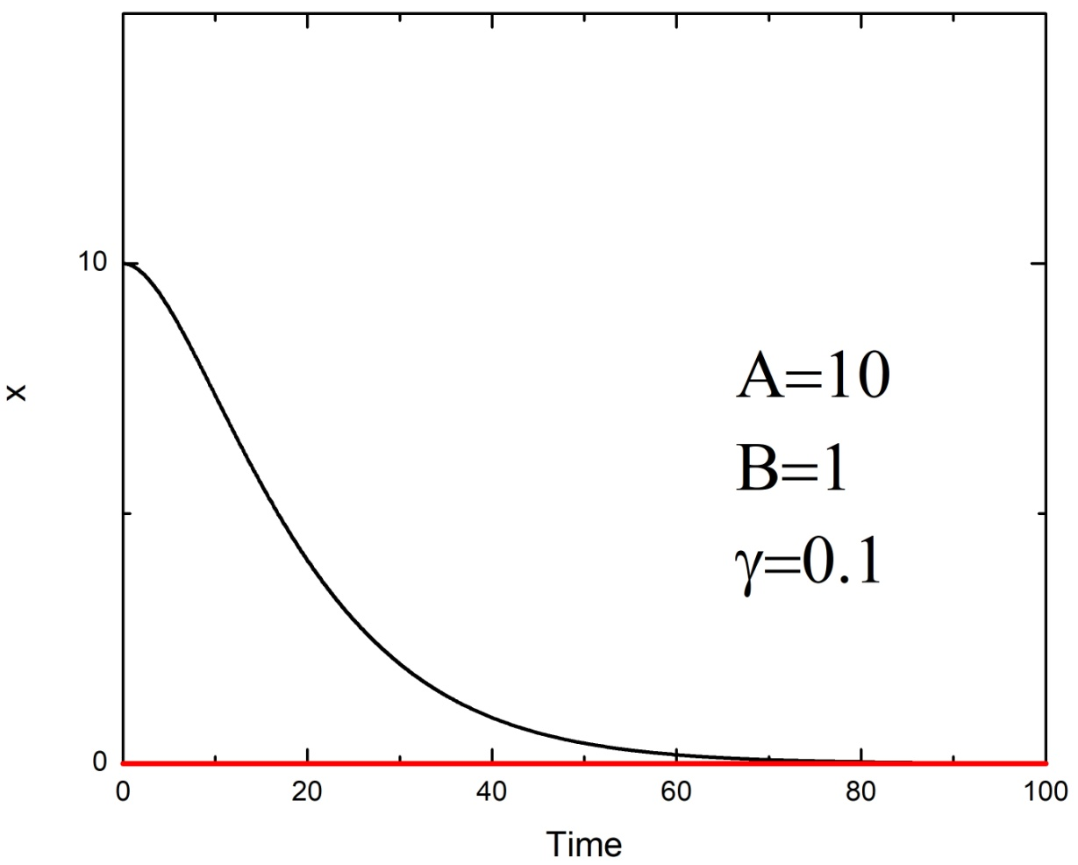
A=40

Slide 36
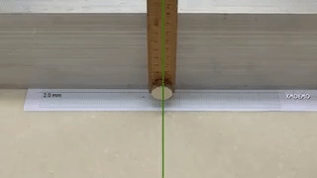
Critical damping

Slide 37
Case 3:
(Overdamping)

Slide 38
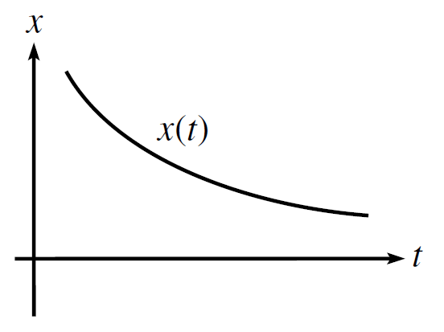
Overdamping
Slow damping
Quick damping

Slide 39
Can the oscillator get to the equilibrium point in finite time?
More problems in tutorial 9

Slide 40
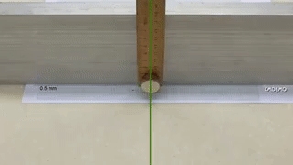
Over damping

Slide 41
Analysis of damping function f(t)
If we are given a spring with a fixed
Underdamped
Overdamped
Critical Damping

Slide 42
Problem 5
(a) Analyse the damping function f(t) for an under damped, over damped and critically damped oscillator with natural frequency ω₀=10 rad/sec. For underdamped and overdamped case, use damping parameter γ₁=9 and γ₂=11 respectively.
Underdamped:
Critically damped:
Overdamped:

Slide 43
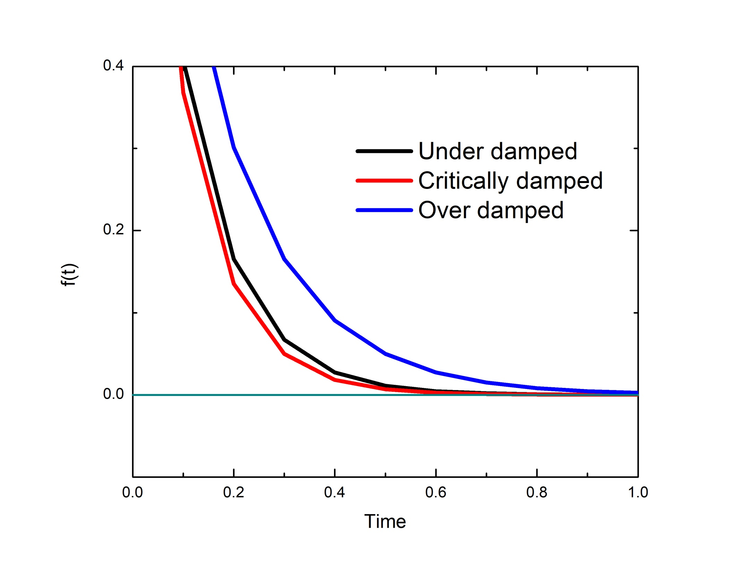

Slide 44
The damped harmonic oscillator
If we are given a spring with a fixed
Underdamped
Overdamped
Critical Damping
The motion converges to zero in quickest way in Critical Damping
Applied where
System needs to be reached equilibrium slowly.
Applied where
System needs to be reached equilibrium quickly.
Doubt clearance of quiz-1/Mid-sem answer scripts is scheduled tomorrow at 4.00 PM, Block 4, Office room.

