Slide 1
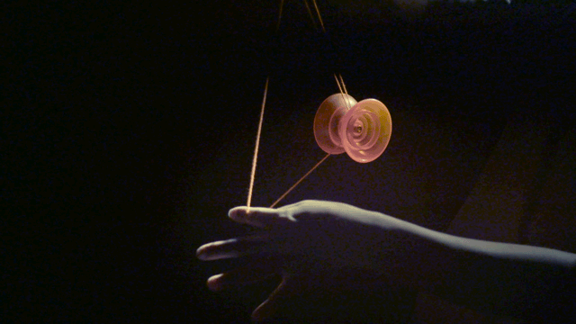
RIGID BODY IN MOTION
Chapter 4

Slide 2
Highlights of the course
Co-ordinate Systems
Introduction to Vector Operators
Work , Energy and Conservation laws
Rigid body in motion
Oscillations and Waves
Quantum Physics

Slide 3
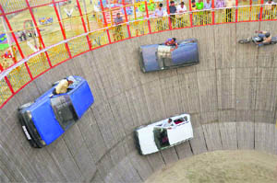
Rotation Vs Translation
Translation
Mass
Force
Linear momentum
Rotation
Moment of Inertia
Torque
Angular momentum

Slide 4
Dynamics of Rotation [Recap]
Rotational Kinetic Energy

Slide 5
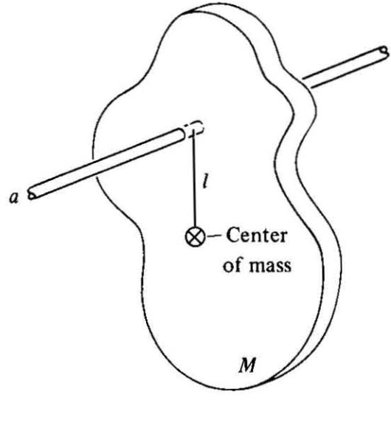
Rigid body Pendulum [Recap]
Z

Slide 6
Work Energy Theorem
Work Energy Theorem for Rotational motion

Slide 7
Vector nature of angular velocity and angular momentum

Slide 8
Vector nature of angular velocity and angular momentum
For infinitesimal rotation,

Slide 9
Vector nature of angular velocity and angular momentum
ω
Direction of velocity is tangential to the circle

Slide 10
Find the velocity of a particle rotating in anti-clock wise direction a vertical plane as shown in the diagram, the particle makes an angle 45 degrees with the –X–axis & +Y-axis and the axis of rotation makes 45 degree with X and Y axis (angular frequency ω make this angle)
z
45º
y
x

Slide 11
Angular momentum of a rigid body

Slide 12
Angular momentum of a rigid body

Slide 14
Angular momentum of a rigid body
Let us introduce moment of Inertias

Slide 15
Angular momentum of a rigid body
Different from what you learned!
Matrix Equation

Slide 16
Angular momentum of a rigid body
?
Equivalent to
Moment of Inertia Matrix

Slide 17
Moment of Inertia Matrix
For a continuous medium,

