Slide 1
 |  |  | Lec 11
1 | 1921PH19 | SAUMYASHREE BARAL | p
2 | 2321PH02 | ARYA KUMAR SIDDHARTH | a
3 | 2321PH07 | NAINCY SHRIVASTAVA | p
4 | 2321PH09 | PRITAM SAMANTA | p
5 | 2321PH10 | REETU SAINI | p
6 | 2321PH13 | SOUBHIK MUKHERJEE | p
7 | 2321PH14 | NEHA CHOUDHARY | p
8 | 2321PH15 | RABI DAS | p
9 | 2321PH19 | SHRUTI SARSWAT | p
10 | 2212PH02 | AMAN KUMAR | p
11 | 2212PH10 | BINAYAK ROUT | p
12 | 2212PH11 | DARPAN SARKAR | p
13 | 2212PH13 | GAURAV JAISWAL | p
14 | 2212PH17 | KAUSHIP SAHA | p
15 | 2212PH20 | NEELLOHIT KARMAKAR | p
16 | 2212PH23 | RITIK PAL | p
17 | 2212PH26 | SOUMIK KARMAKAR | p
18 | 2212PH32 | KAUSTAB BHARASA | p

Slide 2
MOT

Slide 3
Cooling phases
Doppler
Cooling
Milli Kelvin range
MOT
Atomic density
Increased
Magnetic Trapping
Need
Multi-Level
Treatment.
2 level model fails…
Quantum nature of atoms observed
Evaporative Cooling

Slide 15
Effects of magnetic field on 2 Level atom
Uniform B
Uniform magnetic field (Helmholtz coil)
ZEEMAN SPLITTING
+1
0
-1

Slide 16
Effects of magnetic field on 2 Level atom (Using anti-helmhlotz coil)
-1
+1
0
0
+1
-1
-B
0
+B

Slide 17
Effects of magnetic field on 2 Level atom (Using anti-helmhlotz coil)
-1
+1
0
0
+1
-1
-B
0
+B

Slide 18
Effects of magnetic field on 2 Level atom (Using anti-helmhlotz coil)
-1
+1
0
0
+1
-1
-B
0
+B

Slide 19
Effects of magnetic field on 2 Level atom (Using anti-helmhlotz coil)
-1
+1
0
0
+1
-1
-B
0
+B

Slide 20
Magneto optical trapping
Energy
m_{F} = -1
m_{F} = +1
F=1
m_{F} = 0
m_{F} = 0
o
m_{F} = +1
m_{F} = -1
σ⁺
σ⁻
Δm_{F} = +1
Δm_{F} = -1
F=0
0
Z’’
Z’

Slide 21
Effects of magnetic field on 2 Level atom (Using anti-helmhlotz coil)
σ+
Both these will see same energy gap
At identical locations
σ-
-1
+1
0
0
+1
-1
-B
0
+B

Slide 22
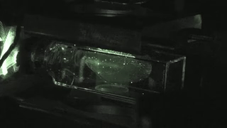

Slide 23
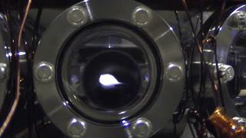

Slide 24
Experiment Sequence

Slide 25
Doppler
Cooling
MOT
Laser
Power
ω₀-kv_{d}
Laser
frequency
ω₀ - ω_{zeeman} - kv
Magnetic
field

Slide 26
Cooling phases
Doppler
Cooling
Milli Kelvin range
MOT
Atomic density
Increased
Magnetic Trapping
Need
Multi-Level
Treatment.
2 level model fails…
Quantum nature of atoms observed
Evaporative Cooling

Slide 27
Approximate Mathematical approach for Deriving Doppler Cooling Force

Slide 28
Force equation in a MOT

Slide 31
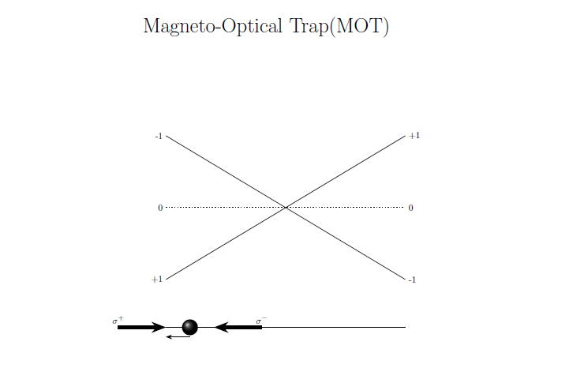
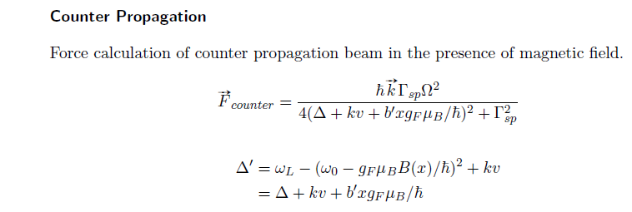

Slide 32
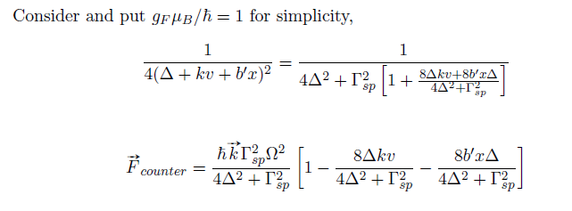
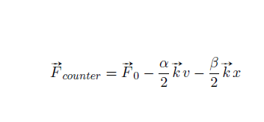

Slide 33
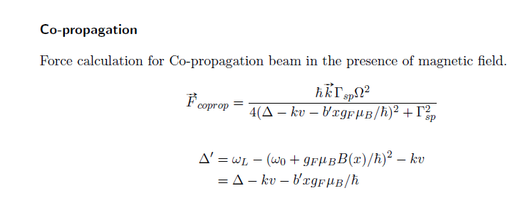
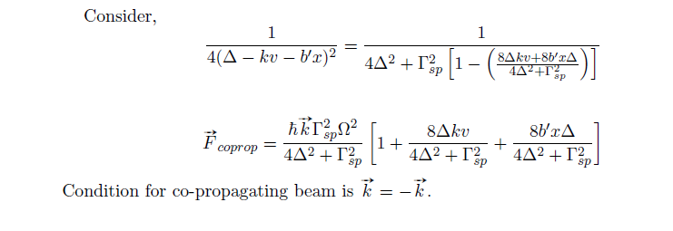

Slide 35
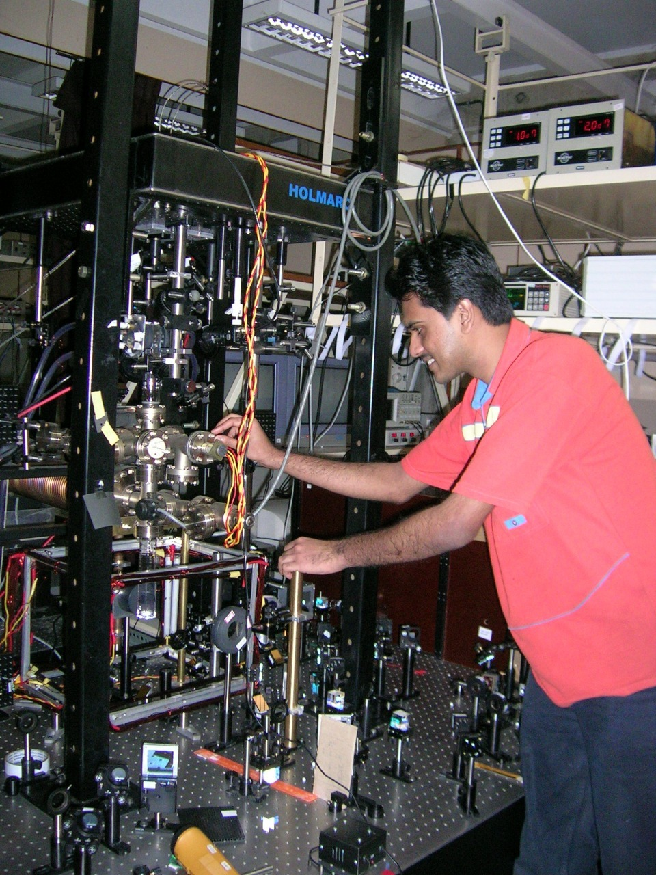
Double MOT system
Assembling of Vacuum chambers, Achieving UHV, Laser Alignment for MOT, Laser locking, Lab view automation, construction of QUIC coils for Magnetic trap etc
RRI Bangalore 2004

Slide 36
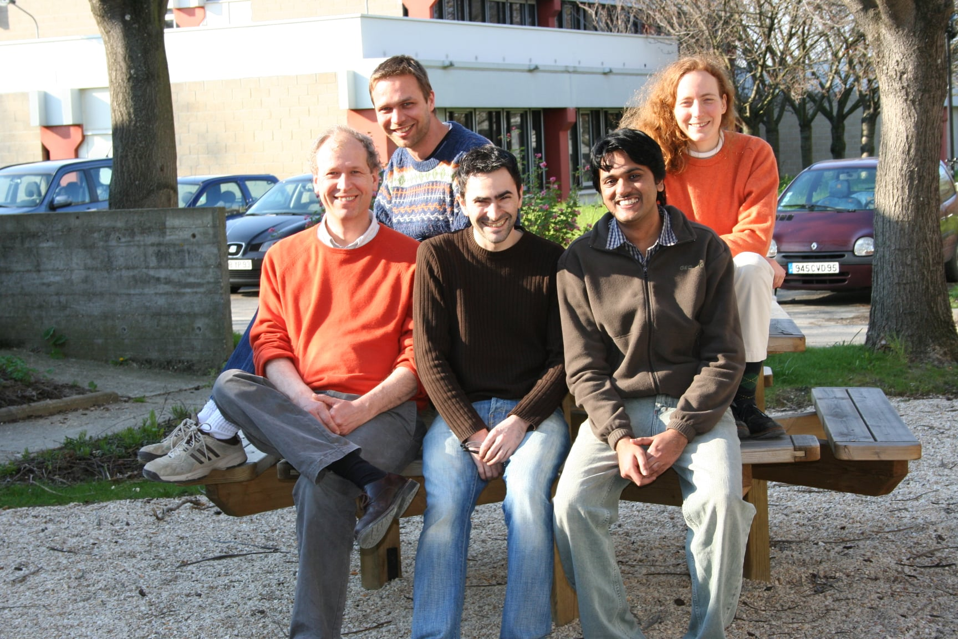
PhD: Ring BEC and RF Spectroscopy
ENS Paris-Institute Galilee / University of Paris13-FRANCE
Marie Curie Fellowship for PhD
2006

Slide 37
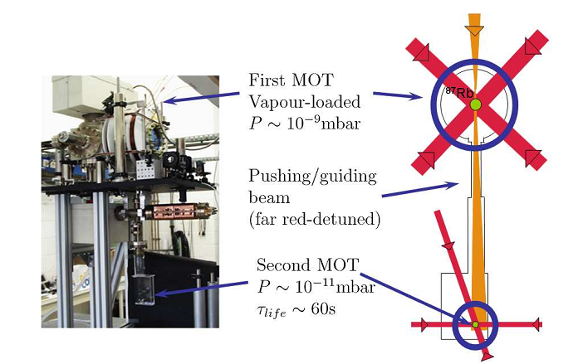
Double MOT Set up

Slide 38
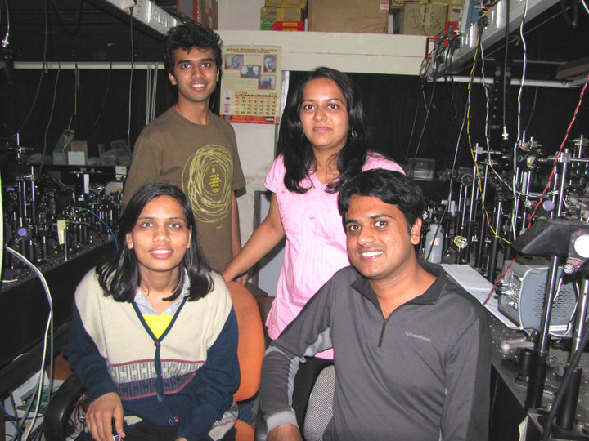
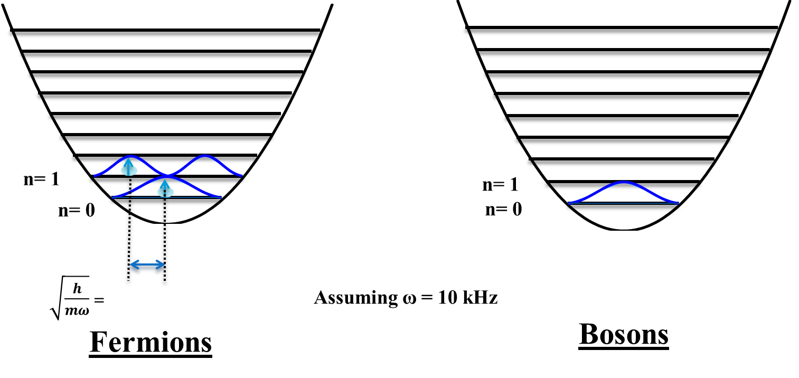
Post Doc 1:
2009
⁴⁰K (Fermionic)
³⁹K (Bosonic)

Slide 39
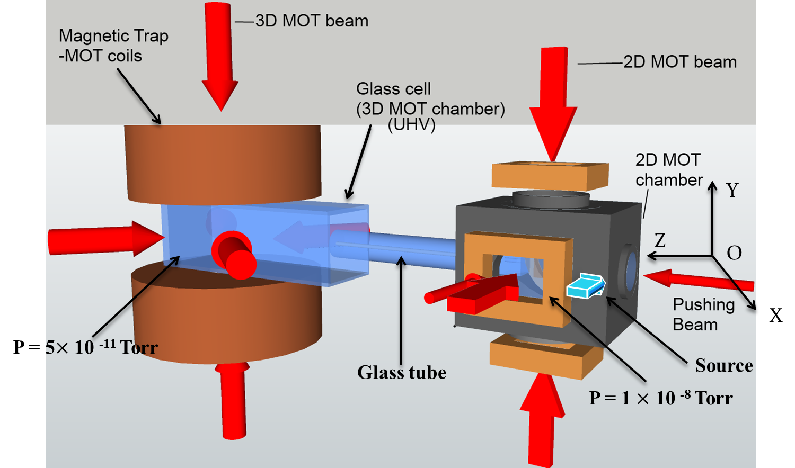
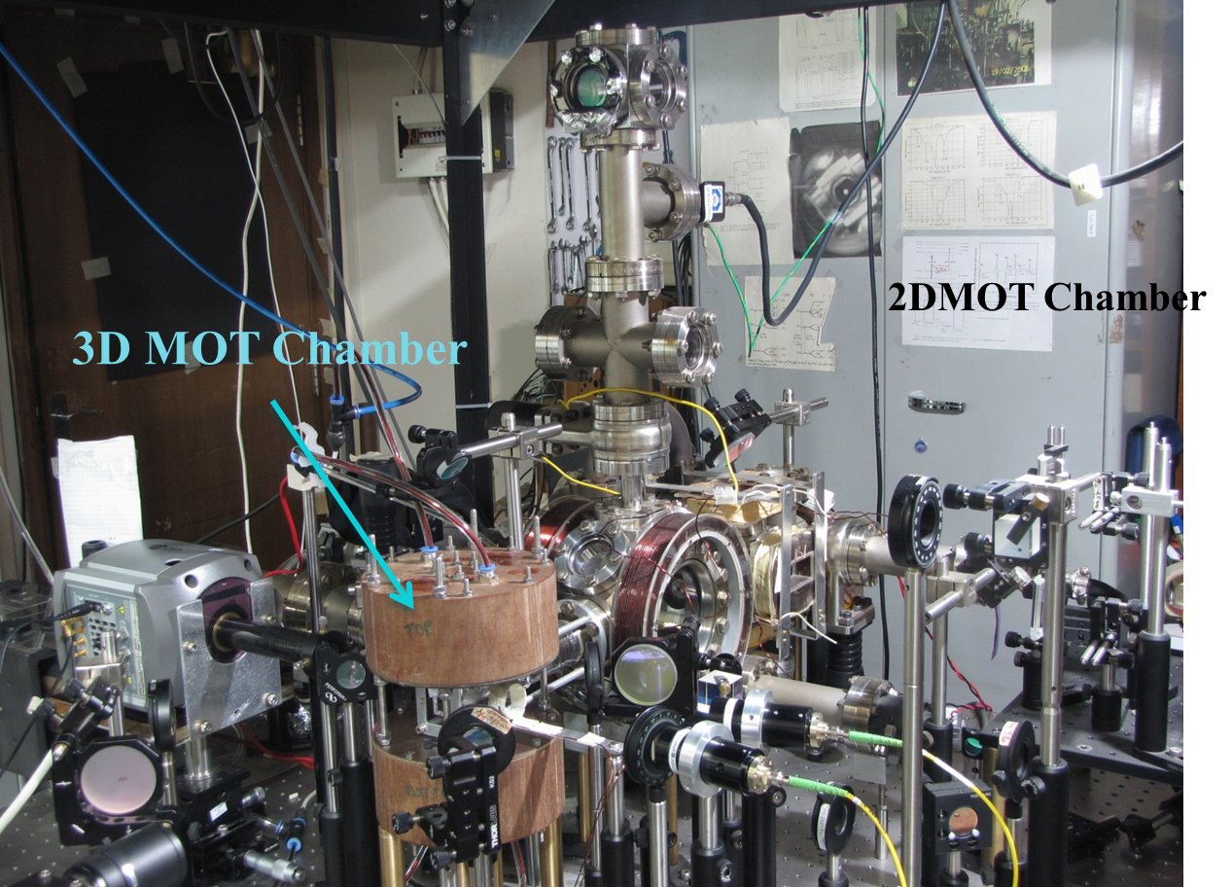
Post Doc 1: TIFR Mumbai

