Slide 1
Season 2, Lecture 5 (S2,L5):
Tutorial 1 (contd..) Mean free path

Slide 3
Problem 2

Slide 4
Solution
1

Slide 5
Solution

Slide 7
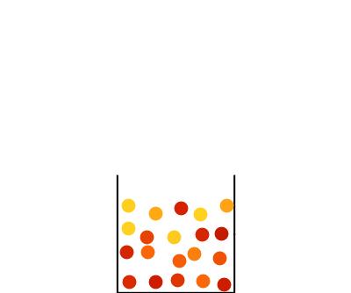

Slide 8
Problem 3

Slide 9
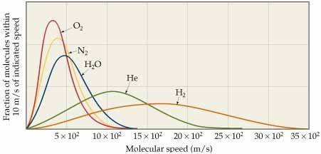
Solution

Slide 10
Concept of Mean free path

Slide 11
Name | L1 | L2 | L3 | L4 | L5
"2201ph34_dolly" <2201ph34_dolly@iitp.ac.in>; | p
"Adhila Aslam" <2201ph01_adhila@iitp.ac.in>; | p
"Aditi Baghel" <2201ph31_aditi@iitp.ac.in>; | p
"Aditya Kumar" <2201ph02_aditya@iitp.ac.in>; | a
"Aditya Singh" <2201ph03_aditya@iitp.ac.in>; | p
"Anil Ram" <2201ph04_anil@iitp.ac.in>; | a
"Animesh Sharma" <2201ph05_animesh@iitp.ac.in>; | p
"Arun Mishra" <2201ph06_arun@iitp.ac.in>; | p
"Aryan Raj" <2201ph32_aryan@iitp.ac.in>; | p
"Ayush Gautam" <2201ph07_ayush@iitp.ac.in>; | p
"Boda Vishnuwardhan" <2201ph08_boda@iitp.ac.in>; | p
"Chanchal Tolani" <2201ph09_chanchal@iitp.ac.in>; | p
"Devansh Srivastava" <2201ph33_devansh@iitp.ac.in>; | p
"Gaurav Verma" <2201ph10_gaurav@iitp.ac.in>; | p

Slide 12
Name | L1 | L2 | L3 | L4 | L5
"Gourav Jha" <2201ph11_gourav@iitp.ac.in>; | a
"Gurinder Dhillon" <2201ph12_gurinder@iitp.ac.in>; | p
"Harsh Joshi" <2201ph13_harsh@iitp.ac.in>; | a
"Himanshu Patel" <2201ph35_himanshu@iitp.ac.in>; | p
"Jigyasa Agrawal" <2201ph36_jigyasa@iitp.ac.in>; | a
"Khushal Yadav" <2201ph14_khushal@iitp.ac.in>; | p
"Krishnakant Chourey" <2201ph15_krishnakant@iitp.ac.in>; | p
"Manas Gupta" <2201ph16_manas@iitp.ac.in>; | a
"Mohit Saini" <2201ph17_mohit@iitp.ac.in>; | p
"Mude Naik" <2201ph18_mude@iitp.ac.in>; | a
"Murari Kumar" <2201ph19_murari@iitp.ac.in>; | a
"Nishant Yadav" <2201ph20_nishant@iitp.ac.in>; | p
"Pranitha Moluguri" <2201ph21_pranitha@iitp.ac.in>; | p

Slide 13
Name | L1 | L2 | L3 | L4 | L5
"Premanandh Sigamala" <2201ph22_premanandh@iitp.ac.in>; | a
"Ruchi Thakur" <2201ph23_ruchi@iitp.ac.in>; | a
"Satyam Sahoo" <2201ph25_satyam@iitp.ac.in>; | p
"Satyam Shandilya" <2201ph24_satyam@iitp.ac.in>; | p
"Shyam Hembram" <2201ph26_shyam@iitp.ac.in>; “ | p
Sougata Saha" <2201ph27_sougata@iitp.ac.in>; | p
"Sumit Rajpoot" <2201ph28_sumit@iitp.ac.in>; | p
"Suprajit Dewanji" <2201ph29_suprajit@iitp.ac.in>; | p
"Yepuri Subhash" <2201ph30_yepuri@iitp.ac.in> | a
Attendance: 75% mandatory

Slide 14
Free paths
…………………
Target Molecule
Assumption: All other molecules are static

Slide 15
Mean free path: Definition
“Average distance travelled by a gas molecule between two successive collisions”

Slide 16
Assumption: All identical
d

Slide 17
=d
Greater than d
lesser than d

Slide 18
How to calculate the mean free path?
d
d

Slide 19
How to calculate the mean free path?
Assumption: All other molecules are static
d
d

Slide 20
How to calculate the mean free path?
Assumption: All other molecules are static
d
d

Slide 22
Maxwell’s correction when molecules are moving

Slide 23
Average relative speed

Slide 24
0

Slide 25
Applying on both sides

