Slide 1
Concept of Doppler Cooling of Atoms

Slide 2
Doppler effect in radiation pressure
Laser cooling in 1-D
v
e
δ
ω_{L}- kv
ω_{L}+ kv
ω_{L}
ω_{o}
ω_{L}
g

Slide 3
Energy Picture For Counter Propagation
Counter Propagating
v
Atom Absorbs Lower Frequency and emits higher frequency
Which means it loses its Kinetic Energy and Velocity
Momentum Picture For Counter Propagation
Atom gets a recoil kick as v_{rec} = hk/M
Rate of change of momentum = hk/t = hk x photon absorption emission rate
Atom decelerate

Slide 4
Energy Picture For C0 Propagation
v
Atom Absorbs Higher Frequency and emits Lower frequency
Which means it increases its Kinetic Energy and Velocity
Momentum Picture For Counter Propagation
Atom gains energy hence accelerate

Slide 5
Some Animations…

Slide 6
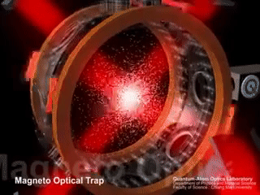

Slide 7
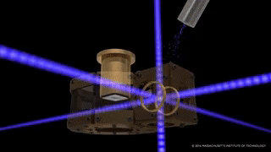

Slide 8
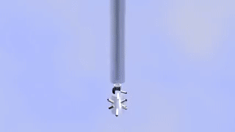

Slide 9
Some real experiments….

Slide 10
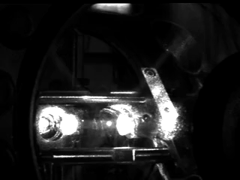

Slide 11
