Slide 1
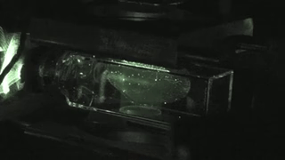

Slide 2
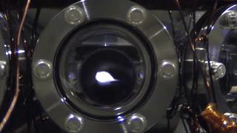

Slide 3
Some tricks to improve Doppler Cooling Using Magnetic field on Atoms
Magneto Optical Trap (MOT)

Slide 4
Effects of magnetic field on 2 Level atom
Uniform B
Uniform magnetic field (Helmholtz coil)
ZEEMAN SPLITTING
+1
0
-1

Slide 5
Effects of magnetic field on 2 Level atom (Using anti-helmhlotz coil)
-1
+1
0
0
+1
-1
-B
0
+B

Slide 6
Magneto optical trapping
Energy
m_{F} = -1
m_{F} = +1
F=1
m_{F} = 0
m_{F} = 0
o
m_{F} = +1
m_{F} = -1
σ⁺
σ⁻
Δm_{F} = +1
Δm_{F} = -1
F=0
0
Z’’
Z’

Slide 7
MOT
v
ω_{zeeman}
+1
ω₀
Counter propagating σ+ Light Absorb’s: ω₀ - ω_{zeeman} + kv
The atom emits: ω₀ - ω_{zeeman} in the perpendicular direction by spontaneous
Emission.
VICE VERSA FOR σ- LIGHT FOR THE ATOM IN OTHER SIDE

Slide 8
Effects of magnetic field on 2 Level atom (Using anti-helmhlotz coil)
σ+
Both these will see same energy gap
At identical locations
σ-
-1
+1
0
0
+1
-1
-B
0
+B

Slide 9
Experiment Sequence

Slide 10
Doppler
Cooling
MOT
Laser
Power
ω₀-kv_{d}
Laser
frequency
ω₀ - ω_{zeeman} + kv
Magnetic
field

Slide 11
Cooling phases
Doppler
Cooling
Milli Kelvin range
MOT
Atomic density
Increased
Magnetic Trapping
Need
Multi-Level
Treatment.
2 level model fails…
Quantum nature of atoms observed
Evaporative Cooling

Slide 12
Approximate Mathematical approach for Deriving Doppler Cooling Force

Slide 13
Force equation in a MOT

Slide 14
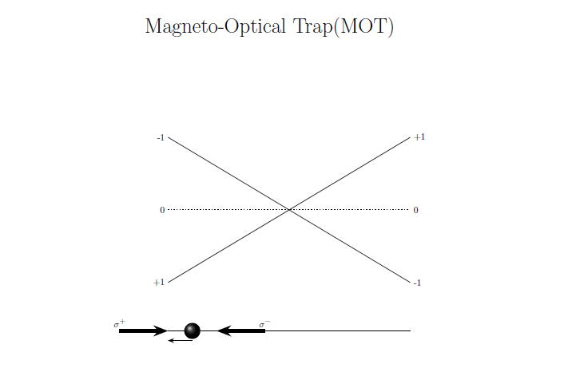
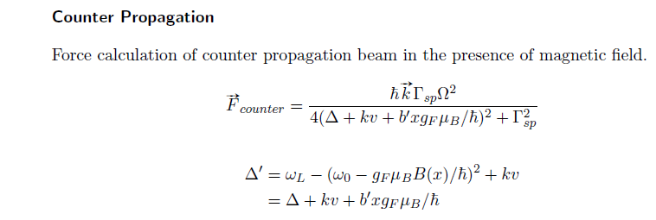

Slide 15
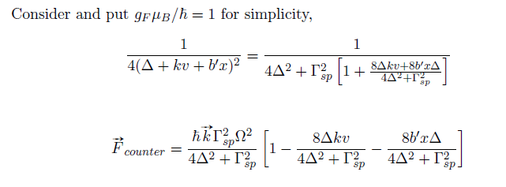
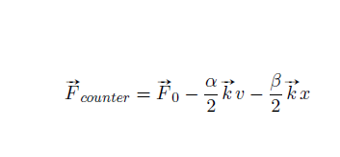

Slide 16
