Slide 1
Magnetic trapping

Slide 3
Potential seen by the atom in different mF states
1/2 kx²
mF = +1
mF = 0
-1/2 kx²
mF = -1

Slide 4
Restoring Force
Hence, restoring force is experienced for atoms having electron in mF =+1 state only (F=-Kx form)
Only those toms will ‘feel’ a trapping potential
This is like a trap for atoms having electron in mF =+1 inside this region
where +1g_{F}µ_{B}B(x) >>> ½ mv_{D}²

Slide 5
Atomic cloud
½ mv_{D}²
mF = +1
+1g_{F}µ_{B}B(x)
+1g_{F}µ_{B}B(x) >>> ½ mv_{D}²
Atoms who has ½ mv²>>> +1g_{F}µ_{B}B(x) will escape the trap leaving
Colder ones behind and they thermalize
Evaporation Process……

Slide 6
Self Evaporation
mF = +1
Overall temperature goes down

Slide 7
How to cool further in conservative trap such that de Broglie wave length becomes significant and atoms start to show quantum nature?

Slide 8
Keep on reducing the potential Barrier?
Such that self evaporation gets promoted?

Slide 13
TECHNICAL PROBLEM ARISES! GETTING STABLE LOW MAGNETIC
FIELDS ARE DIFFICULT IN MAGNETIC TRAP COILS……………
Field value jitters……

Slide 14
Forced Evaporation is the method!

Slide 15
How it works?
Force fully remove the higher energetic atoms in the trap
This will lead to a loss in atom number but overall a reduction occurs in temperature after thermalisation

Slide 16
We know atoms move randomly in the trap
Overall atomic cloud will have average speed of v for a given T
Lets look at this situation in Energy diagram where these atoms are?
Energy
v
How to
Remove them?
Distance

Slide 17
How to do it??

Slide 18
Lets C how it works?......
Lets look at a hotter atom with average speed v in the energy v/s x
These
Atoms move
In this height
On Energy scale
Off course there are many atoms
Doing the same…

Slide 19
Important
Note that ATOMS ARE not actually under uniform circular motion, this is SYMBOLIC
Actual motion is different from the Energy Scale
Picture
Energy Picture is an easy way to understand Forced
Evaporation, compared to actual motion in position space

Slide 20
How to remove those hotter ones?
Think on why we remove them?......
This leads to overall reduction in speed and temperature due to thermalisation effects from elastic collision…………
Recollect the CUT in Boltzmann distribution……..

Slide 21
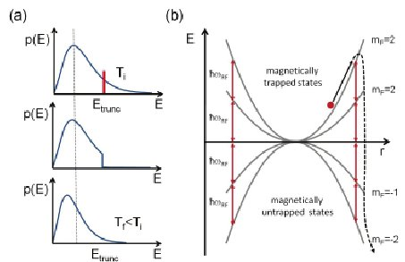
E

Slide 22
Lets C how it works?......
How to remove?

Slide 23
How is the internal structure?
Atoms with higher energy remains in the periphery at farther away distance, hence
They have larger energy
1/2 kx²
mF = +1
mF = 0
-1/2 kx²
mF = -1

Slide 24
How is the internal structure?
mF = +1
mF = 0
mF = -1

Slide 25
How to remove them?
mF = +1
mF = 0
mF = -1

Slide 26
De-excite using light to mF=0
mF = +1
Rf resonant radiation
mF = 0
mF = -1

Slide 27
De-excite using light to mF=0
No Force
On atoms anymore
They escape
mF = +1
Rf resonant radiation
mF = 0
mF = -1

Slide 28
This gets thermalised….. Recollect Distribution

Slide 29
E

Slide 30
This process repeated for lower speed/lower energetic atoms as well
mF = +1
mF = 0
mF = -1

Slide 31
Lets now Summarize the Forced Evaporation

Slide 32
Forced evaporative cooling
H(r) = μ.B_{dc}(r)
E(r) = m_{F}g_{F}µ_{B}B_{dc}
+1
+1
E
=0

Slide 33
Forced evaporative cooling
+1
E
f₁
=0

Slide 34
Forced evaporative cooling
+1
E
f₂
=0

Slide 35
Forced evaporative cooling
+1
E
f₃
=0

Slide 36
Forced evaporative cooling
+1
E
f₄
=0

Slide 39
Temperature measurement
Trap off
Cloud expands
camera
Atom
cloud
Resonant light is shone on to atoms

