Slide 1
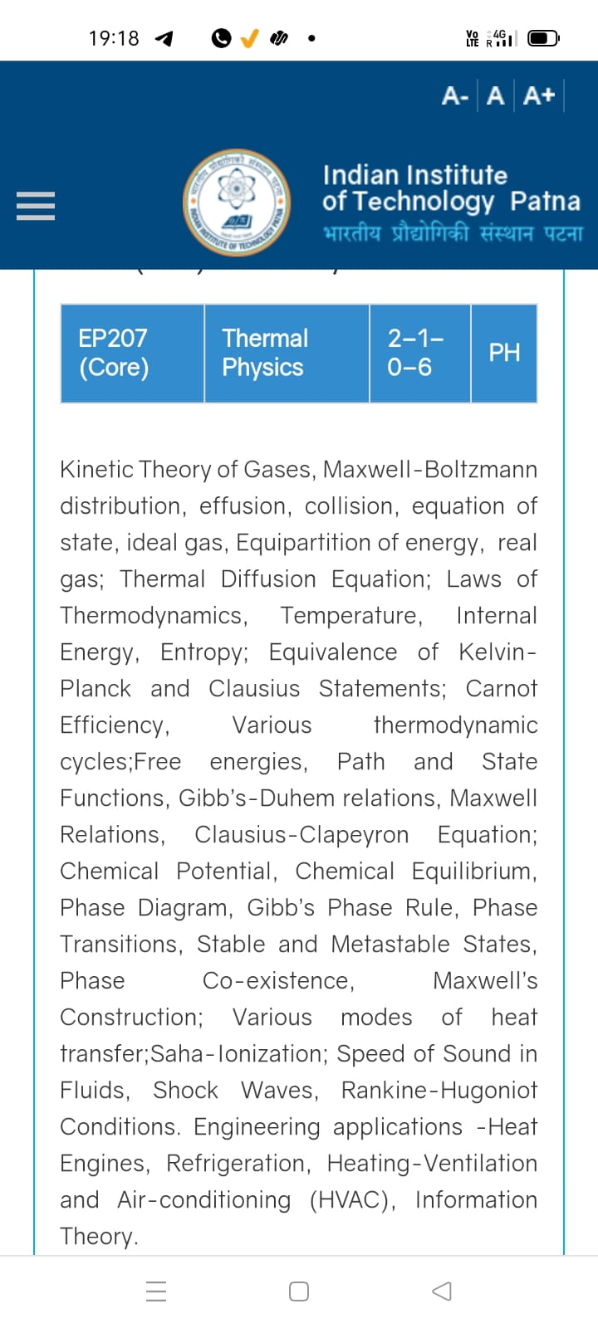
Season 5, Lecture 9 (S5,L9):
EP2104 Thermal physics with engineering applications
3-1-0-4

Slide 2
Time | 11:11:55 | 12-12:55 | 3-3:55 | 4- 4:55 | 02-02:55
Day
Monday |  | R103
Tuesday |  |  | R103
Wednesday |  |  |  | R103
Thursday | R101

Slide 3
 |  | L1 | L2 | L3 | L4 | L5 | L6 | L7 | L8 | L9
 | "Anirudh Karthikeyan" <anirudh_2501ph19@iitp.ac.in>; | p | p | p | p | p | p | q | P | a
2. | "Anshita Meena" <anshita_2501ph08@iitp.ac.in>; | p | p | p | p | p | p | q | P | p
3. | "Aritro Ghosh" <aritro_2501ph03@iitp.ac.in>; | p | a | p | p | p | p | a | P | p
4. | "Arunya Guha" <arunya_2501ph28@iitp.ac.in>; | p | p | a | p | p | p | a | P | p
5. | "Avala Venkata Hemanth" <avala_2501ph37@iitp.ac.in>; | a | a | a | p | p | p | p | P | p
6. | "Ayush Kumar" <ayush_2501ph24@iitp.ac.in>; | p | p | a | p | p | p | a | A | p
7. | "Badavath Madhulatha" <badavath_2501ph38@iitp.ac.in>; | p | p | a | p | p | p | q | P | p
8. | "Banothu Somanna" <banothu_2501ph36@iitp.ac.in>; | p | p | p | p | p | p | a | A | p
9. | "Chenche Shankara Suman" <chenche_2501ph07@iitp.ac.in>; | p | p | p | p | p | a | a | P | p
10. | "Davala Bhuvana Karthik" <davala_2501ph25@iitp.ac.in>; | p | p | p | p | p | p | a | A | p

Slide 4
 |  | L1 | L2 | L3 | L4 | L5 | L6 | L7 | L8 | L9
11. | "David Pratap Singh" <david_2501ph26@iitp.ac.in>; | p | p | q | p | p | p | p | P | p
12. | "Deepak Kumar" <deepak_2503ph03@iitp.ac.in>; | p | p | q | p | p | p | p | P | p
13. | "Dekka Nivas" <dekka_2501ph29@iitp.ac.in>; | p | p | q | p | p | p | p | P | p
14. | "Gamit Marlon Maheshbhai" <gamit_2501ph21@iitp.ac.in>; | p | p | q | p | p | p | p | P | p
15. | "Himesh Katare" <himesh_2501ph33@iitp.ac.in>; | p | p | q | p | p | p | p | P | p
16. | "Jadhav Vedant Rajesh" <jadhav_2501ph06@iitp.ac.in>; | p | p | q | p | p | p | p | P | p
17. | "Johaan Peter Thekkan" <johaan_2501ph05@iitp.ac.in>; | p | p | q | p | p | p | p | P | p
18. | "Karri Akshara" <karri_2501ph13@iitp.ac.in>; | p | p | q | p | p | p | p | P | p
19. | "Kashvi Mehta" <kashvi_2501ph32@iitp.ac.in>; | p | p | q | p | p | p | p | P | p
20. | "Kirti Chandra" <kirti_2501ph35@iitp.ac.in>; | p | p | q | a | p | p | p | P | p

Slide 5
 |  | L1 | L2 | L3 | L4 | L5 | L6 | L7 | L8 | L9
21 | "Krishna Mule" <krishna_2501ph04@iitp.ac.in>; | p | p | q | p | p | p | p | P | p
22. | "Kummetha Sai Darshan Reddy" <kummetha_2501ph17@iitp.ac.in>; | p | p | p | p | p | p | p | P | p
23. | "Maddirala Bhanu Kiran" <maddirala_2501ph31@iitp.ac.in>; | p | p | q | a | a | a | p | P | p
24. | "Manish" <manish_2501ph22@iitp.ac.in>; | p | p | q | p | p | p | p | P | p
25. | "Mohammad Owais Ansari" <mohammad_2501ph18@iitp.ac.in>; | p | p | q | p | p | p | p | P | p
26. | "Muhammed Rehaan Sharafudheen" <muhammed_2501ph20@iitp.ac.in>; | p | p | q | p | p | p | p | P | p
27. | "Nikhil" <nikhil_2501ph34@iitp.ac.in>; | p | p | q | p | p | p | p | P | p
28. | "Poodari Shivani" <poodari_2503ph04@iitp.ac.in>; | p | p | q | p | p | p | p | P | p
29. | "Rahul Yadav" <rahul_2501ph23@iitp.ac.in>; | p | p | q | p | p | p | p | P | p
30. | "Rohit David Paul" <rohit_2501ph11@iitp.ac.in>; | p | p | a | p | a | a | a | P | p

Slide 6
 |  | L1 | L2 | L3 | L4 | L5 | L6 | L7 | L8 | L9
31 . | "Ronak Jakhar" <ronak_2501ph10@iitp.ac.in>; | p | p | p | p | p | p | P | P | p
32. | "Rudraneel Shee" <rudraneel_2501ph15@iitp.ac.in>; | p | p | p | p | p | p | P | P | p
33. | "S Ragul Raagav" <s_2503ph02@iitp.ac.in>; | p | p | p | p | p | p | P | P | p
34. | "Sara Khan" <sara_2501ph30@iitp.ac.in>; | p | p | p | p | p | p | P | P | p
35. | "Shaik Jabeer Sulthan" <shaik_2501ph16@iitp.ac.in>; | p | p | p | p | p | p | a | A | p
36. | "Shourya Sharma" <shourya_2503ph01@iitp.ac.in>; | p | p | a | a | p | a | a | A | a
37. | "Shreyas Saraswatiprasad Waikar" <shreyas_2501ph02@iitp.ac.in>; | p | p | p | p | p | p | p | P | p
38. | "Snehardra Das" <snehardra_2501ph14@iitp.ac.in>; | p | p | p | a | p | p | a | P | a
39. | "Tejeswin R" <tejeswin_2501ph09@iitp.ac.in>; | p | p | a | p | p | a | p | P | p
40. | "Varkatam Akshaya" <varkatam_2501ph12@iitp.ac.in>; | p | p | p | p | p | p | p | P | p

Slide 7
 |  | L1 | L2 | L3 | L4 | L5 | L6 | L7 | L8 | L9
41. | "Vivanshu Chauhan" <vivanshu_2501ph01@iitp.ac.in>; | p | p | p | p | p | p | a | P | p
42. | "Yogesh Kumar" yogesh_2501ph27@iitp.ac.in | p | p | p | p | p | p | a | P | p
Attendance: 75% mandatory

Slide 8
Mean free path, Pressure, Temperature

Slide 9
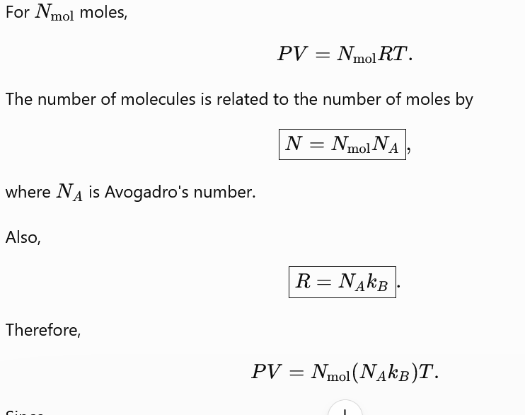

Slide 10
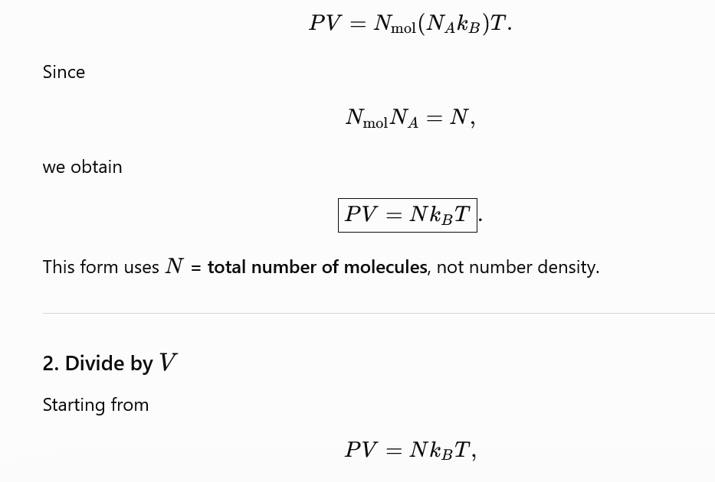
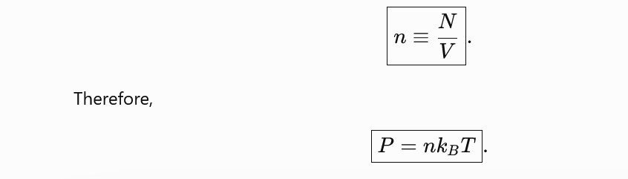

Slide 11
Mean free path, Pressure, Temperature

Slide 12
Pressure of an ideal gas inside a container- Kinetic theory approach

Slide 13
Pressure inside a container- Kinetic theory approach

Slide 14
Pressure inside a container- Kinetic theory approach

Slide 15
Assumptions: very dilute ideal gas
For this i^{th} particle
Velocity remains the same throughout
: only elastic collision take place

Slide 16
Velocity remains the same throughout
: only elastic collision take place

Slide 18
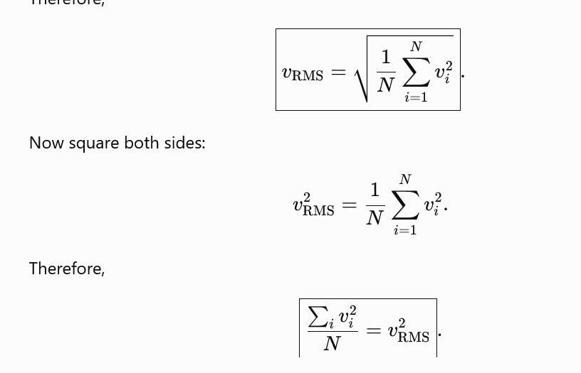

Slide 19
Assumption: Isotropic situation

Slide 20
Tutorial 2

Slide 21
Problem 1

Slide 22
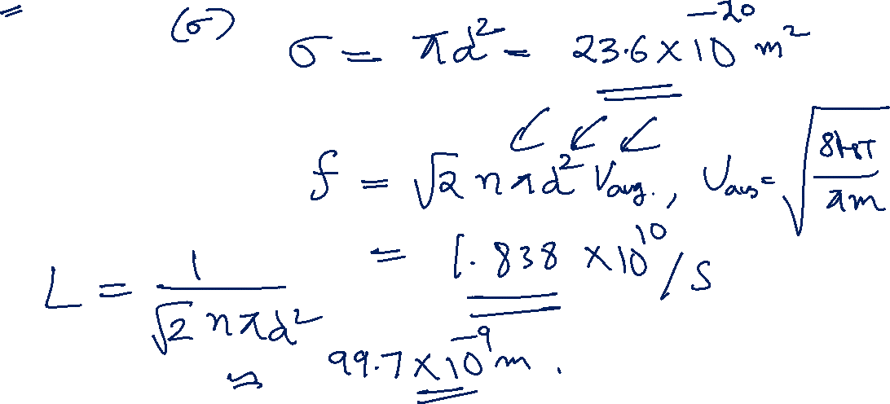
Problem 1

Slide 23
Solution:

Slide 24
Problem 2

Slide 25
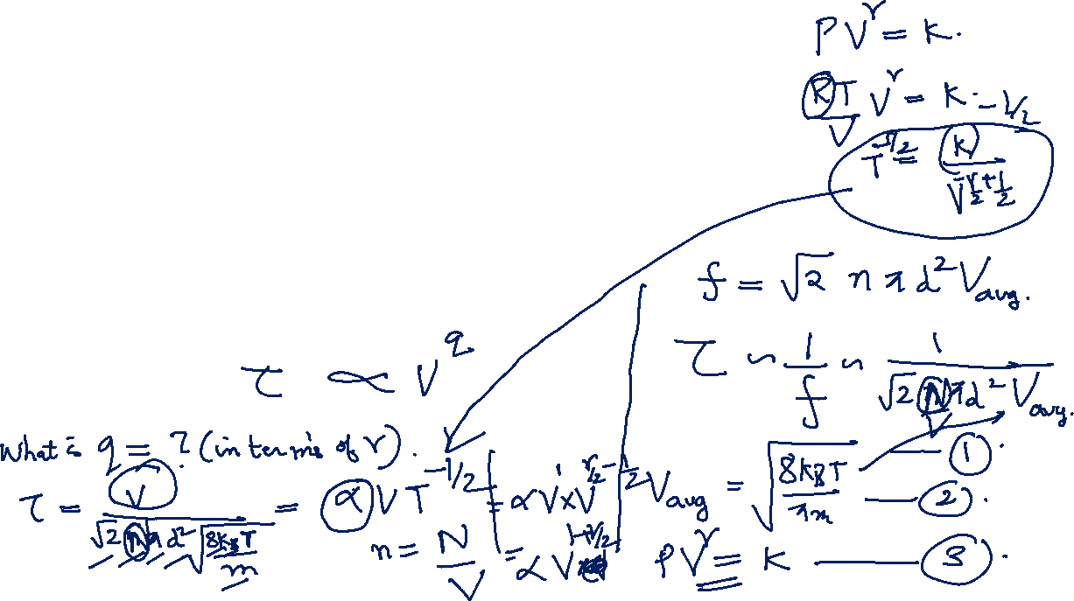
Problem 2

Slide 26
Solution

