Slide 1
RECAP

Slide 2
Temperature measurement
Trap off
Cloud expands
camera
Atom
cloud
Resonant light is shone on to atoms

Slide 3
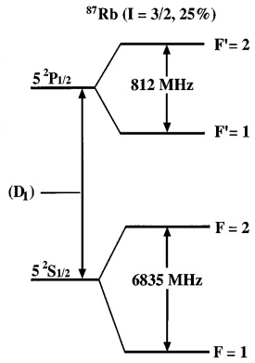
Frequency of detection light?
+2
-2
-2
-1
mF
σ+Light, ΔmF = +1
+1
-1

Slide 4
As seen on Camera: Absorption imaging
Atom
cloud

Slide 5
How it looks in camera?
False
Color
a

Slide 6
Absorption Imaging Sequence
Step 1
Doppler Cooling+ MOT + Magnetic trap
ALL OFF
Expansion
Of atomic cloud
Atomic sample destroyed
t₁ s
Detection light
CCD Camera

Slide 7
Again the sequence starts from beginning! Why? Because atoms are destroyed by detection light
Note: Absorption imaging is a destructive method

Slide 8
Absorption Imaging Sequence
Step 1
Doppler Cooling+ MOT + Magnetic trap
ALL OFF
Expansion
Of atomic cloud
Atomic sample destroyed
It is
Difficult
To get
A ultra short
Light
Pulse
As our laser
Is CW
t₁ s
Detection light
CCD Camera

Slide 9
Absorption Imaging Sequence
Step 2
Doppler Cooling+ MOT + Magnetic trap
ALL OFF
Expansion
Of atomic cloud
Atomic sample destroyed
later
t₂ s
Detection light
CCD Camera

Slide 10
Absorption Imaging Sequence
Step 3
Doppler Cooling+ MOT + Magnetic trap
ALL OFF
Expansion
Of atomic cloud
Atomic sample destroyed
t₃ s
Detection light
CCD Camera

Slide 11
Doppler Cooling+ MOT + Magnetic trap
ALL OFF
Expansion
Of atomic cloud

Slide 13
v
a
a+vt
a+vt’

Slide 14
Size
t
From the fit V is calculated, then T

Slide 15
How to cool further in conservative trap such that de Broglie wave length becomes significant and atoms start to show quantum nature?

Slide 16
Keep on reducing the potential Barrier?
Such that self evaporation gets promoted?

Slide 21
Forced Evaporation is the method!

Slide 22
How it works?
Force fully remove the higher energetic atoms in the trap
This will lead to a loss in atom number but overall a reduction occurs in temperature after thermalisation

Slide 23
We know atoms move randomly in the trap
Overall atomic cloud will have average speed of v for a given T
Lets look at this situation in Energy diagram where these atoms are?
Energy
v
How to
Remove them?
Distance

Slide 24
How to do it??

Slide 25
Lets C how it works?......
Lets look at a hotter atom with average speed v in the energy v/s x
These
Atoms move
In this height
On Energy scale
Off course there are many atoms
Doing the same…

Slide 26
Important
Note that ATOMS ARE not actually under uniform circular motion, this is SYMBOLIC
Actual motion is different from the Energy Scale
Picture
Energy Picture is an easy way to understand Forced
Evaporation, compared to actual motion in position space

Slide 27
How to remove those hotter ones?
Think on why we remove them?......
This leads to overall reduction in speed and temperature due to thermalisation effects from elastic collision…………
Recollect the CUT in Boltzmann distribution……..

Slide 28
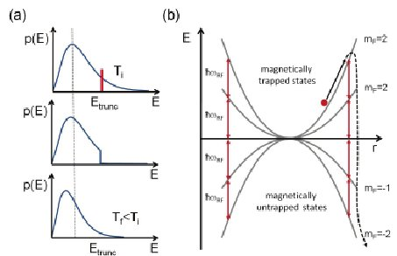
E

Slide 29
Lets C how it works?......
How to remove?

Slide 30
How is the internal structure?
Atoms with higher energy remains in the periphery at farther away distance, hence
They have larger energy
1/2 kx²
mF = +1
mF = 0
-1/2 kx²
mF = -1

Slide 31
How is the internal structure?
mF = +1
mF = 0
mF = -1

Slide 32
How to remove them?
mF = +1
mF = 0
mF = -1

Slide 33
De-excite using light to mF=0
mF = +1
Rf resonant radiation
mF = 0
mF = -1

Slide 34
De-excite using light to mF=0
No Force
On atoms anymore
They escape
mF = +1
Rf resonant radiation
mF = 0
mF = -1

Slide 35
This gets thermalised….. Recollect Distribution

Slide 36
E

Slide 37
This process repeated for lower speed/lower energetic atoms as well
mF = +1
mF = 0
mF = -1

Slide 38
Lets now Summarize the Forced Evaporation

Slide 39
Forced evaporative cooling
H(r) = μ.B_{dc}(r)
E(r) = m_{F}g_{F}µ_{B}B_{dc}
+1
+1
E
=0

Slide 40
Forced evaporative cooling
+1
E
f₁
=0

Slide 41
Forced evaporative cooling
+1
E
f₂
=0

Slide 42
Forced evaporative cooling
+1
E
f₃
=0

Slide 43
Forced evaporative cooling
+1
E
f₄
=0

Slide 44
Steps: RF evaporation
Step 1
Image Analysis
Doppler Cooling+ MOT + Magnetic trap
RF
Evaporation
Frequency f₁
ALL OFF
Expansion
For temperature
Detection light
CCD Camera

Slide 45
Steps: RF evaporation
Step 2
Image Analysis
Doppler Cooling+ MOT + Magnetic trap
RF
Evaporation
Frequency f₁
To f₂
ALL OFF
Expansion
For temperature
Detection light
CCD Camera

Slide 46
Steps: RF evaporation
Step 3
Image Analysis
Doppler Cooling+ MOT + Magnetic trap
RF
Evaporation
Frequency f₁
To f₃
ALL OFF
Expansion
For temperature
Detection light
CCD Camera

Slide 47
Steps: RF evaporation
Distribution
changes
Step 4
Image Analysis
Doppler Cooling+ MOT + Magnetic trap
RF
Evaporation
Frequency f₁
To f₄
ALL OFF
Expansion
For temperature
Detection light
CCD Camera

Slide 48
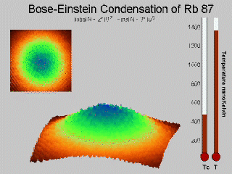
Till how much you do evaporation?

Slide 49
Quantized levels start appearing… Once atoms become quantum particle….

Slide 50
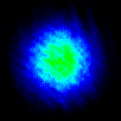
Quantum degeneracy
BEC

Slide 51
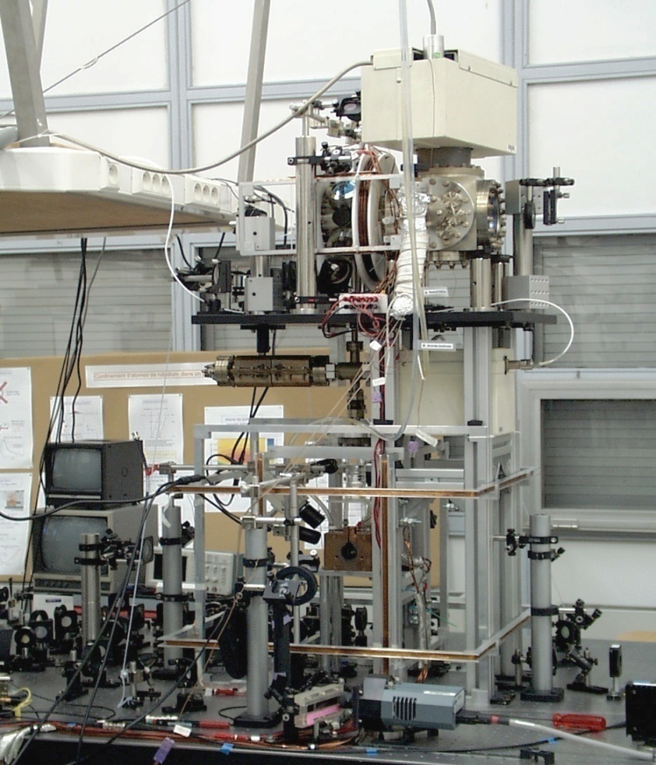
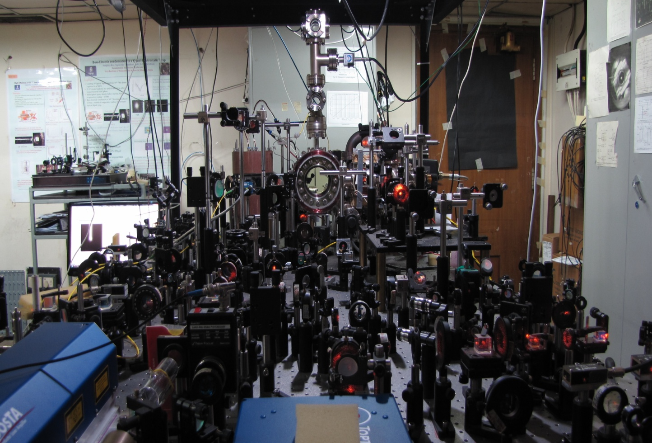
Experimental set up
Paris
TIFR Mumbai

Slide 66
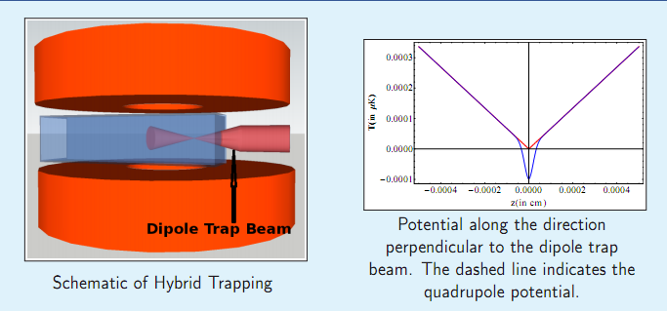
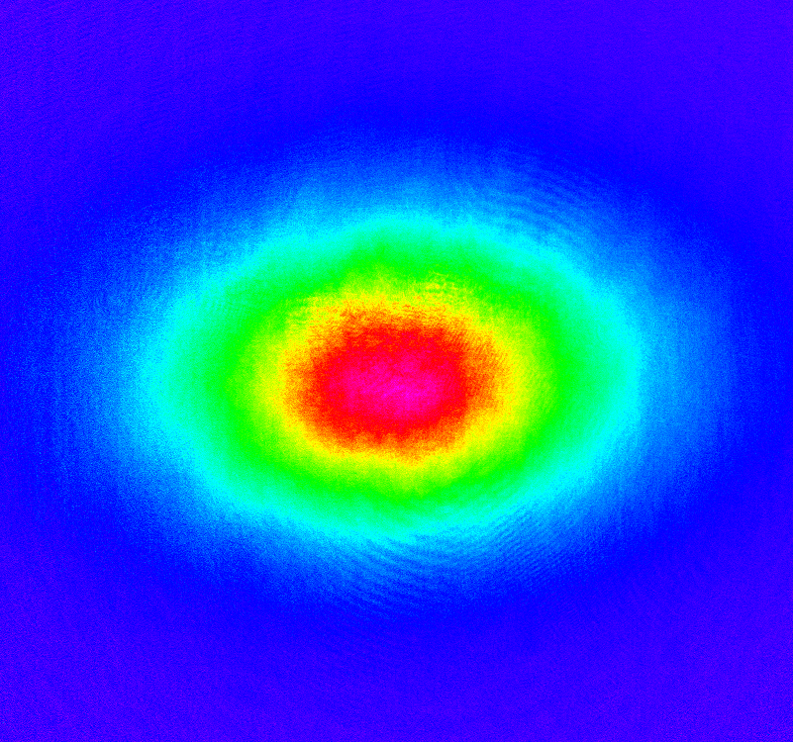
Optical Trap
Optical Dipole trap
w₀
Hybrid trap =
Magnetic + Optical field

