Slide 1
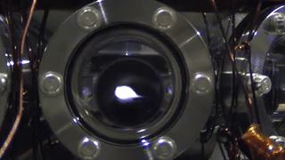
A RECAP ON DOPPLER COOLING

Slide 2
Concept of Doppler Cooling of Atoms

Slide 3
Doppler effect in radiation pressure
Laser cooling in 1-D
v
e
δ
ω_{L}- kv
ω_{L}+ kv
ω_{L}
ω_{o}
ω_{L}
g

Slide 4
Energy Picture For Counter Propagation
Counter Propagating
v
Atom Absorbs Lower Frequency and emits higher frequency
Which means it loses its Kinetic Energy and Velocity
Momentum Picture For Counter Propagation
Atom gets a recoil kick as v_{rec} = hk/M
Rate of change of momentum = hk/t = hk x photon absorption emission rate
Atom decelerate

Slide 5
Energy Picture For C0 Propagation
v
Atom Absorbs Higher Frequency and emits Lower frequency
Which means it increases its Kinetic Energy and Velocity
Momentum Picture For Counter Propagation
Atom gains energy hence accelerate

Slide 6
Some Animations…

Slide 7
Laser cooling in 3-D

Slide 8
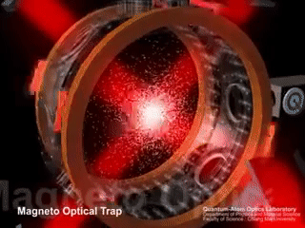

Slide 9
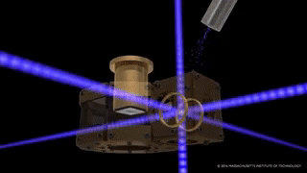

Slide 10
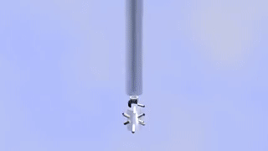

Slide 11
Some real experiments….

Slide 12
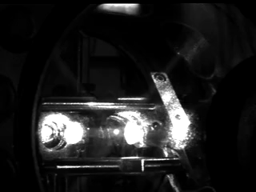

Slide 13
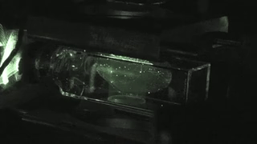

Slide 15
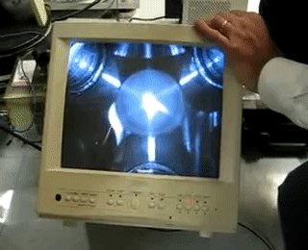

Slide 16
Some Limitations of Doppler Cooling
Minimum Temperature attained in range of fraction of milli Kelvin ONLY…..
For seeing Quantum Behavior of atoms need to reach order of Nano Kelvin
Doppler Cooling has no position dependent force, atoms in periphery leave the cooling region. Force F take a form of F = -αV
Laser Light has some heating effect also for some frequencies for certain velocity class of atoms: Not all the atoms experience the right frequency for cooling effect some atoms gets heating effects from co-propagating light as well………
A competition between heating and cooling arise which leads to an equilibrium temperature.

Slide 17
Some tricks to improve Doppler Cooling Using Magnetic field on Atoms
Magneto Optical Trap (MOT)

Slide 18
Effects of magnetic field on 2 Level atom
Uniform B
Uniform magnetic field (Helmholtz coil)
ZEEMAN SPLITTING
+1
0
-1

Slide 19
Effects of magnetic field on 2 Level atom (Using anti-helmhlotz coil)
-1
+1
0
0
+1
-1
-B
0
+B

Slide 20
Magneto optical trapping
Energy
m_{F} = -1
m_{F} = +1
F=1
m_{F} = 0
m_{F} = 0
o
m_{F} = +1
m_{F} = -1
σ⁺
σ⁻
Δm_{F} = +1
Δm_{F} = -1
F=0
0
Z’’
Z’

