Slide 1
Post-Mid Sem
PH 608 Atomic Collision Physics
Lec 2 (05/03/2024)
Raghavan K E
Associate Professor
Indian Institute of Technology Patna

Slide 2
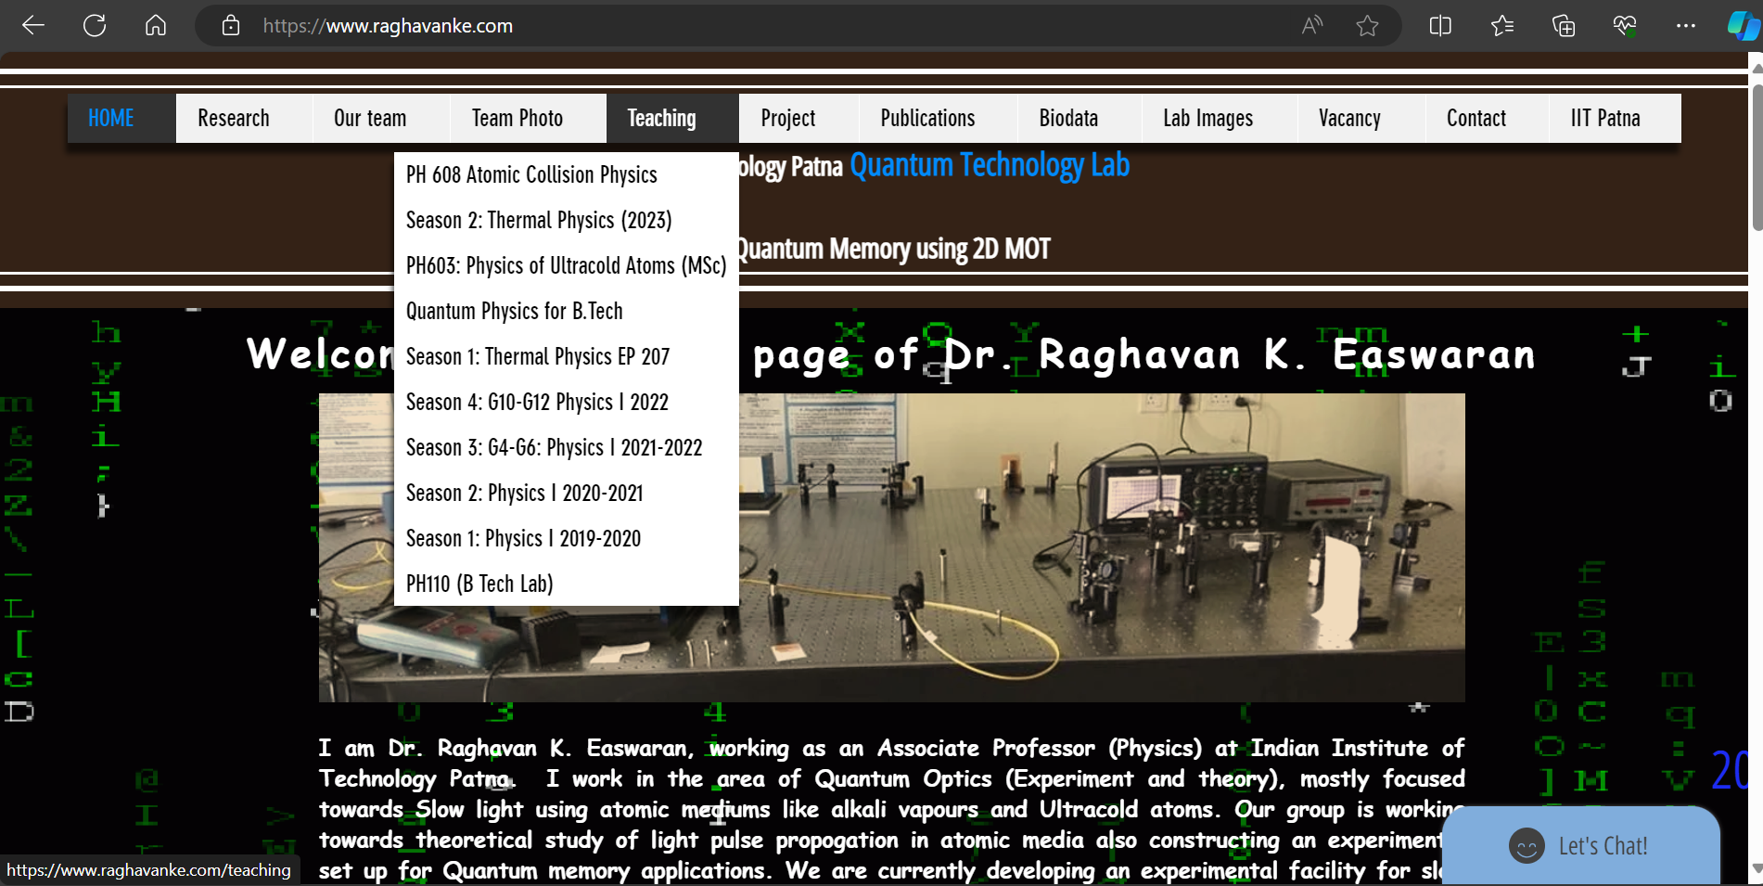

Slide 4
Attendance (Post-Mid Sem)
firstname | lastname | roll_no | lec1 | lec2 | lec3 | lec4 | lec5 | lec6 | lec7 | lec8 | lec9 | lec10 | lec11 | lec12 | lec13 | lec14 | lec15
Rajsekhar | Bhowmick | 2212PH36 p |  | p
Gaurav | Jaiswal | 2212PH13 a |  | a
Neellohit | Karmakar | 2212PH20 p |  | p
Soumik | Karmakar | 2212PH26 p |  | p
Aman | Kumar | 2212PH02 p |  | p
Ritik | Pal | 2212PH23 p |  | p
Binayak | Rout | 2212PH10 p |  | p
Kauship | Saha | 2212PH17 a |  | a
Naincy | Srivastava | 2321ph07 p |  | p
Rabi | Das | 2321ph15 p |  | p
Shruti | Sarswat | 2321ph19 p |  | p

Slide 5
Interatomic Potential: Lennard Jones Potential

Slide 6
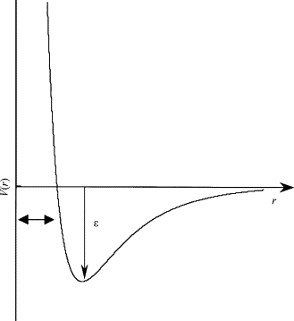
Interatomic Potential: Lennard Jones Potential
Lennard Jones Potential

Slide 7
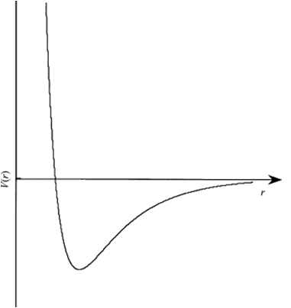
Interatomic potential
A
B
r_{a}
r_{b}
B
E

Slide 8
Interatomic potential
A
B
E
r_{a}
B

Slide 9
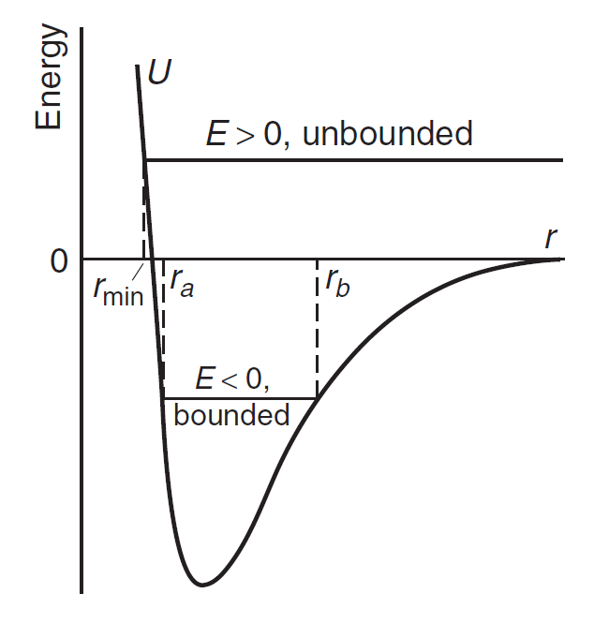
Interatomic potential
Lennard Jones Potential
Nearly Parabolic

Slide 10
Small Oscillations
Taylor series expansion of a function f(x), about
A point x=a is given as
Nearly Parabolic
Harmonic Oscillator

Slide 11
Velocity Vs. Position plot
V
Around
Equilibrium
For small oscillations only
r₀
r
Note that velocity will be maximum at equilibrium point

Slide 13
In a Quantum Scattering we expect………..

Slide 14
Pure background
Pure resonance
Interreference term

Slide 15
Post-Mid-Sem Topics
Recap of Phase-shift analysis for atom-atom collision
Hard-sphere scattering
Case-study: Low-energy scattering in attractive square well
Phase-shift Analysis
Resonances and its widths
Energy differences between the resonances
Scattering length and Scattering Cross-section
Contributions from background (hard sphere), pure resonance and Interference parts
Breit-Wigner resonance and Fano parameterization
Will Square well potential analysis remain valid for other general form of potential?
Phase shift and Time delay in resonances
Some case-studies in cold atoms and Engineering Applications

Slide 16
Upcoming Plans
Derivation of general expression of phase shift without the knowledge of exact form of potential (Recap)
Case study: Hard Sphere Scattering
Expression of Phase shift of any general potential in terms of hard sphere part and potential part
$ξ_{l}: \text{independent} \text{of} \text{details} \text{of} \text{potential}$(hard sphere part) $$ρ_{l}: \text{dependent} \text{of} \text{details} \text{of} \text{the} \text{potential}$$

Slide 17
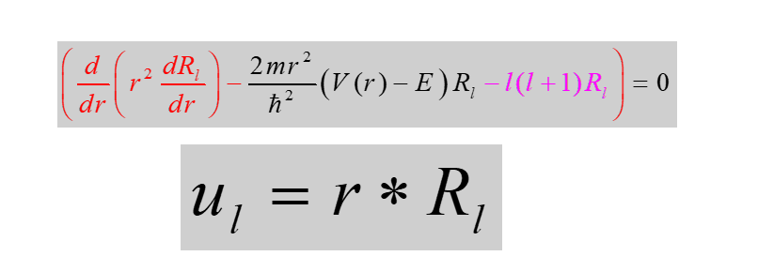
The general expression of phase shift without the knowledge of exact form of potential (Recap)

Slide 18
Scattering parameter
Scattering cross section
How to obtain Scattering phase shift ?
Phase shift is computed with reference to the unscattered wave.

Slide 19
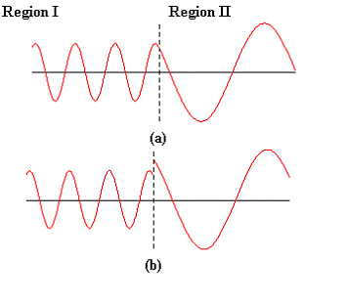
A
B
Active region
How to calculate the scattering phase shift outside the active region?
Impose the boundary condition: R_{l} and R_{l}’ have to be continuous.

Slide 20
A
B
Active region

Slide 21
‘a’
‘a’
Numerically solved!

Slide 22
‘a’: Range of the potential

Slide 24
This is the general expression of phase shift without the knowledge of exact form of potential

Slide 25
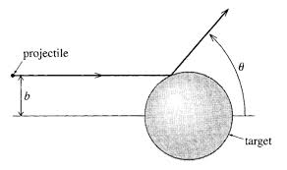
Hard-Sphere scattering

