Slide 1
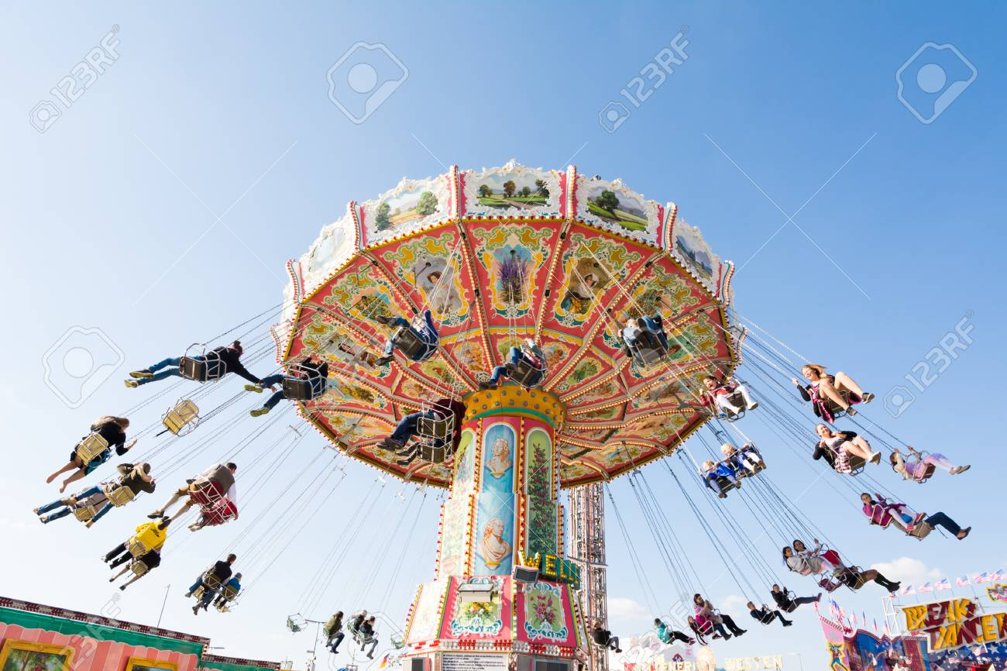
Fictitious Forces (Recap)

Slide 2
Relating the Co-ordinates (Recap) NON-ROTATING TO ROTATING
How to get this relation?

Slide 3
Relating the Co-ordinates (Recap)
P₂
P₁

Slide 4
Vector nature of angular velocity and angular momentum
Direction of velocity is tangential to the circle

Slide 5
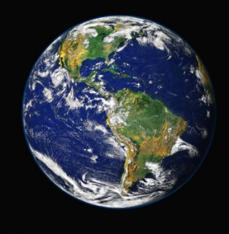
Force
y₁
O₁
x₁
Earth in rotating frame
Centrifugal force
Coriolis force
Azimuthal force

Slide 6
2a. Consider a person moving radially inward on a carousel with a velocity v. Let the carousel rotate in the X-Y plane with angular velocity ω= ωe_{z.}
What are the fictitious forces present?
What is the magnitude and direction of coriolis force?
Z

Slide 7
2a.
Moving radially on a carousel
Z
v
Coriolis force points tangentially inward

Slide 8
2b. Consider a person moving tangentially inward on a carousel with a velocity v. Let the carousel rotate in the X-Y plane with angular velocity ω= ωe_{z.}
What are the fictitious forces present?
What is the magnitude and direction of coriolis force?
Z

Slide 9
2b.
Moving tangentially inward on a carousel
Z
v
Coriolis force points radially outward

Slide 10
Quantitative analysis of fictitious forces in earth’s frame

Slide 11
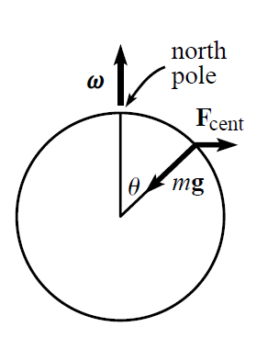
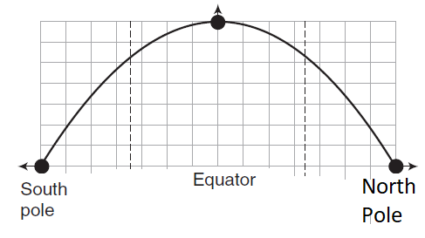
3. A person is standing still on a location P as shown in figure 1 on Earth.
Plot the nature of F_{cent.}
What is the effective gravity felt by him due to centrifugal force?
P
F_{centr}
Fig 1

Slide 12
What is the Direction of ?
Into the plane/board in the direction
r

Slide 13
ω
Direction of ?

Slide 14
Centrifugal force

Slide 15
Effective gravity: Centrifugal force

Slide 16
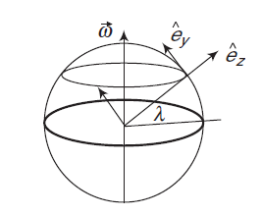
4. Consider an object is dropped under gravity in the –e_{z} direction as shown in figure. In the problem, consider λ as the latitude and ω as the angular velocity of the earth.
What is the nature of the Coriolis force?
Find the coriolis speed and deflection of the object due to the force.
What is the nature of Coriolis force if the object is thrown upward.

Slide 17
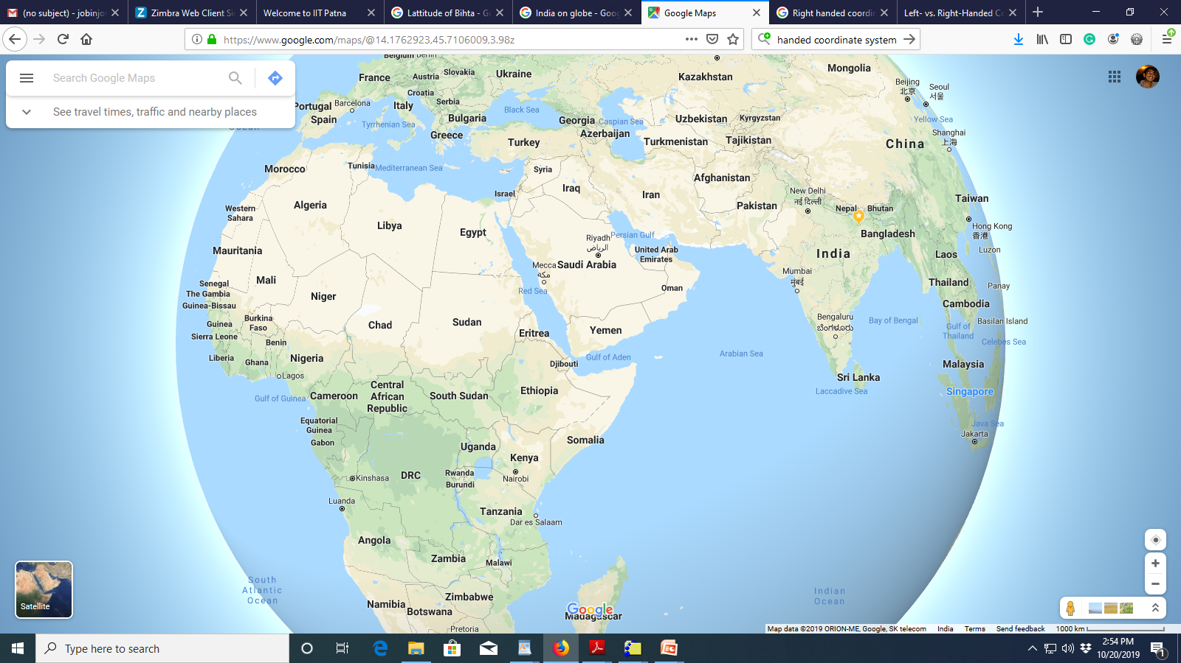
N
W

Slide 19
Coriolis Force (A quantitative analysis in earth frame)
If an object is dropped under gravity

Slide 20
N
W

Slide 21
Coriolis Force (A quantitative analysis in earth frame)
If an object is dropped under gravity

Slide 22
Coriolis Force (A quantitative analysis in earth frame)
If an object is thrown upward under gravity

Slide 23
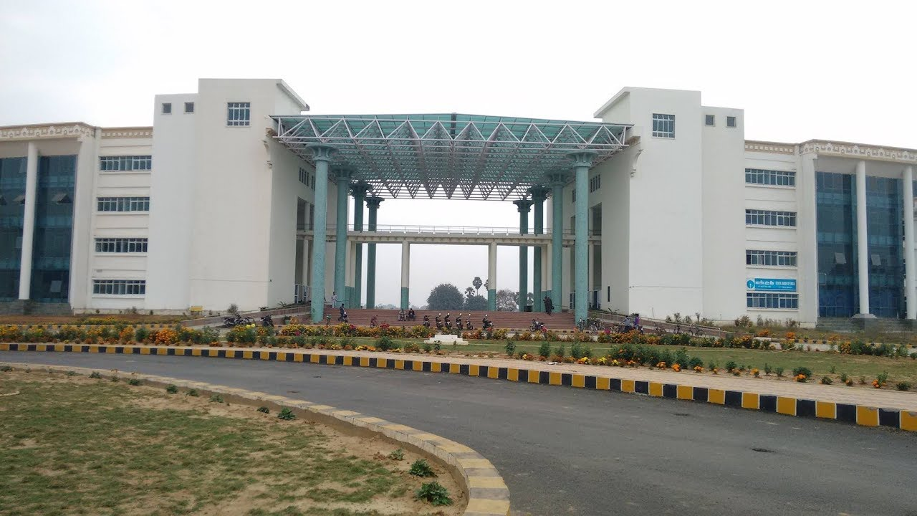
Coriolis effect on mass dropped from IIT Patna admin building
A mass m is released with zero initial velocity from top of IIT Patna admin building. IIT Patna is located at latitude of 25.5⁰. Assume that the admin building is 50 m. tall. Determine the amount of sideways coriolis deflection
Time of fall to cover 50 m=

