Slide 1
Highlights of the course
Co-ordinate Systems
Introduction to Vector Operators
Work , Energy and Conservation laws
Rigid body in motion
Oscillations and Waves
Quantum Physics

Slide 2
Chapter-3:Work , Energy and Conservation laws

Slide 3
Predicting the motion of a system under known constraints
Solve differential equation
Work, energy and conserved quantities

Slide 4
Work Energy Theorem from Force Equation
Change variable from x to t

Slide 5
Work Energy Theorem from Force Equation
The change in kinetic energy equals work done on the particle
W_{ba:} Work done by the force F on the particle
Theorem

Slide 6
Some applications of Work-Energy relation in 1-D
Examples
Mass thrown upward in a Uniform Gravitational field
Simple Harmonic Motion
Vertical Motion in an inverse square field
Newton’s Laws
Vector differential equations
Work Energy Theorem
Energy equations - Scalar

Slide 7
Maximum distance covered when Mass thrown upward in a Uniform Gravitational field
1
Equation of motion
2
Work energy theorem
(t,z,v)
Integrate once with I.C.
Time at which ball reaches maximum height:
Integrate once with I.C.
Integrate eqn (1) again with I.C.
(t₀,z₀,v₀)
Eliminate time using t_{m.}
The solution makes no reference to time!

Slide 8
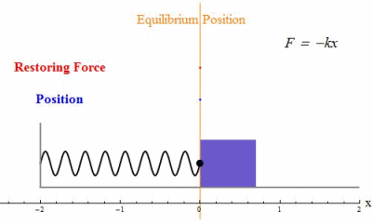
Solving the equation of Simple Harmonic Motion using Work-Energy Theorem
x=0, v=v_{max}
x=x_{0,} v=0
x=x_{1,} v=v₁
Case I
Choose Initial conditions: at t=0, v=0, x=x₀
Case II
Choose Initial conditions: at t=0, V=V_{max}, x=0
Case III
Choose Initial conditions: at t=0, V=V₁ , x=x₁

Slide 9
Solving the equation of Simple Harmonic Motion
x=x₀
Case I
Choose Initial conditions: at t=0, v=0, x=x₀
Integrating again after separating variables

Slide 11
Solving the equation of Simple Harmonic Motion
x₀=0, v=v_{max}
Case II
Choose Initial conditions: at t=0, V=V_{max}, x₀=0
Integrating again after separating variables

Slide 13
Solving the equation of Simple Harmonic Motion
Case III
Choose Initial conditions: at t=0, V=V₁ , x=x₁
x=x_{1,} v=v₁
Integrating again after separating variables

Slide 17
Solving the equation of Simple Harmonic Motion
x=0, v=v_{max}
x=x_{0,} v=0
x=x_{1,} v=v₁
Case I
Choose Initial conditions: at t=0, v=0, x=x₀
Case II
Choose Initial conditions: at t=0, V=V_{max}, x=0
Case III
Choose Initial conditions: at t=0, V=V₁ , x=x₁

