Slide 1
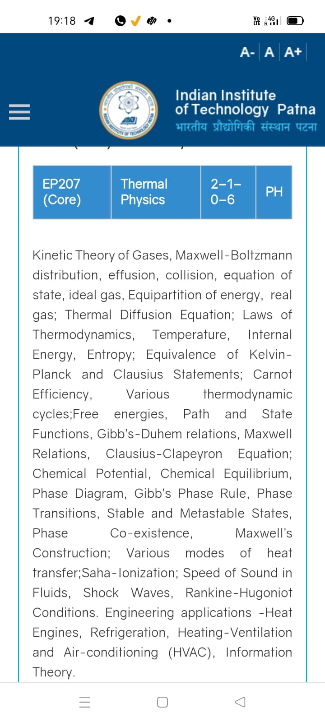
Season 5, Lecture 14 (S5,L14):
EP2104 Thermal physics with engineering applications
3-1-0-4

Slide 2
EP2104 Thermal physics with engineering applications
3-1-0-4
Syllabus
Course Outline Kinetic Theory of Gases, Maxwell-Boltzmann distribution, Mean free path, collision, equation of state, ideal gas, Equipartition of energy, real gas; Thermal Diffusion Equation, effusion; Laws of Thermodynamics, Temperature, Internal Energy, specific heat, Entropy;
Carnot engine, Various thermodynamic cycles; Thermodynamic potentials, Path and State Functions, Gibb’s-Duhem relations, Maxwell Relations; Clausius-Clapeyron Equation; Chemical Potential, Chemical Equilibrium, Phase Diagram, Gibb’s Phase Rule, Phase Transitions, Stable and Metastable States, Phase Co-existence, Maxwell’s Construction; Various modes of heat transfer; Saha-Ionization; Speed of Sound in Fluids, Shock Waves, Rankine-Hugoniot Conditions. Engineering applications -Heat Engines, Joule-Thompson effect and applications to cryogenics, Refrigerators, Heating-Ventilation and Air-conditioning (HVAC), Exergy analysis of engineering systems, Information Theory.
Additional Topics: Thermal Physics and Quantum Memory for Quantum Communication.

Slide 3
Time | 11:11:55 | 12-12:55 | 3-3:55 | 4- 4:55 | 02-02:55
Day
Monday |  | R103
Tuesday |  |  | R103
Wednesday |  |  |  | R103
Thursday | R101

Slide 4
 |  | L1 | L2 | L3 | L4 | L5 | L6 | L7 | L8 | L9 | L10 | L11 | L12 | L13 | L14
 | "Anirudh Karthikeyan" <anirudh_2501ph19@iitp.ac.in>; | p | p | p | p | p | p | q | P | a | a | p | p | p | P
2. | "Anshita Meena" <anshita_2501ph08@iitp.ac.in>; | p | p | p | p | p | p | q | P | p | p | p | p | p | P
3. | "Aritro Ghosh" <aritro_2501ph03@iitp.ac.in>; | p | a | p | p | p | p | a | P | p | p | p | p | p | a
4. | "Arunya Guha" <arunya_2501ph28@iitp.ac.in>; | p | p | a | p | p | p | a | P | p | p | p | p | a | a
5. | "Avala Venkata Hemanth" <avala_2501ph37@iitp.ac.in>; | a | a | a | p | p | p | p | P | p | p | p | p | p | a
6. | "Ayush Kumar" <ayush_2501ph24@iitp.ac.in>; | p | p | a | p | p | p | p | p | p | p | a | p | p | a
7. | "Badavath Madhulatha" <badavath_2501ph38@iitp.ac.in>; | p | p | a | p | p | p | q | P | p | p | p | a | p | P
8. | "Banothu Somanna" <banothu_2501ph36@iitp.ac.in>; | p | p | p | p | p | p | a | A | p | a | p | a | a | P
9. | "Chenche Shankara Suman" <chenche_2501ph07@iitp.ac.in>; | p | p | p | p | p | a | a | P | p | p | p | p | p | a
10. | "Davala Bhuvana Karthik" <davala_2501ph25@iitp.ac.in>; | p | p | p | p | p | p | a | A | p | p | p | p | p | P

Slide 5
 |  | L1 | L2 | L3 | L4 | L5 | L6 | L7 | L8 | L9 | L10 | L11 | L12 | L13 | L14
11. | "David Pratap Singh" <david_2501ph26@iitp.ac.in>; | p | p | q | p | p | p | p | P | p | p | p | a | p | P
12. | "Deepak Kumar" <deepak_2503ph03@iitp.ac.in>; | p | p | q | p | p | p | p | P | p | a | p | p | p | P
13. | "Dekka Nivas" <dekka_2501ph29@iitp.ac.in>; | p | p | q | p | p | p | p | P | p | p | p | p | p | a
14. | "Gamit Marlon Maheshbhai" <gamit_2501ph21@iitp.ac.in>; | p | p | q | p | p | p | p | P | p | a | a | p | p | a
15. | "Himesh Katare" <himesh_2501ph33@iitp.ac.in>; | p | p | q | p | p | p | p | P | p | p | p | p | p | P
16. | "Jadhav Vedant Rajesh" <jadhav_2501ph06@iitp.ac.in>; | p | p | q | p | p | p | p | P | p | p | p | p | p | P
17. | "Johaan Peter Thekkan" <johaan_2501ph05@iitp.ac.in>; | p | p | q | p | p | p | p | P | p | p | p | p | p | P
18. | "Karri Akshara" <karri_2501ph13@iitp.ac.in>; | p | p | q | p | p | p | p | P | p | p | p | p | p | P
19. | "Kashvi Mehta" <kashvi_2501ph32@iitp.ac.in>; | p | p | q | p | p | p | p | P | p | p | p | p | p | P
20. | "Kirti Chandra" <kirti_2501ph35@iitp.ac.in>; | p | p | q | a | p | p | p | P | p | p | p | p | p | P

Slide 6
 |  | L1 | L2 | L3 | L4 | L5 | L6 | L7 | L8 | L9 | L10 | L11 | L12 | L13 | L14
21 | "Krishna Mule" <krishna_2501ph04@iitp.ac.in>; | p | p | q | p | p | p | p | P | p | p | p | p | p | P
22. | "Kummetha Sai Darshan Reddy" <kummetha_2501ph17@iitp.ac.in>; | p | p | p | p | p | p | p | P | p | p | p | p | a | P
23. | "Maddirala Bhanu Kiran" <maddirala_2501ph31@iitp.ac.in>; | p | p | q | a | a | a | p | P | p | p | p | p | p | P
24. | "Manish" <manish_2501ph22@iitp.ac.in>; | p | p | q | p | p | p | p | P | p | p | p | p | p | P
25. | "Mohammad Owais Ansari" <mohammad_2501ph18@iitp.ac.in>; | p | p | q | p | p | p | p | P | p | p | p | p | p | P
26. | "Muhammed Rehaan Sharafudheen" <muhammed_2501ph20@iitp.ac.in>; | p | p | q | p | p | p | p | P | p | p | p | p | p | P
27. | "Nikhil" <nikhil_2501ph34@iitp.ac.in>; | p | p | q | p | p | p | p | P | p | p | p | p | p | a
28. | "Poodari Shivani" <poodari_2503ph04@iitp.ac.in>; | p | p | q | p | p | p | p | P | p | p | p | p | p | a
29. | "Rahul Yadav" <rahul_2501ph23@iitp.ac.in>; | p | p | q | p | p | p | p | P | p | p | p | p | p | a
30. | "Rohit David Paul" <rohit_2501ph11@iitp.ac.in>; | p | p | a | p | a | a | a | P | p | a | p | a | p | a

Slide 7
 |  | L1 | L2 | L3 | L4 | L5 | L6 | L7 | L8 | L9 | L10 | L11 | L12 | L13 | L14
31 . | "Ronak Jakhar" <ronak_2501ph10@iitp.ac.in>; | p | p | p | p | p | p | P | P | p | p | p | p | p | P
32. | "Rudraneel Shee" <rudraneel_2501ph15@iitp.ac.in>; | p | p | p | p | p | p | P | P | p | p | a | p | p | a
33. | "S Ragul Raagav" <s_2503ph02@iitp.ac.in>; | p | p | p | p | p | p | P | P | p | p | p | p | p | a
34. | "Sara Khan" <sara_2501ph30@iitp.ac.in>; | p | p | p | p | p | p | P | P | p | p | p | p | p | P
35. | "Shaik Jabeer Sulthan" <shaik_2501ph16@iitp.ac.in>; | p | p | p | p | p | p | a | A | p | a | p | p | p | a
36. | "Shourya Sharma" <shourya_2503ph01@iitp.ac.in>; | p | p | a | a | p | a | a | A | a | a | a | a | p | a
37. | "Shreyas Saraswatiprasad Waikar" <shreyas_2501ph02@iitp.ac.in>; | p | p | p | p | p | p | p | P | p | p | p | p | p | P
38. | "Snehardra Das" <snehardra_2501ph14@iitp.ac.in>; | p | p | p | a | p | p | a | P | a | a | a | a | p | a
39. | "Tejeswin R" <tejeswin_2501ph09@iitp.ac.in>; | p | p | a | p | p | a | p | P | p | p | p | p | p | a
40. | "Varkatam Akshaya" <varkatam_2501ph12@iitp.ac.in>; | p | p | p | p | p | p | p | P | p | a | p | a | p | a

Slide 8
 |  | L1 | L2 | L3 | L4 | L5 | L6 | L7 | L8 | L9 | L10 | L11 | L12 | L13 | L14
41. | "Vivanshu Chauhan" <vivanshu_2501ph01@iitp.ac.in>; | p | p | p | p | p | p | a | P | p | p | p | p | p | P
42. | "Yogesh Kumar" yogesh_2501ph27@iitp.ac.in | p | p | p | p | p | p | a | P | p | p | p | p | p | a
Attendance: 75% mandatory

Slide 9
Thermal Diffusion equations: Fick’s Law
Fick’s second law

Slide 10
Tutorial 3: Thermal Diffusion

Slide 11
Problem 1
“A diffusing spherical cloud”

Slide 12
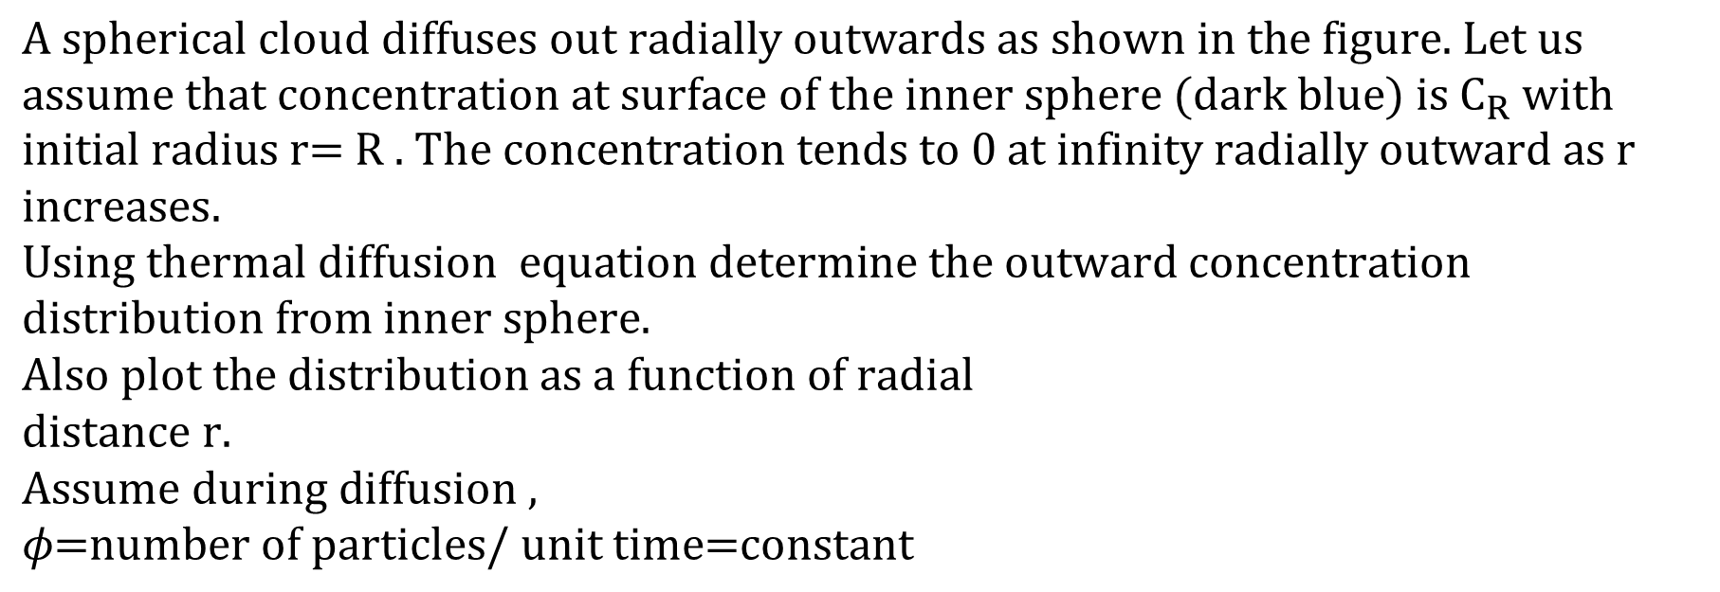
$$\text{A spherical cloud diffuses out radially outwards as shown in the figure. Let us} \\ \text{assume that concentration at surface of the inner sphere }(\text{dark blue})\text{ is }{\text{C}}_{R}\text{ with initial radius r= R }\text{. The concentration tends to 0 at infinity radially outward}\text{ as r increases}\text{. }$$
$$\text{Using thermal diffusion } \text{equation determine the outward concentration distribution from inner sphere.} \\ \text{Also plot the distribution as a function of radial }$$
$$\text{distance r.} \\ \text{Assume during diffusion , }$$
$$φ\text{=number of particles}\text{/}\text{ unit time=constant}$$

Slide 13
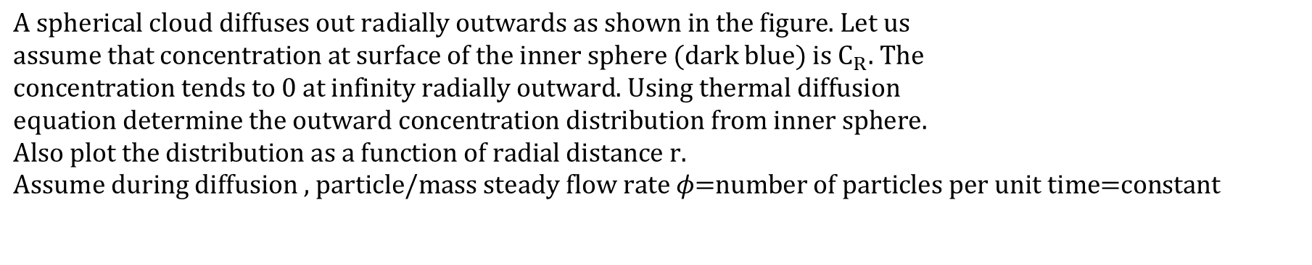
$$\text{A spherical cloud diffuses out radially outwards as shown in the figure. Let us} \\ \text{assume that concentration at surface of the inner sphere }(\text{dark blue})\text{ is }{\text{C}}_{R}\text{. The } \\ \text{concentration tends to 0 at infinity radially outward. Using thermal diffusion } \\ \text{equation determine the outward concentration distribution from inner sphere.} \\ \text{Also plot the distribution as a function of radial distance r.} \\ \text{Assume during diffusion , particle/mass steady flow rate }φ\text{=number of particles} \text{per unit time=constant}$$

Slide 14
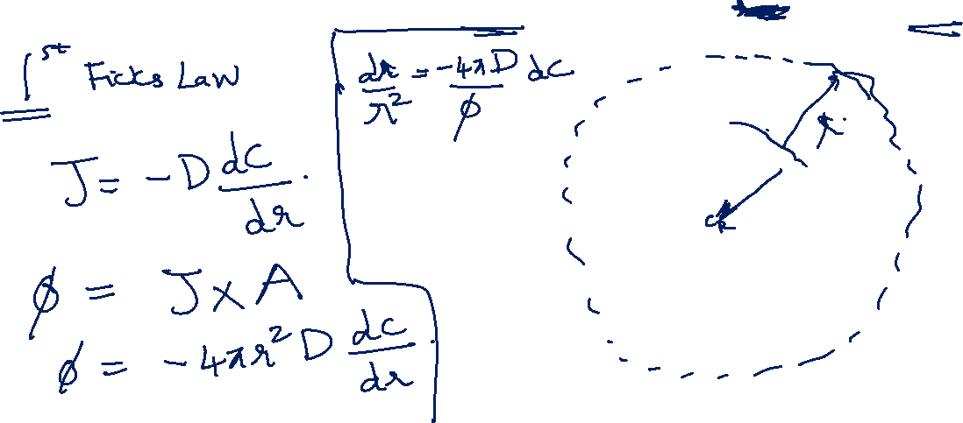

Slide 18
Problem 2
“Medicine storage ”

Slide 20
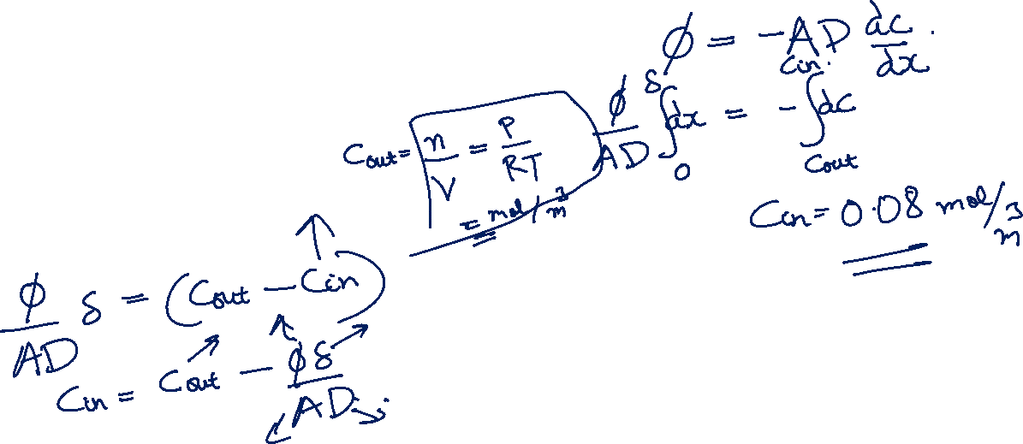

Slide 22
Medicine remains safe

Slide 23
Direction of diffusion
Pd membrane
0.005 mm

Slide 24
Direction of diffusion
Pd membrane
0.005 mm

Slide 25
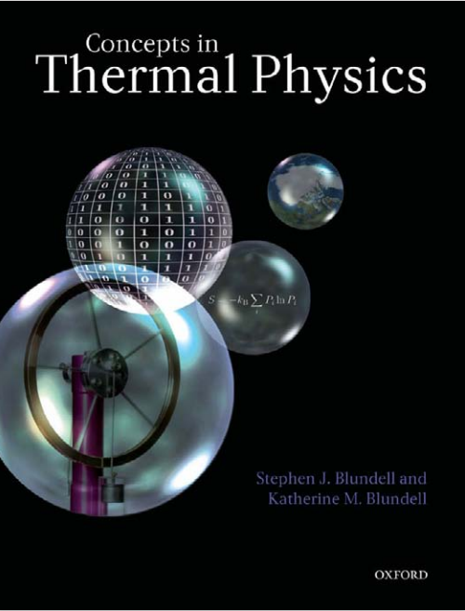

Slide 26
Thermal Diffusion equations: Fick’s Law
Fick’s second law

Slide 27
Tutorial 3: Thermal Diffusion

Slide 29
Direction of diffusion
Pd membrane
0.005 mm

Slide 32
Flux increases

Slide 33
This is called as a “steady state” condition
Plot concentration as a function of x

Slide 35
Plot

Slide 36
Note:
Using variable separable method one can find the solution as

Slide 37
Plot

Slide 38
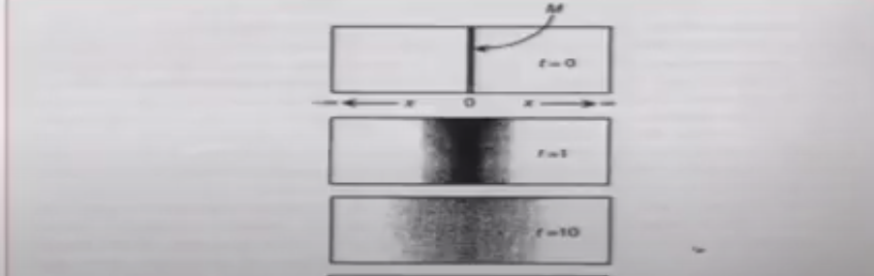

Slide 39
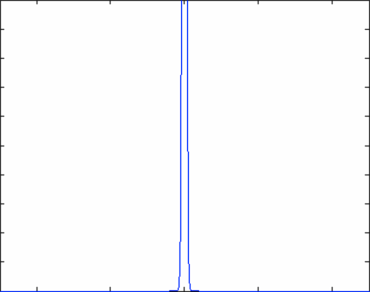
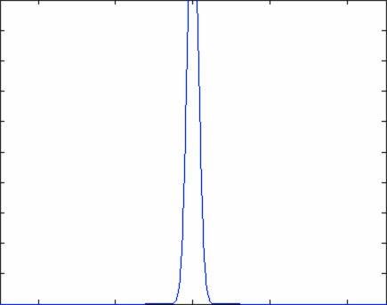

Slide 40
Concept of laser cooling of atoms and Diffusion

Slide 41


Slide 42
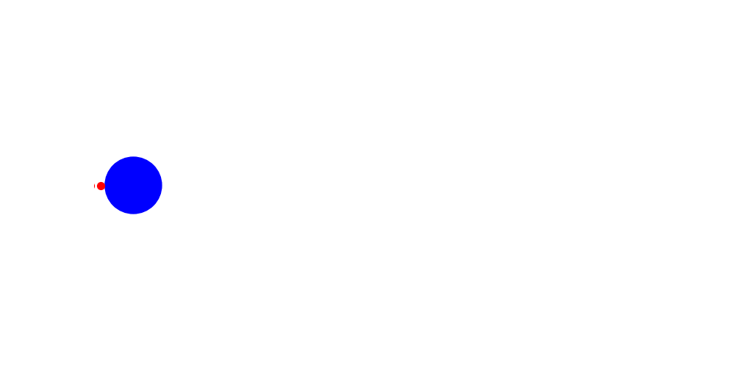

Slide 43
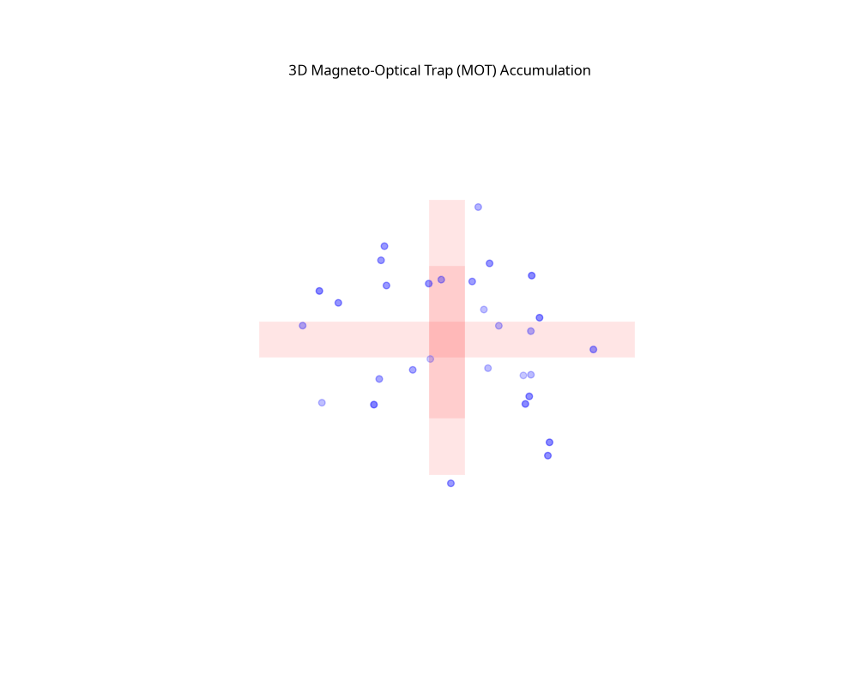

Slide 44


Slide 45
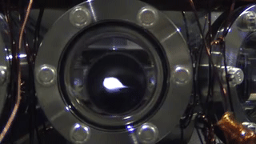
Atomic cloud diffusion in Quantum Technology

Slide 47
v
v

Slide 48
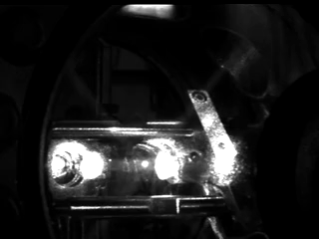

Slide 49
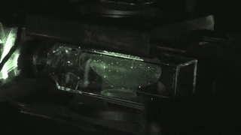

Slide 51
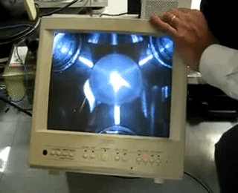

Slide 53
v
a
Non invasive temperature
measurement
a+vt
a+vt’

Slide 54
Size
t
From the fit V is calculated, then T

Slide 55
Stationary atoms and its engineeringapplications

Slide 56
Utracold atoms and modern cutting edge engineering technology
Metrology: Precise measurement of Energy levels, Time and Frequency standards
Quantum Communication
High precision sensors
Quantum Computers

Slide 57


