Slide 1
Oscillations to Waves

Slide 2
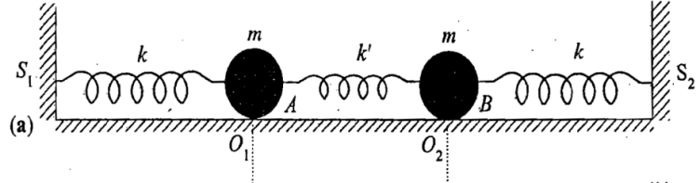
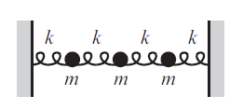
2
D
I
S
C
R
E
T
E
TO
C
O
N
T
I
N
O
U
S
3
.
.
.
N
∞

Slide 3
Recap

Slide 4
3-masses coupled oscillator

Slide 5
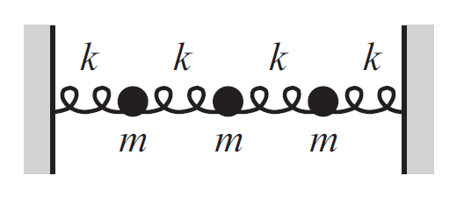
3-masses coupled oscillator
x₁
x₂
x₃

Slide 6
3-masses coupled oscillator

Slide 7
T
U
T
O
R
I
A
L
10
3
EIGEN VALUES = 3 NORMAL MODES
&
3
EIGEN VETORS
Characteristic equation
Eigen values and Eigen vectors
Normal modes and Normal co-ordinates

Slide 8
Solving eigen values and eigen vectors for n-Coupled mass system

Slide 9
n-masses coupled oscillator
What will be the equation of motion for i^{th} mass?
Recollect

Slide 10
N-masses coupled oscillator
ΔX
x₀
x₁
x₂
x₃
x₄
S₀
S₁
S₂
S₃
What will be the equation of motion for i^{th} mass?

Slide 11
Solving n coupled masses equation
will have n values
hence n normal modes will be present
ω
will
Have
n
values

Slide 12
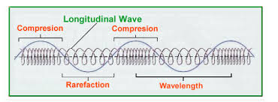
Oscillations to Waves
Longitudinal waves could be generated in a coupled oscillator
An external driving Impulse can generate a disturbance
to n coupled Oscillator
For efficient energy transfer driving impulse frequency should be matched with
normal frequency/normal modes
Looking for space dependence of amplitude!

Slide 13
Derivation of wave equation from n-coupled masses oscillators

Slide 14
Derivation of wave equation from n-couple masses oscillators

Slide 15
Derivation of wave equation from n-couple masses oscillators
Dividing by Δx throughout

