Slide 1
Roll No. | Name
2301PH01 | Aditya Chandra | p | p | p | p | p | p |  |  |  | a | p | p
2301PH02 | Aditya Mittal | p | p | a | p | p | a |  |  |  | p | p | p
2301PH03 | Aditya Prakash Gupta | p | p | p | p | p | p |  |  |  | p | p | p
2301PH04 | Amit Kumar | a | a | p | p | p | p |  |  | p | p | p | p
2301PH05 | Angaanba Ningthoujam | p | p | p | p | p | p |  |  | p | p | p | p
2301PH06 | Arunvishal Palanisamy | a | p | p | p | p | p | p |  | p | p | a | p
2301PH07 | Ashmit Verma | p | p | p | p | p | a | p |  |  | p | p | p
2301PH08 | Azariah Peter | p | p | p | p | p | a | p | p | p | p | p | a

Slide 2
2301PH10 | Muskan Singh | p | p | p | p | p | p | p |  | p | p | p
2301PH11 | Naveen Saini | a | a | p | p | p | p |  | p | p | p | p
2301PH12 | Nishanth Kumaran | p | p | a | p | p | a | p |  | p | a | p
2301PH13 | Nived Krishna M | p | a | a | p | a | p |  | p | p | p | p
2301PH14 | Ratan Deep Prasad | p | p | p | a | p | p |  |  | a | a | a
2301PH16 | Shivam Kumar Kannojia | p | a | p | a | a | a |  |  | p | p | p
2301PH17 | Shivang Rayat | p | p | p | p | p | p |  |  | a | p | p
2301PH18 | Yashraj Singh Thakur | p | p | p | p | p | a |  |  | p | p | p
2301PH19 | Aekampreet Singh Dhir | a | p | p | p | p | a |  |  | p | p | p
2301PH20 | Banoth Naveen | p | p | a | p | a | p | p |  | a | p | p

Slide 3
2301PH21 | Neerati Pranay | p | p | p | p | p | a |  |  |  | a | p | p
2301PH22 | Tanish Dhankhar | a | p | a | a | a | a |  |  |  | p | p | a
2301PH23 | Farhan Farhan | p | p | p | p | a | a |  |  |  | p | p | p
2301PH24 | Utpal Raj Ambastha | p | p | p | p | p | p | p |  |  | p | p | p
2301PH25 | Riya Singh | p | p | p | a | p | a |  |  | p | p | p | p
2301PH27 | Rahul Katravath | p | p | p | a | p | p | p | p | p | p | p | p
2301PH28 | Shivani | p | p | p | p | p | p | p |  |  | p | p | p
2301PH29 | Rakesh Bairwa | a | p | p | p | p | p |  |  |  | p | a | p
2301PH30 | Nikhil Pratap Singh | a | p | p | p | p | a |  |  |  | a | p | p
2301PH31 | Sridutt Rugada | a | p | p | p | a | p |  | p |  | p | p | p
2301PH32 | Anmisha Jadi | p | p | p | p | a | p |  |  |  | p | p | p
Attendance: 75% mandatory

Slide 4
Engineering application 1: Thermal Power Plant using Vapor Cycle (“Rankine Cycle”)

Slide 5
Recollect….
1
isothermal
2
Q_{in}
1
2
T
P
Q=0
T_{hot}
Q=0
adiabatic
adiabatic
T_{cold}
4
3
Q_{out}
isothermal
4
3
S
V

Slide 6
Carnot Efficiency

Slide 21
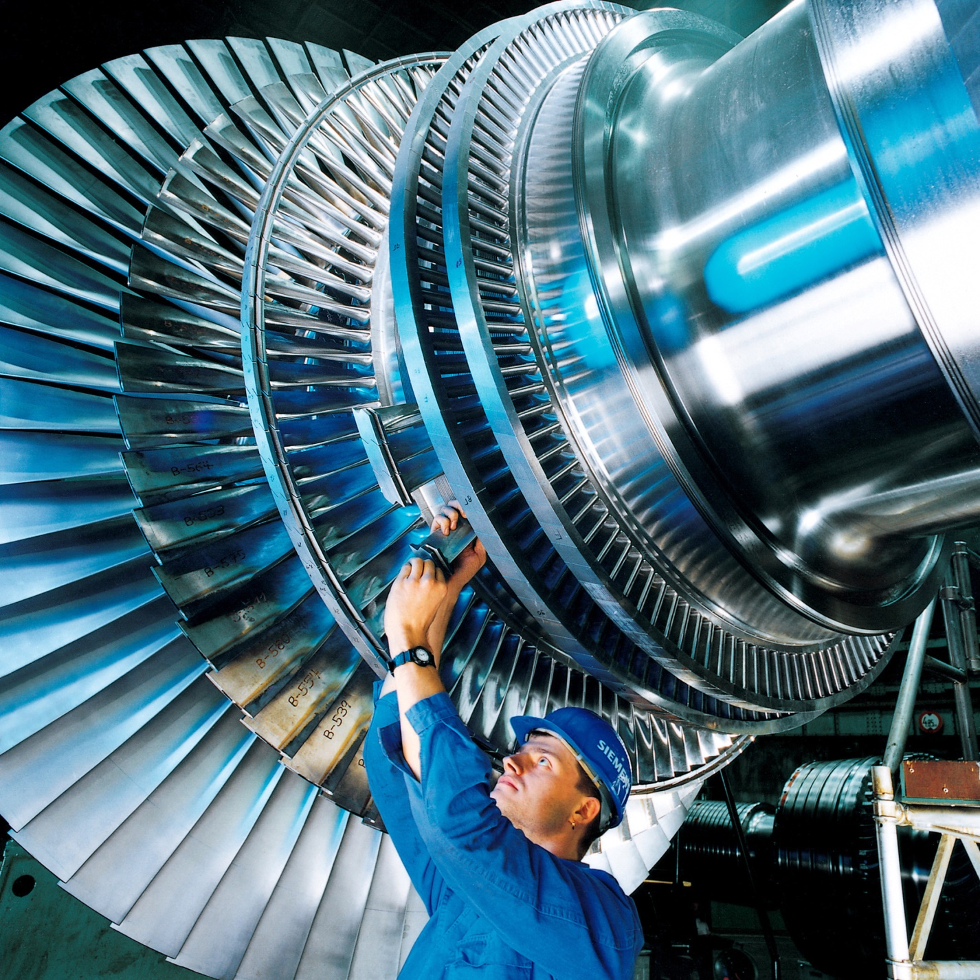

Slide 22
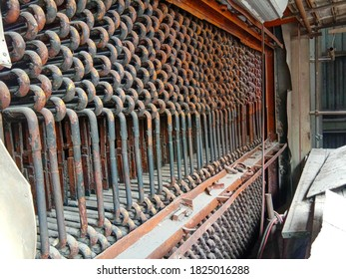
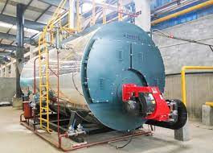
Boiler
Condenser

Slide 23
https://en.wikipedia.org/wiki/List_of_power_stations_in_India

Slide 27
Vapor cycle refrigerator

Slide 32
T-S diagram

Slide 36
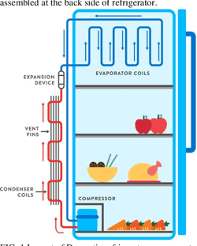
Back side
Front side

