Slide 1
1. Co-ordinate Systems
Continued…
Choice of Co-ordinate systems
Cartesian Co-ordinates: Line, area and volume element
Plane-Polar Co-ordinates: Unit vectors, transformations, Rate of change, velocity and acceleration,
Line element, area element
Cylindrical Co-ordinates: Unit vectors and its transformations, Rate of change, velocity and acceleration, line, area and volume element
Spherical Polar Co-ordinates: Unit vectors and its transformations, Rate of change, velocity and acceleration, line, area and volume element
Lec 2
&
Tut1

Slide 2
Infinitesimal line element in plane polar coordinates
Y
Mathematical approach
X

Slide 3
Taylor series expansion
?
Y
?
X
Taylor series expansion

Slide 4
Infinitesimal line element in plane polar coordinates
Y
X

Slide 5
Elemental area in plane polar coordinates
Y
Elemental area:
X
Area of Circle

Slide 6

Cylindrical Coordinate System
Z
X
$\hat{e}$_{Ф}
Y

Slide 7

Transformation of coordinates
Z
Z
Z
$\hat{e}$_{Ф}
X
$\hat{e}$_{Ф}
Y

Slide 8

Transformation of unit vectors
Z
Z
-
$\hat{e}$_{Ф}
$\hat{e}$_{Ф}
X
$\hat{e}$_{Ф}
Y

Slide 9
Derivatives of unit vectors
Z
X
Y

Slide 10
Infinitesimal line element
Z
P₂
X
P₁
Y

Slide 11
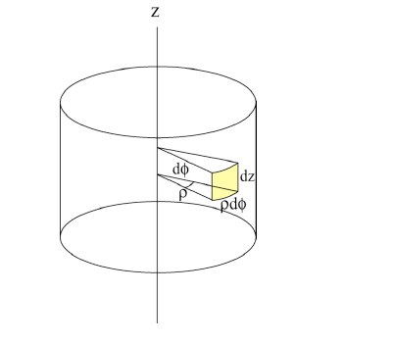

Infinitesimal area element

Slide 12
Infinitesimal Volume element

Slide 13
Domain of integration
Z
R
H
X
Y

Slide 14
Velocity in cylindrical polar co-ordinates

Slide 15
Acceleration in cylindrical polar co-ordinates

