Slide 1
Highlights of the course
Co-ordinate Systems
Introduction to Vector Operators
Work , Energy and Conservation laws
Rigid body in motion
Oscillations and Waves
Quantum Physics

Slide 2
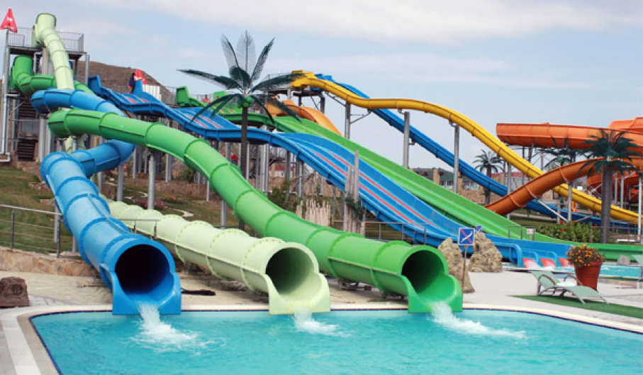
Chapter-3:Work , Energy and Conservation laws

Slide 3
Predicting the motion of a system under known constraints
Solve differential equation
Work, energy and conserved quantities

Slide 4
Work Energy Theorem from Force Equation
Change variable from x to t

Slide 5
Work Energy Theorem from Force Equation
The change in kinetic energy equals work done on the particle
W_{ba:} Work done by the force F on the particle
Theorem

Slide 6
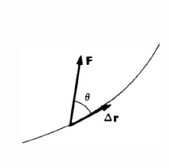
Work Energy Theorem in 3D
Work done on the particle by the total force

Slide 7
Work Energy Theorem- Physical interpretation
For infinitesimally small displacement
does no work!!
Work done on the particle by the total force
For a finite displacement, the work done on the particle is the sum of the contributions from each segment of the path, in the limit where the size of each segment approaches zero.

Slide 8
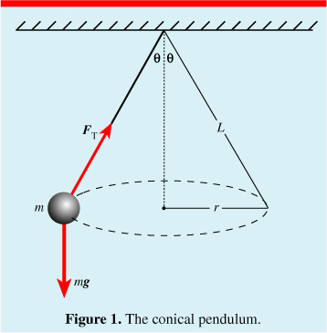
Conical Pendulum
Mass M is fixed to the end of a rod of length l and negligible mass that is pivoted to swing. The mass moves with constant speed in a circular path of constant radius. Find the work done by the string force and weight force.

Slide 9
Conical Pendulum
Since the kinetic energy is constant, the work energy theorem tells that no net work is being done on the mass.
String force and weight force separately do no work.

Slide 10
Work Energy Theorem- Physical interpretation
Work Energy Theorem- is a mathematical consequence of Newton’s second law.
Evaluation of this integral depends on knowing what path the particle actually follows
It needs to know the solution in order to apply the theorem.
Solution
Work-Energy Theorem
Work done on the particle by the total force
Constrained motion
Conservative forces

Slide 11
Conservative Forces
Definition:
The forces whose work integral does not depend on the
particular path but only on the end points are called as
Conservative Forces [Implications will be shown shortly]
Examples are work done by a uniform force, central force etc

Slide 12
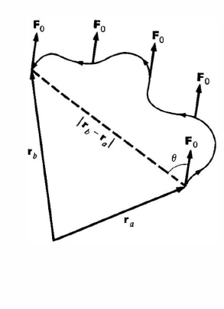
Work done by a uniform Force
For a constant force, work done only depends on the net displacement and not on the path followed.

Slide 13
Work Done by a Central Force
Central force is a radial force which depends only on the distance from the origin
Motion in a plane
It follows that
the work by a central force around a closed path is zero.
Note that work done only depends on initial and final radial distances, and not on the particular path.

Slide 14
Non- Conservative Force
The forces whose work is different for different paths between the initial and final points.
Example is Friction force
Different paths will offer different friction
(0,1)
(1,1)
D
C
A
B
(0,0)
(1,0)

Slide 15
Concept of Potential Energy
For a conservative force
V(r) is known as potential energy function
This proves that if Force is conservative Total Energy E of the system is independent of
Position of particle.
Position ‘a’ and ‘b’ are arbitrary, hence the above relation is true at any point.

Slide 17
Necessary conditions for Conservative Force
Curl of F is zero?
If V(r) is path independent,
Alternatively,
Curl of F is

Slide 18
Necessary conditions for Conservative Force
Curl of F is zero?
Curl of F is

Slide 20
Examples
Find potential energy of Spring Force
Since the central force is conservative,
r
r₀
Choosing potential energy to be zero at equilibrium,,

Slide 21
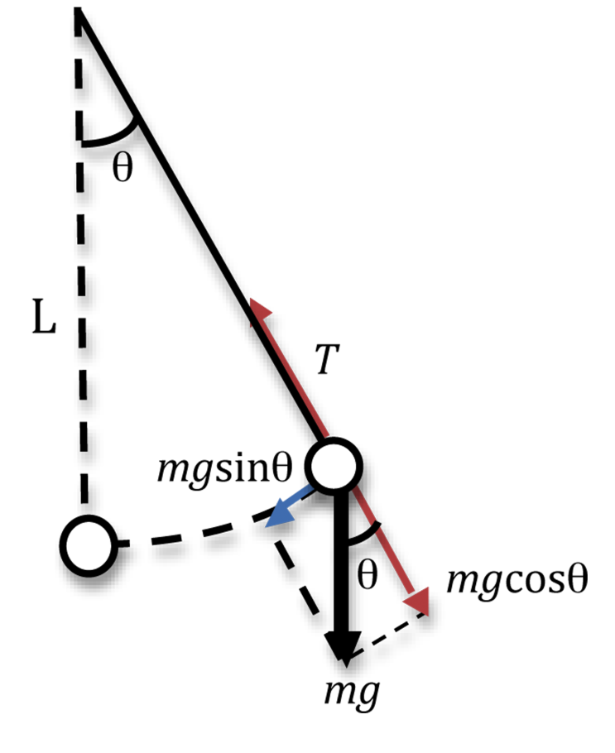
Examples
Find potential energy of Simple pendulum
Since the central force is conservative,
Choosing potential energy to be zero at equilibrium,,

Slide 22
Examples
Central force is conservative by showing that curl F=0

Slide 23
Examples
Central force is conservative by showing that curl F=0

Slide 24
Likewise for the x and y components

