Slide 1
Season 2, Lecture 13 (S2,L13):
Recap, Effusion and Thermodynamics

Slide 2
Name | L9 | L10 | L11 | L12 | L13
"2201ph34_dolly" <2201ph34_dolly@iitp.ac.in>; | p | P | p | A | p
"Adhila Aslam" <2201ph01_adhila@iitp.ac.in>; | p | P | p | p | p
"Aditi Baghel" <2201ph31_aditi@iitp.ac.in>; | p | P | p | p | p
"Aditya Kumar" <2201ph02_aditya@iitp.ac.in>; | p | A | A | A
"Aditya Singh" <2201ph03_aditya@iitp.ac.in>; | p | P | p | p | p
"Animesh Sharma" <2201ph05_animesh@iitp.ac.in>; | p | P | p | p | P
"Arun Mishra" <2201ph06_arun@iitp.ac.in>; | a | P | p | p | P
"Aryan Raj" <2201ph32_aryan@iitp.ac.in>; | p | P | p | p | P
"Boda Vishnuwardhan" <2201ph08_boda@iitp.ac.in>; | p | A | A | p | P
"Chanchal Tolani" <2201ph09_chanchal@iitp.ac.in>; | p | P | p | p | P
"Gaurav Verma" <2201ph10_gaurav@iitp.ac.in>; | p | P | p | A | A

Slide 3
Name | L9 | L10 | L11 | L12 | L13
"Gourav Jha" <2201ph11_gourav@iitp.ac.in>; | a | P | p | p | A
"Gurinder Dhillon" <2201ph12_gurinder@iitp.ac.in>; | p | P | A | A | A
"Harsh Joshi" <2201ph13_harsh@iitp.ac.in>; | p | P | p | p | P
"Himanshu Patel" <2201ph35_himanshu@iitp.ac.in>; | p | P | p | A | P
"Khushal Yadav" <2201ph14_khushal@iitp.ac.in>; | p | P | p | P | P
"Krishnakant Chourey" <2201ph15_krishnakant@iitp.ac.in>; | p | A | A | p | P
"Manas Gupta" <2201ph16_manas@iitp.ac.in>; | a | P | p | P | P
"Mohit Saini" <2201ph17_mohit@iitp.ac.in>; | a | P | p | p | P
"Mude Naik" <2201ph18_mude@iitp.ac.in>; | p | P | p | p | P
"Murari Kumar" <2201ph19_murari@iitp.ac.in>; | p | P | A | p | P
"Nishant Yadav" <2201ph20_nishant@iitp.ac.in>; | p | P | A | p | P
"Pranitha Moluguri" <2201ph21_pranitha@iitp.ac.in>; | p | P | p | p | P

Slide 4
Name | L9 | L10 | L11 | L12 | L13
"Premanandh Sigamala" <2201ph22_premanandh@iitp.ac.in>; | p | P | A | p | A
"Ruchi Thakur" <2201ph23_ruchi@iitp.ac.in>; | p | P | p | p | P
"Satyam Sahoo" <2201ph25_satyam@iitp.ac.in>; | p | P | p | p | P
"Satyam Shandilya" <2201ph24_satyam@iitp.ac.in>; | p | P | A | p | P
"Shyam Hembram" <2201ph26_shyam@iitp.ac.in>; “ | p | P | p | p | P
Sougata Saha" <2201ph27_sougata@iitp.ac.in>; | a | A | A | A | P
"Sumit Rajpoot" <2201ph28_sumit@iitp.ac.in>; | p | P | p | p | P
"Suprajit Dewanji" <2201ph29_suprajit@iitp.ac.in>; | a | P | p | p | A
Attendance: 75% mandatory

Slide 5
Quantum Memory (QM)
Stationary QuBit
i.e QUANTUM MEMORY
(Eg Quantum atomic gas)
Flying QuBit
(Eg a photon)
Flying QuBit
(Eg a photon)
storage
read-out
LIGHT
LIGHT
ATOM + LIGHT
POLARITON
RESEARCH
WORK
Says Quantum gas

Slide 6
Interesting experiment by Prof. Ashkin and his team
Atom
Stream of Photons
Atoms got deflected by laser beam ………………………..HOW?
Effect was very directional

Slide 7
Resonances in systems
Simple Pendulum
Spring mass system
LCR Systems
ATOMIC SYSTEMS

Slide 8
Possibility of Cooling of atoms by Light?
v
v
LIGHT interacts with ATOMS
Radiation Pressure from Light
Atom
Stream of Photons

Slide 9
Model using 2 level system

Slide 10
Two level atom interacting with Light
Atom
Stream of Photons
What are the possible phenomena’s?
Stimulated Absorption
Stimulated Emission
Spontaneous Emission

Slide 11
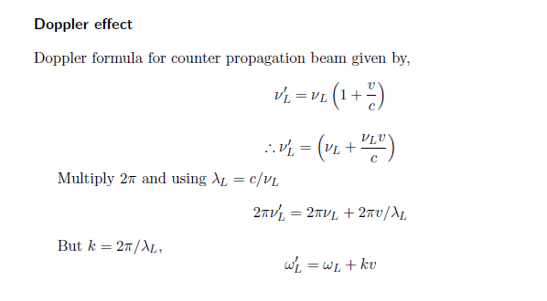
Doppler Effect

Slide 12
Doppler effect in radiation pressure
Laser cooling in 1-D
v
e
δ
ω_{L}- kv
ω_{L}+ kv
ω_{L}
ω_{o}
ω_{L}
g

Slide 13
Atoms decelerate

Slide 14
Laser cooling in 3-D

Slide 15
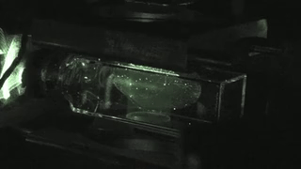

Slide 16
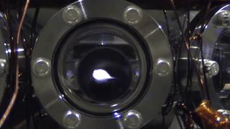

Slide 17
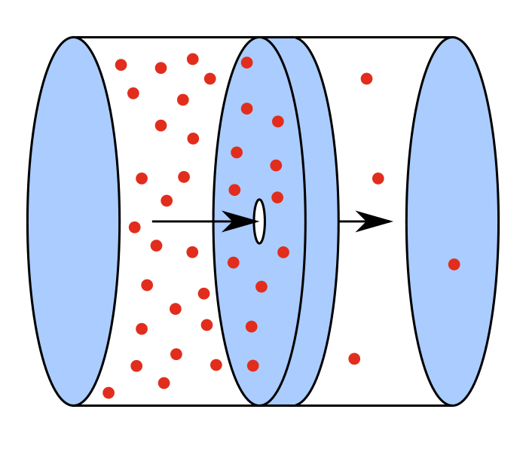
Effusion
Effusion
Effusion occurs through an orifice smaller than the mean free path of the particles in motion

Slide 18
Gas in left chamber is under equilibrium

Slide 19
To maintain gas in left chamber is under equilibrium
Ensures little or no collisions near the opening hence the equilibrium is maintained

Slide 20
Equilibrium is not disturbed
Under the above condition escape of molecules through hole is called as EFFUSION
OR
EFFUSION occurs through an orifice smaller than the mean free path of the particles in motion

Slide 21
dA

Slide 22
Flux of molecules
dA

Slide 23
Volume of slanted cylinder
dA

Slide 25
HOME WORK
Distribution function
Maxwell Boltzmann speed distribution

Slide 26
Mid-sem

Slide 27
Introduction to Thermodynamics
A revision

Slide 28
Macroscopic approach
Does not probe system at molecular level
Thermodynamic variables P,V,T etc
System and rest of universe (reservoir: Infinite heat capacity)
System is separated by a wall

Slide 29
Zeroth Law of Thermodynamics
R. H. Fowler :1931

Slide 30
Statement
If two systems are in thermal equilibrium with a third system then those two are in thermal equilibrium with each other
A
B

Slide 31
Statement
If two systems are in thermal equilibrium with a third system then those two are in thermal equilibrium with each other
B
C

Slide 32
Statement
If two systems are in thermal equilibrium with a third system then those two are in thermal equilibrium with each other
A
C

Slide 33
Statement
Same Temperature
A
C

Slide 34
Statement
No Heat Flow
A
C

Slide 35
B
DIATHERMIC (CONDUCTING)
A
ADIABATIC
(NON
CONDUCTING)
C

Slide 36
B
ADIABATIC
A
DIATHERMIC (CONDUCTING)
C
No heat flow

Slide 37
First Law of Thermodynamics
Law of Conservation of Energy

Slide 38
Statement
Energy is conserved and heat and work are both forms of energy.

Slide 39
Tutorial 4 on First Law of Thermodynamics

Slide 40
P
C
7P₁
P₁
B
A
V
V₁
3V₁

Slide 41
P
C
7P₁
P₁
B
A
V
V₁
3V₁
A to B

Slide 42
P
C
7P₁
P₁
B
A
V
V₁
3V₁
B to C

