Slide 1
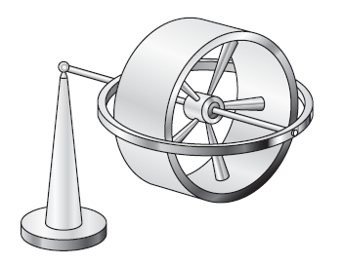
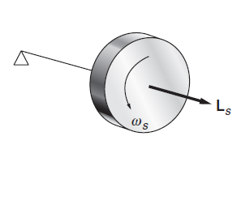
Gyroscope
RECAP

Slide 2
Disk (spin + twist) when continuous torque applied externally?
F Continuosly
Δ
L_{s}
How will be the motion of Disk?
Spin and Rotate?

Slide 3
Gyroscope

Slide 4
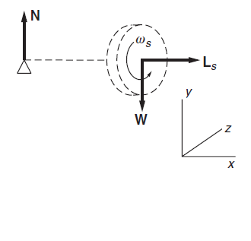
Gyroscope Precision
W

Slide 5
Gyroscope Precision
x
l
z
TOP VIEW
-Z
X

Slide 6
Vector nature of angular velocity and angular momentum
Direction of velocity is tangential to the circle

Slide 7
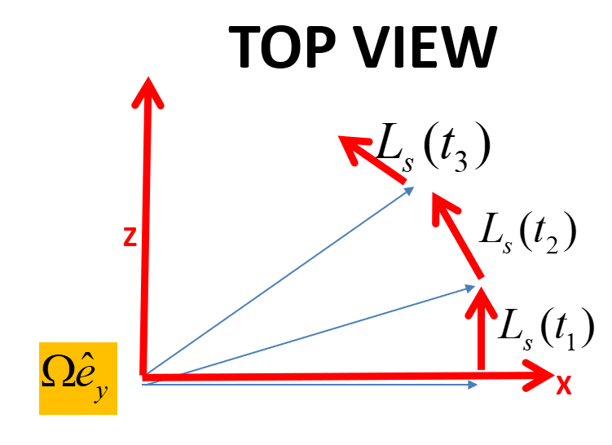
Gyroscope Precision
x
l
z
The torque on the gyroscope must account for the change in L_{s}

Slide 8
If there were no spin
L_{s} =0 then $∆L_{Z}$ = $∆L_{s}$=0
(Just like first case)
L_{s}+$∆L_{Z}$
$∆L_{Z}$ = $∆L_{s}$
x
L_{s}

Slide 9
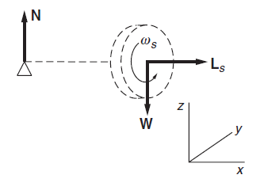
Gyroscope Precision
l

Slide 10
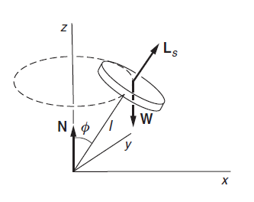
Gyroscope Precision
y
Consider a gyroscope in uniform precession with its axle at angle φ with vertical
The horizontal component of angular momentum is L_{s}sin φ
z
The precessional velocity is independent of φ

Slide 11
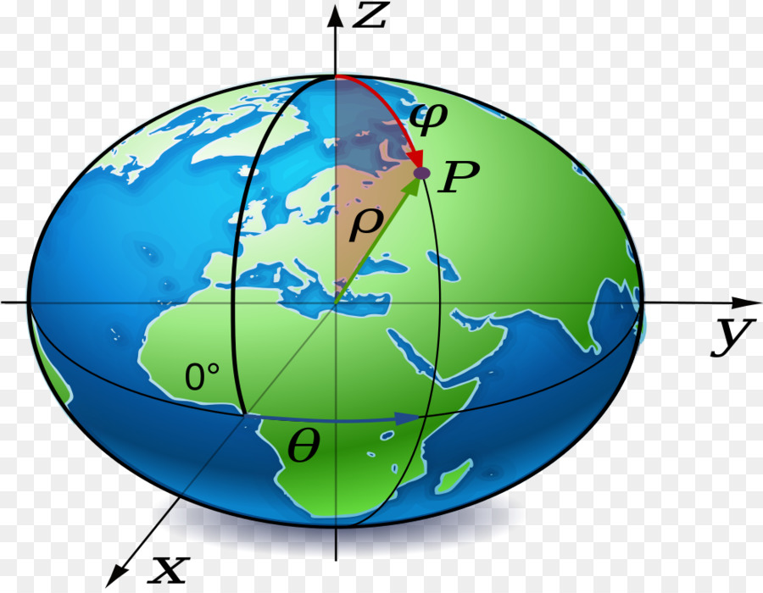
Some consequences of Gyroscopic motion
a. Precession of the spin axis
21 Km

Slide 12
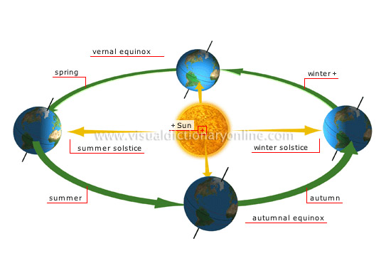

Slide 13
A torque on the earth

Slide 15
North Pole star
Precession of the spin axis
The spin axis precesses (With a period 25810 years)

Slide 16
EULER’S EQUATION OF MOTION

Slide 17
What is Euler’s Equation about?
Euler’s equation derivation- A geometrical approach
Euler’s equation derivation- A mathematical approach

Slide 18
What is Euler’s equation about?
COMPLETE ANALYSIS FOR STABILITY OF A RIGID BODY IN MOTION
SOLUTION OF EULER’S EQUATION GIVES WHETHER MOTION OF RIGID BODY IS BOUND OR UNBOUND
BOUND MOTION = STABLE
UNBOUND MOTION = UNSTABLE

Slide 19
A thought experiment! To understand and derive Euler equations
A GEOMETRICAL APPROACH…….
‘ROTATION OF A CYLINDER’

Slide 20
Another thought experiment!
Initial Conditions…
3
2
In the time interval Δt, the principal axes rotate away from the 1, 2, 3 axes.
1
What are the changes in angular momentum in 1,2 and 3 axis?
ΔL₁, ΔL₂ and ΔL₃?

Slide 21
ΔL₁ due to rotation along ‘1’ axis
3
2
1

Slide 22
ΔL₁ due to rotation along ‘2’ axis
3
2
1

Slide 23
ΔL₁ due to rotation along ‘2’ axis
L₃
L₂
This will not contribute!
L₁

Slide 24
ΔL₁ due to rotation along ‘3’ axis
3
2
1

Slide 25
ΔL₁ due to rotation along ‘3’ axis
L₃
L₂
This will not contribute!
L₁

Slide 26
Equation of motion of a Rigid body: Euler’s equation
3
Dividing by and taking the limit
2
1

Slide 27
Equation of motion of a Rigid body: Euler’s equation
3
2
1

Slide 28
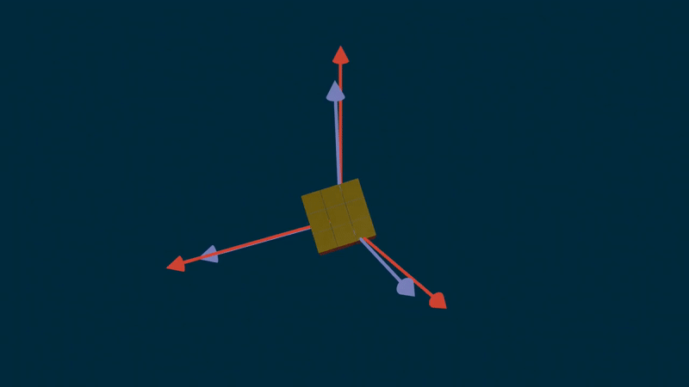

Slide 29
Equation of motion of a Rigid body: Euler’s equation
3
2
1
Euler’s Equations of rigid body motion

Slide 30
A MATHEMATICAL APPROACH!

Slide 31
Lab frame Vs Body frame
3
2
1

