Slide 1
Season 3, Lecture 10 and 11 (S3,L10 & L11):
Thermal Diffusion
Engineering Applications

Slide 2
Roll No. | Name | L1 | L2 | L3 | L4 | L5 | l6 | l7 | l8 | l9 | l10 | l11
2301PH01 | Aditya Chandra | p | P | p | p | P | p | a | p | a | p | a
2301PH02 | Aditya Mittal | p | P | a | p | P | p | p | p | a | a | a
2301PH03 | Aditya Prakash Gupta | p | P | p | p | P | p | p | p | p | a | p
2301PH04 | Amit Kumar | a | P | p | p | P | p | p | p | p | a | p
2301PH05 | Angaanba Ningthoujam | p | P | p | p | P | p | p | p | p | p | p
2301PH06 | Arunvishal Palanisamy | p | P | p | p | P | p | p | p | p | a | p
2301PH07 | Ashmit Verma | p | P | p | p | P | p | p | p | p | p | p
2301PH08 | Azariah Peter | a | A | p | p | P | p | p | p | a | p | a
2301PH09 | Deveshsingh Kuldeepsingh Tomar | p | P | p | p | P | p | c | c | c | c | c

Slide 3
 |  | L1 | L2 | L3 | L4 | l5 | l6 | l7 | l8 | l9 | l10 | l11
2301PH10 | Muskan Singh | p | P | a | p | P | p | p | p | p | p | p
2301PH11 | Naveen Saini | a | P | p | p | P | p | p | p | p | a | p
2301PH12 | Nishanth Kumaran | p | P | p | a | P | p | a | p | p | a | a
2301PH13 | Nived Krishna M | p | P | p | p | P | p | p | a | a | a | a
2301PH14 | Ratan Deep Prasad | p | P | p | p | P | p | p | p | a | a | a
2301PH15 | Ritesh | p | P | p | p | P | p | c | c | c | c | c
2301PH16 | Shivam Kumar Kannojia | p | P | p | p | P | p | p | a | a | p | a
2301PH17 | Shivang Rayat | p | P | p | p | P | p | p | p | p | p | p
2301PH18 | Yashraj Singh Thakur | p | P | p | p | P | p | p | a | p | p | p
2301PH19 | Aekampreet Singh Dhir | p | P | p | p | P | p | p | p | p | p | p
2301PH20 | Banoth Naveen | a | A | a | a | A | a | a | a | a | p | p

Slide 4
 |  | L1 | L2 | L3 | L4 | l5 | l6 | l7 | l8 | l9 | l10 | l11
2301PH21 | Neerati Pranay | p | P | p | p | P | p | p | p | a | p | a
2301PH22 | Tanish Dhankhar | p | P | p | p | P | p | p | p | p | a | a
2301PH23 | Farhan Farhan | p | P | p | a | P | p | p | p | p | a | p
2301PH24 | Utpal Raj Ambastha | p | P | p | p | P | p | p | p | p | p | p
2301PH25 | Riya Singh | p | P | p | p | P | p | p | p | p | p | a
2301PH26 | Aakarsh Sinha | a | P | p | p | P | p | c | c | c | c | c
2301PH27 | Rahul Katravath | a | A | p | p | P | p | p | p | p | a | p
2301PH28 | Shivani | p | P | p | p | P | p | p | p | p | p | p
2301PH29 | Rakesh Bairwa | p | P | a | p | P | p | p | p | p | a | p
2301PH30 | Nikhil Pratap Singh | a | P | p | p | P | p | p | p | p | p | p
2301PH31 | Sridutt Rugada | a | P | p | p | P | p | p | p | p | p | p
2301PH32 | Anmisha Jadi | p | P | p | p | P | p | p | p | p | p | a
Attendance: 75% mandatory

Slide 5
Concept of Diffusion: Kinetic theory of gases

Slide 6
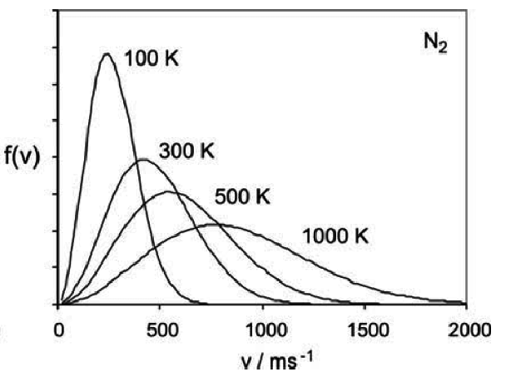
Temperature

Slide 7
Concept of Radiation Pressure, Laser cooling and Diffusion

Slide 8
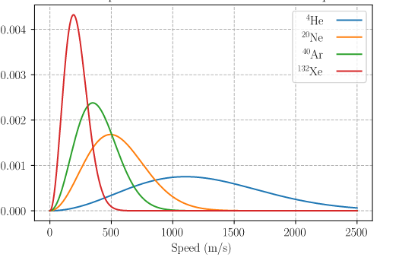
T = 300K
Mass decrease

Slide 9
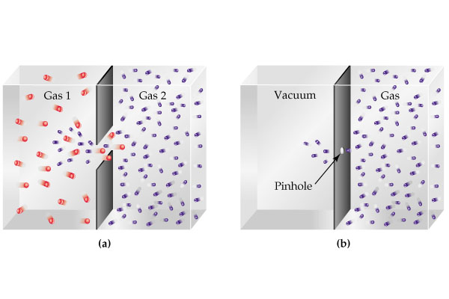

Slide 10
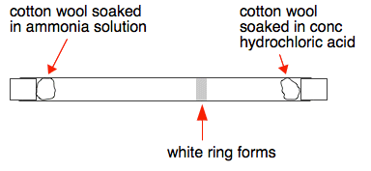

Slide 11
Graham’s Law of Diffusion

Slide 12
Thermal Diffusion equation: Fick’s Laws
(Kinetic theory)

Slide 13
Heat Flow
Charge Flow
Gas/mass Flow
Flux
Heat Flux q
Charge Flux J
Molecular/mass Flux J
Gradient
Law
Material Property
Thermal conductivity K
Electrical conductivity
Diffusion Coefficient

Slide 15
Area A

Slide 16
effect
cause
Flux
Concentration
gradient

Slide 18
Time dependency of concentration (Fick’s second law)
Area =A
C
x

Slide 19
How much concentration inside
this volume change with time?
Apply
Fick’s
Law
C
x

Slide 21
Fick’s second law

Slide 22
Fick’s second law

Slide 23
Thermal Diffusion equation: Fick’s Law
Fick’s second law

Slide 24
Thermal Diffusion equations: Fick’s Law
Fick’s second law

Slide 25
Tutorial 3: Thermal Diffusion

Slide 26
Problem 1
“A diffusing spherical cloud”

Slide 31
Problem 2
“Medicine storage ”

