Slide 1
Highlights of the course
Co-ordinate Systems
Introduction to Vector Operators
Work , Energy and Conservation laws
Rigid body in motion
Oscillations and Waves
Quantum Physics

Slide 2
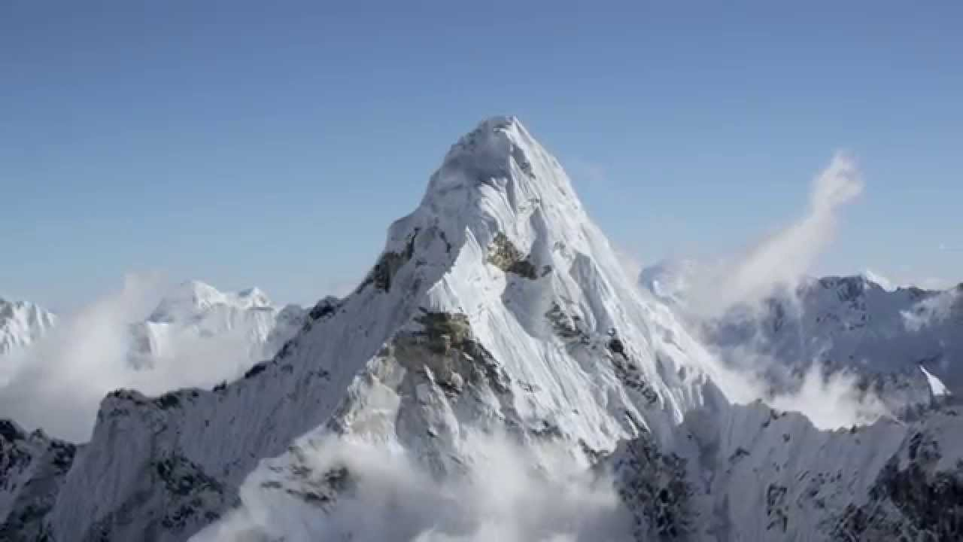
Chapter-2: Introduction to Vector Operators
Gradient, Divergence and Curl

Slide 3
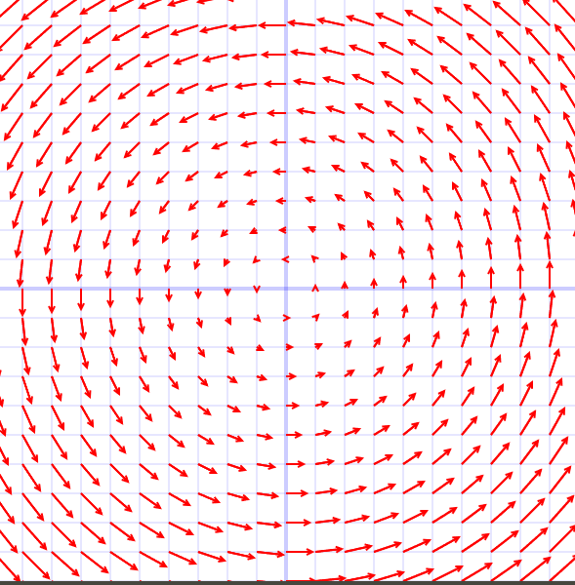
Chapter-2: Introduction to Vector Operators
Gradient, Divergence and Curl (Lecture 8)
Scalar field Vs Vector field
RECAP
The gradient points in the direction of maximum increase of the T.

Slide 4
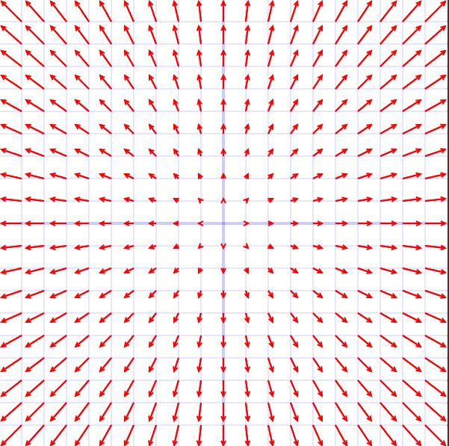
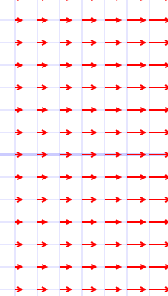
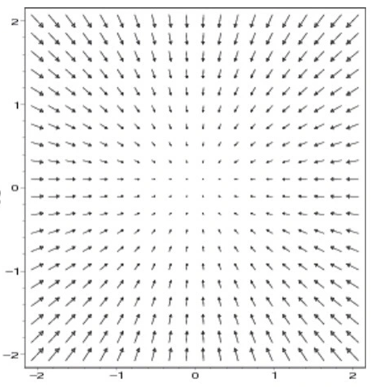
Positive Divergence indicates net increase in the flux of Vector field
0 Divergence indicates constant flow
Negative Divergence indicates net decrease in the flux of Vector field

Slide 5
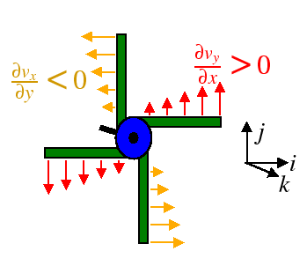
The curl: Geometrical interpretation
Measure of rotation
Positive Curl = Anti-clockwise rotation
Negative Curl= Clockwise rotation
Zero Curl= Irrotational

Slide 6
Gradient of a scalar function in different coordinate system
This definition is independent of the coordinate system used

Slide 7
Gradient in cylindrical polar coordinate system
Gradient

Slide 8
Gradient in cylindrical polar coordinate system
Gradient

Slide 9
Gradient in spherical polar coordinate system
Gradient

Slide 10
Gradient in spherical polar coordinate system

Slide 11
Del operator in different coordinate system
Cartesian Coordinate system
Cylindrical polar Coordinate system
Spherical polar Coordinate system

Slide 12
Divergence in Spherical Polar coordinate system
Spherical polar Coordinate system

Slide 13
Divergence in Spherical polar Coordinate system

Slide 14
Derivatives of Unit Vectors

Slide 15
Divergence in Spherical polar Coordinate system
and proceeding further…..

Slide 16
Divergence in Spherical polar Coordinate system

Slide 17
dr

Slide 18
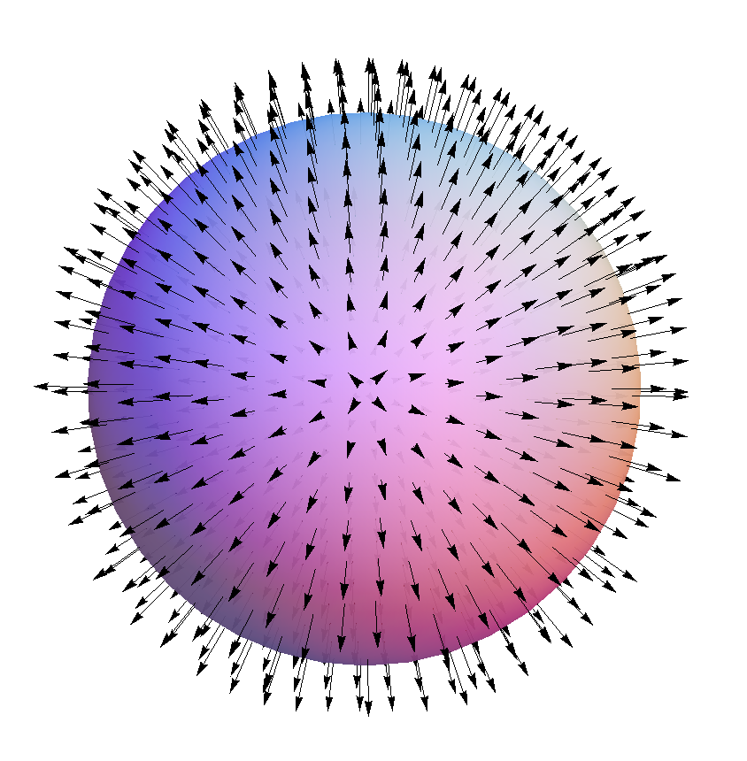
The sum of diverging field
Lines coming from inside
Of the spherical volume
=
Sum of the field lines
In the surface of the sphere
Divergence Theorem

Slide 19
Curl in Spherical Polar coordinate system
Spherical polar Coordinate system
After some steps and rearranging the terms
Try by self

Slide 20
Laplacian – a scalar operator
Laplacian – In Cartesian coordinate system

Slide 21
Laplacian – Spherical polar Coordinate system

Slide 22
Divergence and curl in Cylindrical polar Coordinate system (Try yourself)

Slide 23
Easy way to remember

