Slide 1
PH 110: PHYSICS LAB (B.TECH)
Indian Institute of Technology Patna
The team
Course Co-ordinator B.Tech: Dr. Raghavan K. Easwaran (Room 121, Block-4)
Prof In charge : Dr. Raghavan K. Easwaran
Scientific staff: Mr. Santosh Kumar, Ms. Shabana
Research Scholars (Teaching Assistants)
Lab attendant: Mr. Chandan

Slide 2
THE PLAN
Instructions
Introduction to Experiments
Error Analysis and Linear fit
Introduction to Instruments, Precautions etc
Demonstration of experiments: TAs

Slide 3
Instructions

Slide 4
Instructions
In a laboratory class, you should perform the experiment, complete the calculations & data analysis, and submit the report of the experiment on the same day within the laboratory slot assigned for it.

Slide 5
Instructions
Report sheets (A4 size paper),
Pen, pencil, small scale, eraser, sharpener ( Keep extra)
Instruction manual,
Graph sheets
Scientific calculator
A file cover and any other stationary item required.
What you should bring
to the Lab ?

Slide 6
Instructions
How to write the
Lab Report?
( Lab Report Format):
Title Page: Consisting of Name, Roll No., date, lab group and title of the experiment.
Objective of the experiment, working formula, Explain All the Symbols and
Parameters in the formula. DO NOT WRITE THE THEORY OF THE EXPERIMENT .
Neat Page Margins (Using a Scale), Figure Captions, Table Captions
Neat Experimental Sketch of the Experiment & All the instruments used in the
experiment. LABEL ALL THE COMPONENTS OF EXPERIMENTAL APPARATUS.

Slide 7
Instructions
How to write the
Lab Report?
( Lab Report Format):
Least count of all the equipment's, constants if any to be used and the well
tabulated observations. Observation tables should be neat and self-explanatory.
(Typical tabular columns have been given for some of the experiments.
You may make your own format).
ALL PHYSICAL QUANTITIES IN THE TABLE SHOULD HAVE SUITABLE UNITS.
Relevant substitutions, calculations and error analysis
SEPARATE SECTIONS FOR CALCULATIONS, PLOT ANALYSIS (FITTING ETC),
ERROR ANALYSIS

Slide 8
Instructions
How to write the
Lab Report?
( Lab Report Format):
Results along with the error estimates
(TAKE CARE TO PUT UNITS IN YOUR RESULTS)
RESULTS SHOULD BE HIGHLIGHTED SEPERATELY INSIDE A BOX
Sources of error(s)/suggestion(s)/comment(s).
How to write the
Lab Report?
( Lab Report Format):

Slide 9
Instructions
The title of the graph should be stated on the top of each graph paper.
Abscissa and ordinate along with the units should be mentioned clearly.
The scale for x-axis and y-axis should be mentioned preferably at the top
right corner in the following manner:
X-axis: 1 smallest division = …….. (Unit)
Y-axis: 1 smallest division = ……... (Unit)
If the nature of graphs shows any maxima/minima, vertical and horizontal
lines should be drawn from the point (of maxima/minima) meeting the x-axis and
y-axis respectively.
Write coordinates at the point on the axes where these two lines meet.
Plot the graph for linear regression line (where ever applicable).
How to document your
Plots/ Graphs?

Slide 10
Instructions
Day to Day Performance in Lab
Initial preparation 10 Marks
Viva voce 10 Marks
Observations & Graph 20 Marks
Calculation of result 05 Marks
Error Analysis 05 Marks
TOTAL 50 Marks
End Semester examination: 50 Marks
Scheme for evaluation

Slide 11
A day in Lab
Enter the lab with well prepared lab report, identify your experiment and
wait for the research scholar/scientific staff for demonstration
Perform experiment on your own
$$vg∝ \frac{1}{OD}$$
Care fully take the data, perform calculation & plot graph
Error analysis, graph analysis and results obtained should get highlighted neatly
Get your readings signed by research scholar/scientific staff
Viva will be taken
Submit the report by 5

Slide 12
List of Experiments
Ex 1 Decay of Current in a Capacitive Circuit
Ex 2 Q-Factor of an LCR Circuit
Ex 3 Study of Hall Effect
Ex 4 Interference of sound waves : speed of sound in Air
Ex 5 ‘g’ by A Compound Pendulum
Ex 6 Speed of Light in Glass using spectrometer
Ex 7 Determination of e/m
Ex 8 Interference of Light: Newton’s Ring
Ex 9 Surface Tension of Water by Method of Capillary Ascent
Ex 10 Determination of Plank’s constant by Photoelectric Effect
$$vg∝ \frac{1}{OD}$$

Slide 13
Mechanical
Compound pendulum
Screw gauge, Vernier Caliper
Current progress
Instruments
Other apparatus
e/m
Photoelectric effect
Optics
Spectrometer
Travelling microscope
Optomechanics: Collimator, Lens, Prism, mirrors, beam splitter, filter
Instruments
Electrical and Electronics
Function generator
Oscilloscope
Guass probe for magnetic field measurement
Sensitive Voltmeter and Ammeter
Multimeter
Power supply
Speaker and Mike assembly on a movable rail
Electrical components: Inductance, Capacitance, Resistor, Electrical bread board

Slide 14
Objective of experiments

Slide 15
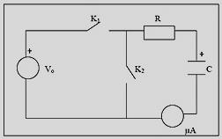
Decay of Current in a Capacitive Circuit
Objective
To study the decay of current with time in RC circuit and to determine the time constant of the circuit.
References
1. E. M. Purcell, Electricity and Magnetism (Berkley Physics Course - Volume 2), Tata McGraw-Hill (2008).
2. D. Halliday and R. Resnick, Physics II, Wiley Eastern Limited (1966).

Slide 16
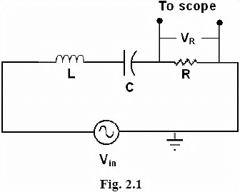
Q-Factor of an LCR Circuit
Objective
o study forced damped oscillations using LCR circuit and determine the Q-factor of the circuit
References
1. D. Halliday and R. Resnick, Physics II, Wiley Eastern Limited (1966).

Slide 17
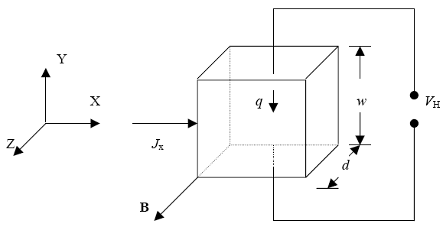
3. Study of Hall Effect
Objective
To study Hall Effect in extrinsic semiconducting samples and determine the type, density and mobility of majority charge carriers.
References
1. C. Kittel, Introduction to Solid State Physics, John Wiley & Sons (1996).
2. D. J. Griffiths, Introduction to Electrodynamics, Prentice-Hall (1999).

Slide 18
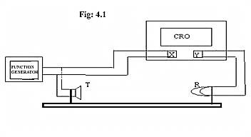
4. Determination of Speed of Sound in Air
Objective
To determine the speed of sound in air at room temperature using a cathode ray oscilloscope
References
1. F. A. Jenkins and H. E. White, Fundamentals of Optics, McGraw-Hill (1981).

Slide 19
4. Determination of Speed of Sound in Air
Objective
To determine the speed of sound in air at room temperature using a cathode ray oscilloscope
References
1. F. A. Jenkins and H. E. White, Fundamentals of Optics, McGraw-Hill (1981).

Slide 20
5. Determination of ‘g’ by a Compound Pendulum
Objective
To determine the value of acceleration due to gravity ‘g’ by a compound pendulum.
References
1. D. Kleppner and R. J. Kolenkow, An Introduction to Mechanics, McGraw-Hill (1999).
2. C. Kittel, W. D. Knight, M. A. Ruderman, C. A. Helmholz and B. J. Moyer, Mechanics (Berkley Physics Course - Volume 1), Tata McGraw-Hill (2008).

Slide 21
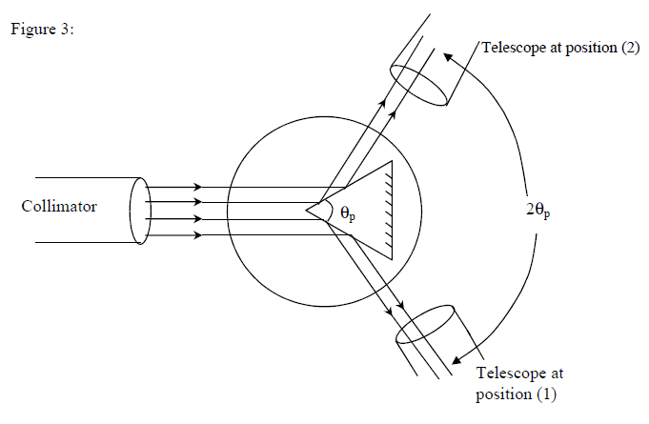
6. Speed of Light in Glass
$$v=$$
Objective
To determine the speed of propagation of light waves in glass.
$$v=\frac{csin\left(\frac{α}{2}\right)}{sin\left[\frac{\left(α+δ_{m}\right)}{2}\right]}$$
Find the Angle of Prism
Angle of Minimum Deviation
5. References
1. F. A. Jenkins and H. E. White, Fundamentals of Optics, McGraw-Hill (1981).
2. E. Hecht, Optics, Pearson Education (2002).
3. A. Ghatak, Optics, Tata McGraw-Hill (2005).

Slide 22
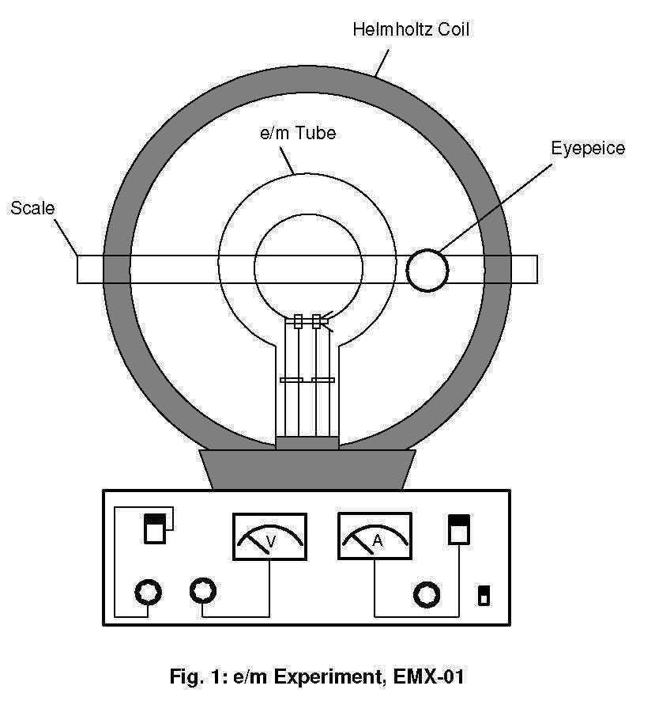
7. Determination of e/m
Objective
To measure the e/m ratio by Thomson’s method.

Slide 23
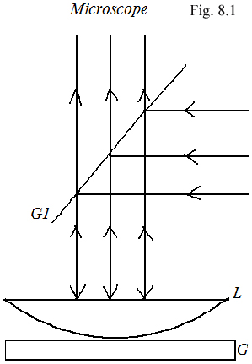
8. Interference of Light: Newton’s Ring
Objective
To study the interference of light using the method of Newton’s rings and determine the radius of curvature of the lens.
References
1. F. A. Jenkins and H. E. White, Fundamentals of Optics, McGraw-Hill (1981).
2. E. Hecht, Optics, Pearson Education (2002).
3. A. Ghatak, Optics, Tata McGraw-Hill (2005).
4. B. K. Mathur, Principles of Optics, New Gopal Printing Press (1993).

Slide 24
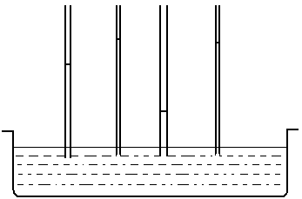
9. Surface Tension of Water by Method of Capillary Ascent
Objective
To measure the surface tension of water by method of capillary ascent

Slide 25
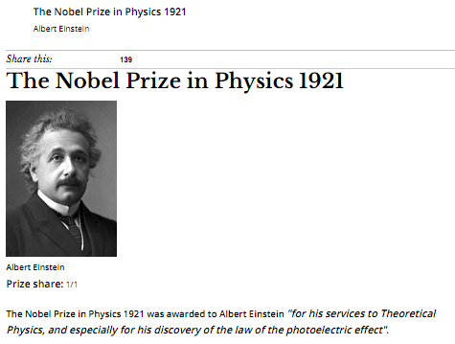
10. Determination of Planck’s Constant
Objective
To understand Photoelectric effect and measure the Planck’s constant

Slide 26
Error Analysis
Instrumental errors (Eg. Zero offset)
Absolute error
(Actual Value – Measured value) in percentage
3. Maximum possible error (log error)
Example 1
y = C x₁^{m} x₂^{n}
$$\frac{∆y}{y}=\left|m\right|\left(\frac{∆x_{1}}{x_{1}}\right)+\left|n\right|\left(\frac{∆x_{2}}{x_{2}}\right)$$

Slide 27
Error Analysis
Example 2
ρ = (πr² V) / (I L)
Where, r is the radius and L is the length of the wire, V is the voltage and I is the current flowing through the wire. The maximum possible error in the measurement of resistivity (Δρ/ρ) depends on the fractional uncertainties in the voltage (∆V/V), current (∆I/I), etc. and is given by
Δρ/ρ = 2 (Δr/r) + (Δl/l) + (ΔV/V) + (ΔL/L)

Slide 28
Linear Fitting
We use Linear Regression Fitting Method
y
x
Experimental Data points may not match with theoretical prediction exactly

Slide 30
Linear Fitting
Y
Sum of the square of the residuals
X

Slide 31
Linear Fitting
Note that E is a function of parameters a and b. We need to find a,b such that E is minimum.
The necessary condition for E to be minimum is given by:
This gives two normal equations for which a and be could be solved
(1)
(2)
After knowing the a and b, a straight line y = ax + b could be plotted along with the data points,
Which will pass through all the data points with minimum residuals with each data points
If Function is of the form y = ce^{x}, then ln(y) = lnc + x ,so a plot of ln(y) vs x would be a straight line.

Slide 32
Linear Fitting
Could be done using Scientific Calculators
Assignment for Submission
1. Using the method of least squares, find an equation of the form that fits the following data:
This gives two normal equations for which a and be could be solved
x | 0 | 1 | 2 | 3 | 4
y | 1 | 5 | 10 | 22 | 38

Slide 33
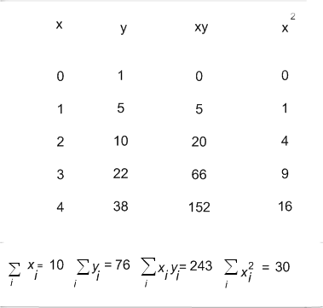
Hint
This gives two normal equations for which a and be could be solved
Use the Normal equations, Find a and b.
Required fit is of the form y = ax + b

Slide 34
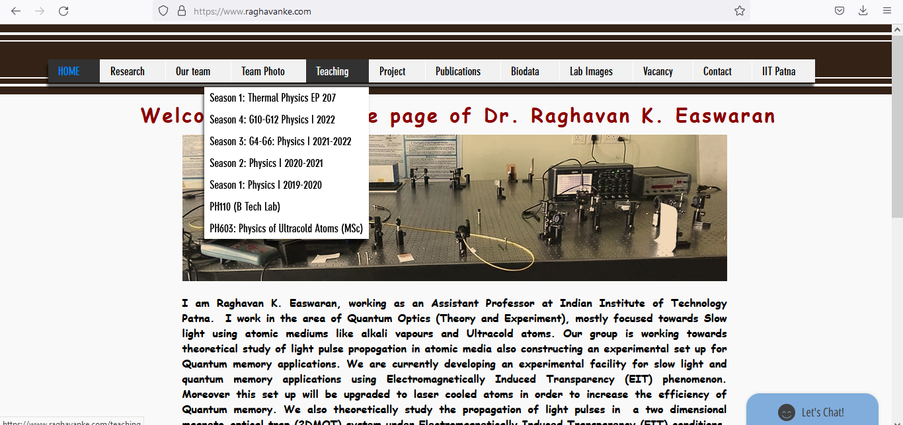
Some important links

Slide 35
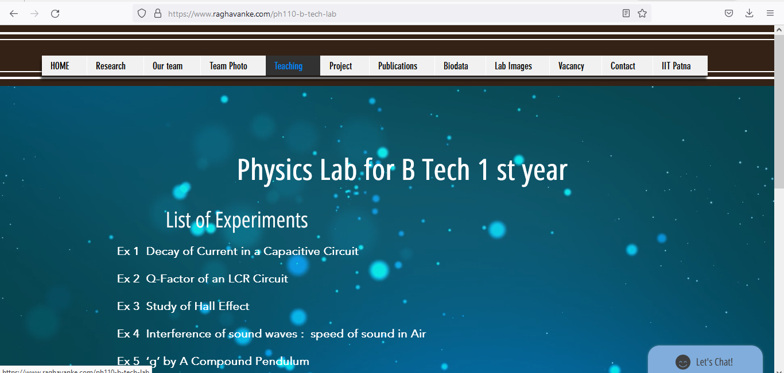

Slide 36
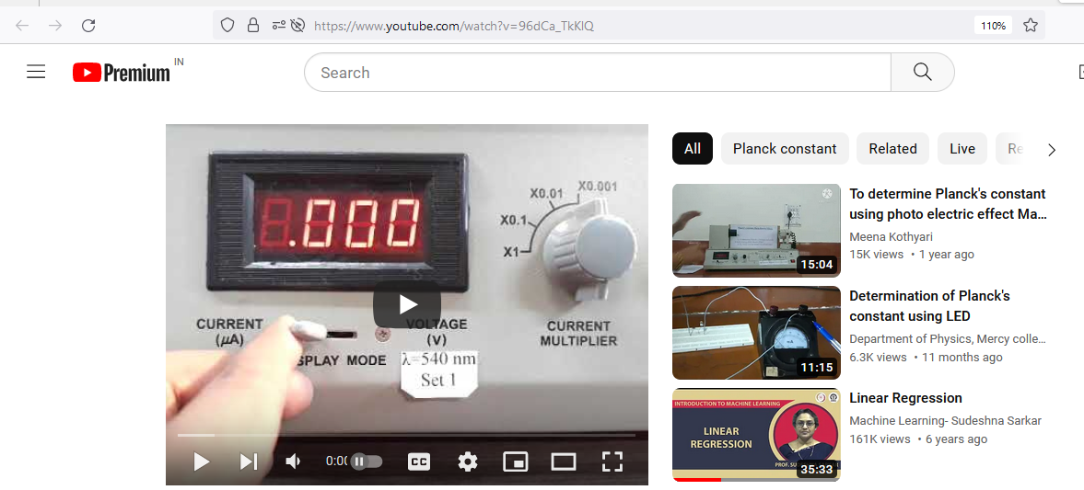
https://www.youtube.com/watch?v=96dCa_TkKlQ
http://172.16.1.6/index.php/2015-02-12-04-35-25/
b-tech-lab-videos-phy

Slide 37
THANK YOU

