Slide 1
Quiz 3 Solutions

Slide 2
Question 1

Slide 3
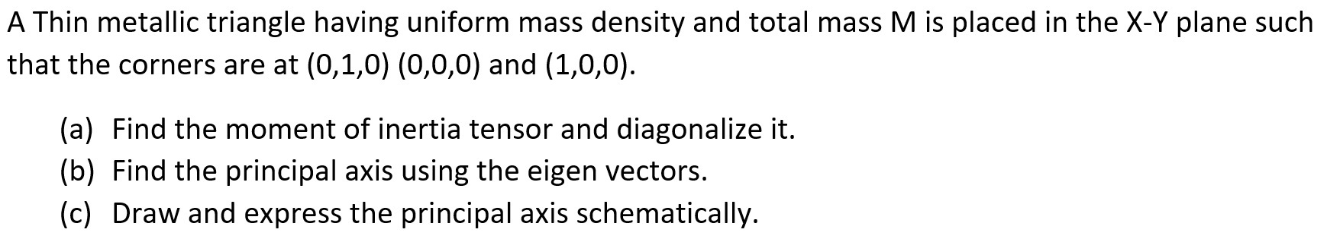
5 Marks

Slide 4
Step 1: Finding MI Matrix [I]--------------1 Marks

Slide 6
Step 2: Finding diagonal MI Matrix [I]--------------1 Marks
β=M/12=σ/24

Slide 7
The diagonal MI matrix is

Slide 8
Step 3: Finding Eigen vector--------------2 Marks
Finding eigen vector corresponding to λ₁ =4β
Eigenvector corresponding to λ_{1:}

Slide 9
Finding eigen vector corresponding to λ₂ =3β
Eigenvector corresponding to λ_{2:}

Slide 10
Finding eigen vector corresponding to λ₃ =β
Eigenvector corresponding to λ_{3:}

Slide 11
Step 4: Represent principal axes-------------1 Marks
Eigenvectors are

Slide 12
Question 2

Slide 13
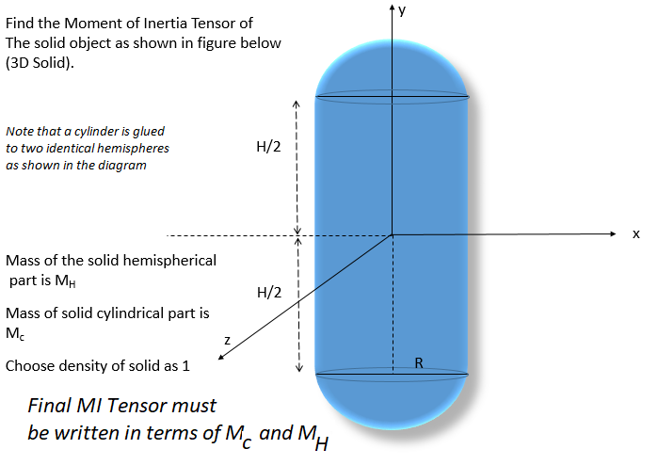

Slide 14



From diagram given
0.5 Marks
Step 1 MI of cylinder region
0.5 Marks
Mass of the Cylinder M_{c}

Slide 15

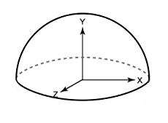


0.5 Marks
Step 2 MI of hemispherical caps
0.5 Marks

Slide 16
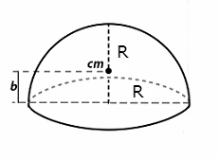


Step 3 I_{xx} and I_{zz} about the CM of hemispherical caps
Also M_{H} is given as
0.5 Marks

Slide 17
Step 4: Translate the axes from the center of mass of hemisphere to the center of
mass of the whole body (capsule)
0.5 Marks
Total MI will be the sum of MIs of the Hemisphere caps + Cylinder in all the 3 directions
MI OF THE BODY = MI OF THE CYLINDER+MI OF HEMISPHERICAL CAPS
As given in the problem MIs will be written in terms of M_{c} and M_{H}
0.5 Marks
Similarly for other components as well

Slide 18
Step 5 MI of Tensor
Reduce 1 mark if MI components are not written in terms of M_{C} and M_{H}
Reduce 1 mark if MI Tensor form not written
1.5 Marks

