Slide 3
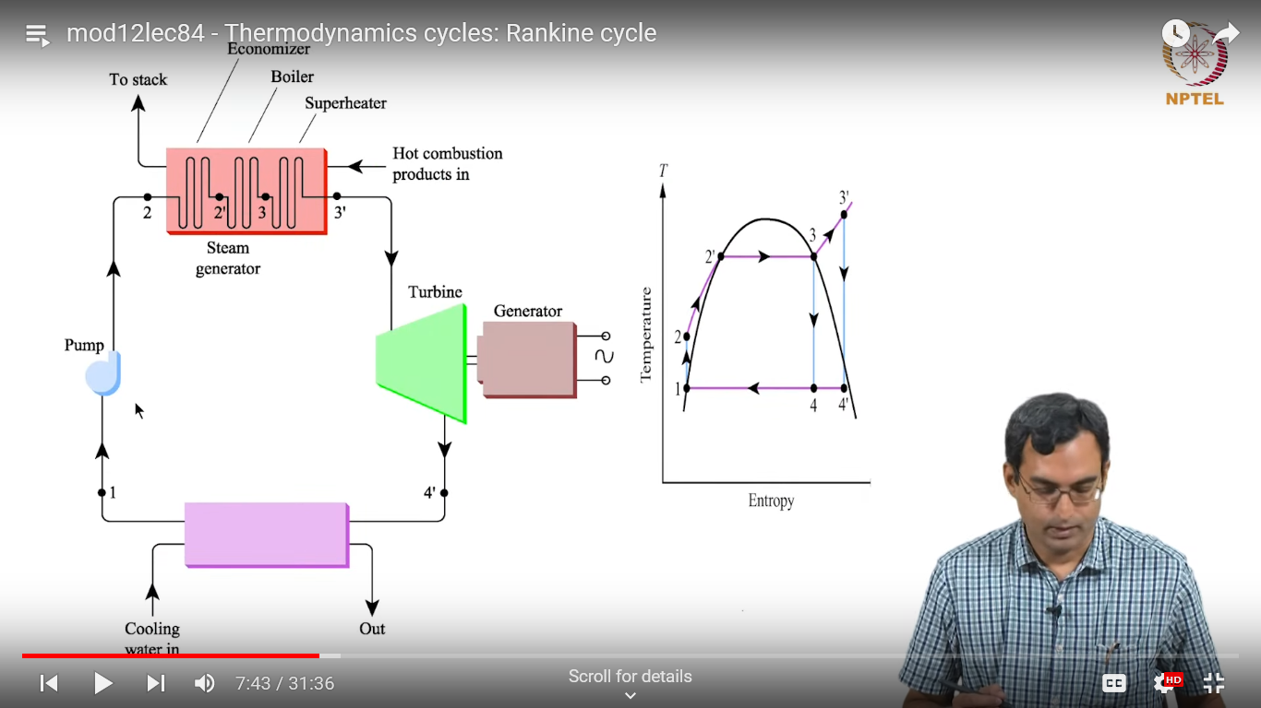

Slide 4
Vapor cycle refrigerator

Slide 5
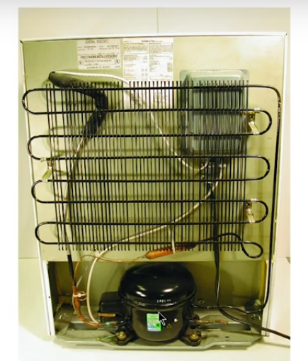

Slide 6
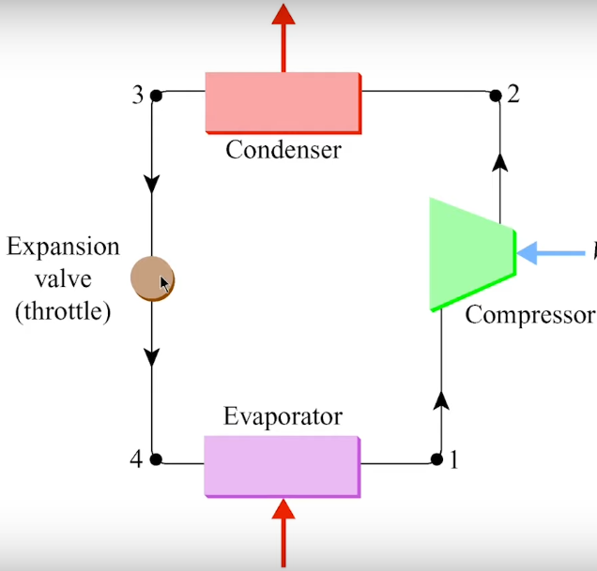

Slide 9
T-S diagram

Slide 14
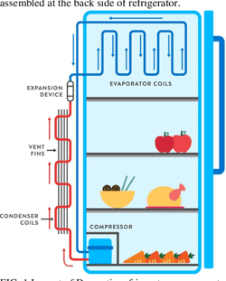
Back side
Front side

Slide 15
Air-conditioner (AC)

Slide 17
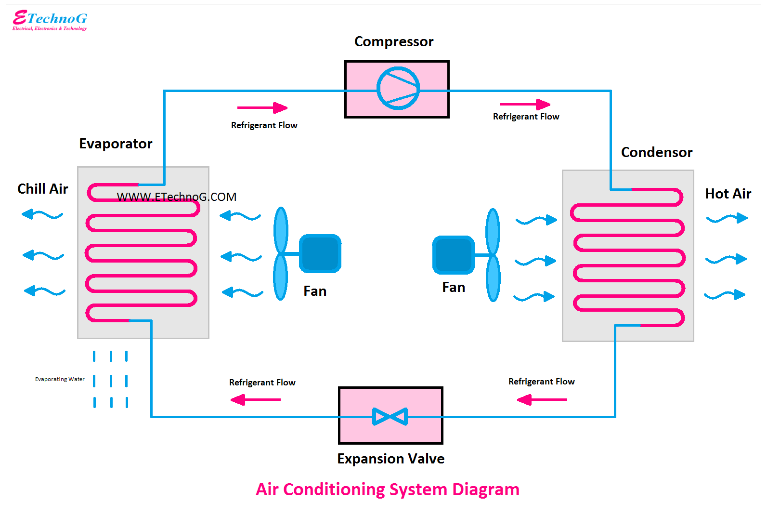

Slide 18
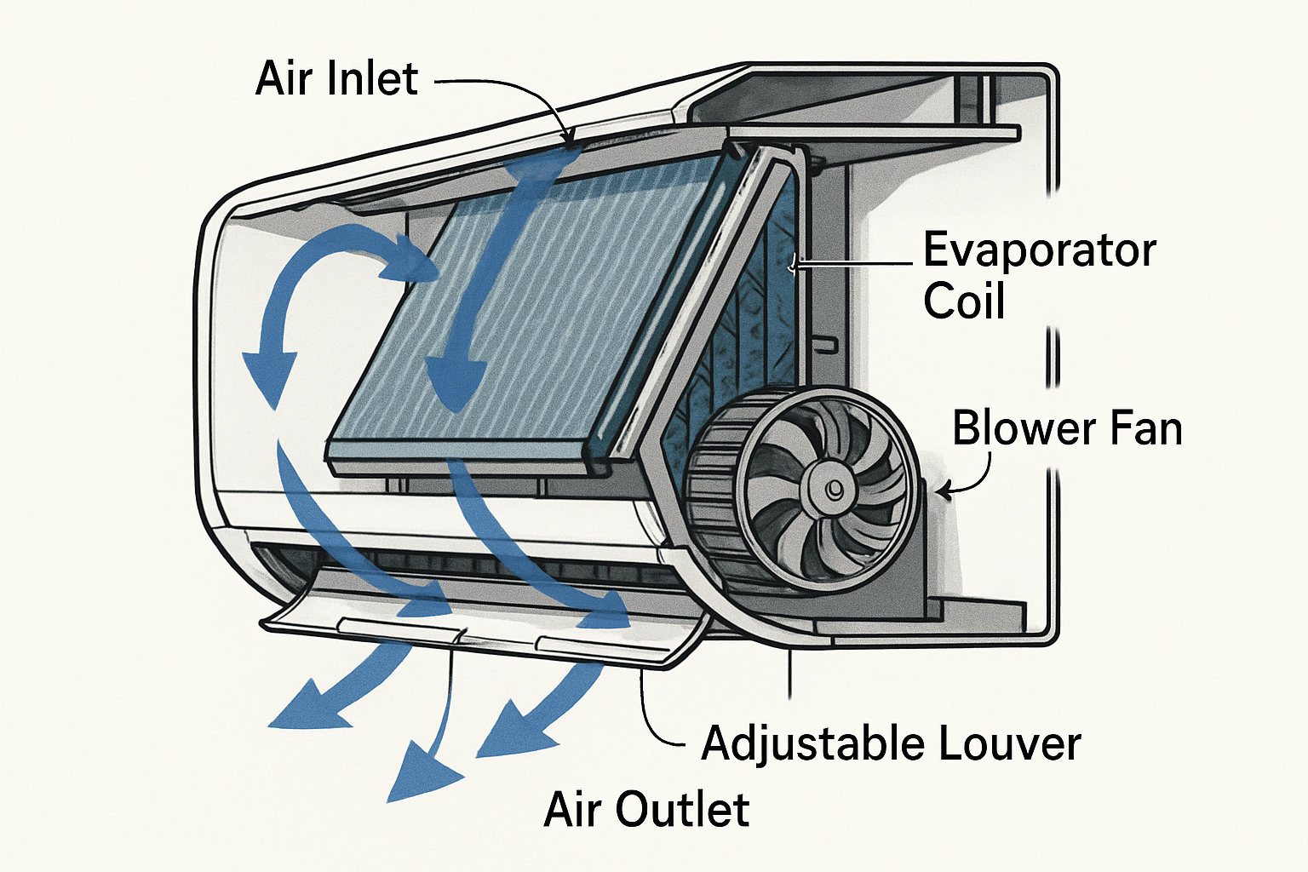

Slide 19
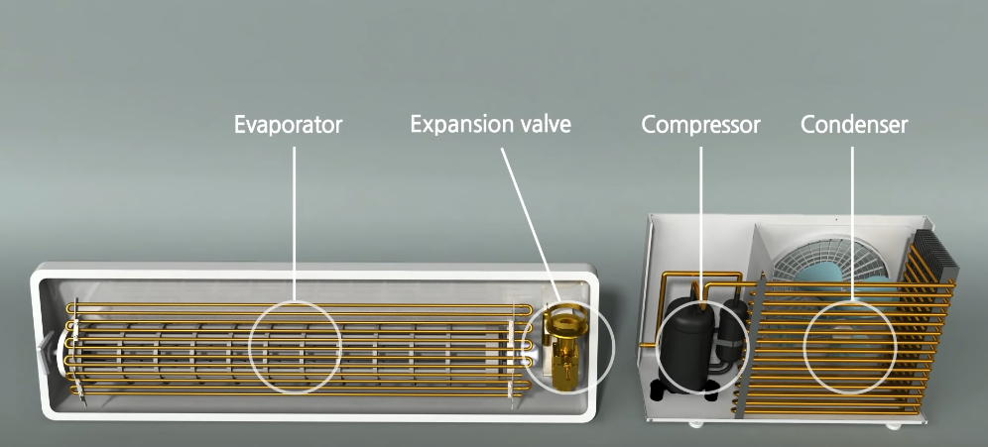

Slide 20
For Cooling the Room (Forced Convection): The Blower Fan forces the cooled air out of the unit and into the room. This movement of air carries the coldness (or, more accurately, the absence of heat) to all parts of the room, lowering the overall temperature. This is the primary way the air conditioner cools the space.
At the Evaporator Coil: The fan forces the warm room air to move across the cold coil, which is a form of forced convection.
At the Condenser Coil: In the outdoor unit, the Condenser Fan forces air across the hot condenser coil to carry the rejected heat away into the atmosphere.

Slide 21
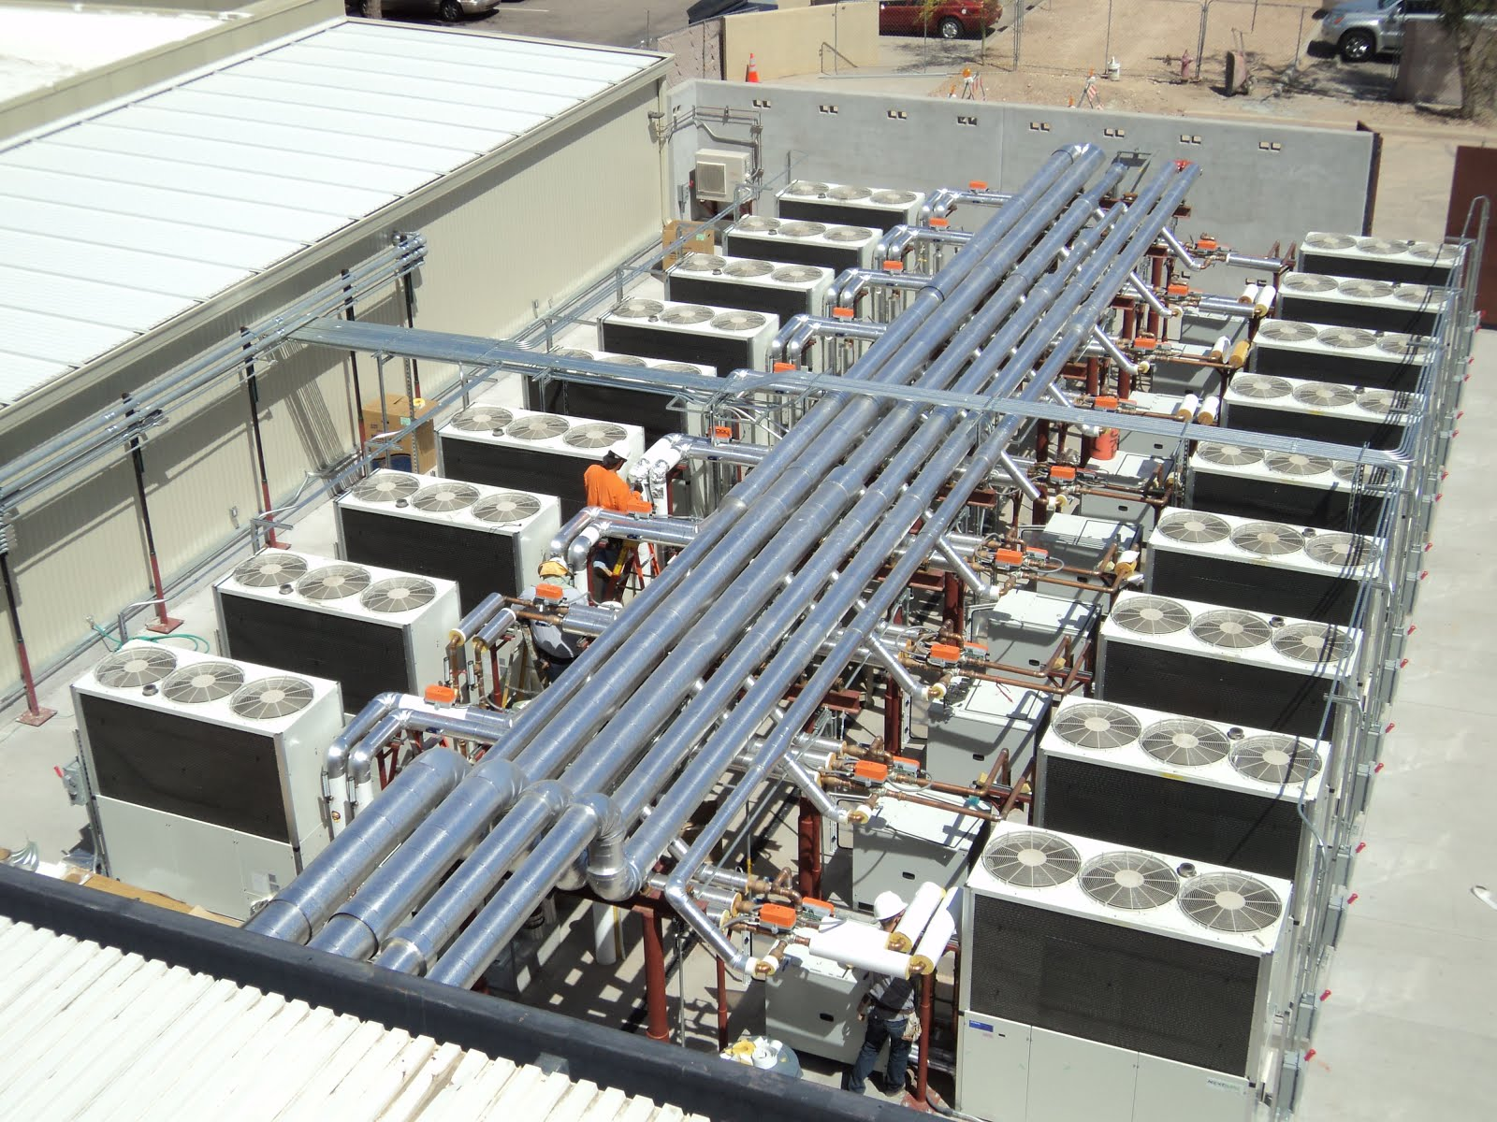

Slide 22
Engineering Problem on Rankine Cycle

Slide 23
In a steam power plant operating on the Rankine cycle, steam enters the turbine at 4 MPa, 400 ºC (Super heated vapor region) and exits at a pressure of 15 kPa. Then it enters the condenser and exits as saturated water. Next, a pump feeds back the water to the boiler.
Draw the entire rankine cycle by marking the processes neatly.
Determine the heat supplied to the working fluid in the cycle.
Provided the enthalpy at the entrance of the condenser as 2192.5 kJ/Kg, find the work output of Turbine
From steam table
Enthalpy h =3214.5 kJ/Kg at 400C, 4MPa (at inlet of turbine)
Entropy h= 6.771 KJ/KgK at 400 C, 4 MPa (at inlet of turbine)
Entropy of saturated vapor (on saturated vapor line) at 15 kPa = 8.007 kJ/KgK
Enthalpy of saturated liquid (on saturated liquid line) at 15 kPa = 225.8 kJ/Kg
Specific volume of liquid at the entrance of pump at 15 kPa = 0.001014 m³/Kg

Slide 24
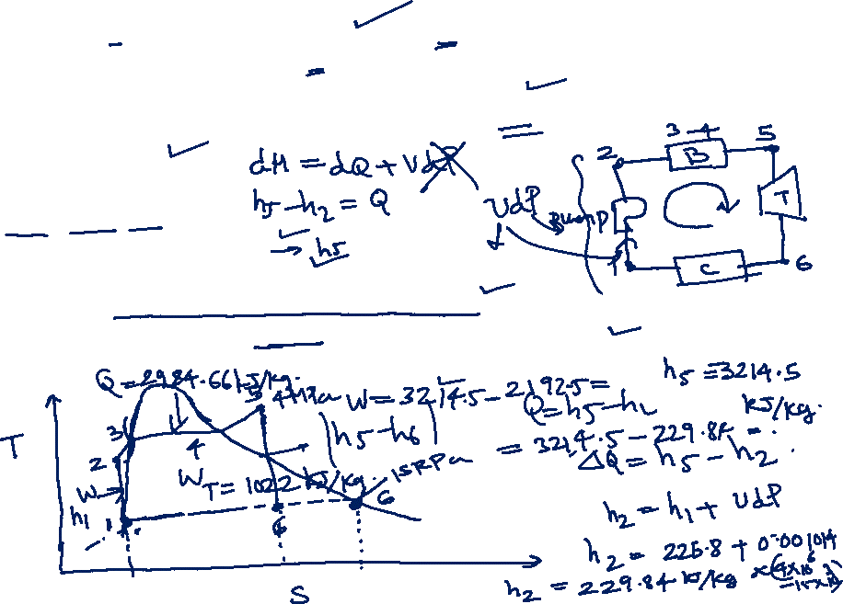
In a steam power plant operating on the Rankine cycle, steam enters the turbine at 4 MPa, 400 ºC (Super heated vapor region) and exits at a pressure of 15 kPa. Then it enters the condenser and exits as saturated water. Next, a pump feeds back the water to the boiler.
Determine the heat supplied to the working fluid in the cycle.
Provided the enthalpy at the entrance of the condenser as 2192.5 kJ/Kg, find the work output of Turbine
From steam table
Enthalpy h =3214.5 kJ/Kg at 400 C
Entropy h= 6.771 Kj/KgK at 400 C (at inlet of turbine)
Entropy of saturated vapor (on saturated vapor line) at 15 kPa = 8.007 kJ/KgK
Enthalpy of saturated liquid (on saturated liquid line) at 15 kPa = 225.8 kJ/Kg
Specific volume of liquid at the entrance of pump at 15 kPa = 0.001014 m³/Kg

Slide 25
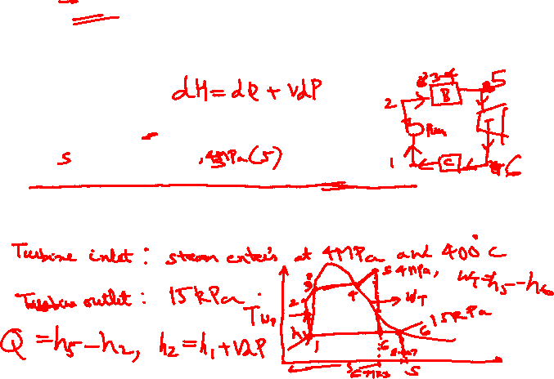
In a steam power plant operating on the Rankine cycle, steam enters the turbine at 4 MPa, 400 ºC (Super heated vapor region) and exits at a pressure of 15 kPa. Then it enters the condenser and exits as saturated water. Next, a pump feeds back the water to the boiler.
Determine the heat supplied to the working fluid in the cycle.
Provided the enthalpy at the entrance of the condenser as 2192.5 kJ/Kg, find the work output of Turbine
From steam table
Enthalpy h =3214.5 kJ/Kg at 400 C
Entropy h= 6.771 Kj/KgK at 400 C (at inlet of turbine)
Entropy of saturated vapor (on saturated vapor line) at 15 kPa = 8.007 kJ/KgK
Enthalpy of saturated liquid (on saturated liquid line) at 15 kPa = 225.8 kJ/Kg
Specific volume of liquid at the entrance of pump at 15 kPa = 0.001014 m³/Kg

Slide 26
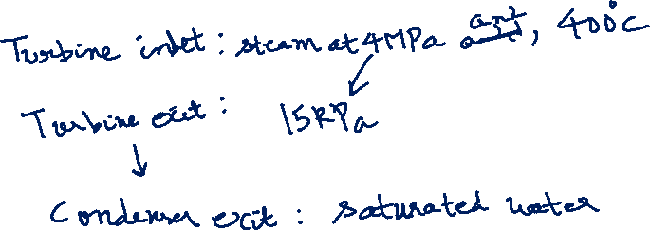
In a steam power plant operating on the Rankine cycle, steam enters the turbine at 4 MPa, 400 ºC (Super heated vapor region) and exits at a pressure of 15 kPa. Then it enters the condenser and exits as saturated water. Next, a pump feeds back the water to the boiler.
Determine the heat supplied to the working fluid in the cycle.
Provided the enthalpy at the entrance of the condenser as 2192.5 kJ/Kg, find the work output of Turbine
From steam table
Enthalpy h =3214.5 kJ/Kg at 400 C
Entropy h= 6.771 Kj/KgK at 400 C (at inlet of turbine)
Entropy of saturated vapor (on saturated vapor line) at 15 kPa = 8.007 kJ/KgK
Enthalpy of saturated liquid (on saturated liquid line) at 15 kPa = 225.8 kJ/Kg
Specific volume of liquid at the entrance of pump at 15 kPa = 0.001014 m³/Kg

Slide 27
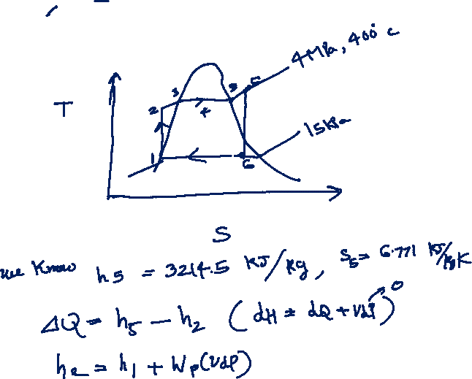

Slide 28
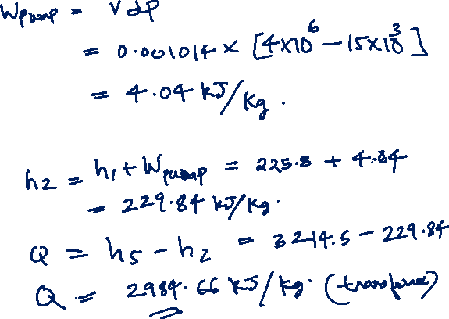

Slide 29
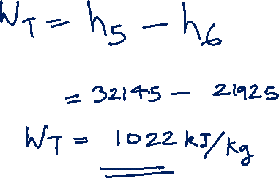

Slide 30
Engineering Problem on Vapor Cycle

Slide 31
In a vapour compression refrigeration cycle working with refrigerant R-134A, the evaporator and condenser temperatures are -5 C and 30 C respectively. Draw the T-S diagram of a vapor compression refrigerator cycle
Determine
Compression work
Refrigerating effect
Heat rejected in the condenser
COP
From the data sheet of R-134 A, following information are provided
Enthalpy at the inlet of compressor at -5C = 395.9 kJ/Kg
Enthalpy at the inlet of condenser at 30C and 771 kPa = 420.8 kJ/Kg
Enthalpy after throttling and at the inlet of evaporator = 241.8 kJ/Kg

Slide 32
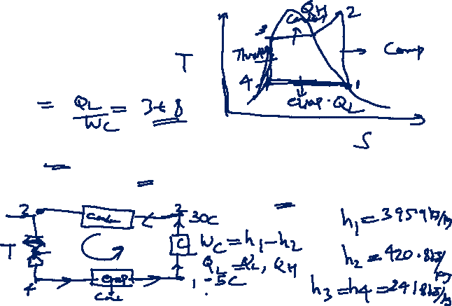
In a vapour compression refrigeration cycle working with refrigerant R-134A, the evaporator and condenser temperatures are -5 C and 30 C respectively. The process follows the T-S diagram shown
Determine
Compression work
Refrigerating effect
Heat rejected in the condenser
COP
From the data sheet of R-134 A, following information are provided
Enthalpy at the inlet of compressor at -5C = 395.9 kJ/Kg
Enthalpy at the inlet of condenser at 30C and 771 kPa = 420.8 kJ/Kg
Enthalpy after throttling and at the inlet of evaporator = 241.8 kJ/Kg

Slide 33
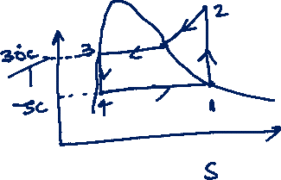

In a vapour compression refrigeration cycle working with refrigerant R-134A, the evaporator and condenser temperatures are -5 C and 30 C respectively. The process follows the T-S diagram shown
Determine
Compression work
Refrigerating effect (QL)
Heat rejected in the condenser
COP of refrigerator
From the data sheet of R-134 A, following information are provided
Enthalpy at the inlet of compressor at -5C = 395.9 kJ/Kg
Enthalpy at the inlet of condenser at 30C and 771 kPa = 420.8 kJ/Kg
Enthalpy after throttling and at the inlet of evaporator = 241.8 kJ/Kg

Slide 34
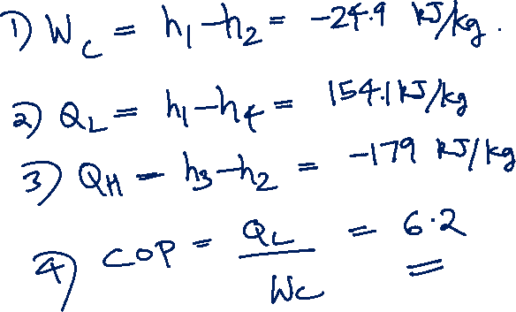


Slide 35
Tutorial 5
Second Law

Slide 36
Gas Turbines and Engines

Slide 37
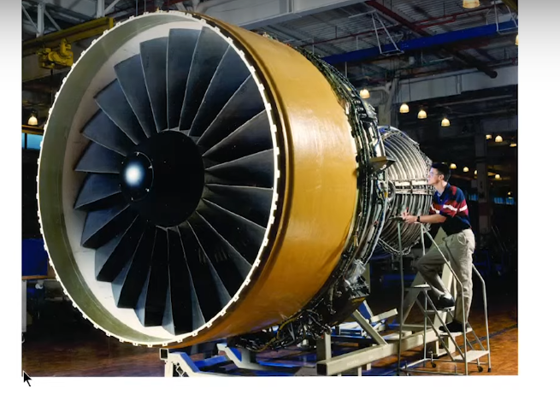

Slide 39
Convert P-V diagram of Carnot Cycle to T-S diagram also calculate efficiency using T-S diagram
1
isothermal
2
Q_{in}
1
2
T
P
Q=0
T_{hot}
Q=0
adiabatic
adiabatic
T_{cold}
4
3
Q_{out}
isothermal
4
3
S
V

Slide 40
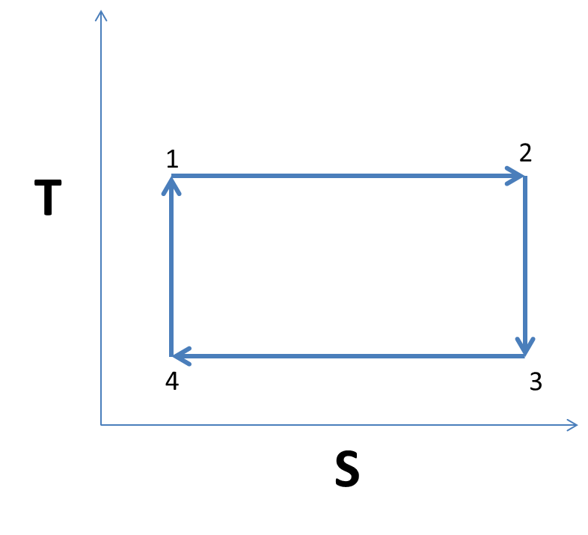

Slide 41
1 to 2 to 3 to 4 to 1
3
P
adiabatic
2
4
adiabatic
1
V

Slide 42
1 to 2 to 3 to 4 to 1
3
P
adiabatic
2
4
adiabatic
1
V
T
2
1 to 2
1
S

Slide 43
1 to 2 to 3 to 4 to 1
3
P
adiabatic
2
4
adiabatic
1
V
3
2 to 3
2
T
1
S

Slide 44
1 to 2 to 3 to 4 to 1
3
P
adiabatic
2
4
adiabatic
1
V
3
3 to 4
T
2
4
1
S

Slide 45
1 to 2 to 3 to 4 to 1
3
P
adiabatic
2
4
adiabatic
1
V
3
3 to 4
T
2
4
1
Using
S

Slide 46
1 to 2 to 3 to 4 to 1
3
P
adiabatic
2
4
adiabatic
1
V
3
3 to 4
T
2
4
1
S

Slide 47
1 to 2 to 3 to 4 to 1
3
P
adiabatic
2
4
adiabatic
1
V
3
3 to 4
T
2
4
1
S

Slide 48
1 to 2 to 3 to 4 to 1
3
P
adiabatic
2
4
adiabatic
1
V
3
3 to 4
T
2
4
1
S

Slide 49
1 to 2 to 3 to 4 to 1
3
P
adiabatic
2
4
adiabatic
1
V
3
4 to 1
T
2
4
1
S

Slide 50
Gas Turbines and Engines

Slide 61
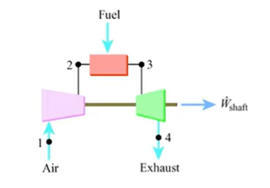
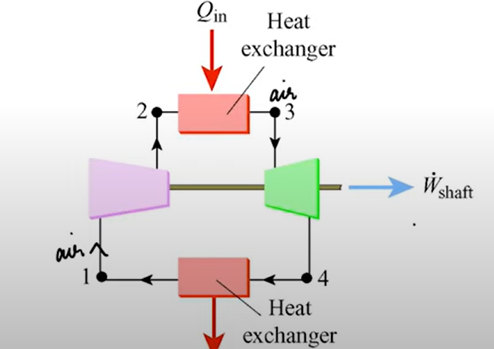

Slide 62
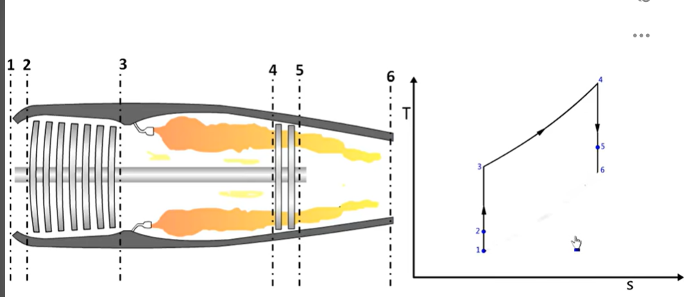

Slide 63
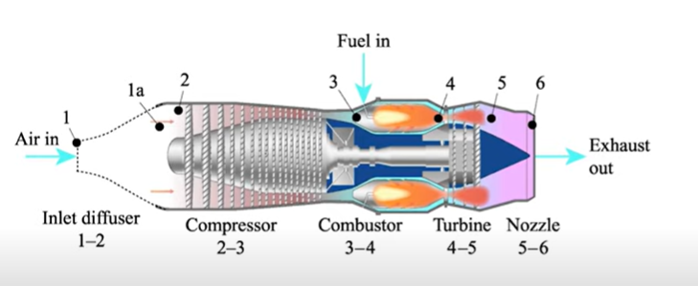

Slide 64
Applications of Phase Transition’s
Vapor-Liquid
Liquid-Vapor
1. Thermal Power Plant
2. Refrigerator
3. Air Conditions
4. Gas Turbine: Power generation
5. Aircraft Gas Turbine , Propeller, Jet Engines

