Slide 1
Season 2, Lecture 38 :
Gas Turbines, Air craft engines, Quantum Technology (not for exam)

Slide 2
Name | L37
"2201ph34_dolly" <2201ph34_dolly@iitp.ac.in>; | p
"Adhila Aslam" <2201ph01_adhila@iitp.ac.in>; | a
"Aditi Baghel" <2201ph31_aditi@iitp.ac.in>; | p
"Aditya Kumar" <2201ph02_aditya@iitp.ac.in>; | p
"Aditya Singh" <2201ph03_aditya@iitp.ac.in>; | p
"Animesh Sharma" <2201ph05_animesh@iitp.ac.in>; | p
"Arun Mishra" <2201ph06_arun@iitp.ac.in>; | p
"Aryan Raj" <2201ph32_aryan@iitp.ac.in>; | p
"Boda Vishnuwardhan" <2201ph08_boda@iitp.ac.in>; | a
"Chanchal Tolani" <2201ph09_chanchal@iitp.ac.in>; | p
"Gaurav Verma" <2201ph10_gaurav@iitp.ac.in>; | pp

Slide 3
Name | L37
"Gourav Jha" <2201ph11_gourav@iitp.ac.in>; | a
"Gurinder Dhillon" <2201ph12_gurinder@iitp.ac.in>; | p
"Harsh Joshi" <2201ph13_harsh@iitp.ac.in>; | p
"Himanshu Patel" <2201ph35_himanshu@iitp.ac.in>; | p
"Khushal Yadav" <2201ph14_khushal@iitp.ac.in>; | p
"Krishnakant Chourey" <2201ph15_krishnakant@iitp.ac.in>; | p
"Manas Gupta" <2201ph16_manas@iitp.ac.in>; | p
"Mohit Saini" <2201ph17_mohit@iitp.ac.in>; | p
"Mude Naik" <2201ph18_mude@iitp.ac.in>; | p
"Murari Kumar" <2201ph19_murari@iitp.ac.in>; | a
"Nishant Yadav" <2201ph20_nishant@iitp.ac.in>; | p
"Pranitha Moluguri" <2201ph21_pranitha@iitp.ac.in>; | a

Slide 4
Name | L37
"Premanandh Sigamala" <2201ph22_premanandh@iitp.ac.in>; | p
"Ruchi Thakur" <2201ph23_ruchi@iitp.ac.in>; | p
"Satyam Sahoo" <2201ph25_satyam@iitp.ac.in>; | a
"Satyam Shandilya" <2201ph24_satyam@iitp.ac.in>; | p
"Shyam Hembram" <2201ph26_shyam@iitp.ac.in>; “ | p
Sougata Saha" <2201ph27_sougata@iitp.ac.in>; | p
"Sumit Rajpoot" <2201ph28_sumit@iitp.ac.in>; | a
"Suprajit Dewanji" <2201ph29_suprajit@iitp.ac.in>; | p
Attendance: 75% mandatory

Slide 5
Gas Turbines and Engines

Slide 15
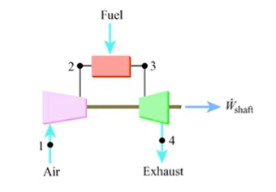
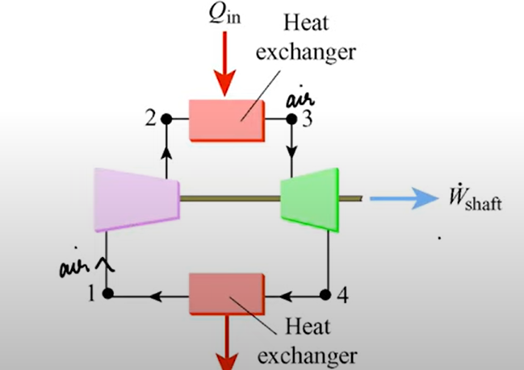

Slide 16
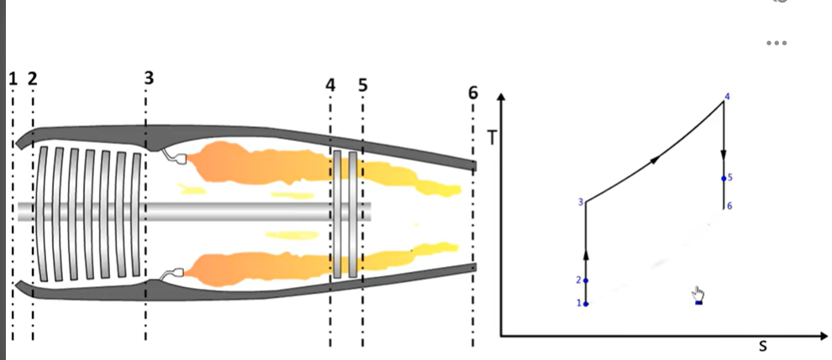

Slide 17
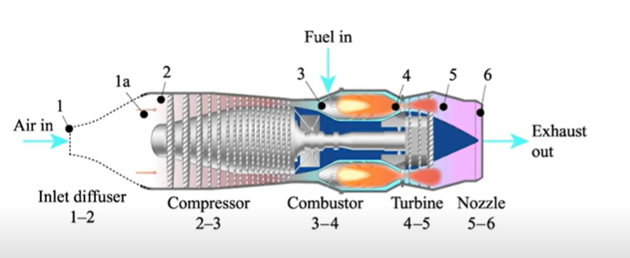

Slide 18
Applications of Phase Transition’s
Vapor-Liquid
Liquid-Vapor
1. Thermal Power Plant
2. Refrigerator
3. Air Conditions
4. Gas Turbine: Power generation
5. Aircraft Gas Turbine , Propeller, Jet Engines

Slide 19
More Phase Transition’s
Bose-Einstein Condensation and Plasma

Slide 20
Bose-Einstein Condensate (BEC)
Towards Quantum Technology, Information theory and Engineering Applications

Slide 25
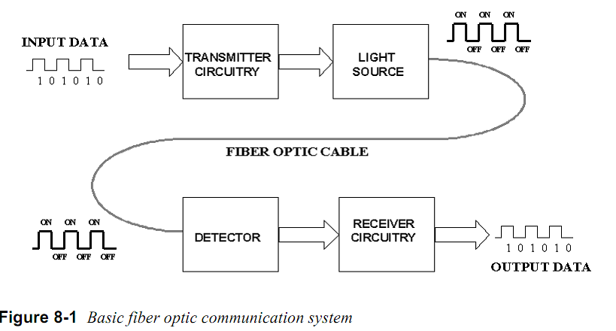
Basic optical communication

Slide 26
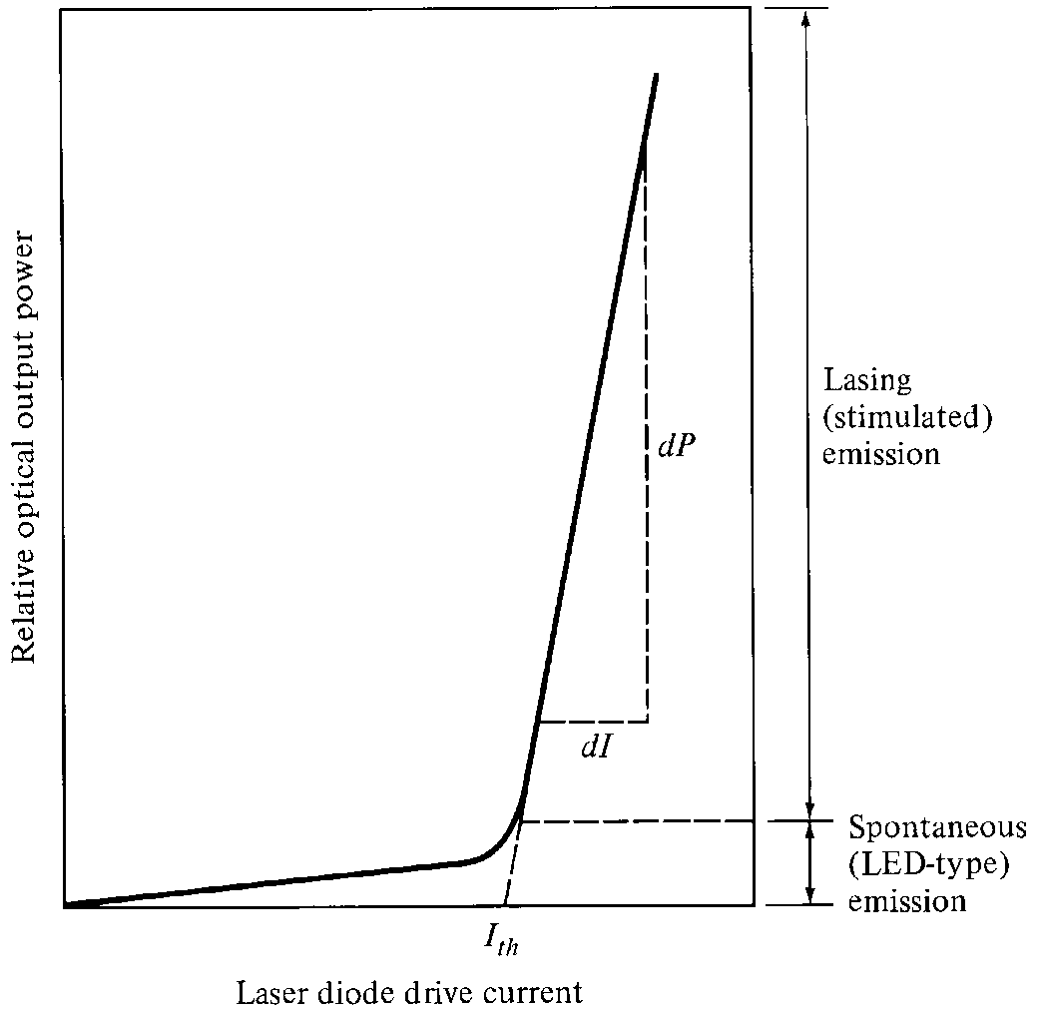
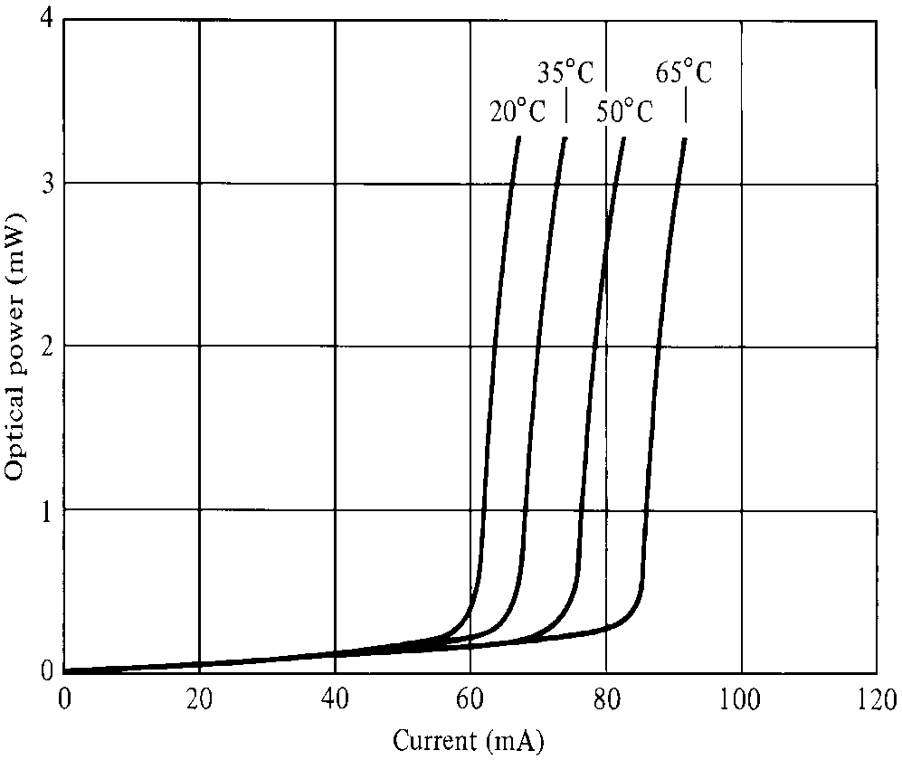
Laser Diode Characteristics
Very good for digital modulation

Slide 27
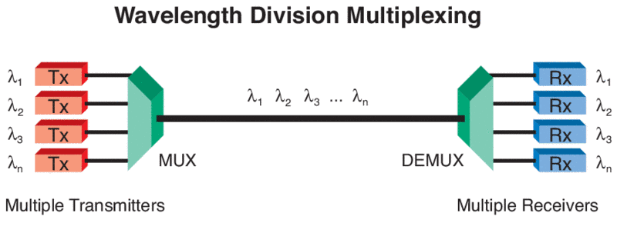
Wavelength Division Multiplexing and utilisation
For broad band communication

Slide 28
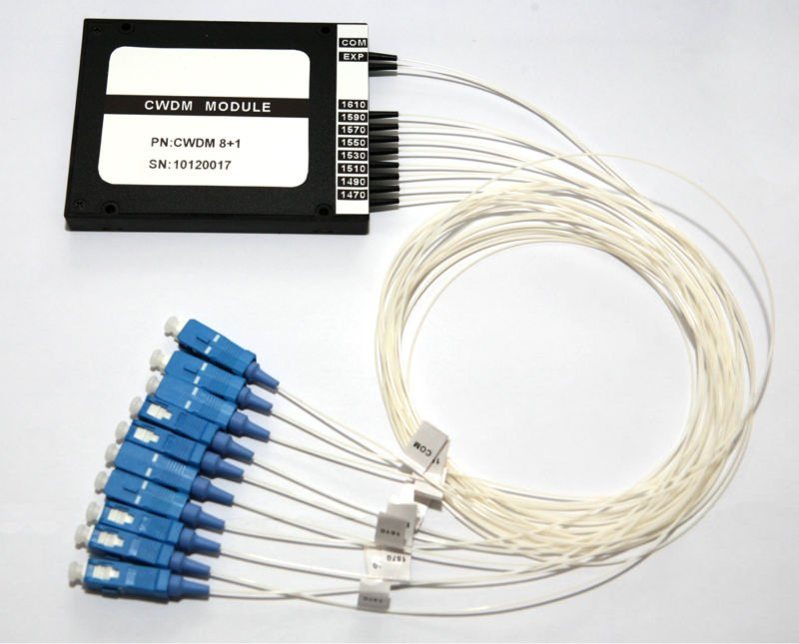
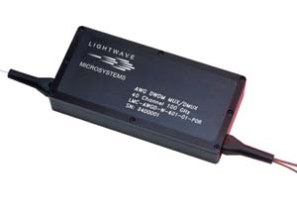
Wavelength Division MUX (Multiplexer)

Slide 29
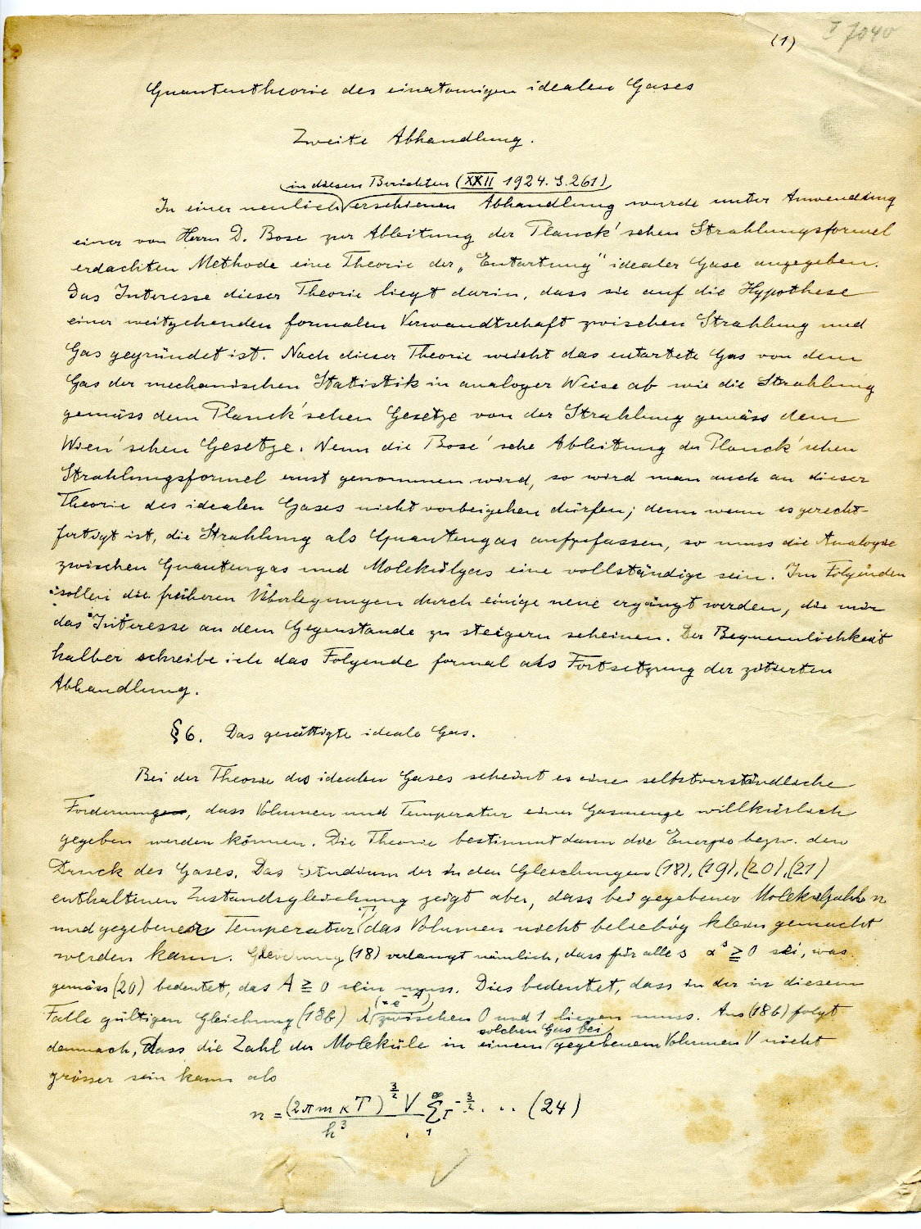
A new phase transition predicted ………………….in 1925

Slide 30
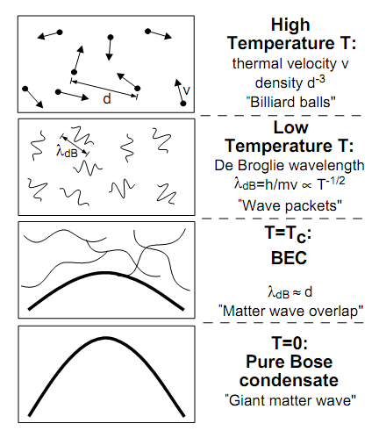
How Cold is Ultra Cold?
Kelvin
Celsius
300
26.8
Room Temperature
Water freezes
250
-23.2
200
-73.2
150
-123.2
100
-173.2
Air liquefies
50
-223.2
≈ 3K Deep space
0
-273.2
Absolute Zero
All motion stops
New state of Matter: Bose –Einstein Condensate
W.Ketterle, Cornell, C.Weimann, MIT
NOBEL PRIZE 2001
Laser Cooling and Evaporative cooling Technique

Slide 31
Realized in 1995 at MIT

Slide 32
How this phase transition was achieved?
“Laser Cooling of atoms” using Doppler effect
+
“Evaporative Cooling”

Slide 33
Bose-Einstein condensation
PREDICTION BY BOSE………………
BEC is a phenomena in which, below a critical temperature Tc, a macroscopic number of bosons occupies lowest energy state

Slide 34
Ultracold atoms
Quantum Behaviour of Light
Quantum matter
Quantum gas

Slide 35
What is Doppler Laser Cooling?

Slide 36
Interesting experiment by Prof. Ashkin and his team in 1975
Atom
Stream of Photons
Atoms got deflected by laser beam ………………………..HOW?
Effect was very directional

Slide 37
Resonances in systems
Simple Pendulum
Spring mass system
LCR Systems
ATOMIC SYSTEMS

Slide 38
Possibility of Cooling of atoms by Light?
v
v
LIGHT interacts with ATOMS
Radiation Pressure from Light
Atom
Stream of Photons

Slide 39
Model using 2 level system

Slide 40
Two level atom interacting with Light
Atom
Stream of Photons
What are the possible phenomena’s?
Stimulated Absorption
Stimulated Emission
Spontaneous Emission

Slide 43
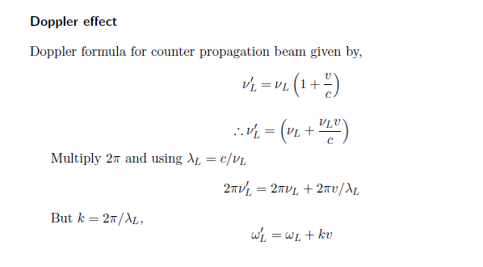
Doppler Effect

Slide 44
Doppler effect in radiation pressure
Laser cooling in 1-D
v
e
δ
ω_{L}- kv
ω_{L}+ kv
ω_{L}
ω_{o}
ω_{L}
g

Slide 46
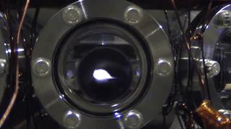
DOPPLER COOLING

Slide 47
Concept of Doppler Cooling of Atoms

Slide 48
Doppler effect in radiation pressure
Laser cooling in 1-D
v
e
δ
ω_{L}- kv
ω_{L}+ kv
ω_{L}
ω_{o}
ω_{L}
g

Slide 49
Energy Picture For Counter Propagation
Counter Propagating
v
Atom Absorbs Lower Frequency and emits higher frequency
Which means it loses its Kinetic Energy and Velocity
Momentum Picture For Counter Propagation
Atom gets a recoil kick as v_{rec} = hk/M
Rate of change of momentum = hk/t = hk x photon absorption emission rate
Atom decelerate

Slide 50
Energy Picture For C0 Propagation
v
Atom Absorbs Higher Frequency and emits Lower frequency
Which means it increases its Kinetic Energy and Velocity
Momentum Picture For Counter Propagation
Atom gains energy hence accelerate

Slide 51
Some Animations…

Slide 52
Laser cooling in 3-D

Slide 53
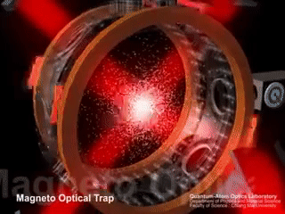

Slide 54
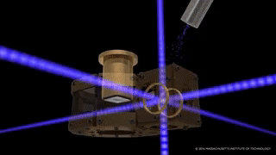

Slide 55
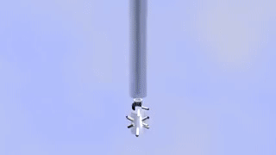

Slide 56
Some real experiments….

Slide 57
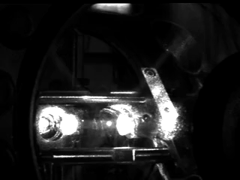

Slide 58
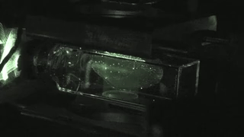

Slide 60
