Slide 1
Concept of LASER/Doppler Cooling of Atoms

Slide 10
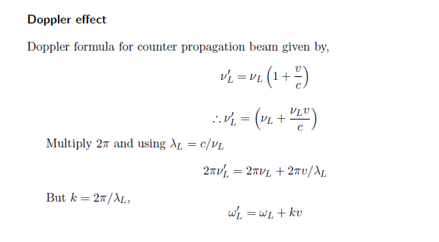
Doppler Effect

Slide 13
Red and blue detuning

Slide 14
Doppler effect in radiation pressure
Laser cooling in 1-D
v
e
δ
ω_{L}- kv
ω_{L}+ kv
ω_{L}
ω_{o}
ω_{L}
g

Slide 15
Atoms decelerate

Slide 17
Laser cooling in 3-D

Slide 18
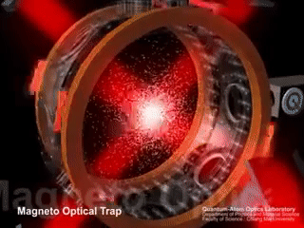

Slide 19
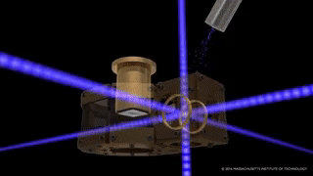

Slide 20
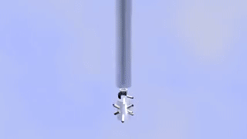

Slide 21
Some real experiments….

Slide 22
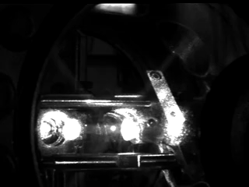

Slide 23
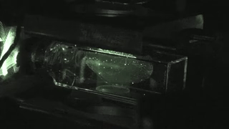

Slide 24
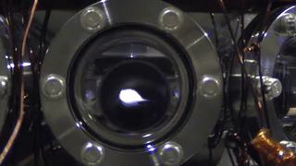

Slide 25
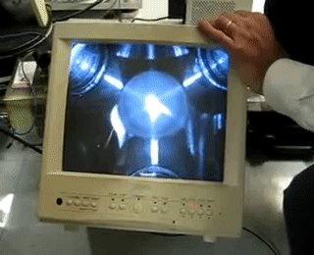

Slide 32
PH 603 Physics of ultracold atoms
Force experienced by atoms

Slide 35
Model: Force on a Hypothetical two level atom under motion interacting with
two lights (Co-prop and Counter Prop) simultaneously in 1-D

Slide 36
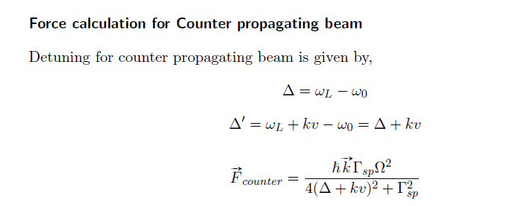

Slide 37
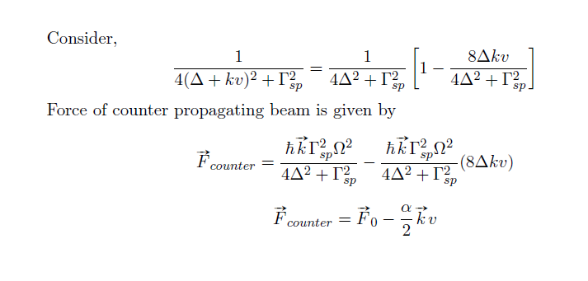

Slide 38
