Slide 2
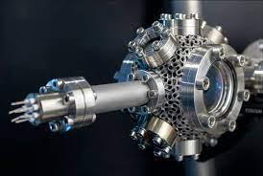
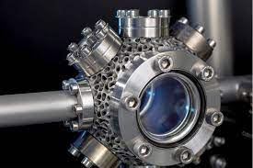
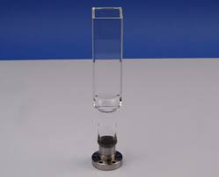

Slide 4
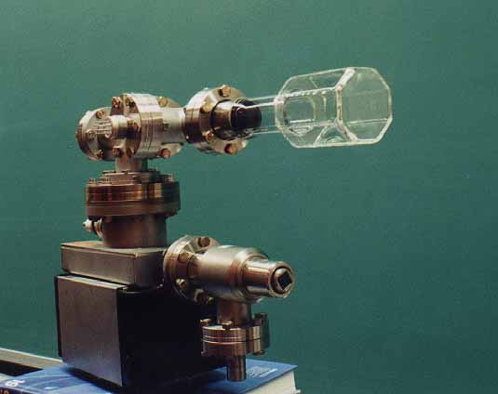

Slide 5
Laser cooling in 3-D

Slide 6
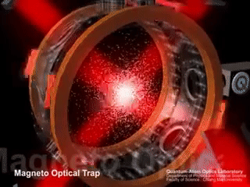

Slide 7
Some real experiments….

Slide 8
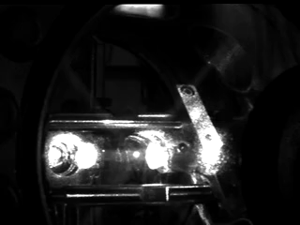

Slide 9
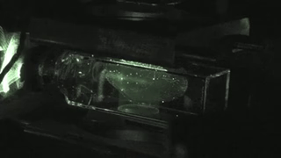

Slide 10
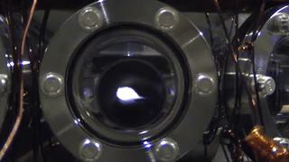

Slide 11
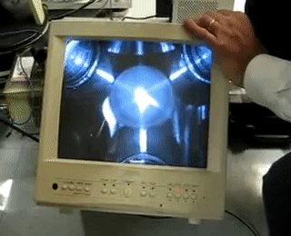

Slide 12
Some Limitations of Doppler Cooling
Minimum Temperature attained in range of fraction of milli Kelvin ONLY…..
For seeing Quantum Behavior of atoms need to reach order of Nano Kelvin
Doppler Cooling has no position dependent force, atoms in periphery leave the cooling region. Force F take a form of F = -αV
Laser Light has some heating effect also for some frequencies for certain velocity class of atoms: Not all the atoms experience the right frequency for cooling effect some atoms gets heating effects from co-propagating light as well………
A competition between heating and cooling arise which leads to an equilibrium temperature.

Slide 15
Experimental sequence of laser cooling

