Slide 1
Quantum Physics
Symmetric Finite well (Contd..)and Harmonic Oscillator
Last topic of the course……

Slide 2
$$Csin(ux) or Dcos(ux)$$
$$\text{for}\text{ −}\text{a}\text{ <}\text{x}\text{<}\text{a}$$
$$Be^{κx}, \text{for} x<−a$$
$$Fe^{−κx}, \text{for} x>a$$
V(x)
X=-a
X=a
(X)
E<0

Slide 3
Applying boundary condition at x=a
Taking the ratio of the
two equations yields :
V(x)
X=-a
X=a
(X)
E<0

Slide 4
Squaring and adding the equations yield:
Multiplying a² on both sides

Slide 5
Have the variable transformations for simplicity
Therefore:

Slide 6
Therefore from the continuity of wavefunction and its derivative at boundaries, we get
Solve graphically

Slide 7
Solve graphically
Z
Look for the intersection points of the two graph

Slide 8
tanz v/s z
0

Slide 9
intersection point
0

Slide 10
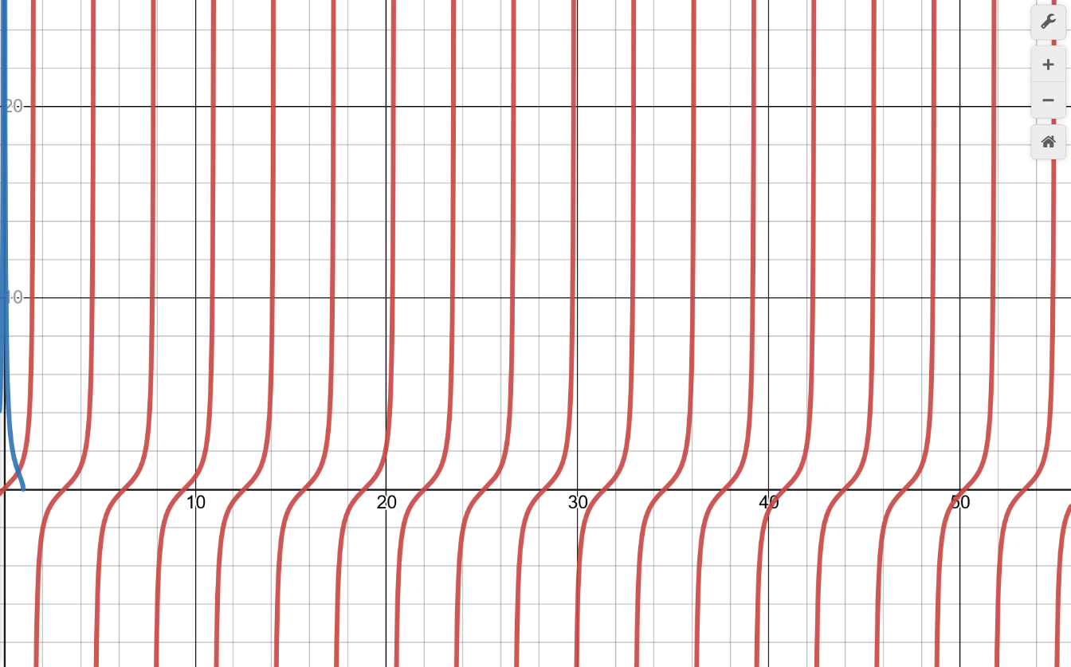
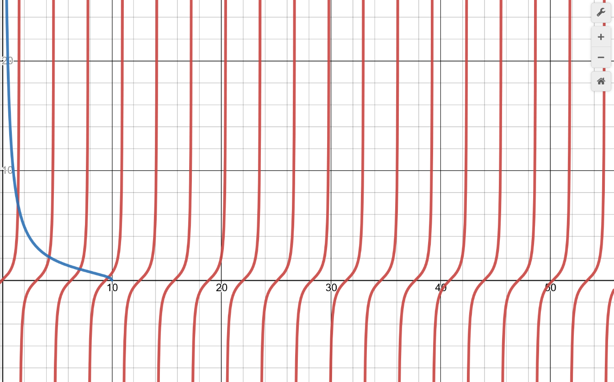

Slide 11
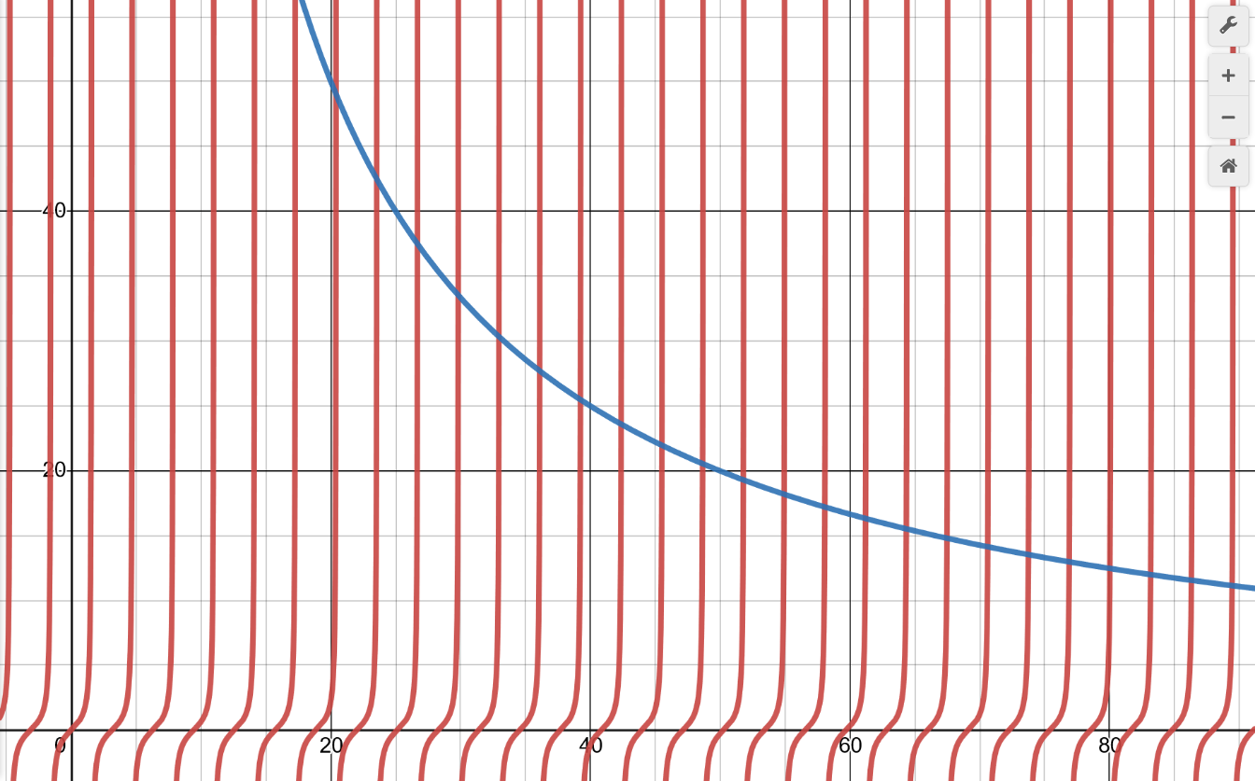
Larger z₀ means: wide, deep well

Slide 12
Wider, deeper well could accommodate more bound states

Slide 13
Larger z₀ means: wide, deep well

Slide 14
0

Slide 15
Will be only true for large values of z₀
Corresponds to the KE of particle in a box!

Slide 16
Try the even function yourself
Hint:

Slide 17
Wider, deeper well could accommodate more bound states

Slide 18
What about shallow, narrow well?
As z₀ decreases, there are fewer and fewer bound states, until finally only one remains!
There is always minimum one bound state, no matter how weak is the well!

Slide 19
intersection point
0
90
There is always minimum one bound state, no matter how weak is the well!

Slide 20
1D Harmonic Oscillator

Slide 21
Schrodinger equation for 1D Harmonic Oscillator
V

Slide 22
Many constants
Will introduce another constant α which absorbs all these constants and get a nicer form

Slide 23
Let’s choose

Slide 24
After simplifying
Asymptotic solution

Slide 25
What about for smaller values of ζ?

Slide 26
Substituting and simplifying we get

Slide 27
Polynomial solution
Hermite Polynomial

