Slide 1
EP3203 Atomic and Molecular Physics
3-1-2-5
Syllabus
Recap of Atomic physics experiments: a historical overview and recap of Quantum Physics, One electron atom and its representation example Alkali atoms: Rubidium as a case study, Fine structure and Hyperfine structure of alkali atoms, Zeeman effect , Fine, hyperfine and Zeeman spectroscopy, doppler broadening of spectral lines, saturation absorption spectroscopy, applications of atomic physics in experiments, Interaction of one electron atoms with electromagnetic radiation, electric field polarizations, electric dipole selection rules, Spectrum of one electron atoms like alkali gas in the presence of magnetic fields, Line intensities and the life time of the excited states, Line shapes and widths. Many electron atoms: L-S coupling , Hartree- Fock method and the SCF, Molecular structure, Born-Oppenheimer approximation, Electronic structure of diatomic molecule, Electronic, Rotational,
Vibrational and Vibration-Rotation Spectra of diatomic molecules
Additional Topics: Atomic Physics and Quantum Memory for Quantum Communication.
Suggested Readings:
Textbooks: • B.H. Bransden and C.J. Joachain, Physics of Atoms and Molecules,
Longman Scientific and Technical, 1983.
• Gordon W and F. Drake, Springer Handbook of Atomic, Molecular,
and Optical Physics, Springer, 2006.
• W. Demtroder, Atoms, Molecules and Photons, Springer, 2010.
• H. Haken and H.C. Wolf, Physics of Atoms and Quanta, Springer, 2005.
• H. E. White, Introduction to Atomic Spectra, McGraw Hill, 2019
• G. K. Woodgate, Elementary Atomic Structure, 2nd Ed., Clerenton Press, Oxford, 2002
• M. Karplus and R. N. Porter, Atoms and Molecules: An Introduction for Students of Physical Chemistry
References:
• Ira N. Levine, Quantum Chemistry, 6th Edition, PHI Learning Private Limited, New Delhi, 2009.
• John P. Lowe and Kirk A. Peterson, Quantum Chemistry, 3rd Edition, Academic Press, 2009.
• Peter Atkins and Ronald Friedman, 4thEdition, Oxford Univ. Press, 2012.
• Collin N. Banwell and Elain M. Mc Cash, Fundamentals of Molecular Spectroscopy, 4thEdition, Tata McGraw Hills, 2008.

Slide 2

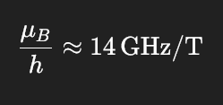
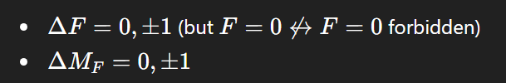
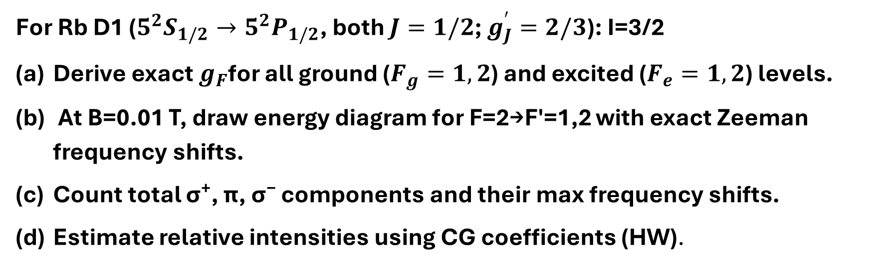
For Rb D1 ($5^{2}S_{1/2}→5^{2}P_{1/2}$, both $J=1/2$; $g_{J}^{′}=2/3$): I=3/2
Derive exact $g_{F}$for all ground ($F_{g}=1,2$) and excited ($F_{e}=1,2$) levels.
At B=0.01 T, draw energy diagram for F=2→F'=1,2 with exact Zeeman frequency shifts.
Count total σ⁺, π, σ⁻ components and their max frequency shifts.
Estimate relative intensities using CG coefficients (HW).

Slide 3
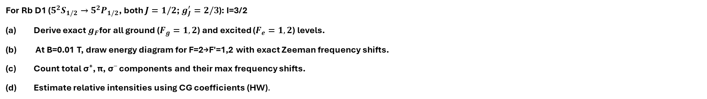
For Rb D1 ($5^{2}S_{1/2}→5^{2}P_{1/2}$, both $J=1/2$; $g_{J}^{′}=2/3$): I=3/2
Derive exact $g_{F}$for all ground ($F_{g}=1,2$) and excited ($F_{e}=1,2$) levels.
At B=0.01 T, draw energy diagram for F=2→F'=1,2 with exact Zeeman frequency shifts.
Count total σ⁺, π, σ⁻ components and their max frequency shifts.
Estimate relative intensities using CG coefficients (HW).

Slide 4
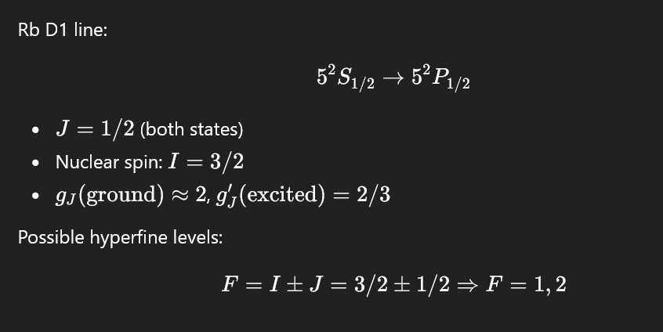

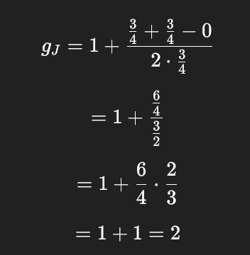
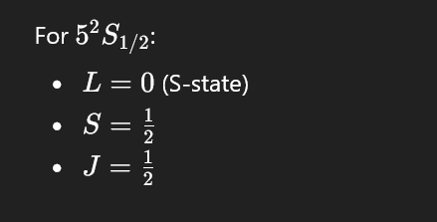
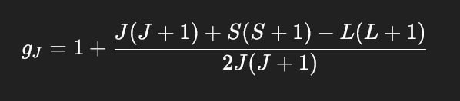
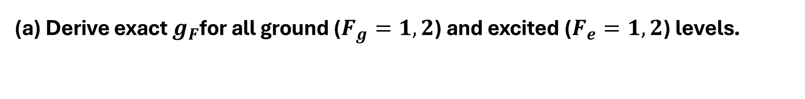
(a) Derive exact $g_{F}$for all ground ($F_{g}=1,2$) and excited ($F_{e}=1,2$) levels.
Computing gJ for ground state

Slide 5
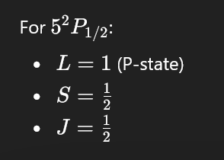
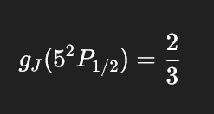
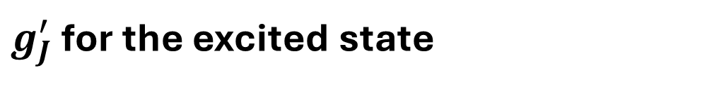
$g_{J}^{′}$ for the excited state

Slide 6
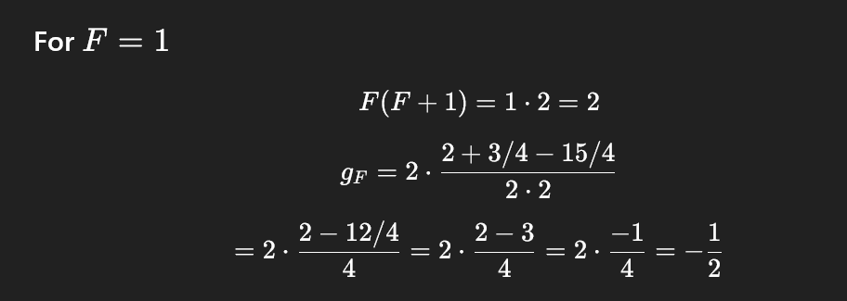
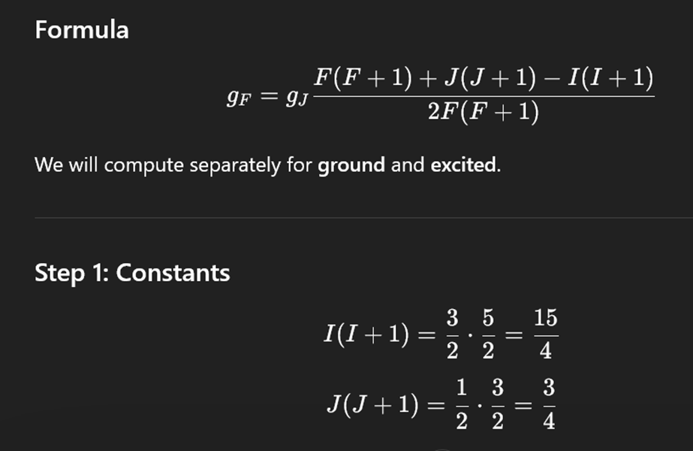
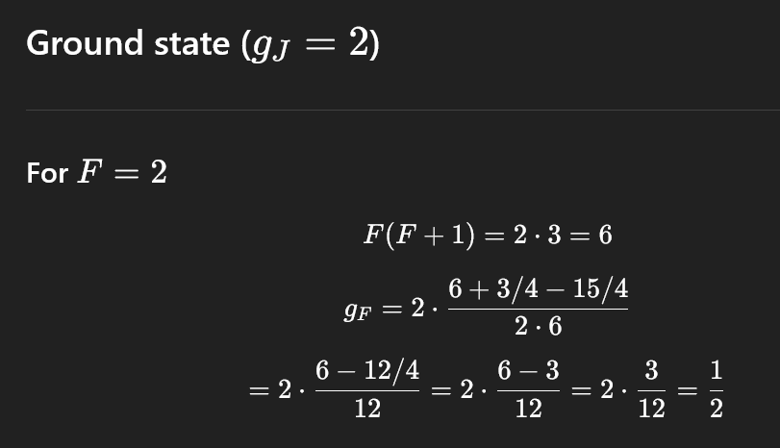
Computing g_{F} for F = 1 state
Computing g_{F} for F = 2 state

Slide 7
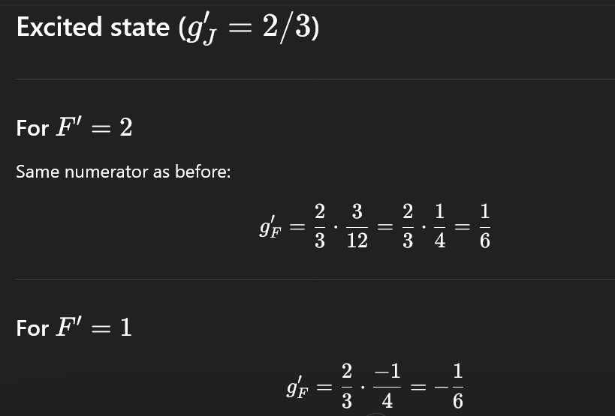
Computing g_{F’} for excited states 5P_{1/2} F’=1 and F’ = 2 state

Slide 8
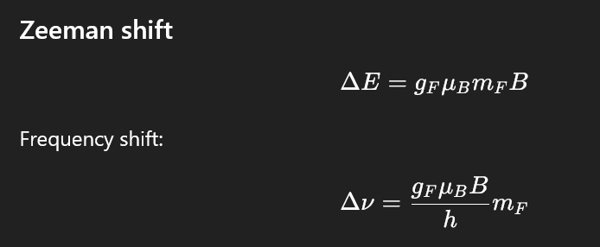
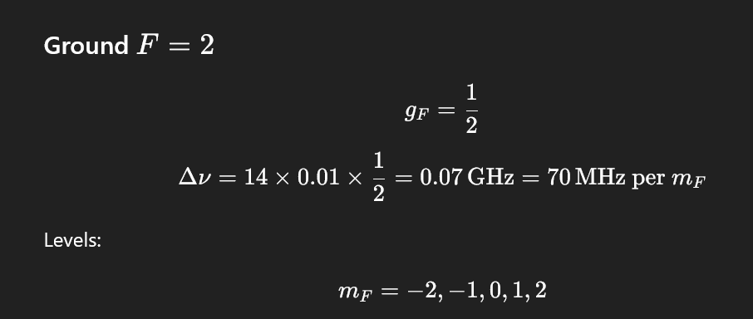
(b). At B=0.01 T, draw energy diagram for F=2→F'=1,2 with exact Zeeman frequency shifts.

Slide 9
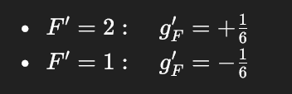
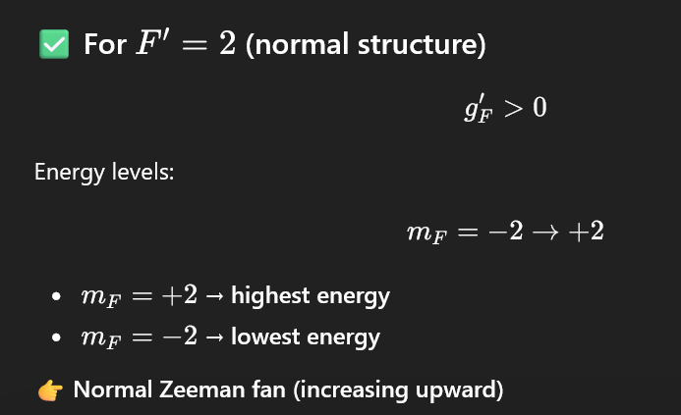
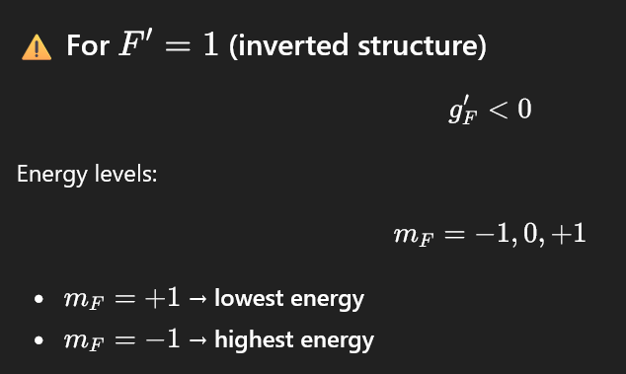

Slide 10
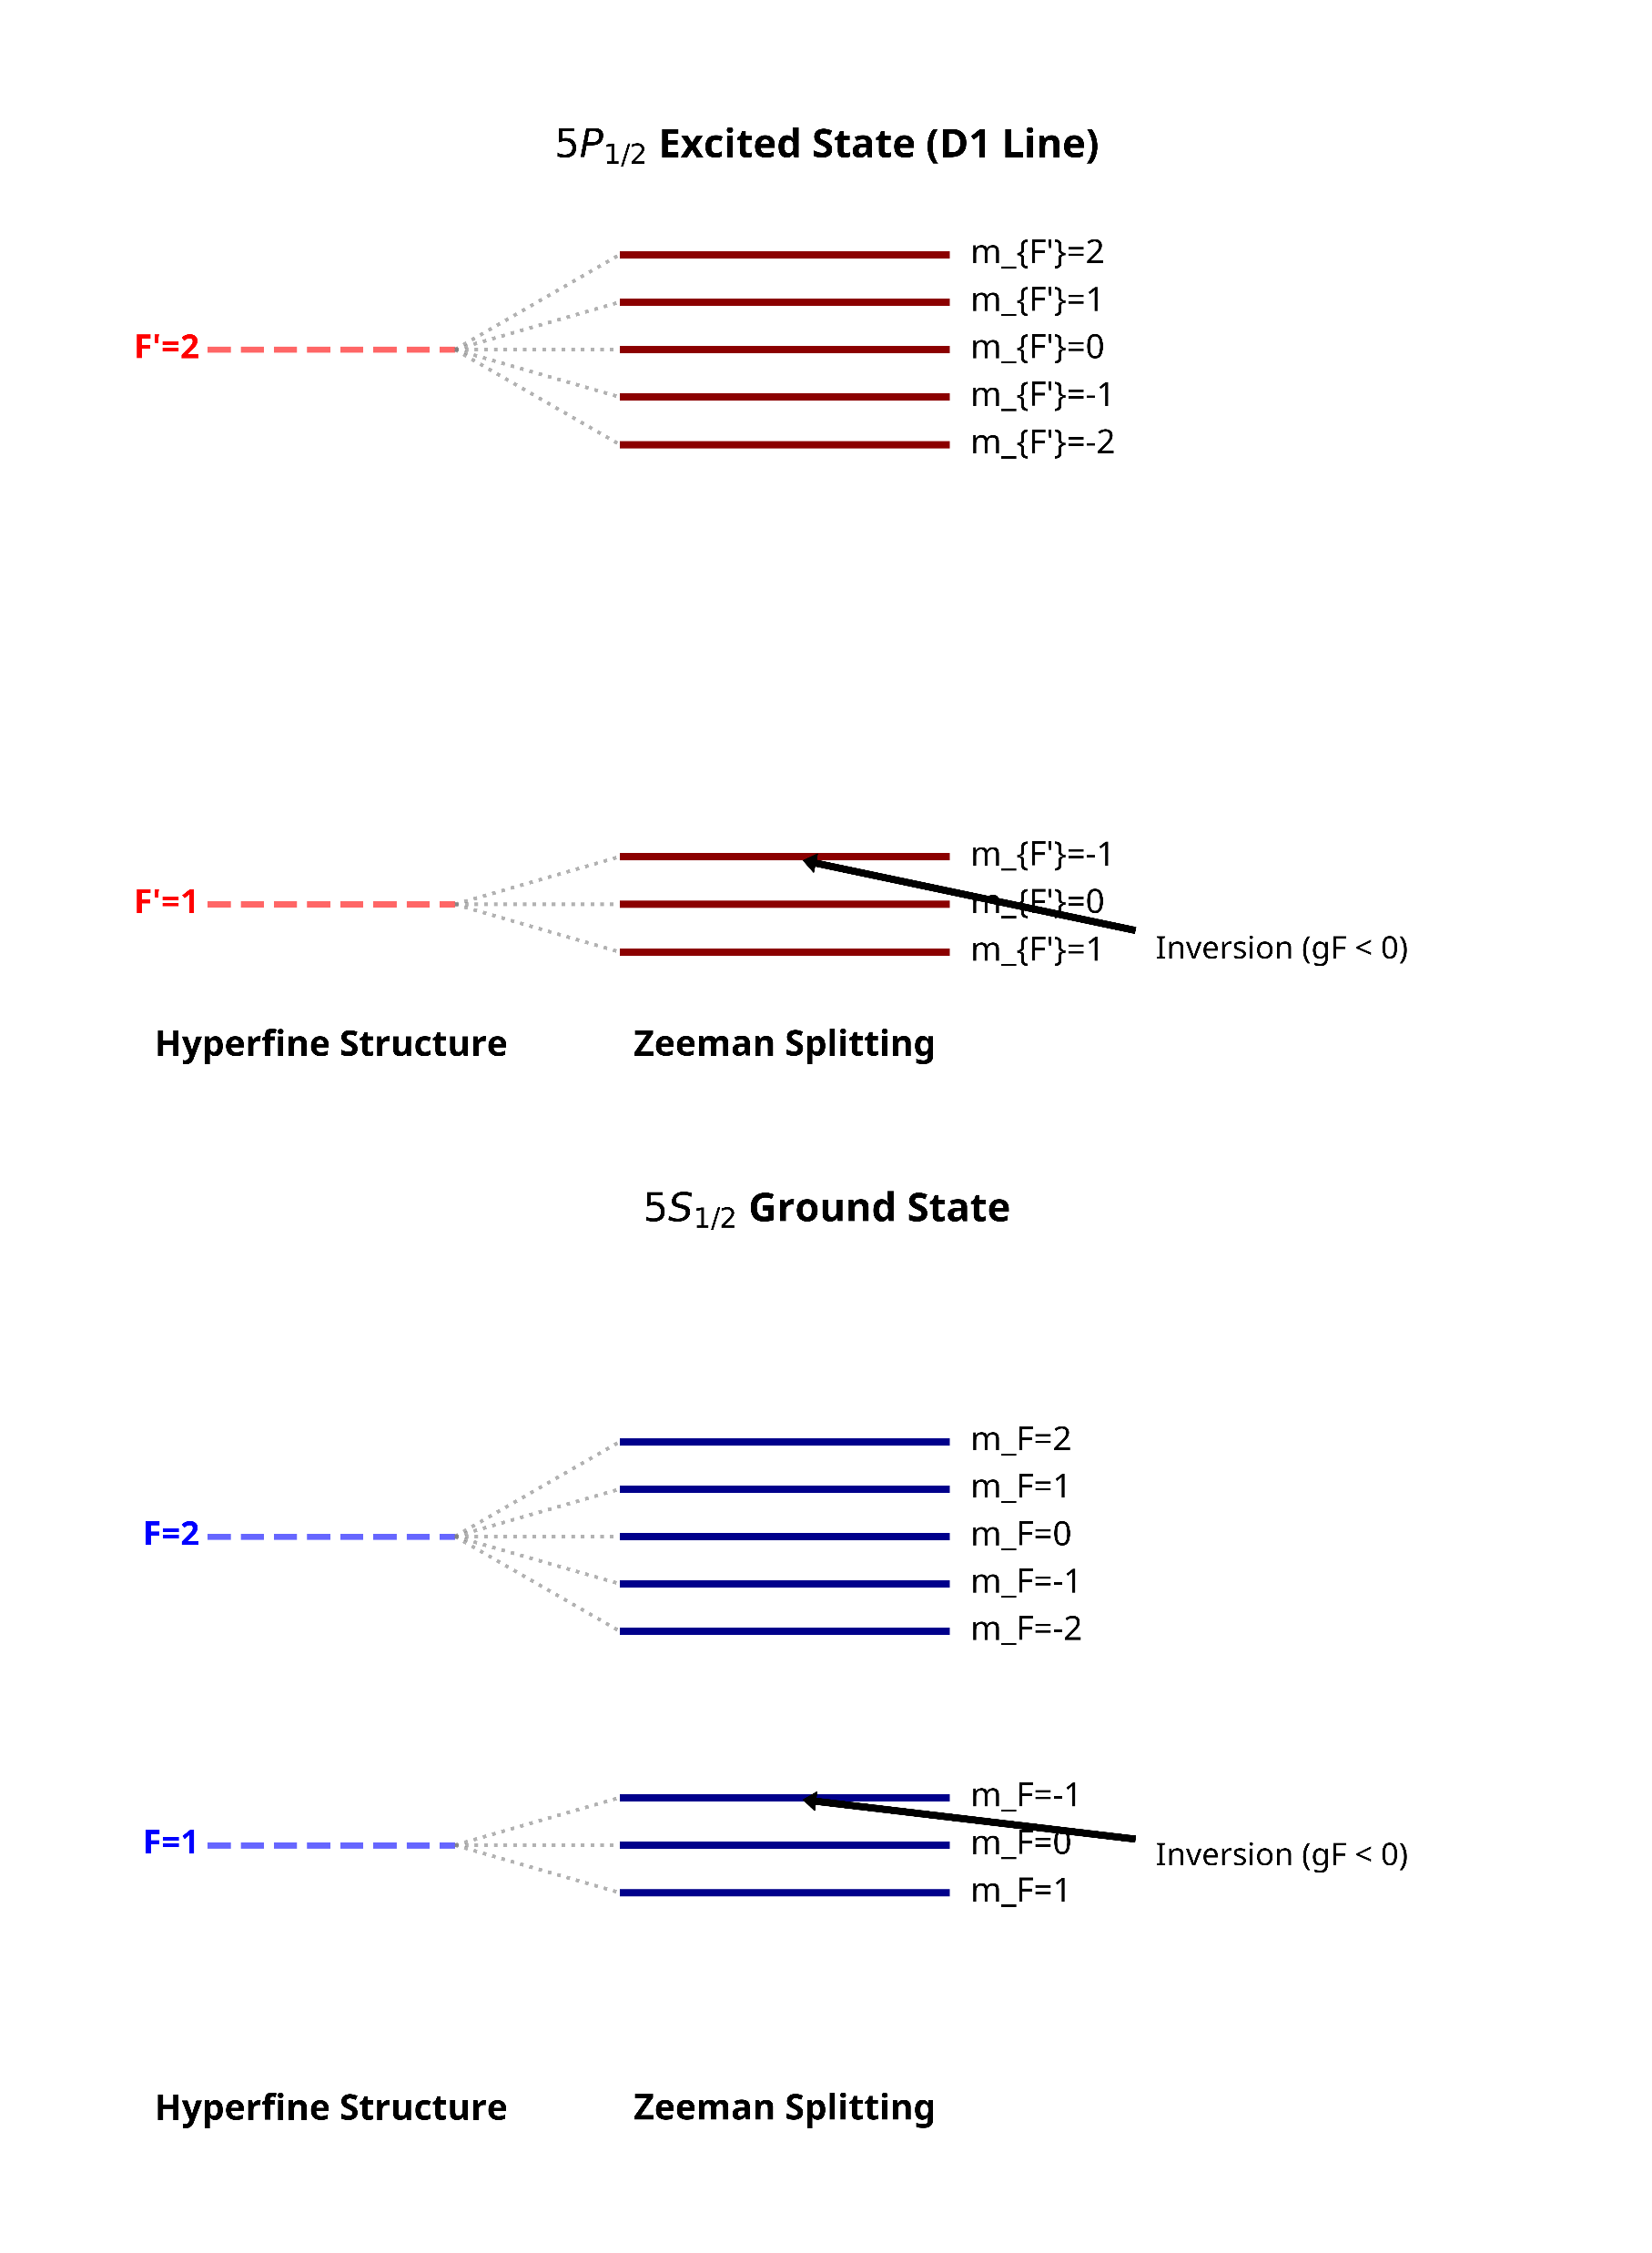

Slide 11
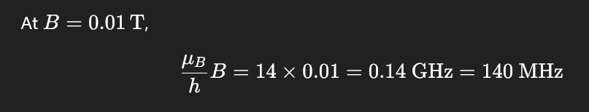
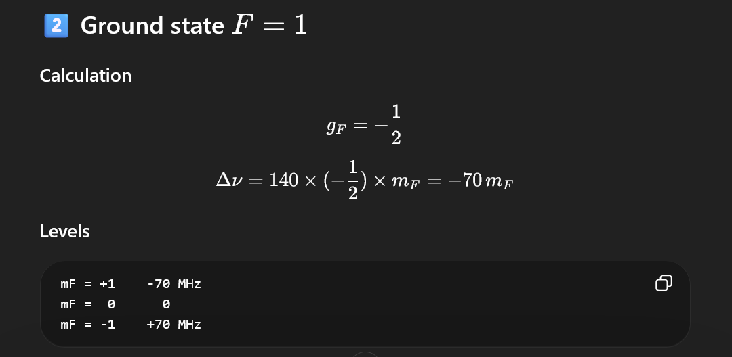

Slide 12
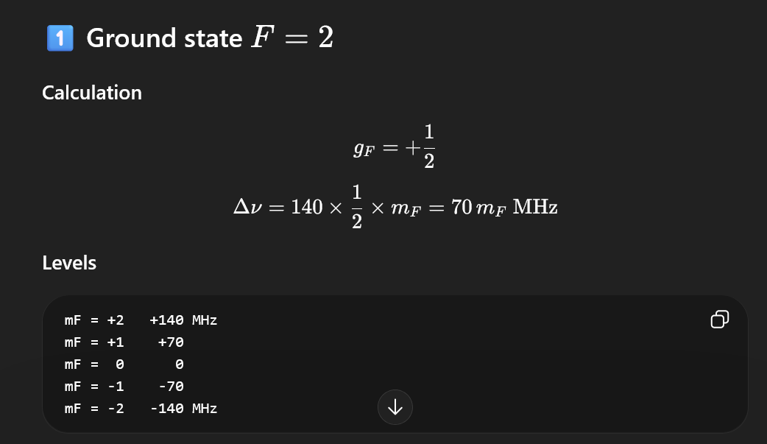

Slide 13
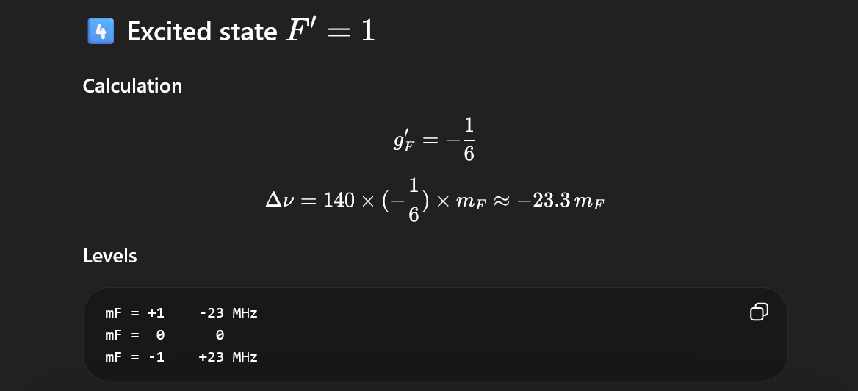

Slide 14
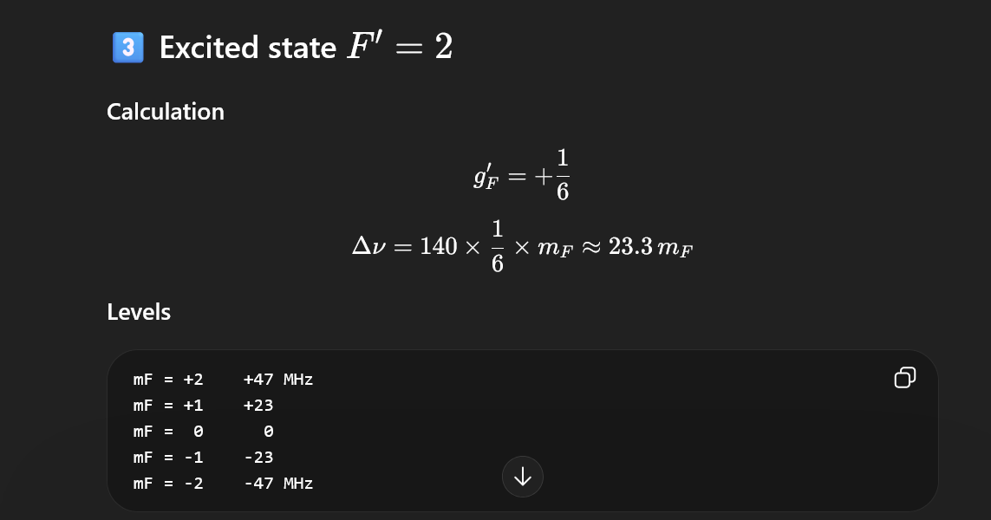

Slide 15
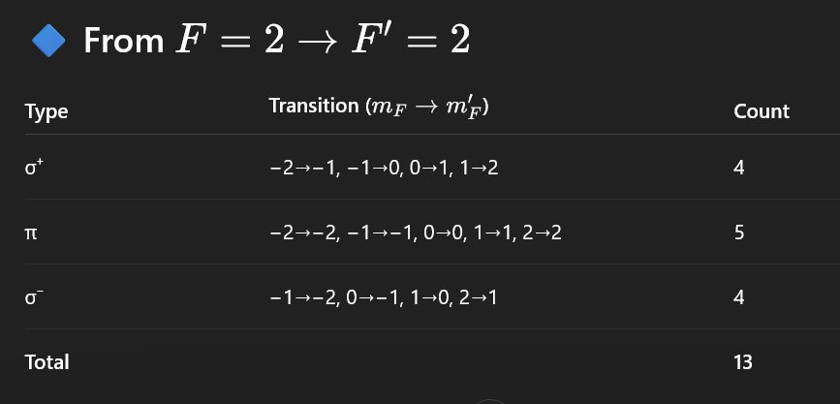
(c)Count total σ⁺, π, σ⁻ components and their max frequency shifts.

Slide 16
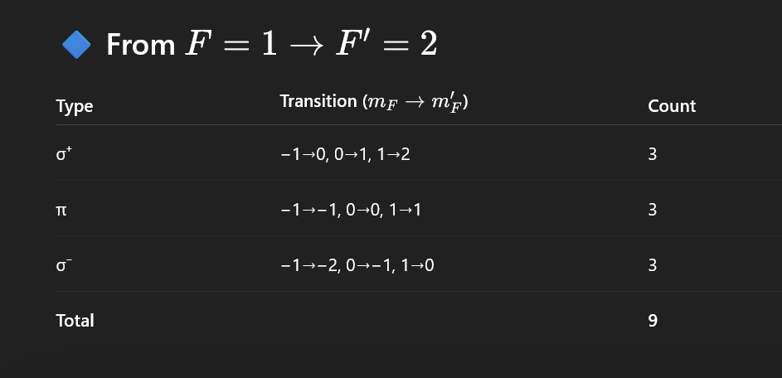

Slide 17
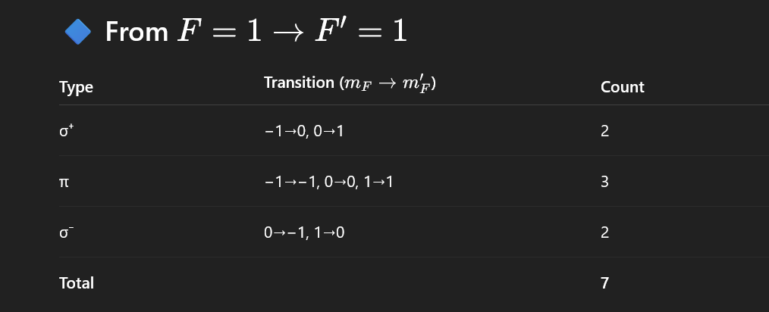

Slide 18


Slide 19
(d) Estimate relative intensities using CG coefficients (HW).
I∝CG²
F → F′ | mF | σ⁺ (mF′, CG²) | π (mF′, CG²) | σ⁻ (mF′, CG²)
2 → 2 | -2 | -1, 1/5 | -2, 4/5 | —
2 → 2 | -1 | 0, 2/5 | -1, 3/5 | -2, 4/5
2 → 2 | 0 | 1, 3/5 | 0, 2/5 | -1, 3/5
2 → 2 | 1 | 2, 4/5 | 1, 3/5 | 0, 2/5
2 → 2 | 2 | — | 2, 4/5 | 1, 1/5
-------- | ---- | -------------- | -------------- | --------------
2 → 1 | -2 | -1, 4/15 | — | —
2 → 1 | -1 | 0, 3/15 | -1, 1/5 | —
2 → 1 | 0 | 1, 2/15 | 0, 2/5 | -1, 2/15
2 → 1 | 1 | — | 1, 1/5 | 0, 3/15
2 → 1 | 2 | — | — | 1, 4/15
-------- | ---- | -------------- | -------------- | --------------
1 → 2 | -1 | 0, 2/15 | -1, 1/5 | -2, 4/15
1 → 2 | 0 | 1, 3/15 | 0, 2/5 | -1, 3/15
1 → 2 | 1 | 2, 4/15 | 1, 1/5 | 0, 2/15
-------- | ---- | -------------- | -------------- | --------------
1 → 1 | -1 | 0, 1/2 | -1, 1/2 | —
1 → 1 | 0 | 1, 1/2 | — | -1, 1/2
1 → 1 | 1 | — | 1, 1/2 | 0, 1/2

Slide 20
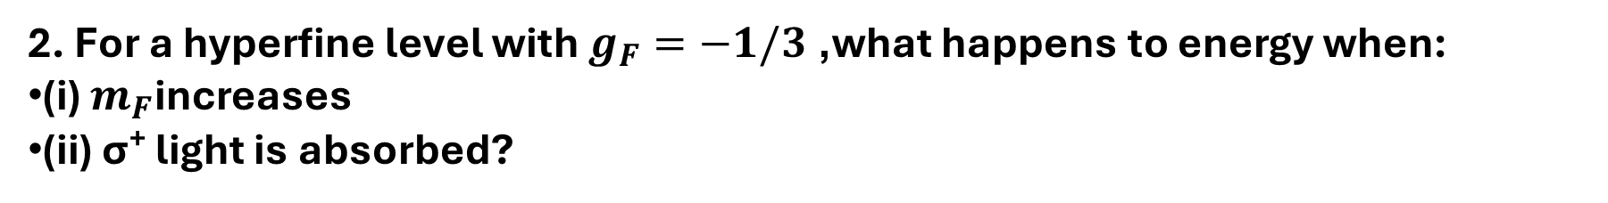
2. For a hyperfine level with $g_{F}=−1/3$, what happens to energy when:
(i) $m_{F}$increases
(ii) σ⁺ light is absorbed?

Slide 21
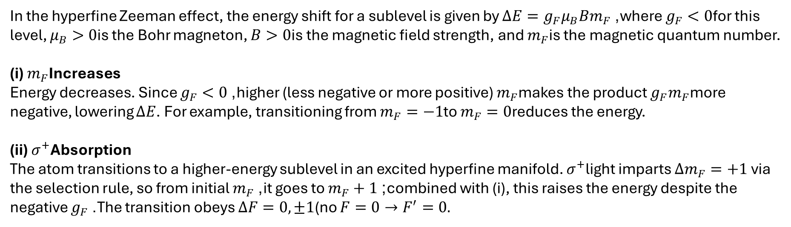
2. For a hyperfine level with $g_{F}=−1/3$, what happens to energy when:
(i) $m_{F}$increases
(ii) σ⁺ light is absorbed?
In the hyperfine Zeeman effect, the energy shift for a sublevel is given by $ΔE=g_{F}μ_{B}Bm_{F}$, where $g_{F}<0$for this level, $μ_{B}>0$is the Bohr magneton, $B>0$is the magnetic field strength, and $m_{F}$is the magnetic quantum number.
(i) $m_{F}$Increases
Energy decreases. Since $g_{F}<0$, higher (less negative or more positive) $m_{F}$makes the product $g_{F}m_{F}$more negative, lowering $ΔE$. For example, transitioning from $m_{F}=−1$to $m_{F}=0$reduces the energy.
(ii) $σ^{+}$Absorption
The atom transitions to a higher-energy sublevel in an excited hyperfine manifold. $σ^{+}$light imparts $Δm_{F}=+1$ via the selection rule, so from initial $m_{F}$, it goes to $m_{F}+1$; combined with (i), this raises the energy despite the negative $g_{F}$. The transition obeys $ΔF=0,±1$(no $F=0→F^{′}=0.$

Slide 22
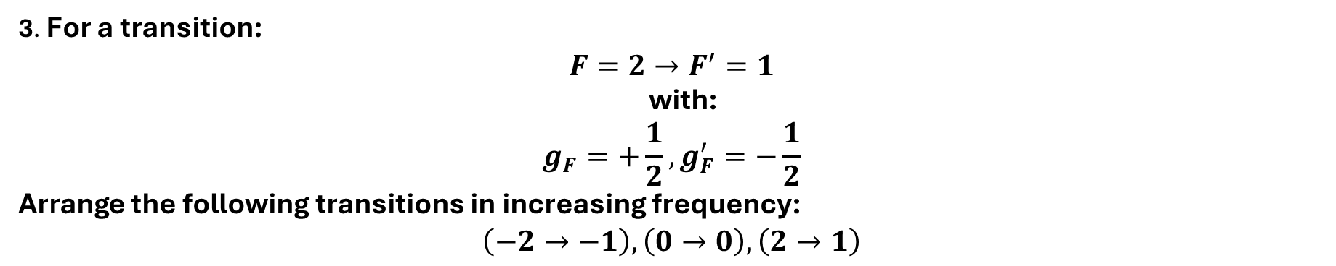
3. For a transition:
$$F=2→F^{′}=1$$
with:
$$g_{F}=+\frac{1}{2}, g_{F}^{′}=−\frac{1}{2}$$
Arrange the following transitions in increasing frequency:
$$\left(−2→−1\right), \left(0→0\right), \left(2→1\right)$$

Slide 23
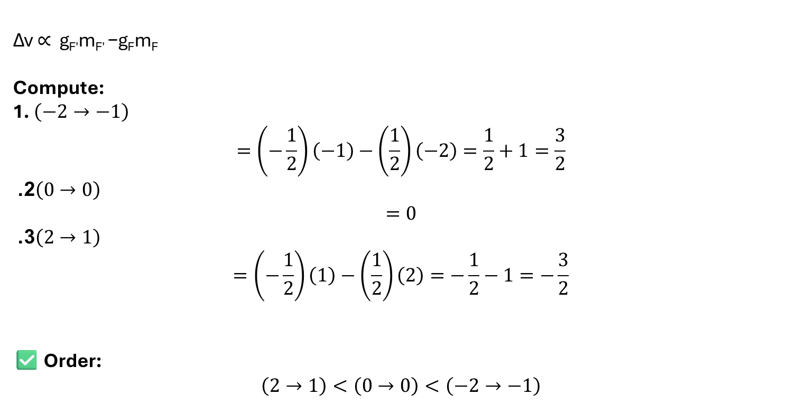
3. For a transition:
$$F=2→F^{′}=1$$
with:
$$g_{F}=+\frac{1}{2}, g_{F}^{′}=−\frac{1}{2}$$
Arrange the following transitions in increasing frequency:
$$\left(−2→−1\right), \left(0→0\right), \left(2→1\right)$$
Δν ∝ g_{F′​}m_{F′} ​−g_{F​}m_{F​}
Compute:
1. $\left(−2→−1\right)$
$$=\left(−\frac{1}{2}\right)\left(−1\right)−\left(\frac{1}{2}\right)\left(−2\right)=\frac{1}{2}+1=\frac{3}{2}$$
2. $\left(0→0\right)$
$$=0$$
3. $\left(2→1\right)$
$$=\left(−\frac{1}{2}\right)\left(1\right)−\left(\frac{1}{2}\right)\left(2\right)=−\frac{1}{2}−1=−\frac{3}{2}$$
✅ Order:
$$\left(2→1\right)<\left(0→0\right)<\left(−2→−1\right)$$

Slide 24
4. When Do σ⁺ and σ⁻ Overlap? Find condition on g_{F}, g_{F′} ​
such that: σ⁺ and σ⁻ transitions have same frequency σ⁺ and σ⁻ transitions have same frequency

Slide 25
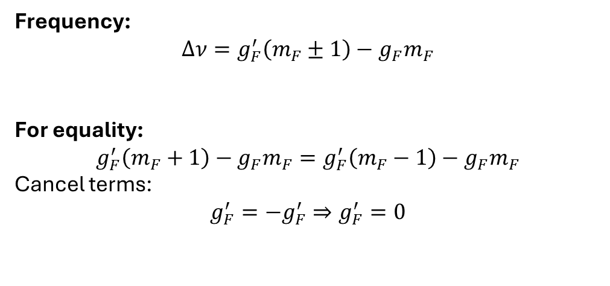
4. When Do σ⁺ and σ⁻ Overlap? Find condition on g_{F}, g_{F′} ​
such that: σ⁺ and σ⁻ transitions have same frequency σ⁺ and σ⁻ transitions have same frequency
Frequency:
$$Δν=g_{F}^{′}\left(m_{F}±1\right)−g_{F}m_{F}$$
For equality:
$$g_{F}^{′}\left(m_{F}+1\right)−g_{F}m_{F}=g_{F}^{′}\left(m_{F}−1\right)−g_{F}m_{F}$$
Cancel terms:
$$g_{F}^{′}=−g_{F}^{′}⇒g_{F}^{′}=0$$

Slide 26
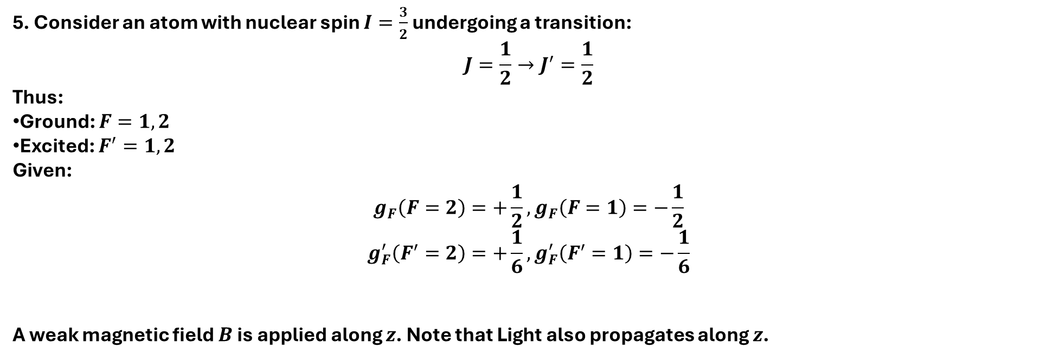
5. Consider an atom with nuclear spin $I=\frac{3}{2}$ undergoing a transition:
$$J=\frac{1}{2}→J^{′}=\frac{1}{2}$$
Thus:
Ground: $F=1,2$
Excited: $F^{′}=1,2$
Given:
$$g_{F}\left(F=2\right)=+\frac{1}{2}, g_{F}\left(F=1\right)=−\frac{1}{2}$$
$$g_{F}^{′}\left(F^{′}=2\right)=+\frac{1}{6}, g_{F}^{′}\left(F^{′}=1\right)=−\frac{1}{6}$$
A weak magnetic field $B$ is applied along $z$. Note that Light also propagates along $z$.
Which transitions are completely absent (dark) in this geometry using a diagram?
Revisit (a) considering the spin angular momentum part of circular polarization
(b) Find all transitions (if any) whose Zeeman shift is independent of magnetic field.
(c) Is it possible for two different transitions pairs to have the same frequency shift?
If yes, give possible examples.
(d)Among all allowed transitions, identify the one with maximum positive frequency shift.

Slide 27
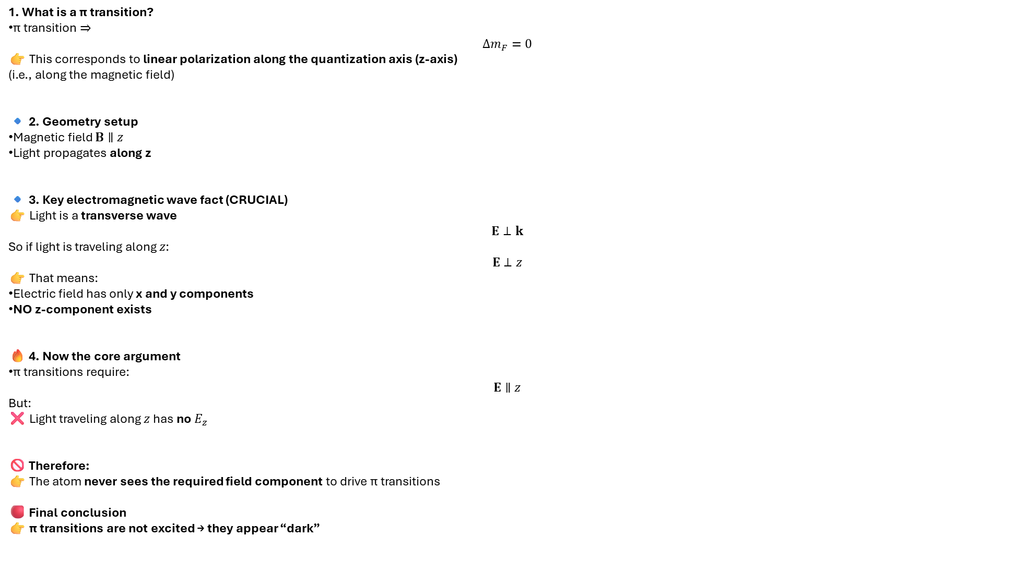
1. What is a π transition?
π transition ⇒
$$Δm_{F}=0$$
👉 This corresponds to linear polarization along the quantization axis (z-axis)
(i.e., along the magnetic field)
🔹 2. Geometry setup
Magnetic field $B∥z$
Light propagates along z
🔹 3. Key electromagnetic wave fact (CRUCIAL)
👉 Light is a transverse wave
$$E⊥k$$
So if light is traveling along $z$:
$$E⊥z$$
👉 That means:
Electric field has only x and y components
NO z-component exists
🔥 4. Now the core argument
π transitions require:
$$E∥z$$
But:
❌ Light traveling along $z$has no $E_{z}$
🚫 Therefore:
👉 The atom never sees the required field component to drive π transitions
🔴 Final conclusion
👉 π transitions are not excited → they appear “dark”

Slide 28
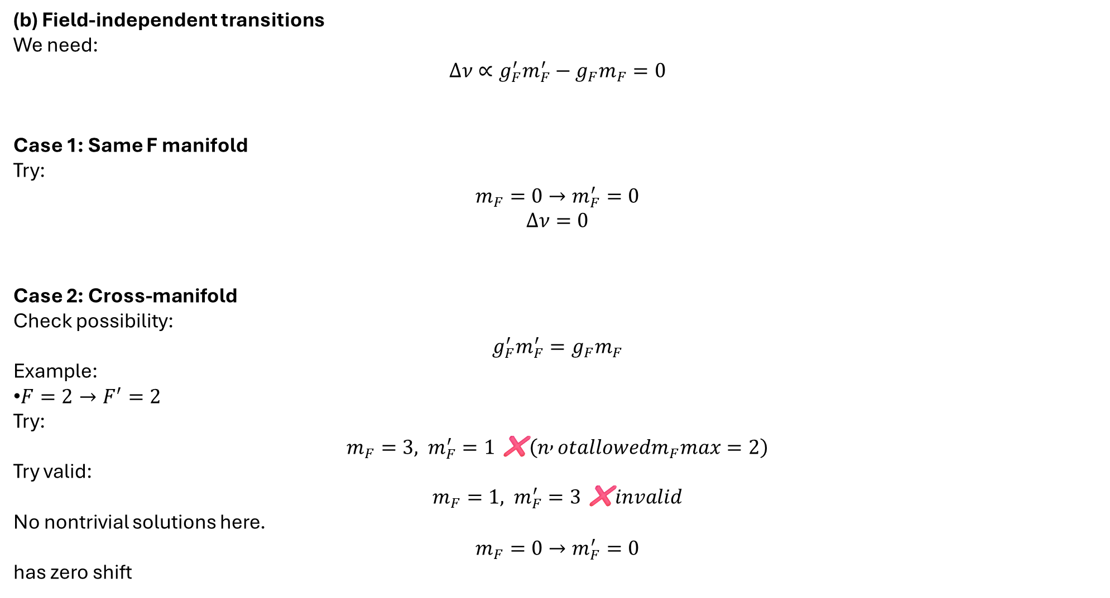
(b) Field-independent transitions
We need:
$$Δν∝g_{F}^{′}m_{F}^{′}−g_{F}m_{F}=0$$
Case 1: Same F manifold
Try:
$$m_{F}=0→m_{F}^{′}=0$$
$$Δν=0$$
Case 2: Cross-manifold
Check possibility:
$$g_{F}^{′}m_{F}^{′}=g_{F}m_{F}$$
Example:
$F=2→F^{′}=2$
Try:
$$m_{F}=3, m_{F}^{′}=1 \text{❌}\left(n , otallowedm_{F}max=2\right)$$
Try valid:
$$m_{F}=1, m_{F}^{′}=3 \text{❌}invalid$$
No nontrivial solutions here.
$$m_{F}=0→m_{F}^{′}=0$$
has zero shift

Slide 29
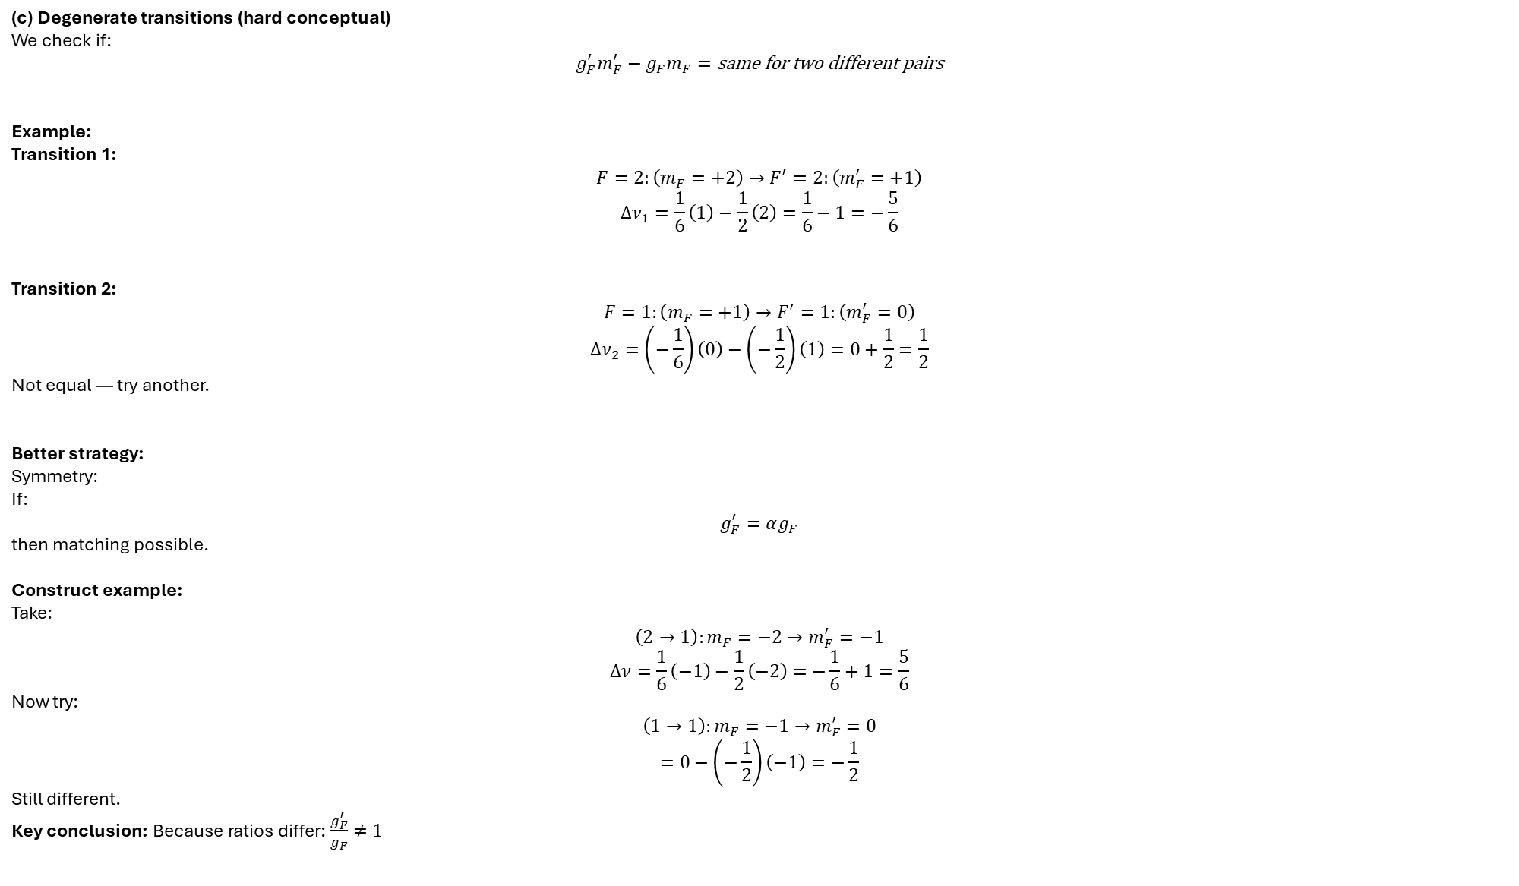
(c) Degenerate transitions (hard conceptual)
We check if:
$$g_{F}^{′}m_{F}^{′}−g_{F}m_{F}=\text{same for two different pairs}$$
Example:
Transition 1:
$$F=2:\left(m_{F}=+2\right)→F^{′}=2:\left(m_{F}^{′}=+1\right)$$
$$Δν_{1}=\frac{1}{6}\left(1\right)−\frac{1}{2}\left(2\right)=\frac{1}{6}−1=−\frac{5}{6}$$
Transition 2:
$$F=1:\left(m_{F}=+1\right)→F^{′}=1:\left(m_{F}^{′}=0\right)$$
$$Δν_{2}=\left(−\frac{1}{6}\right)\left(0\right)−\left(−\frac{1}{2}\right)\left(1\right)=0+\frac{1}{2}=\frac{1}{2}$$
Not equal — try another.
Better strategy:
Symmetry:
If:
$$g_{F}^{′}=αg_{F}$$
then matching possible.
Construct example:
Take:
$$\left(2→1\right):m_{F}=−2→m_{F}^{′}=−1$$
$$Δν=\frac{1}{6}\left(−1\right)−\frac{1}{2}\left(−2\right)=−\frac{1}{6}+1=\frac{5}{6}$$
Now try:
$$\left(1→1\right):m_{F}=−1→m_{F}^{′}=0$$
$$=0−\left(−\frac{1}{2}\right)\left(−1\right)=−\frac{1}{2}$$
Still different.
Key conclusion: Because ratios differ: $\frac{g_{F}^{′}}{g_{F}}≠1$

Slide 30
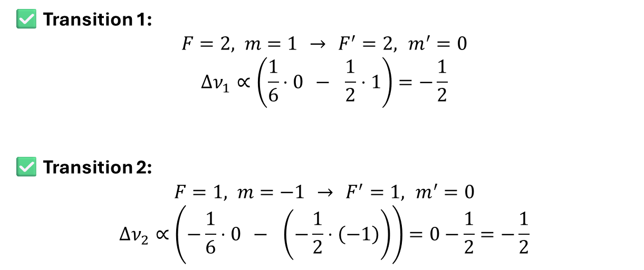
✅ Transition 1:
$$F=2, m=1 → F^{′}=2, m^{′}=0$$
$$Δν_{1}∝\left(\frac{1}{6}⋅0 − \frac{1}{2}⋅1\right)=−\frac{1}{2}$$
✅ Transition 2:
$$F=1, m=−1 → F^{′}=1, m^{′}=0$$
$$Δν_{2}∝\left(−\frac{1}{6}⋅0 − \left(−\frac{1}{2}⋅\left(−1\right)\right)\right)=0−\frac{1}{2}=−\frac{1}{2}$$

Slide 31
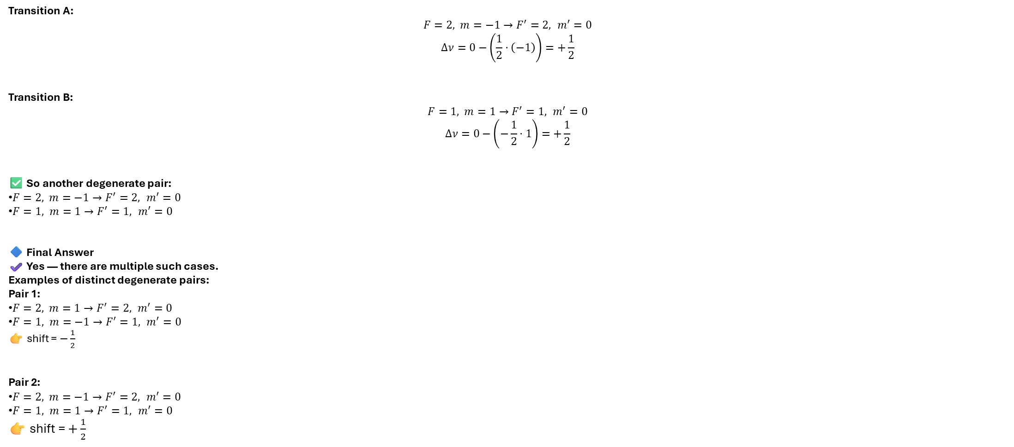
Transition A:
$$F=2, m=−1→F^{′}=2, m^{′}=0$$
$$Δν=0−\left(\frac{1}{2}⋅\left(−1\right)\right)=+\frac{1}{2}$$
Transition B:
$$F=1, m=1→F^{′}=1, m^{′}=0$$
$$Δν=0−\left(−\frac{1}{2}⋅1\right)=+\frac{1}{2}$$
✅ So another degenerate pair:
$F=2, m=−1→F^{′}=2, m^{′}=0$
$F=1, m=1→F^{′}=1, m^{′}=0$
🔷 Final Answer
✔️ Yes — there are multiple such cases.
Examples of distinct degenerate pairs:
Pair 1:
$F=2, m=1→F^{′}=2, m^{′}=0$
$F=1, m=−1→F^{′}=1, m^{′}=0$
👉 shift = $−\frac{1}{2}$
Pair 2:
$F=2, m=−1→F^{′}=2, m^{′}=0$
$F=1, m=1→F^{′}=1, m^{′}=0$
👉 shift = $+\frac{1}{2}$

Slide 32
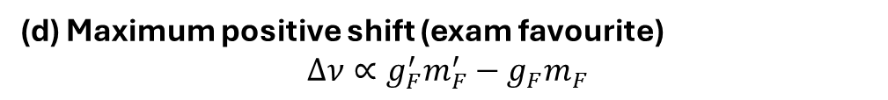
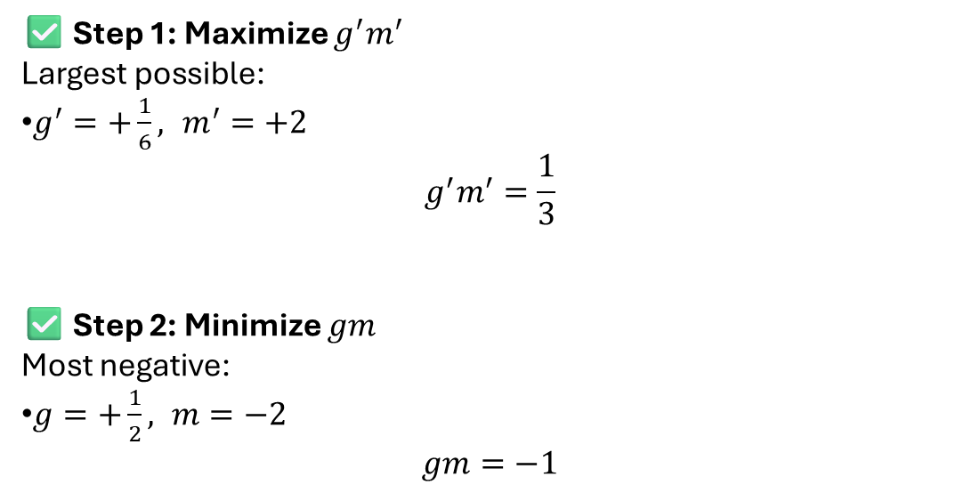
(d) Maximum positive shift (exam favourite)
$$Δν∝g_{F}^{′}m_{F}^{′}−g_{F}m_{F}$$
✅ Step 1: Maximize $g^{′}m^{′}$
Largest possible:
$g^{′}=+\frac{1}{6}, m^{′}=+2$
$$g^{′}m^{′}=\frac{1}{3}$$
✅ Step 2: Minimize $gm$
Most negative:
$g=+\frac{1}{2}, m=−2$
$$gm=−1$$

Slide 33

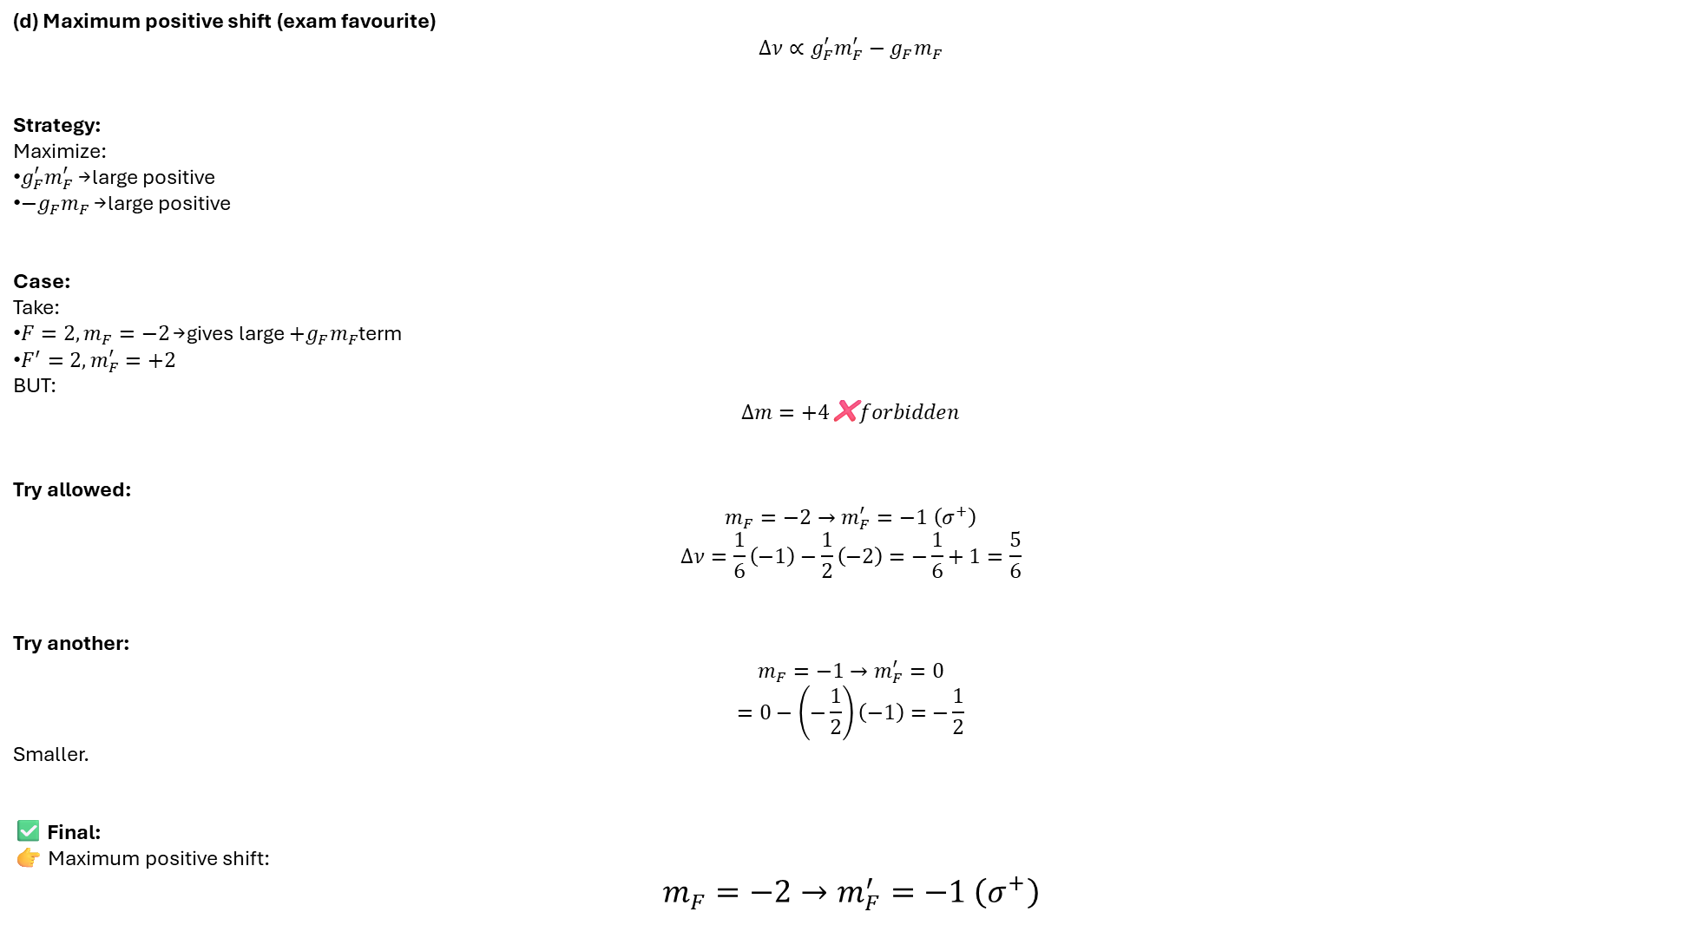
(d) Maximum positive shift (exam favourite)
$$Δν∝g_{F}^{′}m_{F}^{′}−g_{F}m_{F}$$
Strategy:
Maximize:
$g_{F}^{′}m_{F}^{′}$→ large positive
$−g_{F}m_{F}$→ large positive
Case:
Take:
$F=2,m_{F}=−2$→ gives large $+g_{F}m_{F}$term
$F^{′}=2,m_{F}^{′}=+2$
BUT:
$$Δm=+4\text{❌}forbidden$$
Try allowed:
$$m_{F}=−2→m_{F}^{′}=−1 \left(σ^{+}\right)$$
$$Δν=\frac{1}{6}\left(−1\right)−\frac{1}{2}\left(−2\right)=−\frac{1}{6}+1=\frac{5}{6}$$
Try another:
$$m_{F}=−1→m_{F}^{′}=0$$
$$=0−\left(−\frac{1}{2}\right)\left(−1\right)=−\frac{1}{2}$$
Smaller.
✅ Final:
👉 Maximum positive shift:
$$m_{F}=−2→m_{F}^{′}=−1 \left(σ^{+}\right)$$
Transition giving MAXIMUM positive shift
$$\boxed{F=2, m=−2 → F^{′}=2, m^{′}=−1}$$

Slide 34
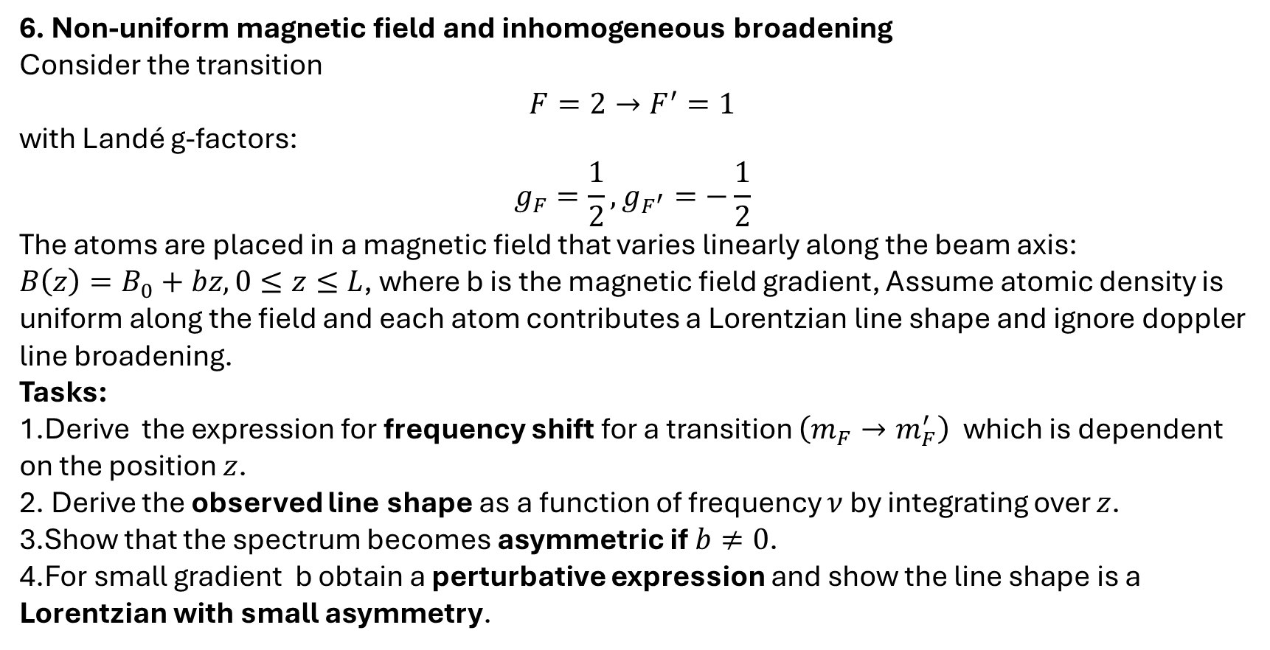
6. Non-uniform magnetic field and inhomogeneous broadening
Consider the transition
$$F=2→F^{′}=1$$
with Landé g-factors:
$$g_{F}=\frac{1}{2}, g_{F^{′}}=−\frac{1}{2}$$
The atoms are placed in a magnetic field that varies linearly along the beam axis:
$B\left(z\right)=B_{0}+bz, 0≤z≤L$, where b is the magnetic field gradient, Assume atomic density is uniform along the field and each atom contributes a Lorentzian line shape and ignore doppler line broadening.
Tasks:
Derive the expression for frequency shift for a transition $\left(m_{F}→m_{F}^{′}\right)$ which is dependent on the position $z$.
Derive the observed line shape as a function of frequency $ν$by integrating over $z$.
Show that the spectrum becomes asymmetric if $b≠0$.
For small gradient b obtain a perturbative expression and show the line shape is a Lorentzian with small asymmetry.

Slide 35
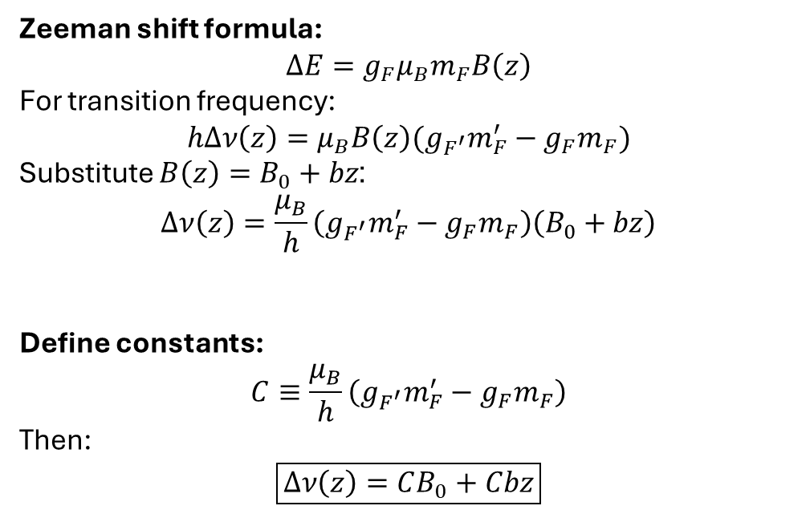
Zeeman shift formula:
$$ΔE=g_{F}μ_{B}m_{F}B\left(z\right)$$
For transition frequency:
$$hΔν\left(z\right)=μ_{B}B\left(z\right)(g_{F^{′}}m_{F}^{′}−g_{F}m_{F})$$
Substitute $B\left(z\right)=B_{0}+bz$:
$$Δν\left(z\right)=\frac{μ_{B}}{h}\left(g_{F^{′}}m_{F}^{′}−g_{F}m_{F}\right)\left(B_{0}+bz\right)$$
Define constants:
$$C≡\frac{μ_{B}}{h}\left(g_{F^{′}}m_{F}^{′}−g_{F}m_{F}\right)$$
Then:
$$\boxed{Δν\left(z\right)=CB_{0}+Cbz}$$

Slide 36
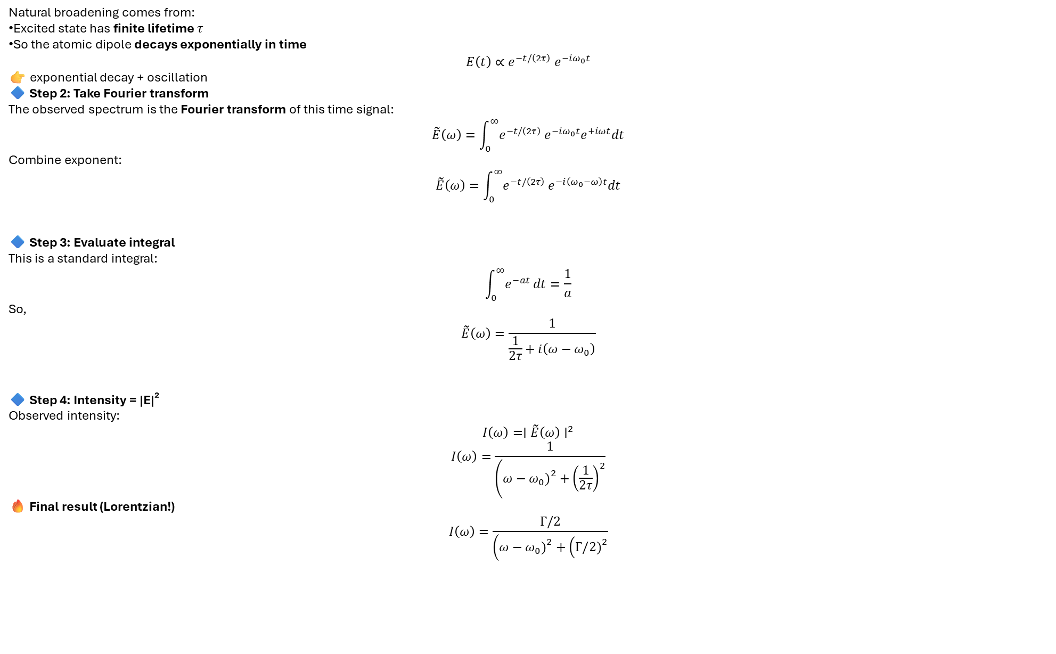
Natural broadening comes from:
Excited state has finite lifetime $τ$
So the atomic dipole decays exponentially in time
$$E\left(t\right)∝e^{−t/\left(2τ\right)} e^{−iω_{0}t}$$
👉 exponential decay + oscillation
🔷 Step 2: Take Fourier transform
The observed spectrum is the Fourier transform of this time signal:
$$\tilde{E}\left(ω\right)=\int_{0}^{∞}{e^{−t/\left(2τ\right)}}e^{−iω_{0}t}e^{+iωt}dt$$
Combine exponent:
$$\tilde{E}\left(ω\right)=\int_{0}^{∞}{e^{−t/\left(2τ\right)}}e^{−i\left(ω_{0}−ω\right)t}dt$$
🔷 Step 3: Evaluate integral
This is a standard integral:
$$\int_{0}^{∞}{e^{−at}}dt=\frac{1}{a}$$
So,
$$\tilde{E}\left(ω\right)=\frac{1}{\frac{1}{2τ}+i\left(ω−ω_{0}\right)}$$
🔷 Step 4: Intensity = |E|²
Observed intensity:
$$I\left(ω\right)=∣\tilde{E}\left(ω\right)∣^{2}$$
$$I\left(ω\right)=\frac{1}{\left(ω−ω_{0}{\left.)\right.}^{2}+{\left(\frac{1}{2τ}\right)}^{2}\right.}$$
🔥 Final result (Lorentzian!)
$$I\left(ω\right)=\frac{Γ/2}{\left(ω−ω_{0}{\left.)\right.}^{2}+\left(Γ/2{\left.)\right.}^{2}\right.\right.}$$

Slide 37
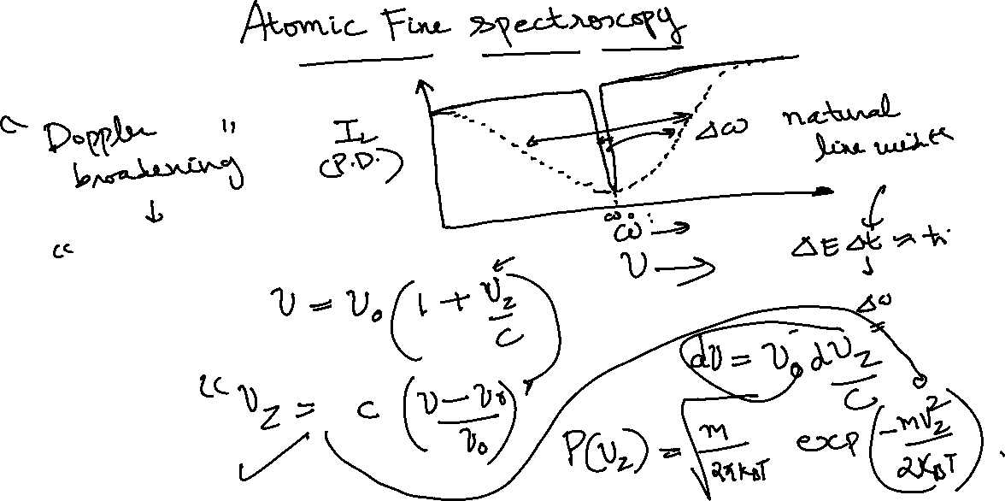

Slide 38
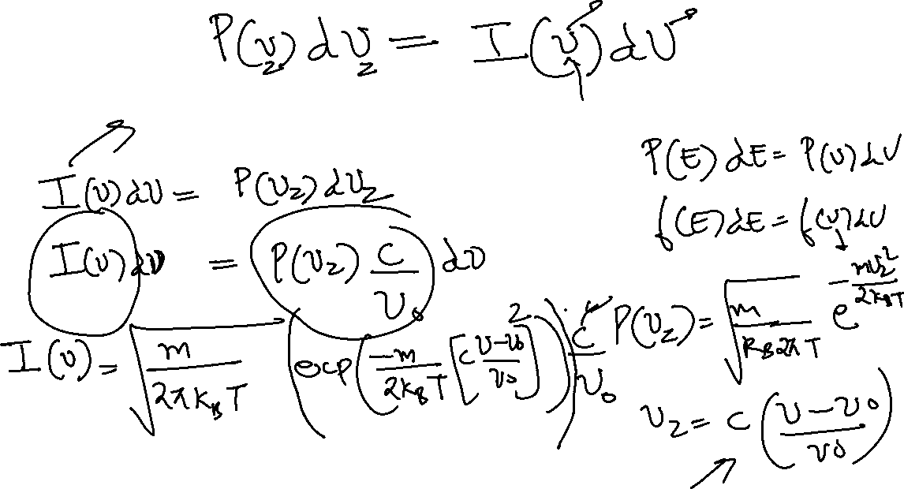

Slide 39
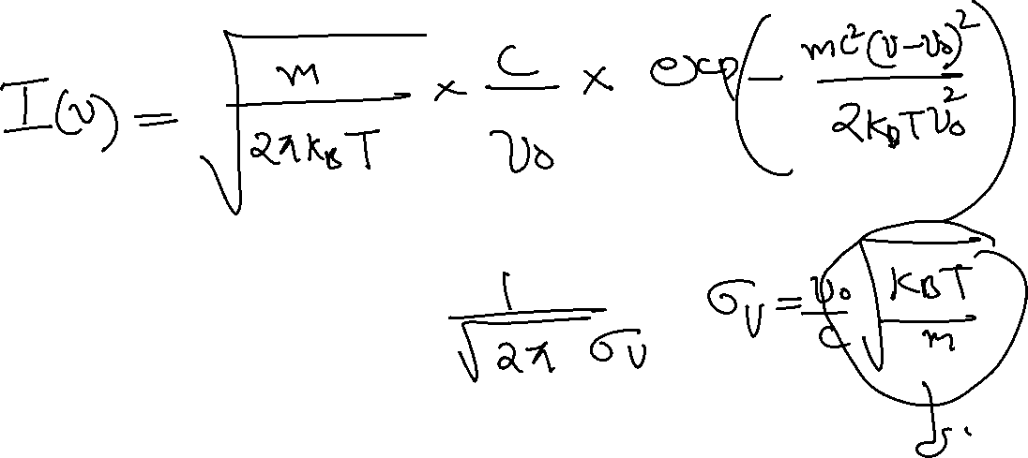

Slide 40


Slide 41

Each atom contributes a Lorentzian profile:
$$I\left(ν , z\right)=\frac{1}{\left(ν−ν_{0}−Δν\left(z\right){\left.)\right.}^{2}+\left(Γ/2{\left.)\right.}^{2})\right.\right.}$$
Total observed intensity:
$$I\left(ν\right)=\int_{0}^{L}{\frac{dz}{\left(ν−ν_{0}−CB_{0}−Cbz{\left.)\right.}^{2}+\left(Γ/2{\left.)\right.}^{2})\right.\right.}}$$
Change variable:
Let:
$$x=ν−ν_{0}−CB_{0}−Cbz$$
Then:
$$dx=−Cb dz$$
Limits:
$z=0⇒x_{1}=ν−ν_{0}−CB_{0}$
$z=L⇒x_{2}=ν−ν_{0}−CB_{0}−CbL$

Slide 42

Integral becomes:
$$I\left(ν\right)=\frac{1}{∣Cb∣}\int_{x_{2}}^{x_{1}}{\frac{dx}{x^{2}+\left(Γ/2{\left.)\right.}^{2}\right.}}$$
Standard integral:
$$\int{\frac{dx}{x^{2}+a^{2}}}=\frac{1}{a}{\tan{}}^{−1}\left(\frac{x}{a}\right)$$
Final result:
$$\boxed{I\left(ν\right)=\frac{1}{∣Cb∣}⋅\frac{2}{Γ}\left[{\tan{}}^{−1}\text{ ⁣}\left(\frac{x_{1}}{Γ/2}\right)−{\tan{}}^{−1}\text{ ⁣}\left(\frac{x_{2}}{Γ/2}\right)\right]}$$
Substitute back:
$$\boxed{I\left(ν\right)∝{\tan{}}^{−1}\text{ ⁣}\left(\frac{ν−ν_{0}−CB_{0}}{Γ/2}\right)−{\tan{}}^{−1}\text{ ⁣}\left(\frac{ν−ν_{0}−CB_{0}−CbL}{Γ/2}\right)}$$

Slide 43




$$\boxed{I\left(ν\right)∝{\tan{}}^{−1}\text{ ⁣}\left(\frac{ν−ν_{0}−CB_{0}}{Γ/2}\right)−{\tan{}}^{−1}\text{ ⁣}\left(\frac{ν−ν_{0}−CB_{0}−CbL}{Γ/2}\right)}$$

Slide 44



Slide 45


Slide 46



Slide 47


Slide 48


Small gradient limit $bL≪Γ/μ_{B}$
Let:
$$δ=CbL \left(\text{small}\right)$$

Slide 49

7. Consider a transition
$$F=1→F^{′}=0$$
with effective Zeeman shift coefficient:
$$Δν\left(z\right)=αB\left(z\right)$$
The magnetic field varies quadratically along the beam axis:
$$B\left(z\right)=B_{0}+bz+cz^{2}, 0≤z≤L$$
Atoms are not uniformly distributed. Their density is:
$$n\left(z\right)=n_{0}e^{−z/L}$$
Each atom contributes a Lorentzian:
$$I\left(ν , z\right)∝\frac{1}{[ν−ν_{0}−Δν\left(z\right)]^{2}+\left(Γ/2{\left.)\right.}^{2}\right.}$$

Slide 50
Many electron atoms: case study Helium atom the simplest one to begin
A Recap Tutorials

Slide 51
1. Write down the electronic configuration for Helium atom
2. Write down the Hamiltonian for Helium atom explaining each term
3. Write down the wavefunction for Helium atom when electrons are in 1s² groundstate elloborate the spatial part and spin part and explain why antisymmetric wavefunction is needed for satisfying paulis exclusion principle? Also write down the slater determinant
4. Write down the wavefunction for 1s¹2s¹ configuration, also explain if triplet states are possible, write slater determinant for 1s12s1 case and comparewith 1s2 case for all configurations
5.justify with diagram which has higher and lower energy with energy level diagram using spectroscopy symbol what is superscript and subscript for this 1S0 3S1 explain clearly

Slide 52

1. Write down the electronic configuration for Helium atom
2. Write down the Hamiltonian for Helium atom explaining each term
3. Write down the wavefunction for Helium atom when electrons are in 1s² ground state
Elloborate the spatial part and spin part and explain why antisymmetric wavefunction is needed for satisfying paulis exclusion principle? Also write down the slater determinant
4. Write down the wavefunction for 1s¹2s¹ configuration also all the configurations and explain if a triplet stat is possible or not?
5.justify with diagram which has higher and lower energy with energy level diagram using spectroscopy symbol
8
Using below notations
$φ_{1s}\left(r_{1}\right)$→ electron 1 at position $r_{1}$in 1s
$φ_{1s}\left(r_{2}\right)$→ electron 2 at position $r_{2}$in 1s
$α\left(1\right)$→ electron 1 spin up
$β\left(2\right)$→ electron 2 spin down
Also exchange terms:
$φ_{1s}\left(r_{1}\right)α\left(2\right)$→ electron 2 has spin but position label swaps in full wavefunction

Slide 53

1. Electronic configuration of Helium (Z = 2)
Helium has 2 electrons.
Ground state configuration:
$$\boxed{1s^{2}}$$
Both electrons occupy the lowest-energy orbital (1s).
2. Hamiltonian of Helium atom
For two electrons (coordinates $r_{1},r_{2}$):
$$\boxed{\hat{H}=−\frac{ℏ^{2}}{2m}∇_{1}^{2}−\frac{ℏ^{2}}{2m}∇_{2}^{2}−\frac{2e^{2}}{4πε_{0}r_{1}}−\frac{2e^{2}}{4πε_{0}r_{2}}+\frac{e^{2}}{4πε_{0}r_{12}}}$$
Explanation of terms
Kinetic energy
$$−\frac{ℏ^{2}}{2m}∇_{1}^{2}, −\frac{ℏ^{2}}{2m}∇_{2}^{2}$$
Electron–nucleus attraction
$$−\frac{2e^{2}}{4πε_{0}r_{1}}, −\frac{2e^{2}}{4πε_{0}r_{2}}$$
(Z = 2 for helium)
Electron–electron repulsion
$$+\frac{e^{2}}{4πε_{0}r_{12}}$$
This term makes helium not exactly solvable.

Slide 54

We will use:
$φ_{1s}\left(r_{1}\right)$→ electron 1 at position $r_{1}$in 1s
$φ_{1s}\left(r_{2}\right)$→ electron 2 at position $r_{2}$in 1s
$α\left(1\right)$→ electron 1 spin up
$β\left(2\right)$→ electron 2 spin down
And vice versa

Slide 55

II. CASE 1: $1s^{2}$(GROUND STATE)
1. Spatial Part (fully expanded)
Since both electrons are in same orbital:
$$\boxed{Ψ_{\text{space}}=φ_{1s}\left(r_{1}\right)φ_{1s}\left(r_{2}\right)}$$
Exchange:
$$φ_{1s}\left(r_{2}\right)φ_{1s}\left(r_{1}\right)=\text{same}$$
So only one spatial form exists.

Slide 56

2. Spin Part (expanded with labels)
Allowed (Singlet only):
$$\boxed{χ=\frac{1}{\sqrt{2}}\left[α\left(1\right)β\left(2\right)−β\left(1\right)α\left(2\right)\right]}$$
Meaning:
$α\left(1\right)β\left(2\right)$:
electron 1 → spin up
electron 2 → spin down
$β\left(1\right)α\left(2\right)$:
electron 1 → spin down
electron 2 → spin up

Slide 57


3. Total Wavefunction (FULLY EXPANDED)
$$\boxed{Ψ=\frac{1}{\sqrt{2}}[φ_{1s}\left(r_{1}\right)φ_{1s}\left(r_{2}\right)α\left(1\right)β\left(2\right)−φ_{1s}\left(r_{1}\right)φ_{1s}\left(r_{2}\right)β\left(1\right)α\left(2\right)]}$$
4. Interpretation (VERY IMPORTANT)
Two terms represent:
Term 1:
electron 1 at $r_{1}$, spin up
electron 2 at $r_{2}$, spin down
Term 2:
electron 1 at $r_{1}$, spin down
electron 2 at $r_{2}$, spin up
Subtracting ensures antisymmetry.

Slide 58

1s12s1
1. Start from the physical idea
We have two electrons:
one in $1s$orbital
one in $2s$orbital
But electrons are indistinguishable particles.
👉 That means:
You cannot say “electron 1 is in 1s” and “electron 2 is in 2s” permanently.
Instead, both possibilities must be included:

Slide 59

2. Two possible arrangements
Arrangement 1:
$$φ_{1s}\left(r_{1}\right)φ_{2s}\left(r_{2}\right)$$
electron 1 → 1s
electron 2 → 2s
Arrangement 2 (exchange):
$$φ_{1s}\left(r_{2}\right)φ_{2s}\left(r_{1}\right)$$
electron 1 → 2s
electron 2 → 1s
👉 Both describe the same physical situation, so the correct wavefunction must include BOTH.

Slide 60

3. Forming valid wavefunctions
Now we combine these two possibilities.
There are only two independent combinations:
(A) Symmetric combination
$$\boxed{Ψ_{\text{space}}^{\left(+\right)}=\frac{1}{\sqrt{2}}\left[φ_{1s}\left(r_{1}\right)φ_{2s}\left(r_{2}\right)+φ_{1s}\left(r_{2}\right)φ_{2s}\left(r_{1}\right)\right]}$$
Check symmetry:
$$Ψ\left(2 , 1\right)=+Ψ\left(1 , 2\right)$$
👉 Symmetric
(B) Antisymmetric combination
$$\boxed{Ψ_{\text{space}}^{\left(−\right)}=\frac{1}{\sqrt{2}}\left[φ_{1s}\left(r_{1}\right)φ_{2s}\left(r_{2}\right)−φ_{1s}\left(r_{2}\right)φ_{2s}\left(r_{1}\right)\right]}$$
Check:
$$Ψ\left(2 , 1\right)=−Ψ\left(1 , 2\right)$$
👉 Antisymmetric

Slide 61

4. Why do BOTH exist?
Because:
$1s$and $2s$are different orbitals
The two arrangements are not identical
So we can form two linearly independent states

Slide 62

1. Triplet states (S = 1, symmetric spin)
(i) दोनों spin up
$$\boxed{χ_{+1}=α\left(1\right)α\left(2\right)}$$
(ii) mixed symmetric
$$\boxed{χ_{0}=\frac{1}{\sqrt{2}}\left[α\left(1\right)β\left(2\right)+β\left(1\right)α\left(2\right)\right]}$$
(iii) दोनों spin down
$$\boxed{χ_{−1}=β\left(1\right)β\left(2\right)}$$
2. Singlet state (S = 0, antisymmetric spin)
$$\boxed{χ_{\text{singlet}}=\frac{1}{\sqrt{2}}\left[α\left(1\right)β\left(2\right)−β\left(1\right)α\left(2\right)\right]}$$

Slide 63

A. SINGLET STATE
(Spatial symmetric × Spin antisymmetric)
Wavefunction
$$Ψ_{S}=\frac{1}{\sqrt{2}}\left[φ_{1s}\left(r_{1}\right)φ_{2s}\left(r_{2}\right)+φ_{1s}\left(r_{2}\right)φ_{2s}\left(r_{1}\right)\right]⋅\frac{1}{\sqrt{2}}\left[α\left(1\right)β\left(2\right)−β\left(1\right)α\left(2\right)\right]$$

Slide 64


Slide 65


Slide 66


Slide 67

3. Wavefunction for ground state $1s^{2}$
Total wavefunction must satisfy:
$$\boxed{Ψ_{\text{total}}=Ψ_{\text{space}}⋅χ_{\text{spin}}}$$
(A) Spatial part
Both electrons in 1s orbital:
$$ψ_{1s}\left(r\right)=\frac{Z^{3}}{πa_{0}^{3}}e^{−Zr/a_{0}}$$
So:
$$Ψ_{\text{space}}\left(1 , 2\right)=ψ_{1s}\left(r_{1}\right)ψ_{1s}\left(r_{2}\right)$$
This is symmetric:
$$Ψ\left(1 , 2\right)=Ψ\left(2 , 1\right)$$
(B) Spin part
Possible spin states:
Singlet (antisymmetric):
$$χ_{0}=\frac{1}{\sqrt{2}}\left(α\left(1\right)β\left(2\right)−β\left(1\right)α\left(2\right)\right)$$
Triplet (symmetric):
$$αα, ββ, \frac{1}{\sqrt{2}}\left(αβ+βα\right)$$

Slide 68

Pauli Exclusion Principle
Electrons are fermions, so:
$$\boxed{Ψ_{\text{total}} \text{must be antisymmetric}}$$
Since spatial part is symmetric → spin must be antisymmetric.
So ground state is:
$$\boxed{Ψ=ψ_{1s}\left(1\right)ψ_{1s}\left(2\right)⋅χ_{0}}$$
Slater Determinant (1s²)
$$Ψ=\frac{1}{\sqrt{2}}∣\begin{matrix}ψ_{1s}\left(1\right)α\left(1\right) & ψ_{1s}\left(1\right)β\left(1\right) \\ ψ_{1s}\left(2\right)α\left(2\right) & ψ_{1s}\left(2\right)β\left(2\right)\end{matrix}∣$$
Expanding:
$$=\frac{1}{\sqrt{2}}ψ_{1s}\left(1\right)ψ_{1s}\left(2\right)\left[α\left(1\right)β\left(2\right)−β\left(1\right)α\left(2\right)\right]$$

Slide 69

4. Wavefunction for $1s^{1}2s^{1}$
Now electrons occupy different orbitals.
Spatial part
$$Ψ_{\text{space}}=\frac{1}{\sqrt{2}}\left[ψ_{1s}\left(1\right)ψ_{2s}\left(2\right)±ψ_{1s}\left(2\right)ψ_{2s}\left(1\right)\right]$$
$+$→ symmetric
$−$→ antisymmetric
Spin possibilities
Triplet (S = 1) → symmetric spin
→ spatial must be antisymmetric
$$Ψ=\frac{1}{\sqrt{2}}\left[ψ_{1s}\left(1\right)ψ_{2s}\left(2\right)−ψ_{1s}\left(2\right)ψ_{2s}\left(1\right)\right]⋅χ_{\text{triplet}}$$
Singlet (S = 0) → antisymmetric spin
→ spatial must be symmetric
$$Ψ=\frac{1}{\sqrt{2}}\left[ψ_{1s}\left(1\right)ψ_{2s}\left(2\right)+ψ_{1s}\left(2\right)ψ_{2s}\left(1\right)\right]⋅χ_{0}$$
Are triplet states possible?
$$\boxed{\text{YES}\text{ (only when orbitals are different)}}$$
Not possible for $1s^{2}$, but allowed for $1s2s$

Slide 70


Slater determinant (1s, 2s)
$$Ψ=\frac{1}{\sqrt{2}}∣\begin{matrix}ψ_{1s}\left(1\right)α\left(1\right) & ψ_{2s}\left(1\right)α\left(1\right) \\ ψ_{1s}\left(2\right)α\left(2\right) & ψ_{2s}\left(2\right)α\left(2\right)\end{matrix}∣$$
(similar forms for β and mixed spins)
Comparison: 1s21s^21s2 vs 1s2s1s2s1s2s
Feature | $$1s^{2}$$ | $$1s2s$$
Orbitals | Same | Different
Spatial symmetry | Symmetric only | Both possible
Spin states | Only singlet | Singlet + Triplet
Energy splitting | No | Yes

Slide 71

5. Energy levels & Spectroscopic notation
Term symbol:
$$\boxed{{}^{2S+1}L_{J}}$$
$2S+1$: multiplicity (singlet = 1, triplet = 3)
$L$: orbital (S, P, D...)
$J$: total angular momentum

Slide 72

For helium:
Ground state
$$\boxed{{}^{1}S_{0}}$$
S = 0 → singlet
L = 0 → S
J = 0
Excited state $1s2s$
Singlet:
$${}^{1}S_{0}$$
Triplet:
$${}^{3}S_{1}$$
Energy ordering
$$\boxed{\left.\left.E{\left.(\right.}^{3}S_{1}\right)<E{\left.(\right.}^{1}S_{0}\right)}$$
Why?
Triplet state:
electrons avoid each other more
less electron-electron repulsion
lower energy

Slide 73
Higher Energy
^1S0 (singlet)
|
|
^3S1 (triplet)
|
|
^1S0 (ground state 1s²)
Lower Energy

Slide 74

Using mathematical spin operators, show that S=1, m_{s}=0 for the below triplet spin state
$$\boxed{χ_{0}=\frac{1}{\sqrt{2}}\left[α\left(1\right)β\left(2\right)+β\left(1\right)α\left(2\right)\right]}$$

Slide 75


1. Eigenvalue equations (starting point)
🔹 Total spin magnitude:
$$\boxed{{\hat{S}}^{2} Ψ=S\left(S+1\right)ℏ^{2} Ψ}$$
🔹 z-component of spin:
$$\boxed{{\hat{S}}_{z} Ψ=M_{S}ℏ Ψ}$$
👉 Our goal is to show that for:
$$χ_{t,0}=\frac{1}{\sqrt{2}}\left[α\left(1\right)β\left(2\right)+β\left(1\right)α\left(2\right)\right]$$
we get:
$$M_{S}=0, S=1$$

Slide 76



2. Define operators
$${\hat{S}}_{z}={\hat{S}}_{1z}+{\hat{S}}_{2z}$$
$${\hat{S}}^{2}={\hat{S}}_{1}^{2}+{\hat{S}}_{2}^{2}+2 {\hat{S}}_{1}⋅{\hat{S}}_{2}$$
🔴 3. Prove eigenvalue of ${\hat{S}}_{z}$
$${{\hat{S}}_{z}χ}_{t,0}=\frac{1}{\sqrt{2}}{\hat{S}}_{z}\left[α\left(1\right)β\left(2\right)+β\left(1\right)α\left(2\right)\right]$$
Apply ${\hat{S}}_{z}$on first term:
$${\hat{S}}_{z}\left[α\left(1\right)β\left(2\right)\right]=$$
$$\text{=}\left(\frac{ℏ}{2}−\frac{ℏ}{2}\right)α\left(1\right)β\left(2\right)=0$$
Similarly Apply on second term:
$${\hat{S}}_{z}\left[β\left(1\right)α\left(2\right)\right]=\left(−\frac{ℏ}{2}+\frac{ℏ}{2}\right)β\left(1\right)α\left(2\right)=0$$
Combine:
$${\hat{S}}_{z}χ_{t,0}=0$$
Compare with eigenvalue equation:
$${\hat{S}}_{z}χ_{t,0}=M_{S}ℏχ_{t,0}$$
$$⇒M_{S}=0$$

Slide 77





Term 1
Term 2

Slide 78



Slide 79







Slide 80


Slide 81



Slide 82





Slide 83



Slide 84


Slide 85





Slide 86



Slide 87


Slide 88


Slide 89

1. Write down the Hamiltonian as below for Helium 1s2 configuration and find the expectation value integral using the slater determinant?
1. Hamiltonian for Helium
In atomic units:
$$H=−\frac{1}{2}\left(∇_{1}^{2}+∇_{2}^{2}\right)−\frac{Z}{r_{1}}−\frac{Z}{r_{2}}+\frac{1}{r_{12}}$$
Break it into parts:
$$H=h\left(1\right)+h\left(2\right)+V_{ee}$$
where
$$h\left(i\right)=−\frac{1}{2}∇_{i}^{2}−\frac{Z}{r_{i}}, V_{ee}=\frac{1}{r_{12}}$$

Slide 90


1. Hamiltonian for Helium
In atomic units:
$$H=−\frac{1}{2}\left(∇_{1}^{2}+∇_{2}^{2}\right)−\frac{Z}{r_{1}}−\frac{Z}{r_{2}}+\frac{1}{r_{12}}$$
Break it into parts:
$$H=h\left(1\right)+h\left(2\right)+V_{ee}$$
where
$$h\left(i\right)=−\frac{1}{2}∇_{i}^{2}−\frac{Z}{r_{i}}, V_{ee}=\frac{1}{r_{12}}$$
2. Slater Determinant (INCLUDING SPIN)
Spin-orbitals:
$$χ_{a}\left(1\right)=φ\left(1\right)α\left(1\right), χ_{b}\left(1\right)=φ\left(1\right)β\left(1\right)$$
Slater determinant:
$$Ψ\left(1 , 2\right)=\frac{1}{\sqrt{2}}∣\begin{matrix}φ\left(1\right)α\left(1\right) & φ\left(1\right)β\left(1\right) \\ φ\left(2\right)α\left(2\right) & φ\left(2\right)β\left(2\right)\end{matrix}∣$$
🔸 Expand determinant
$$Ψ=\frac{1}{\sqrt{2}}[φ\left(1\right)φ\left(2\right)α\left(1\right)β\left(2\right)−φ\left(1\right)φ\left(2\right)β\left(1\right)α\left(2\right)]$$
Factor spatial part:
$$\boxed{Ψ=φ\left(1\right)φ\left(2\right) \frac{1}{\sqrt{2}}\left[α\left(1\right)β\left(2\right)−β\left(1\right)α\left(2\right)\right]}$$

Slide 91


3. Energy Expectation Value
$$E=\left\langle Ψ∣H∣Ψ\right\rangle$$
We evaluate term by term.
🔹 4. One-Electron Part
$$E_{1}=\left\langle Ψ∣h\left(1\right)+h\left(2\right)∣Ψ\right\rangle$$
🔸 Substitute full wavefunction
$$E_{1}=\int{Ψ^{∗}}\left(1 , 2\right) \left[h\left(1\right)+h\left(2\right)\right] Ψ\left(1 , 2\right) dτ_{1}dτ_{2}$$
Substitute:
$$Ψ=φ\left(1\right)φ\left(2\right) χ_{s}$$
where
$$χ_{s}=\frac{1}{\sqrt{2}}\left[α\left(1\right)β\left(2\right)−β\left(1\right)α\left(2\right)\right]$$
🔸 Separate spin and spatial parts
Since $h\left(1\right)$acts only on spatial coordinates:
$$E_{1}=\int{∣}χ_{s}∣^{2}dσ_{1}dσ_{2}\int{φ}\left(1\right)φ\left(2\right) \left[h\left(1\right)+h\left(2\right)\right] φ\left(1\right)φ\left(2\right) d^{3}r_{1}d^{3}r_{2}$$

Slide 92

Coulomb term (why normalization appears)
$$J=\iint{\frac{φ^{2}\left(1\right)φ^{2}\left(2\right) α^{∗}\left(1\right)α\left(1\right) β^{∗}\left(2\right)β\left(2\right)}{r_{12}}}$$
Now separate:
$$J=\left[\int{α^{∗}}α dσ_{1}\right]\left[\int{β^{∗}}β dσ_{2}\right]×\left(\text{spatial integral}\right)$$
Each gives:
$$\int{α^{∗}}α=1, \int{β^{∗}}β=1$$
👉 So spin part becomes:
$$1×1=1$$

Slide 93

Spin normalization
$$\int{∣}χ_{s}∣^{2}dσ_{1}dσ_{2}=1$$
So:
$$E_{1}=\int{φ}\left(1\right)φ\left(2\right) \left[h\left(1\right)+h\left(2\right)\right] φ\left(1\right)φ\left(2\right)$$
🔸 Expand
$$=\int{φ^{2}}\left(2\right)φ\left(1\right)h\left(1\right)φ\left(1\right)+\int{φ^{2}}\left(1\right)φ\left(2\right)h\left(2\right)φ\left(2\right)$$
$$=2\left\langle φ∣h∣φ\right\rangle$$

Slide 94

🔸 Substitute full wavefunction
$$E_{ee}=\int{φ^{2}}\left(1\right)φ^{2}\left(2\right) χ_{s}^{∗}\left(1 , 2\right)χ_{s}\left(1 , 2\right) \frac{1}{r_{12}} dτ_{1}dτ_{2}$$
🔸 Expand spin part explicitly
$$χ_{s}=\frac{1}{\sqrt{2}}\left(αβ−βα\right)$$
So:
$$∣χ_{s}∣^{2}=\frac{1}{2}\left[α\left(1\right)β\left(2\right)α\left(1\right)β\left(2\right)+β\left(1\right)α\left(2\right)β\left(1\right)α\left(2\right)−2α\left(1\right)β\left(2\right)β\left(1\right)α\left(2\right)\right]$$

Slide 95

Integrate spin terms
Term 1:
$$\int{α}\left(1\right)α\left(1\right) dσ_{1}=1, \int{β}\left(2\right)β\left(2\right) dσ_{2}=1$$
→ contributes 1
Term 2:
Also → 1
Term 3 (cross term):
$\int{α}\left(1\right)β\left(1\right) dσ_{1}=0$ A spin-up electron has zero probability amplitude to be spin-down.
→ contributes 0
🔸 Result
$$\int{∣}χ_{s}∣^{2}dσ_{1}dσ_{2}=1$$
So:
$$E_{ee}=\int{\frac{φ^{2}\left(1\right)φ^{2}\left(2\right)}{r_{12}}}d^{3}r_{1}d^{3}r_{2}$$
Probability of the electron being in its assigned spin state is 1.”

Slide 96

Write the Hamiltonian for helium.
$$\hat{H}=−\frac{ℏ^{2}}{2m}\left(∇_{1}^{2}+∇_{2}^{2}\right)−\frac{Ze^{2}}{r_{1}}−\frac{Ze^{2}}{r_{2}}+\frac{e^{2}}{r_{12}}$$
❗ New Term Appears
$$\frac{e^{2}}{r_{12}} \text{(}\text{electron−electron repulsion)}$$
Why This Is a Problem
Attempt (Wrong Approach)
Assume:
$$ψ\left(r_{1} , r_{2}\right)=ψ_{a}\left(r_{1}\right)ψ_{b}\left(r_{2}\right)$$
❌ Issue:
The term $\frac{1}{r_{12}}$couples coordinates.
Equation is not separable.
Approximate Solution (Independent Particle Approximation)
We guess:
$$ψ\left(r_{1} , r_{2}\right)=ψ_{a}\left(r_{1}\right)ψ_{b}\left(r_{2}\right)$$
But this ignores electron correlation.

Slide 97

3. Fundamental Quantum Requirement
⚠️ Key Principle: Indistinguishability of Electrons
Electrons are identical fermions → governed by:
👉 Pauli Exclusion Principle
Rule:
$$Ψ\left(1 , 2\right)=−Ψ\left(2 , 1\right)$$
👉 Wavefunction must be antisymmetric
🔹 4. Failure of Simple Product Wavefunction
Problem 3
Check symmetry of:
$$ψ\left(r_{1} , r_{2}\right)=ψ_{a}\left(r_{1}\right)ψ_{b}\left(r_{2}\right)$$
Swap electrons:
$$ψ\left(r_{2} , r_{1}\right)=ψ_{a}\left(r_{2}\right)ψ_{b}\left(r_{1}\right)$$
❌ Not equal to ± original → violates fermion symmetry

Slide 98

5. Fix: Symmetrization
We try:
Symmetric form:
$$Ψ_{S}=\frac{1}{\sqrt{2}}\left[ψ_{a}\left(1\right)ψ_{b}\left(2\right)+ψ_{a}\left(2\right)ψ_{b}\left(1\right)\right]$$
Antisymmetric form:
$$Ψ_{A}=\frac{1}{\sqrt{2}}\left[ψ_{a}\left(1\right)ψ_{b}\left(2\right)−ψ_{a}\left(2\right)ψ_{b}\left(1\right)\right]$$
✅ Correct choice:
Antisymmetric → electrons are fermions
🔹 6. Spin Comes Into Play
Total wavefunction:
$$Ψ=ψ\left(\text{space}\right)×χ\left(\text{spin}\right)$$
To maintain anti-symmetry:
If spatial part symmetric → spin antisymmetric (singlet)
If spatial part antisymmetric → spin symmetric (triplet)

Slide 99
If there are n electrons, how wavefunction could get defined?

Slide 100

If there are n electrons, how wavefunction could get defined?
7. Generalization to N Electrons
Problem 4
Construct antisymmetric wavefunction for N electrons.
❌ Naive approach:
Too many permutations:
$$N!\text{ terms}$$
🔹 8. Solution: Slater Determinant
👉 Slater determinant
Definition:
$$Ψ=\frac{1}{\sqrt{N!}}∣\begin{matrix}φ_{1}\left(1\right) & φ_{2}\left(1\right) & ⋯ & φ_{N}\left(1\right) \\ φ_{1}\left(2\right) & φ_{2}\left(2\right) & ⋯ & φ_{N}\left(2\right) \\ ⋮ & ⋮ & ⋱ & ⋮ \\ φ_{1}\left(N\right) & φ_{2}\left(N\right) & ⋯ & φ_{N}\left(N\right)\end{matrix}∣$$

Slide 101
Without Slater determinant:
Electrons treated independently
Violates indistinguishability
With Slater determinant:
Exchange symmetry enforced
Leads to:
  Exchange energy
  Correct statistics
  Proper atomic structure

Slide 102

Using a trial wavefunction:
$$ψ\left(r_{1} , r_{2}\right)=\frac{Z_{\text{eff}}^{3}}{πa_{0}^{3}}e^{−Z_{\text{eff}}\left(r_{1}+r_{2}\right)/a_{0}}$$
Estimate the ground state energy of helium using variational method.

Slide 103


Using a trial wavefunction:
$$ψ\left(r_{1} , r_{2}\right)=\frac{Z_{\text{eff}}^{3}}{πa_{0}^{3}}e^{−Z_{\text{eff}}\left(r_{1}+r_{2}\right)/a_{0}}$$
Estimate the ground state energy of helium using variational method.
Solution
Step 1: Hamiltonian
$$H=−\frac{1}{2}\left(∇_{1}^{2}+∇_{2}^{2}\right)−\frac{2}{r_{1}}−\frac{2}{r_{2}}+\frac{1}{r_{12}}$$
Step 2: Energy Expression
$$E\left(Z_{\text{eff}}\right)=2\left(−\frac{Z_{\text{eff}}^{2}}{2}\right)+2\left(Z_{\text{eff}}\right)\left(−2+Z_{\text{eff}}\right)+\frac{5}{8}Z_{\text{eff}}$$
Simplify:
$$E\left(Z_{\text{eff}}\right)=−Z_{\text{eff}}^{2}+2Z_{\text{eff}}\left(Z_{\text{eff}}−2\right)+\frac{5}{8}Z_{\text{eff}}$$
$$=Z_{\text{eff}}^{2}−4Z_{\text{eff}}+\frac{5}{8}Z_{\text{eff}}$$
$$=Z_{\text{eff}}^{2}−\frac{27}{8}Z_{\text{eff}}$$

Slide 104

Step 3: Minimize Energy
$$\frac{dE}{dZ_{\text{eff}}}=2Z_{\text{eff}}−\frac{27}{8}=0$$
$$Z_{\text{eff}}=\frac{27}{16}≈1.6875$$
Step 4: Ground State Energy
$$E=−2.85\text{ a.u.}≈−77.5\text{ eV}$$
✅ Final Answer:
$$E≈−77.5\text{ eV}$$
(Exact ≈ −78.98 eV → good approximation)

Slide 105

Step 1: Slater Determinant
$$Ψ=\frac{1}{\sqrt{2}}\left[φ_{a}\left(1\right)φ_{b}\left(2\right)−φ_{a}\left(2\right)φ_{b}\left(1\right)\right]$$
Step 2: Expectation Value
$$E=\left\langle Ψ∣H∣Ψ\right\rangle$$
Split terms:
Direct Term:
$$J=\iint{∣}φ_{a}\left(1\right)∣^{2}\frac{1}{r_{12}}∣φ_{b}\left(2\right)∣^{2}dτ_{1}dτ_{2}$$
Exchange Term:
$$K=\iint{φ_{a}^{∗}}\left(1\right)φ_{b}\left(1\right)\frac{1}{r_{12}}φ_{b}^{∗}\left(2\right)φ_{a}\left(2\right)dτ_{1}dτ_{2}$$
Step 3: Final Energy
$$E=E_{a}+E_{b}+J−K$$
✅ Key Result:
$J$: Coulomb repulsion
$K$: pure quantum exchange effect
Two electrons occupy orbitals $φ_{a},φ_{b}$. Show that total energy contains exchange term and derive it.

