Slide 1
Season 2, Lecture 16(S2,L16):
Second Law Equivalence
Tutorial 5

Slide 2
Tutorials + Practice problems
Theoretical Concepts understtod through Problems
Application “Engineering real life problems and solution”
Focused on Job Perspective
Clear differences between Physics Problems and Engineering Problems

Slide 4
Second Law of Thermodynamics
Revision

Slide 5
Kelvin-Planck’s statement
Kelvin’s statement of the second law of thermodynamics: ‘No process is possible whose sole result is the complete conversion of heat into work.’
Heat
Work

Slide 6
Engine
We define an engine as a system operating a cyclic process that converts heat into work. It has to be cyclic so that it can be continuously operated, producing a steady power.
One such engine is the Carnot engine, which is based upon a process called a
Carnot cycle

Slide 9
Kelvin’s statement
Kelvin’s statement of the second law of thermodynamics: ‘It is impossible to construct an
Engine that operating in a cycle, will produce no effect other than the extraction of heat from a reservoir and the performance of an equivalent amount of work.’

Slide 10
Clausius statement
Clausius’ statement of the second law of thermodynamics: ‘No process is possible whose sole result is the transfer of heat from a colder to a hotter body.’

Slide 12
ASYMMETRY

Slide 13
Refrigerator

Slide 14
Clausius statement
Clausius statement of the second law of thermodynamics: ‘It is impossible to construct a refrigerator that, operating in cycle, will produce no effect other than the transfer of heat from a lower-temperature reservoir to a higher temperature reservoir.’

Slide 15
Equivalence of Kelvin-Planck’s and Clausius statements

Slide 16
Kelvin-Planck’s statement of the second law of thermodynamics: ‘No process is possible whose sole result is the complete conversion of heat into work.’
Clausius’ statement of the second law of thermodynamics: ‘No process is possible whose sole result is the transfer of heat from a colder to a hotter body.’

Slide 17
If Kelvin’s statement is violated, what happens?
R

Slide 18
R
R

Slide 19
R
R

Slide 20
R
R
Violating
Kelvin’s
Violated
Clausius

Slide 21
Violating Kelvin’s Statement Violated Clausius Statement
Let us check the reverse

Slide 22
Violating
Clausius

Slide 23
R
E
W
W
Violating
Clausius
Violated
Kelvin

Slide 24
Violating Clausius Statement Violated Kelvin’s Statement

Slide 25
Re-visit Carnot Cycle

Slide 26
Carnot Efficiency

Slide 27
Definition of Entropy from Carnot Cycle

Slide 28
Let us re-visit Tutorial 4, Problem 2

Slide 29
Carnot Cycle
A
isothermal
Q_{in}
B
P
Q=0
T_{hot}
Q=0
adiabatic
adiabatic
T_{cold}
C
D
Q_{out}
isothermal
V

Slide 30
A
isothermal
Q_{in}
B
P
Q=0
T_{hot}
Q=0
adiabatic
adiabatic
T_{cold}
C
D
Q_{out}
isothermal
V

Slide 31
A
isothermal
Q_{in}
B
P
Q=0
T_{hot}
Q=0
adiabatic
adiabatic
T_{cold}
C
D
Q_{out}
isothermal
V

Slide 32
A
isothermal
Q_{in}
B
P
Q=0
T_{hot}
Q=0
adiabatic
adiabatic
T_{cold}
C
D
Q_{out}
isothermal
V

Slide 33
Definition of Entropy
For a Cyclic Process
State function

Slide 34
Tutorial 5
Second Law

Slide 35
Convert P-V diagram of Carnot Cycle to T-S diagram also calculate efficiency using T-S diagram
1
isothermal
2
Q_{in}
1
2
T
P
Q=0
T_{hot}
Q=0
adiabatic
adiabatic
T_{cold}
4
3
Q_{out}
isothermal
4
3
S
V

Slide 36
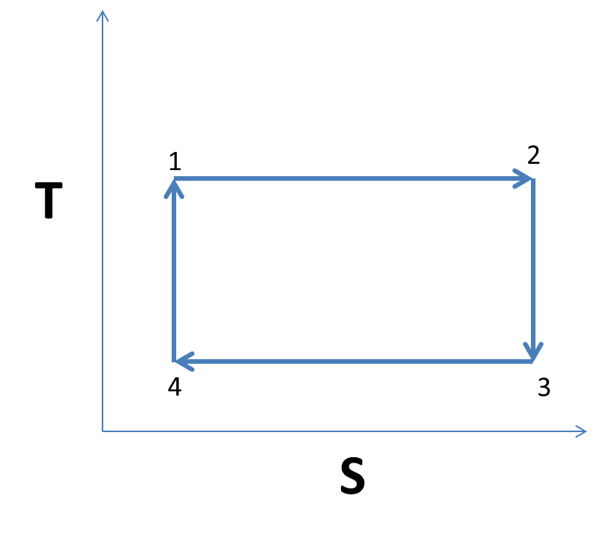

Slide 37
1 to 2 to 3 to 4 to 1
3
P
adiabatic
2
4
adiabatic
1
V

Slide 38
1 to 2 to 3 to 4 to 1
3
P
adiabatic
2
4
adiabatic
1
V
T
2
1 to 2
1
S

Slide 39
1 to 2 to 3 to 4 to 1
3
P
adiabatic
2
4
adiabatic
1
V
3
2 to 3
2
T
1
S

Slide 40
1 to 2 to 3 to 4 to 1
3
P
adiabatic
2
4
adiabatic
1
V
3
3 to 4
T
2
4
1
S

Slide 41
1 to 2 to 3 to 4 to 1
3
P
adiabatic
2
4
adiabatic
1
V
3
3 to 4
T
2
4
1
Using
S

Slide 42
1 to 2 to 3 to 4 to 1
3
P
adiabatic
2
4
adiabatic
1
V
3
3 to 4
T
2
4
1
S

Slide 43
1 to 2 to 3 to 4 to 1
3
P
adiabatic
2
4
adiabatic
1
V
3
3 to 4
T
2
4
1
S

Slide 44
1 to 2 to 3 to 4 to 1
3
P
adiabatic
2
4
adiabatic
1
V
3
3 to 4
T
2
4
1
S

Slide 45
1 to 2 to 3 to 4 to 1
3
P
adiabatic
2
4
adiabatic
1
V
3
4 to 1
T
2
4
1
S

Slide 46
3
3
P₃
P
Adiabatic
P₂
1
2
V₂
V
V₁

Slide 47
1 to 2
2 to 3

Slide 48
3 to 1
Adiabatic
Also

Slide 49
S

Slide 50
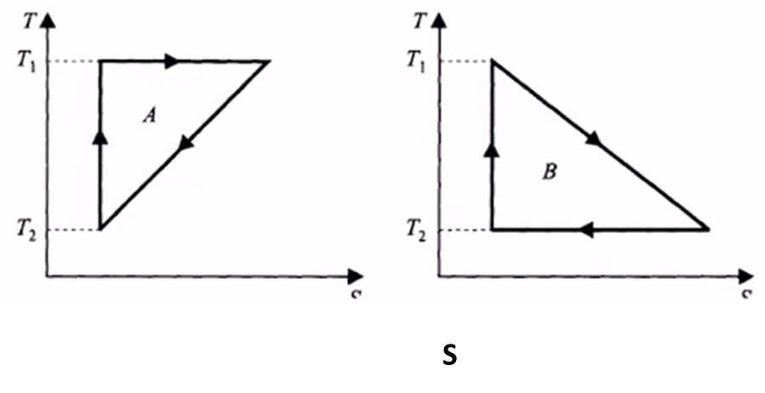
Isothermal expansion
3
2
Adiabatic
1
S1
S2

Slide 51
S1
S2

Slide 52
Name | L9 | L10 | L11 | L12 | L13 | L14 | L15 | L16
"2201ph34_dolly" <2201ph34_dolly@iitp.ac.in>; | p | P | p | A | p | p | p | P
"Adhila Aslam" <2201ph01_adhila@iitp.ac.in>; | p | P | p | p | p | p | p | P
"Aditi Baghel" <2201ph31_aditi@iitp.ac.in>; | p | P | p | p | p | p | p | A
"Aditya Kumar" <2201ph02_aditya@iitp.ac.in>; | p | A | A | A |  | p | p | P
"Aditya Singh" <2201ph03_aditya@iitp.ac.in>; | p | P | p | p | p | p | p | P
"Animesh Sharma" <2201ph05_animesh@iitp.ac.in>; | p | P | p | p | P | p | p | P
"Arun Mishra" <2201ph06_arun@iitp.ac.in>; | a | P | p | p | P | p | p | A
"Aryan Raj" <2201ph32_aryan@iitp.ac.in>; | p | P | p | p | P | p | p | A
"Boda Vishnuwardhan" <2201ph08_boda@iitp.ac.in>; | p | A | A | p | P | a | p | P
"Chanchal Tolani" <2201ph09_chanchal@iitp.ac.in>; | p | P | p | p | P | p | p | P
"Gaurav Verma" <2201ph10_gaurav@iitp.ac.in>; | p | P | p | A | A | a | a | A

Slide 53
Name | L9 | L10 | L11 | L12 | L13 | L14 | L15
"Gourav Jha" <2201ph11_gourav@iitp.ac.in>; | a | P | p | p | A | a | p | A
"Gurinder Dhillon" <2201ph12_gurinder@iitp.ac.in>; | p | P | A | A | A | a | a | P
"Harsh Joshi" <2201ph13_harsh@iitp.ac.in>; | p | P | p | p | P | a | p | P
"Himanshu Patel" <2201ph35_himanshu@iitp.ac.in>; | p | P | p | A | P | p | p | P
"Khushal Yadav" <2201ph14_khushal@iitp.ac.in>; | p | P | p | P | P | p | a | P
"Krishnakant Chourey" <2201ph15_krishnakant@iitp.ac.in>; | p | A | A | p | P | p | p | P
"Manas Gupta" <2201ph16_manas@iitp.ac.in>; | a | P | p | P | P | p | p | P
"Mohit Saini" <2201ph17_mohit@iitp.ac.in>; | a | P | p | p | P | p | p | A
"Mude Naik" <2201ph18_mude@iitp.ac.in>; | p | P | p | p | P | p | a | P
"Murari Kumar" <2201ph19_murari@iitp.ac.in>; | p | P | A | p | P | a | a | A
"Nishant Yadav" <2201ph20_nishant@iitp.ac.in>; | p | P | A | p | P | p | p | P
"Pranitha Moluguri" <2201ph21_pranitha@iitp.ac.in>; | p | P | p | p | P | p | p | P

Slide 54
Name | L9 | L10 | L11 | L12 | L13 | L14 | L15
"Premanandh Sigamala" <2201ph22_premanandh@iitp.ac.in>; | p | P | A | p | A | a | a | P
"Ruchi Thakur" <2201ph23_ruchi@iitp.ac.in>; | p | P | p | p | P | p | p | P
"Satyam Sahoo" <2201ph25_satyam@iitp.ac.in>; | p | P | p | p | P | p | a | P
"Satyam Shandilya" <2201ph24_satyam@iitp.ac.in>; | p | P | A | p | P | p | p | P
"Shyam Hembram" <2201ph26_shyam@iitp.ac.in>; “ | p | P | p | p | P | a | a | P
Sougata Saha" <2201ph27_sougata@iitp.ac.in>; | a | p | p | p | P | p | p | A
"Sumit Rajpoot" <2201ph28_sumit@iitp.ac.in>; | p | P | p | p | P | p | a | P
"Suprajit Dewanji" <2201ph29_suprajit@iitp.ac.in>; | a | P | p | p | A | p | p | P
Attendance: 75% mandatory

