Slide 1
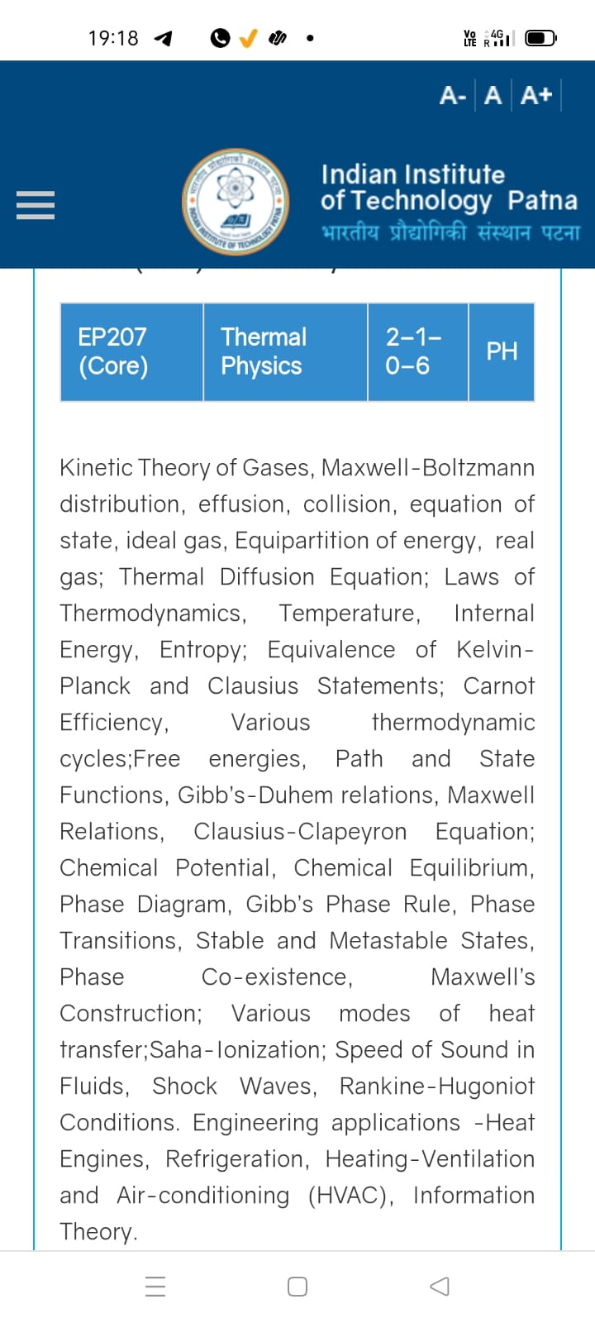
Season 5, Lecture 6 (S5,L6):
EP2104 Thermal physics with engineering applications
3-1-0-4

Slide 2
Time | 11:11:55 | 12-12:55 | 3-3:55 | 4- 4:55 | 02-02:55
Day
Monday |  | R103
Tuesday |  |  | R103
Wednesday |  |  |  | R103
Thursday | R101

Slide 3
 |  | L1 | L2 | L3 | L4 | L5 | L6
 | "Anirudh Karthikeyan" <anirudh_2501ph19@iitp.ac.in>; | p | p | p | p | p | p
2. | "Anshita Meena" <anshita_2501ph08@iitp.ac.in>; | p | p | p | p | p | p
3. | "Aritro Ghosh" <aritro_2501ph03@iitp.ac.in>; | p | a | p | p | p | p
4. | "Arunya Guha" <arunya_2501ph28@iitp.ac.in>; | p | p | a | p | p | p
5. | "Avala Venkata Hemanth" <avala_2501ph37@iitp.ac.in>; | a | a | a | p | p | p
6. | "Ayush Kumar" <ayush_2501ph24@iitp.ac.in>; | p | p | a | p | p | p
7. | "Badavath Madhulatha" <badavath_2501ph38@iitp.ac.in>; | p | p | a | p | p | p
8. | "Banothu Somanna" <banothu_2501ph36@iitp.ac.in>; | p | p | p | p | p | p
9. | "Chenche Shankara Suman" <chenche_2501ph07@iitp.ac.in>; | p | p | p | p | p | a
10. | "Davala Bhuvana Karthik" <davala_2501ph25@iitp.ac.in>; | p | p | p | p | p | p

Slide 4
 |  | L1 | L2 | L3 | L4 | L5 | L6
11. | "David Pratap Singh" <david_2501ph26@iitp.ac.in>; | p | p | q | p | p | p
12. | "Deepak Kumar" <deepak_2503ph03@iitp.ac.in>; | p | p | q | p | p | p
13. | "Dekka Nivas" <dekka_2501ph29@iitp.ac.in>; | p | p | q | p | p | p
14. | "Gamit Marlon Maheshbhai" <gamit_2501ph21@iitp.ac.in>; | p | p | q | p | p | p
15. | "Himesh Katare" <himesh_2501ph33@iitp.ac.in>; | p | p | q | p | p | p
16. | "Jadhav Vedant Rajesh" <jadhav_2501ph06@iitp.ac.in>; | p | p | q | p | p | p
17. | "Johaan Peter Thekkan" <johaan_2501ph05@iitp.ac.in>; | p | p | q | p | p | p
18. | "Karri Akshara" <karri_2501ph13@iitp.ac.in>; | p | p | q | p | p | p
19. | "Kashvi Mehta" <kashvi_2501ph32@iitp.ac.in>; | p | p | q | p | p | p
20. | "Kirti Chandra" <kirti_2501ph35@iitp.ac.in>; | p | p | q | a | p | p

Slide 5
 |  | L1 | L2 | L3 | L4 | L5 | L6
21 | "Krishna Mule" <krishna_2501ph04@iitp.ac.in>; | p | p | q | p | p | p
22. | "Kummetha Sai Darshan Reddy" <kummetha_2501ph17@iitp.ac.in>; | a | a | a | a | a | a
23. | "Maddirala Bhanu Kiran" <maddirala_2501ph31@iitp.ac.in>; | p | p | q | a | a | a
24. | "Manish" <manish_2501ph22@iitp.ac.in>; | p | p | q | p | p | p
25. | "Mohammad Owais Ansari" <mohammad_2501ph18@iitp.ac.in>; | p | p | q | p | p | p
26. | "Muhammed Rehaan Sharafudheen" <muhammed_2501ph20@iitp.ac.in>; | p | p | q | p | p | p
27. | "Nikhil" <nikhil_2501ph34@iitp.ac.in>; | p | p | q | p | p | p
28. | "Poodari Shivani" <poodari_2503ph04@iitp.ac.in>; | p | p | q | p | p | p
29. | "Rahul Yadav" <rahul_2501ph23@iitp.ac.in>; | p | p | q | p | p | p
30. | "Rohit David Paul" <rohit_2501ph11@iitp.ac.in>; | p | p | a | p | a | a

Slide 6
 |  | L1 | L2 | L3 | L4 | L5 | L6
31 . | "Ronak Jakhar" <ronak_2501ph10@iitp.ac.in>; | p | p | p | p | p | p
32. | "Rudraneel Shee" <rudraneel_2501ph15@iitp.ac.in>; | p | p | p | p | p | p
33. | "S Ragul Raagav" <s_2503ph02@iitp.ac.in>; | p | p | p | p | p | p
34. | "Sara Khan" <sara_2501ph30@iitp.ac.in>; | p | p | p | p | p | p
35. | "Shaik Jabeer Sulthan" <shaik_2501ph16@iitp.ac.in>; | p | p | p | p | p | p
36. | "Shourya Sharma" <shourya_2503ph01@iitp.ac.in>; | p | p | a | a | p | a
37. | "Shreyas Saraswatiprasad Waikar" <shreyas_2501ph02@iitp.ac.in>; | p | p | p | p | p | p
38. | "Snehardra Das" <snehardra_2501ph14@iitp.ac.in>; | p | p | p | a | p | p
39. | "Tejeswin R" <tejeswin_2501ph09@iitp.ac.in>; | p | p | a | p | p | a
40. | "Varkatam Akshaya" <varkatam_2501ph12@iitp.ac.in>; | p | p | p | p | p | p

Slide 7
 |  | L1 | L2 | L3 | L4 | L5 | L6
41. | "Vivanshu Chauhan" <vivanshu_2501ph01@iitp.ac.in>; | p | p | p | p | p | p
42. | "Yogesh Kumar" yogesh_2501ph27@iitp.ac.in | p | p | p | p | p | p
Attendance: 75% mandatory

Slide 8
Problem 2

Slide 9
Distribution function
Maxwell Boltzmann speed distribution

Slide 10
Problem 2

Slide 15
(a) Complete Analysis of distribution function

Slide 16
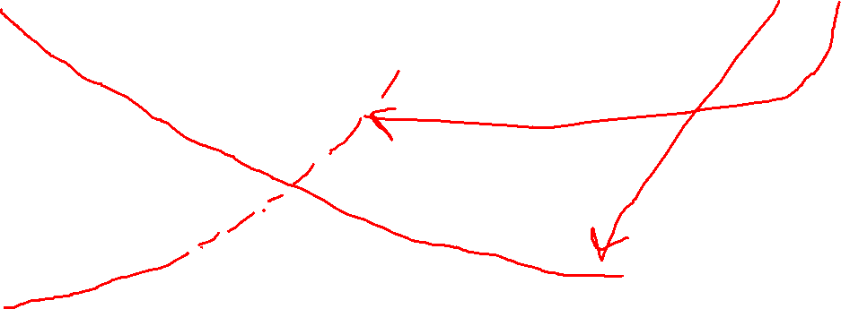
Complete Analysis of distribution function

Slide 17
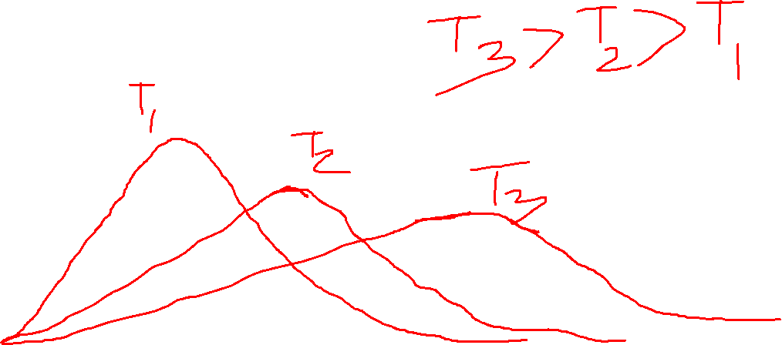
(b) With temperature

Slide 18
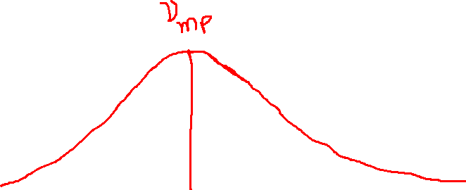
(c) Most Probable speed
Most probable speed

Slide 19
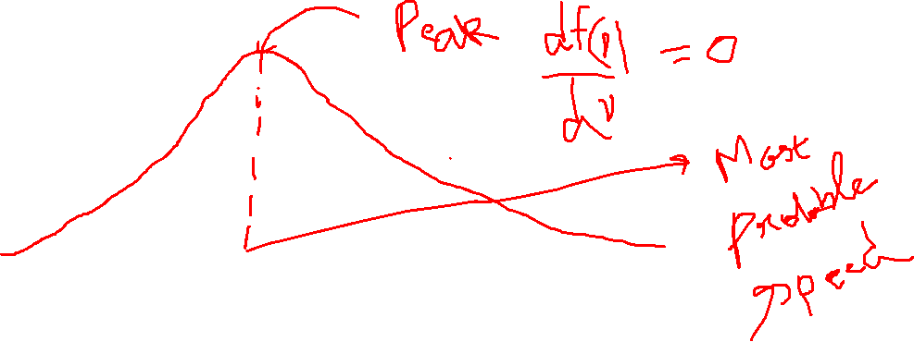
Complete Analysis of distribution function

Slide 20
Average speed
(d)
Root mean square speed (RMS)

Slide 21
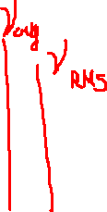
(e) A comparison

Slide 22
Problem 3
$$\text{Find the probability of finding Nitrogen }(N_{2})\text{ gas at} \text{300K, whose } \text{speeds are in the range of }v_{mp}−0.005v_{mp}\text{ and }v_{mp}+0.005v_{mp}?$$

Slide 23
$$\text{Find the probability of finding Nitrogen }(N_{2})\text{ gas at 300K, whose } \text{speeds are in the range of }v_{mp}−0.005v_{mp}\text{ and }v_{mp}+0.005v_{mp}?$$

Slide 24
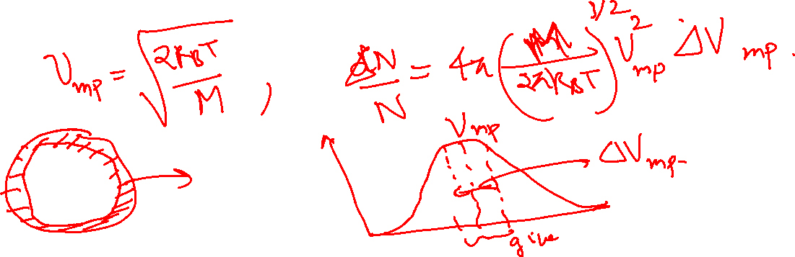
Problem 3
$$\text{Find the probability of finding Nitrogen }(N_{2})\text{ gas at 300K, whose } \text{speeds are in the range of }v_{mp}−0.005v_{mp}\text{ and }v_{mp}+0.005v_{mp}?$$

Slide 25
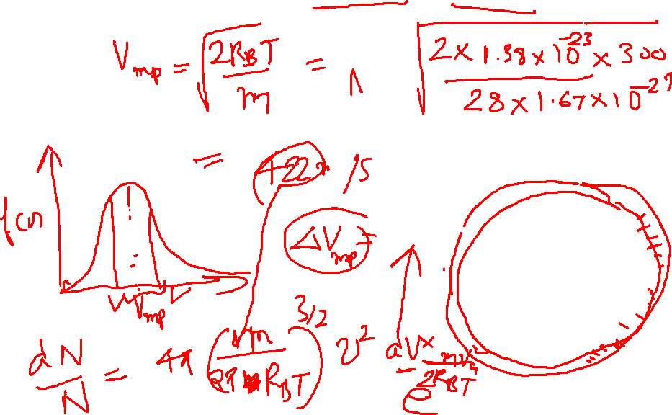
Solution:
$$\text{Find the probability of finding Nitrogen gas at 300K, whose } \\ \text{speeds are in the range of }v_{mp}−0.005v_{mp}\text{ and }v_{mp}+0.005v_{mp}?$$

Slide 26
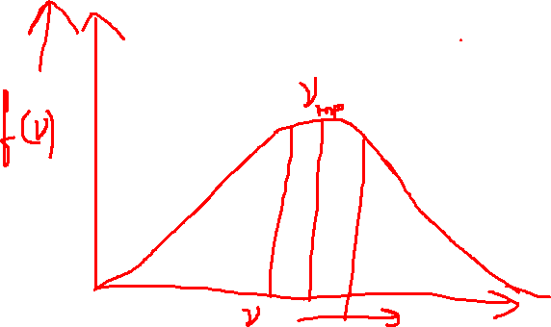
Solution:
$$\text{Find the probability of finding Nitrogen gas at 300K, whose } \\ \text{speeds are in the range of }v_{mp}−0.005v_{mp}\text{ and }v_{mp}+0.005v_{mp}?$$

Slide 27
Problem 4

Slide 29
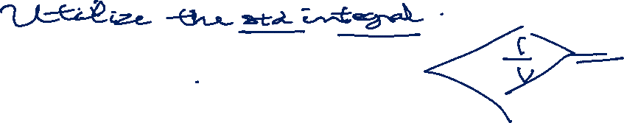
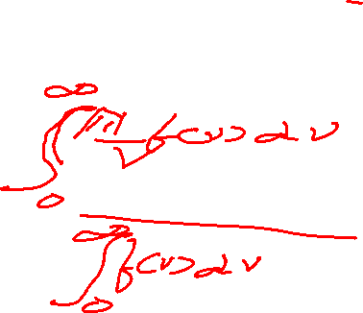
Problem 4

Slide 30
Solution

Slide 31
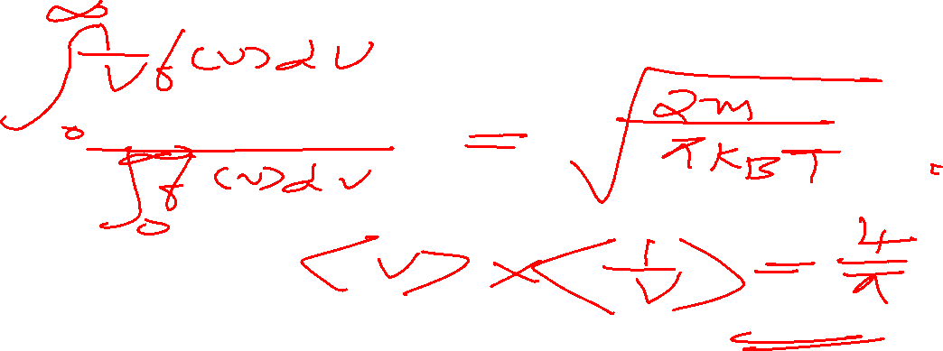
Solution

