Slide 1
Highlights of the course
Co-ordinate Systems
Introduction to Vector Operators
Work , Energy and Conservation laws
Rigid body in motion
Oscillations and Waves
Quantum Physics

Slide 2
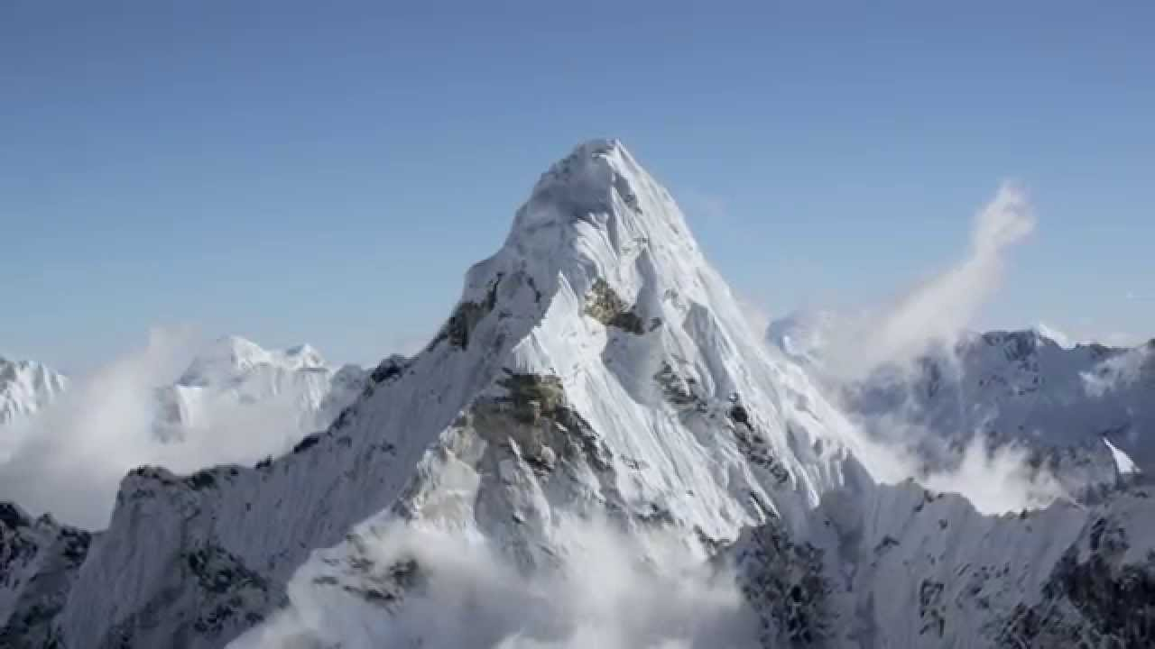
Chapter-2: Introduction to Vector Operators
Gradient, Divergence and Curl

Slide 3
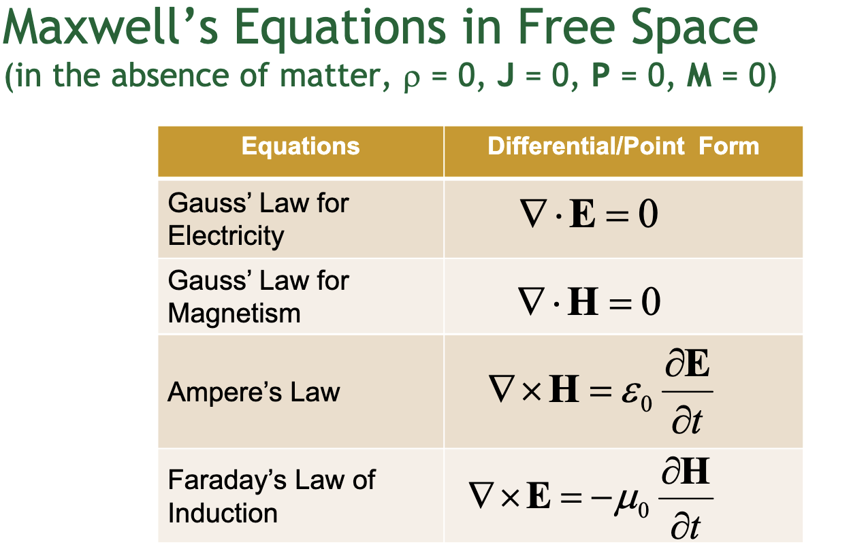
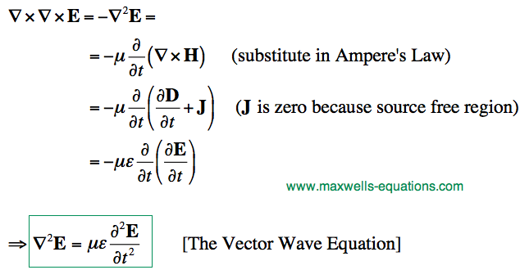
Many many more to learn in Science and Engineering ………

Slide 4
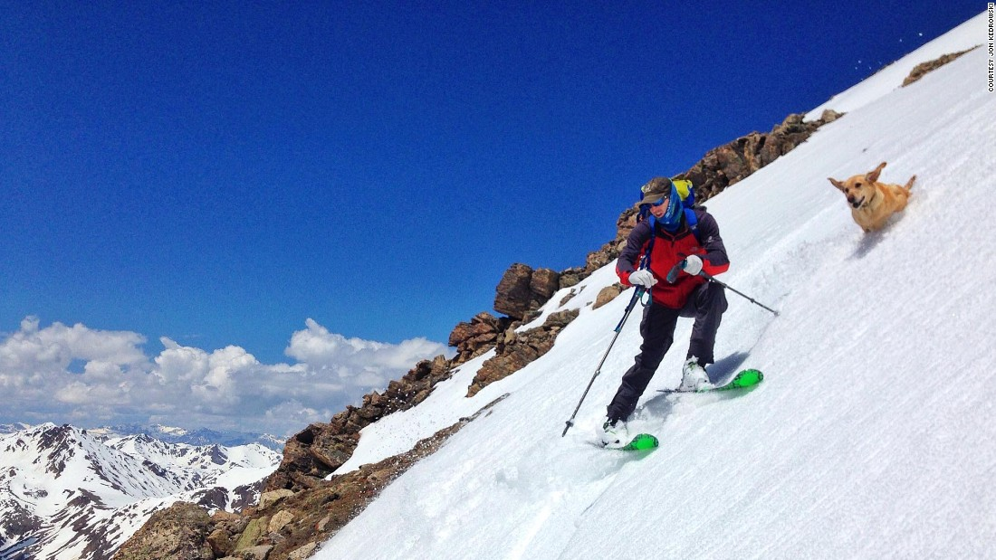
Ordinary Derivatives
Z
X

Slide 5
Ordinary Derivatives
f(x)
f(x)
x
x
?
RECOLLECT
(By Taylor
Series) for
Plane polar

Slide 6
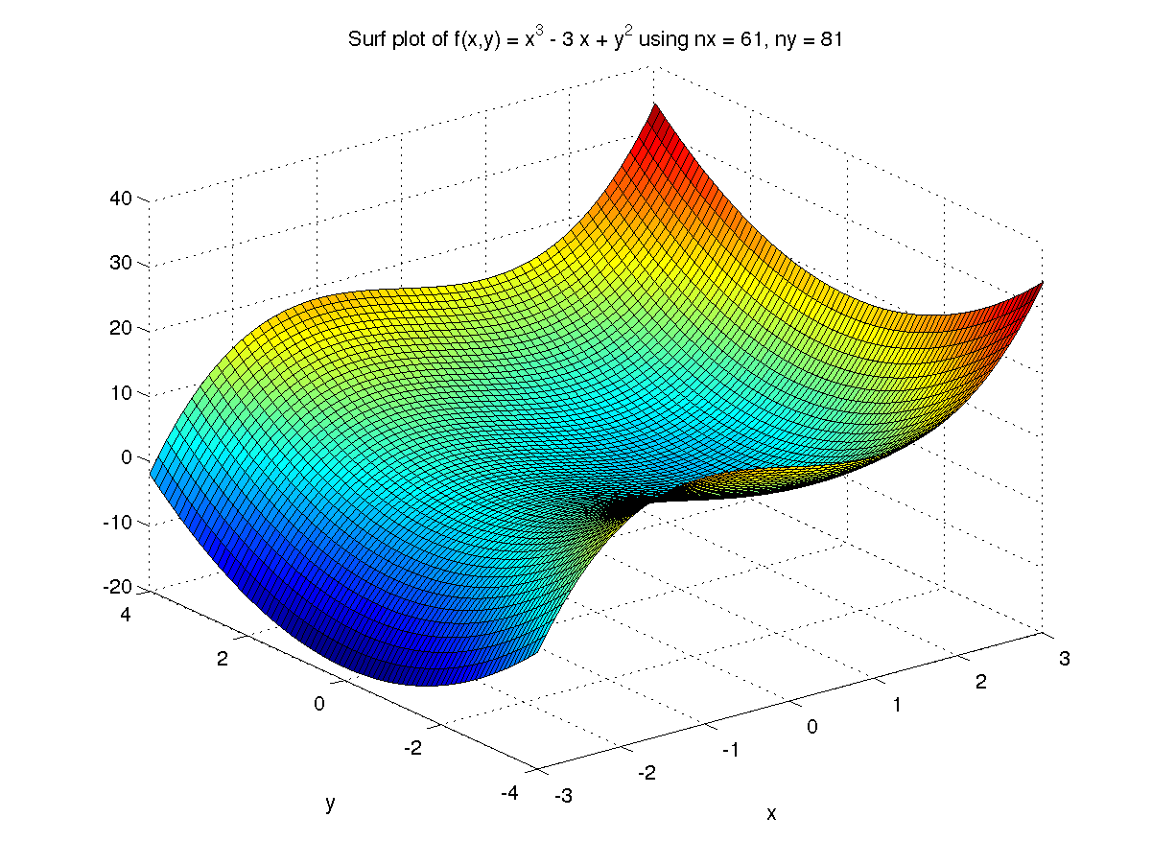
Derivative of a function in 3D
Derivative is directional!

Slide 7
Scalar Field Function
A function of space whose
value at each point is a
scalar quantity
Example: Temperature

Slide 8
Gradient of a scalar function
Partial derivative
Example
in spherical polar

Slide 9
Gradient of a function
Gradient

Slide 10
Gradient: Geometrical interpretation
dT is maximum when gradient points in the direction of .
Maximum increase in the temperature occurs when gradient
and the are parallel to each other

Slide 11
An example
Variation of temperature in a region is given by the function Find whether the unit vector points in the direction of maximum
increase of temperature at location (1,1).
Yes the given unit vector
Points in the increasing
Direction of temperature

Slide 12
Another example
Find the gradient of
What would it mean for the gradient to vanish?
Stationary point of f(x,y,z)

Slide 13
Vector operator (The del operator)
Three ways the operator can act:
The divergence and curl operates on a VECTOR FIELD .
Examples of vector fields are Velocity of fluid flow , Electric field, Magnetic field etc

Slide 14
Vector Field
A vector field in the plane is an assignment of a vector to every point (x,y) in the plane.
Algebraically a vector field is a function of (x, y) whose value is a vector
i.e. F(x, y) is a vector field if
Lets see some examples……………

Slide 15
Vector Field

Slide 16
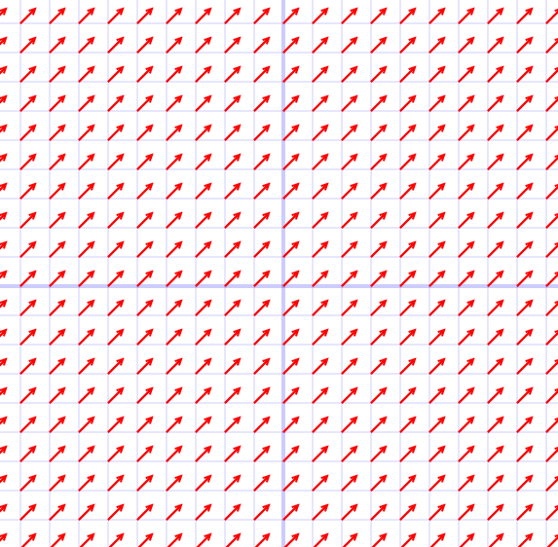
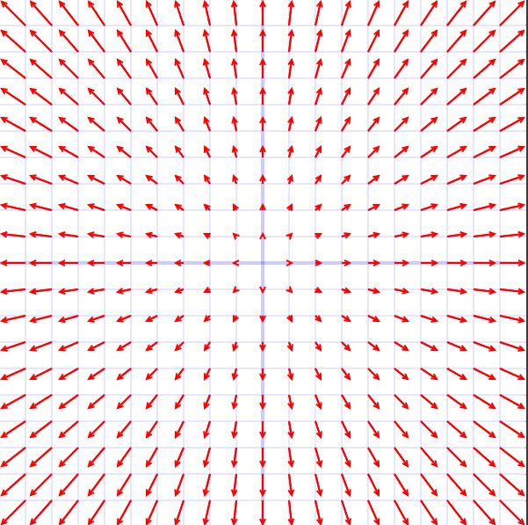
Vector Field

Slide 17
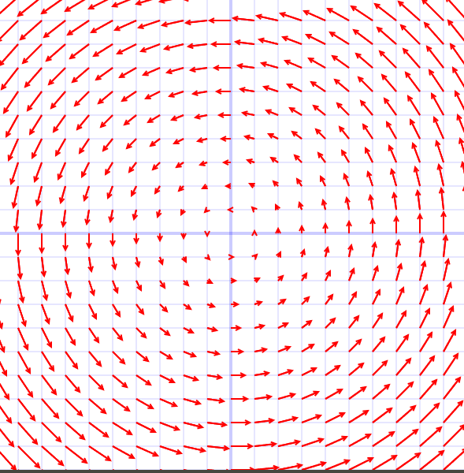
Vector Field
(4,0)
(4,4)
(0,4)

Slide 18
Announcement
First Quiz on 31st December (Friday, 10:AM)
Online Quiz, 1 hour duration
Maximum marks 10

