Slide 1
Waves to Quantum Physics

Slide 2
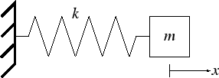
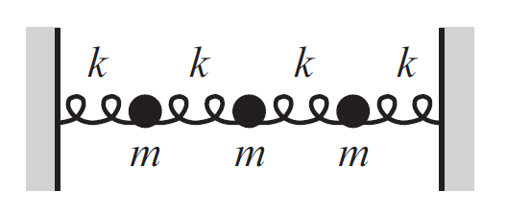
RECAP: Oscillations
One equation of motion
One resonance frequency &
One Normal mode
3 equations of motion
3 resonant frequencies
& 3 normal modes
We studied Equation of motion for N coupled oscillator
ΔX
n equations of motion
n resonant frequencies
& n normal modes
What will be the equation of motion for i^{th} mass?
Change of notation to S
Displacements S₁, S₂, ……..S_{N} as a function of time was studied

Slide 3
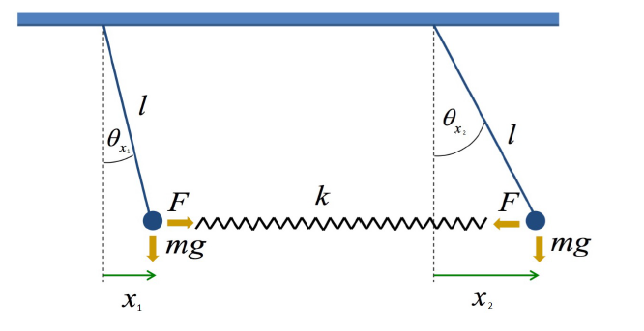
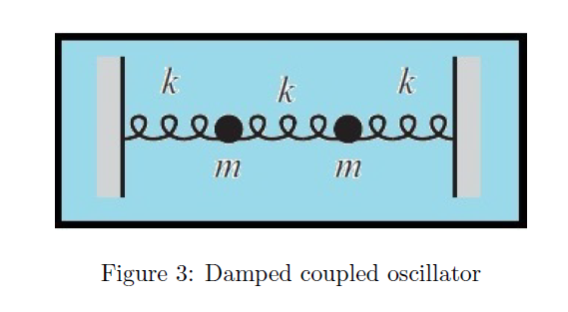
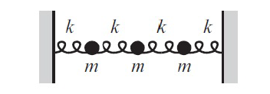
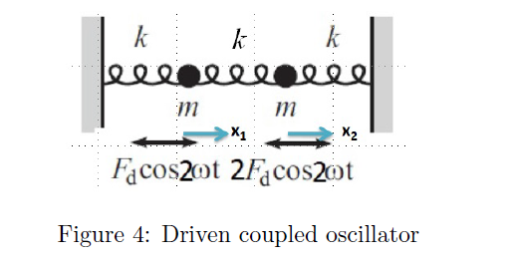
RECAP: Oscillations
This equation solve ONLY for time dependence of displacements S_{i}(t)
across the equilibrium point
Oscillations around the equilibrium point was studied using many examples

Slide 4
Oscillations to Waves
How are they related?

Slide 5
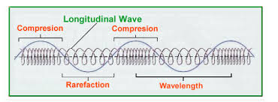
Oscillations to Waves
How are they related?
A wave can be thought of as a disturbance or oscillation that travels through space-time, accompanied by a transfer of energy.
If the direction of wave propagation is parallel to the direction it oscillates then its called as Longitudinal waves.
Longitudinal waves generated in a coupled oscillator
A wave does not move mass in the direction of propagation; it transfers energy.

Slide 6
Longitudinal waves

Slide 7
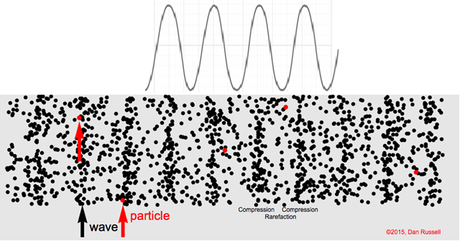
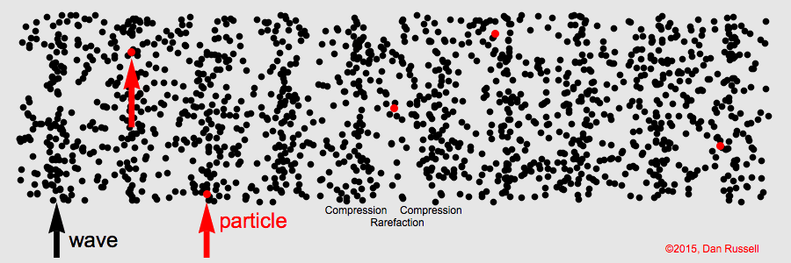
This equation solve ONLY for time dependence of displacements S_{i}
Need to invent a differential equation which gives spatial dependence also.

Slide 8
RECAP: Derivation of Wave Equation in a medium (Large N)

Slide 9
RECAP: Derivation of Wave Equation
Need to bring spatial derivatives for
understanding wave propagation
Rate of rate of change of displacement with respect
to SPATIAL CO-ORDINATE x need to be known

Slide 10
Derivation of wave equation
Dividing by Δx throughout

Slide 11
In the limit Δx tending to 0 i.e. N→∞
Wave equation
How to solve this wave equation? We need to find S(x,t)

Slide 12
The trial Solution:
ω correspond to normal mode frequency
Wave equation

Slide 14
General solution of Wave equation
Thus the general solution is:
Let’s recapitulate……

Slide 15
We know
Let’s Choose A and B as

Slide 16
Thus the general solution of a wave equation is:

Slide 17
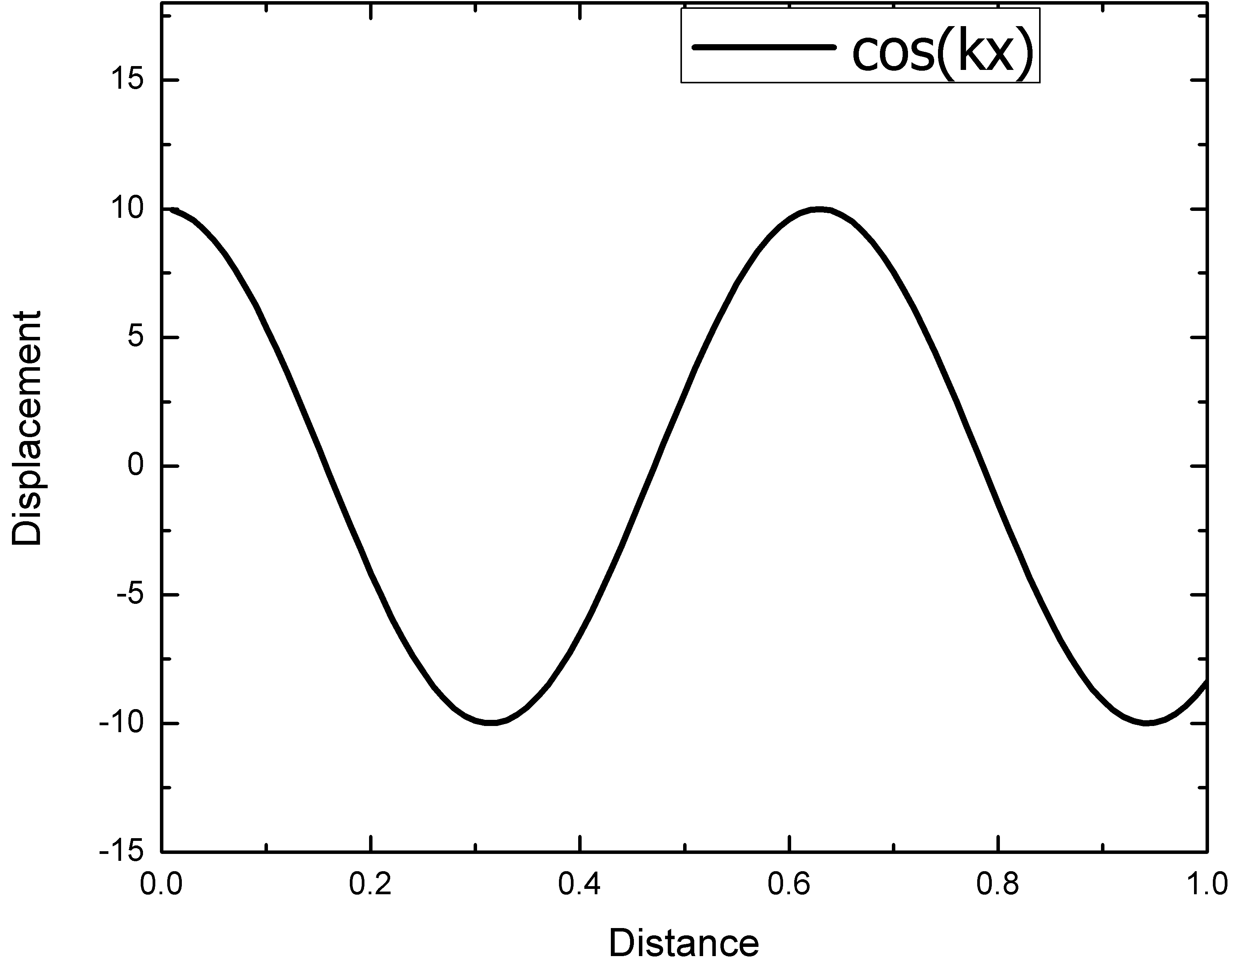
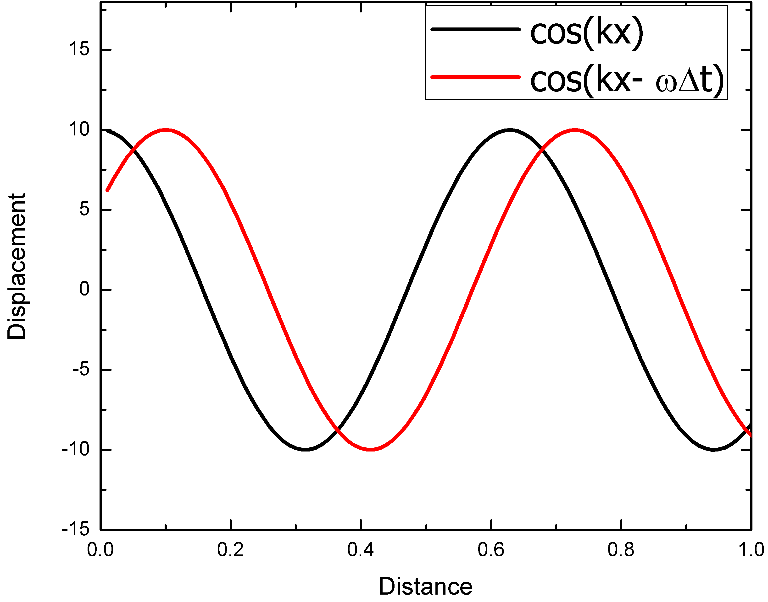
Plot of cos(κ x –ωt)
x=0 and t = 0, cosine has
Max value hence κ x = 0
ΔX
After t = Δt, cosine has max value and wave has moved a distance Δx, hence κΔx –ω Δt = 0
v = Δx/Δt = ω/ κ

Slide 18
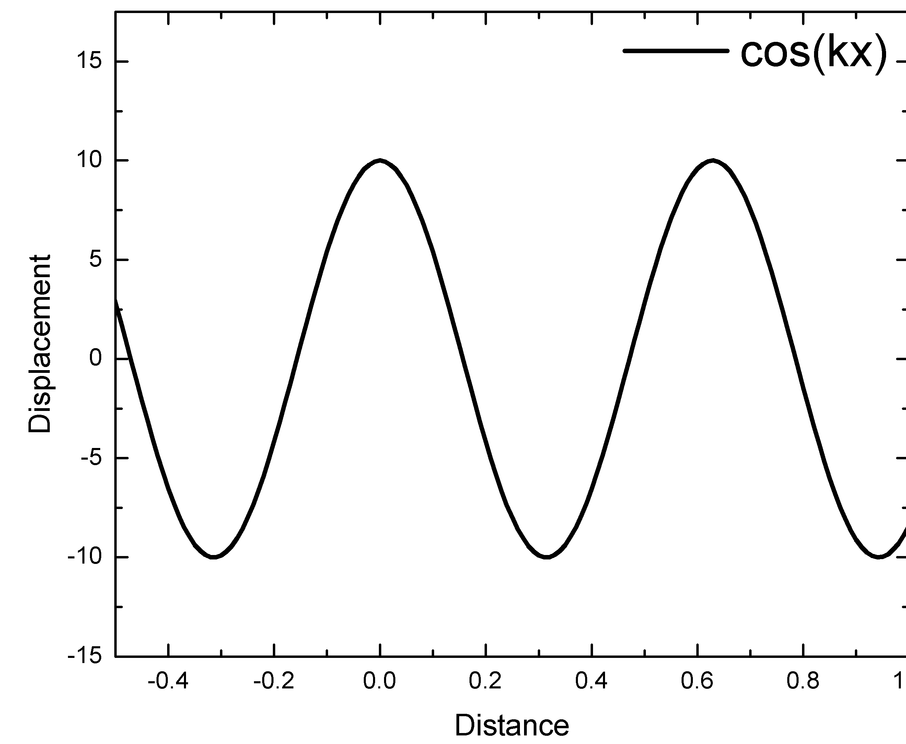
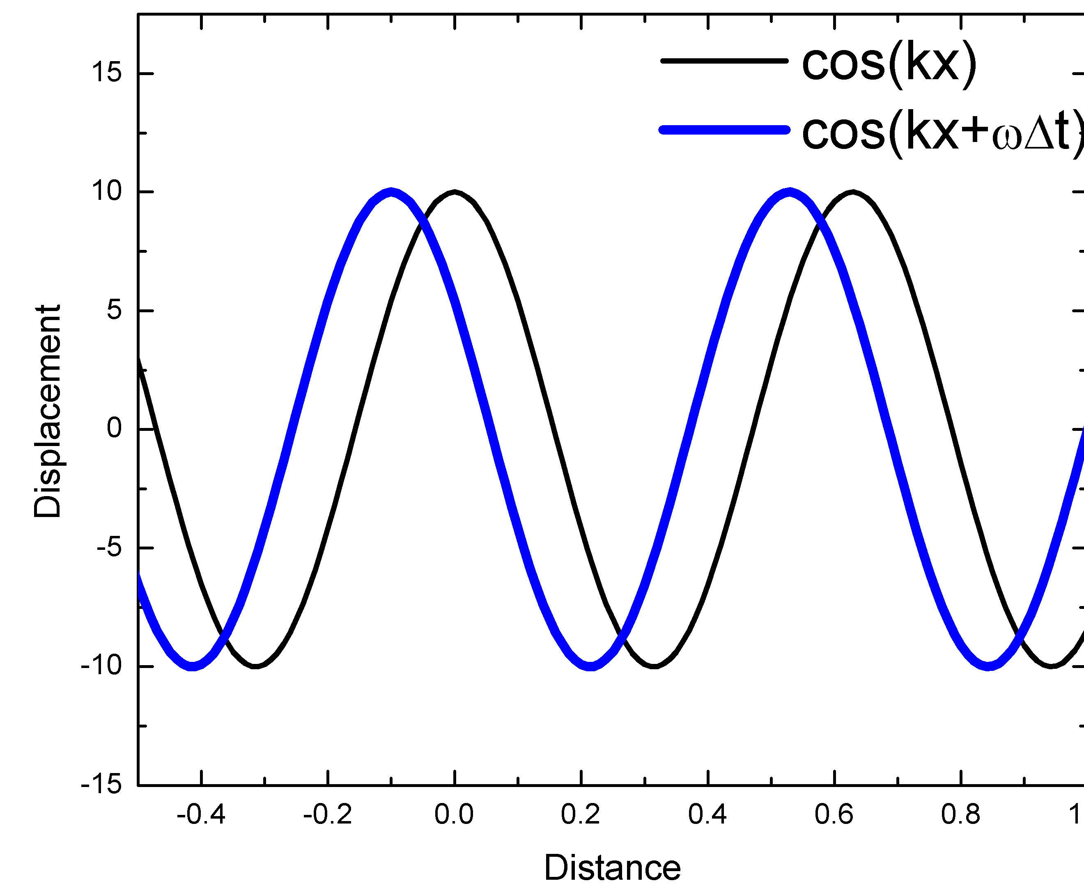
Plot of cos(κx +ωt)
x=0 and t = 0, cosine has
Max value hence κ x –ωt = 0
ΔX
After t = Δt, the wave has moved a distance Δx, hence κΔx +ω Δt = 0 v = Δx/Δt = -ω/ κ

Slide 19
Thus the general solution of a wave equation is:
Left going
Right going
Constants are determined by initial conditions

Slide 20
Displacement as function of position and time

Slide 21
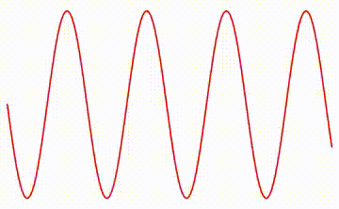
Wave moving
S(x,t)
x

Slide 22
Longitudinal Waves

Slide 23
Transverse Waves
Transverse waves also follow the same treatment
Similar analysis

Slide 24
Wave in 3 dimension

Slide 25
Electro-Magnetic Wave

Slide 26
Particle
Wave
Mechanics
Optics

Slide 27
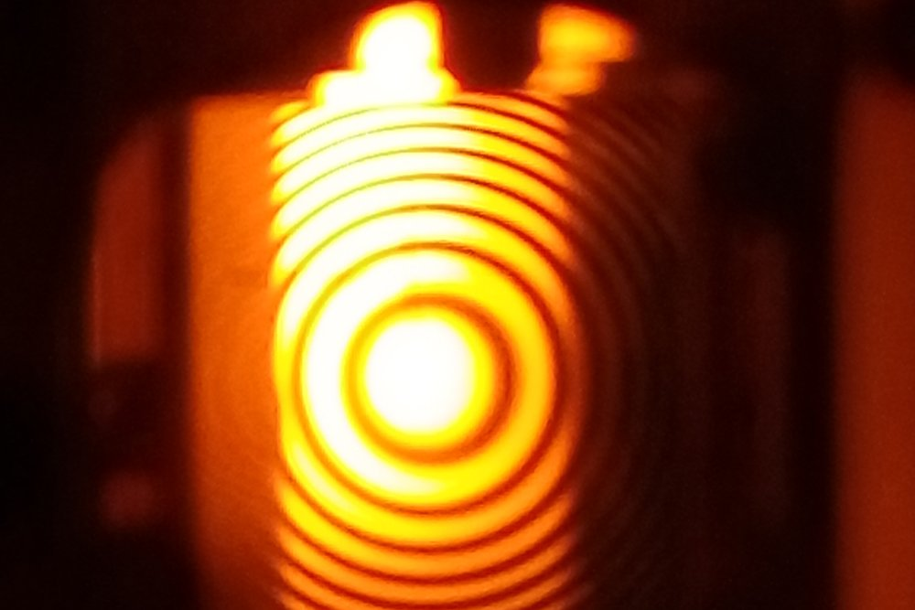
Wave nature of light

Slide 28
Few surprises/Contradictions in the beginning of 19th Century!
Particle nature of light

Slide 29
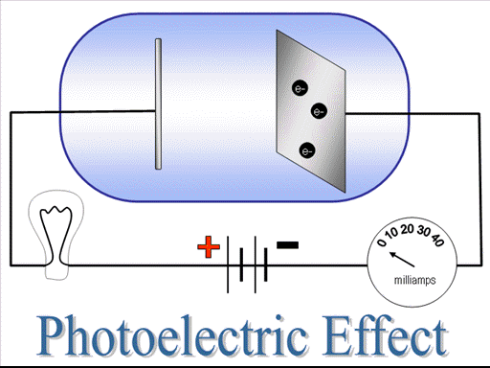
Photoelectric Effect

Slide 30
Quantum Physics
Wave
Particle
Particle
Wave

