Slide 1
Post-Mid Sem
PH 608 Atomic Collision Physics
Lec 4 (11/03/2024)
Raghavan K E
Associate Professor
Indian Institute of Technology Patna

Slide 2
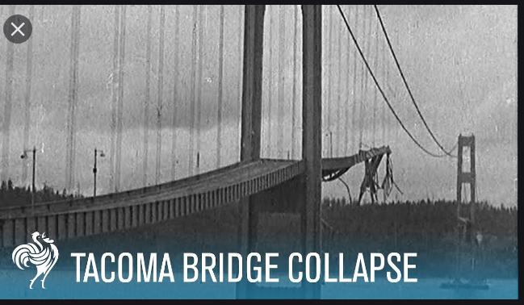
Resonances
in collision

Slide 3
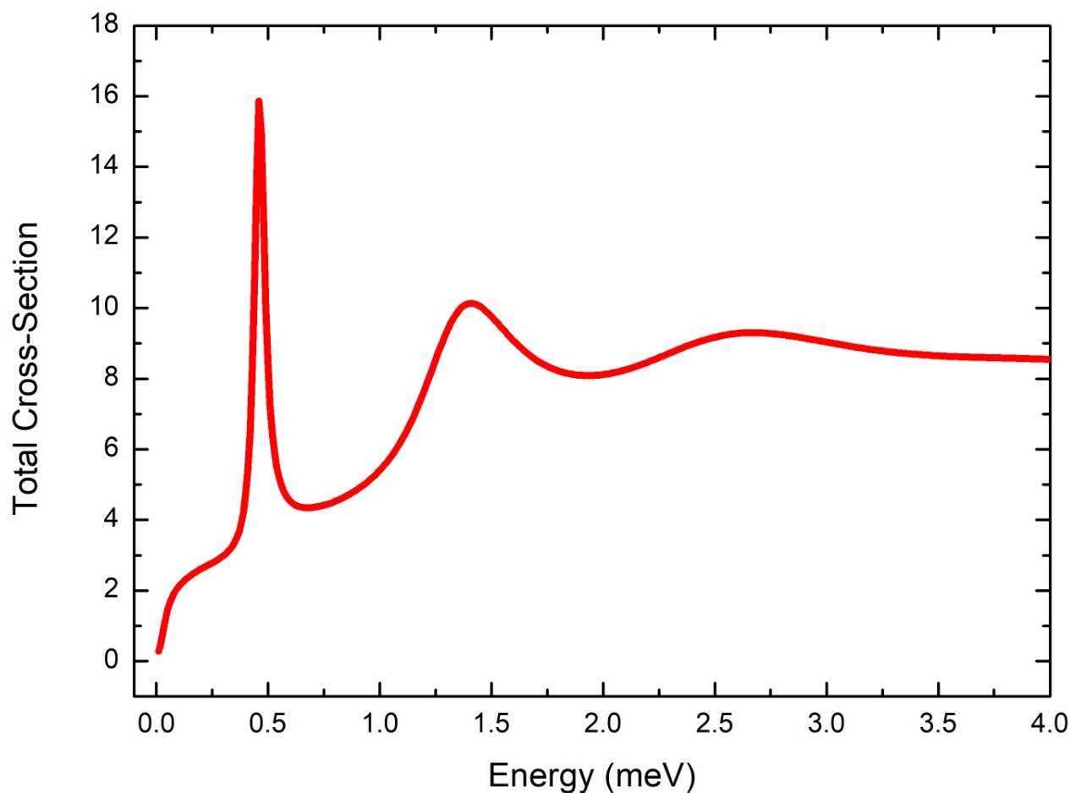
H-Kr scattering

Slide 4
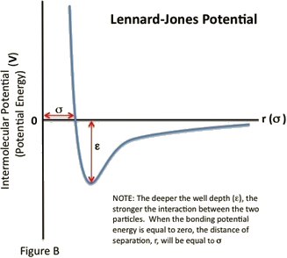
Quantum scattering of two atoms (Interaction Potenatial)
A
B

Slide 5
Quantum scattering of two atoms
A
B

Slide 6
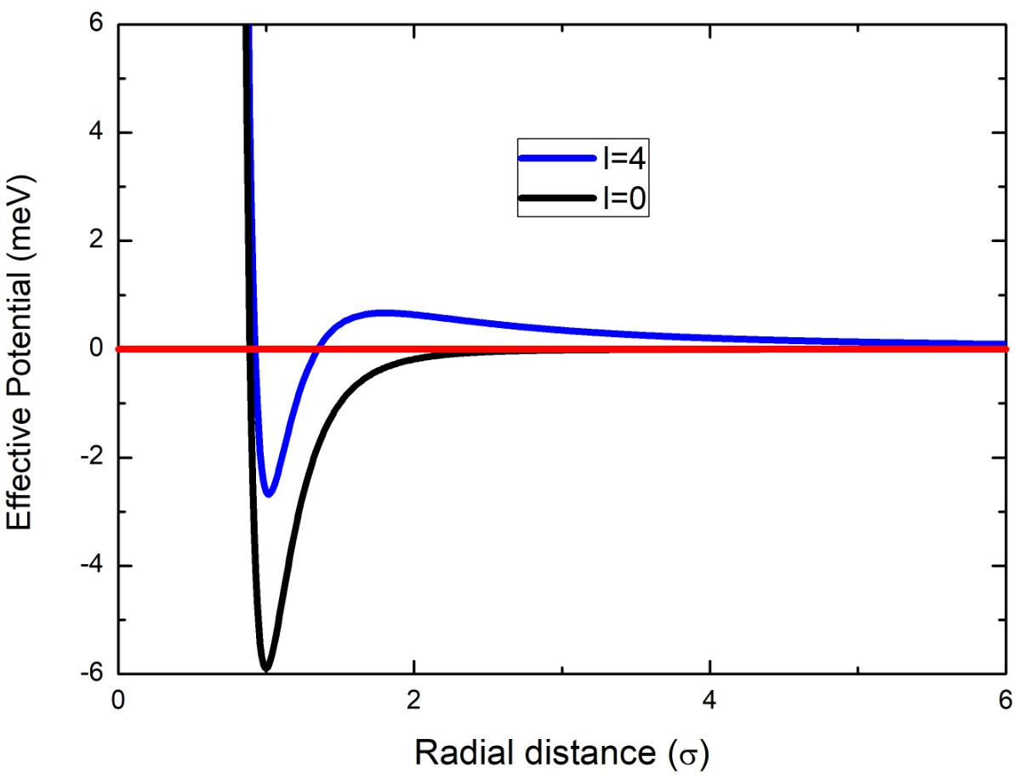
Scattering resonance
Effective Potential:

Slide 7
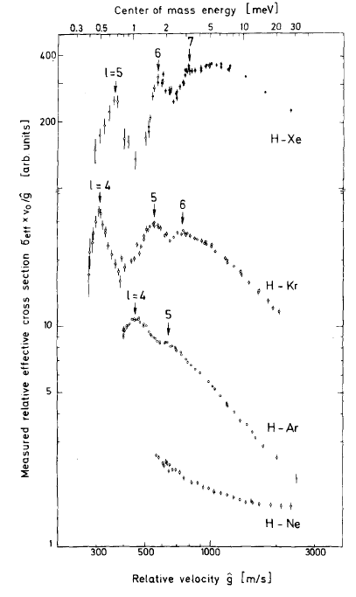
Scattering cross-section
Scattering cross section

Slide 8
Attendance (Post-Mid Sem)
firstname | lastname | roll_no | lec1 | lec2 | lec3 | lec4 | lec5 | lec6 | lec7 | lec8 | lec9 | lec10 | lec11 | lec12 | lec13 | lec14 | lec15
Rajsekhar | Bhowmick | 2212PH36 p |  | p | p | p
Gaurav | Jaiswal | 2212PH13 a |  | a | a | p
Neellohit | Karmakar | 2212PH20 p |  | p | p | p
Soumik | Karmakar | 2212PH26 p |  | p | p | p
Aman | Kumar | 2212PH02 p |  | p | p | a
Ritik | Pal | 2212PH23 p |  | p | p | p
Binayak | Rout | 2212PH10 p |  | p | p | p
Kauship | Saha | 2212PH17 a |  | a | P | a
Naincy | Srivastava | 2321ph07 p |  | p | p | p
Rabi | Das | 2321ph15 p |  | p | p | p
Shruti | Sarswat | 2321ph19 p |  | p | p | p

Slide 9
Upcoming Plans
Derivation of general expression of phase shift without the knowledge of exact form of potential (Recap)
Case study: Hard Sphere Scattering
Expression of Phase shift of any general potential in terms of hard sphere part and potential part
$ξ_{l}: \text{independent} \text{of} \text{details} \text{of} \text{potential}$(hard sphere part) $$ρ_{l}: \text{dependent} \text{of} \text{details} \text{of} \text{the} \text{potential}$$

Slide 10
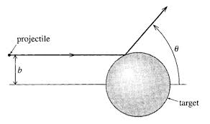
Hard-Sphere scattering

Slide 12
What about R_{l}¹?
Zero!............

Slide 13
For r>a
Compare R_{l}¹(ka) and R_{l}²(ka)

Slide 14
In the low-energy region (k→0),

Slide 15
In the low-energy region (k→0),
We see that the tan(δ_{l}) decreases rapidly with l and therefore only s-waves are important

Slide 16
$$\tan{(}δ_{l=0})=\sin{(}δ_{l=0})=−(ka)$$

Slide 17
For r>a
In the high-energy region (k→ ∞),

Slide 19
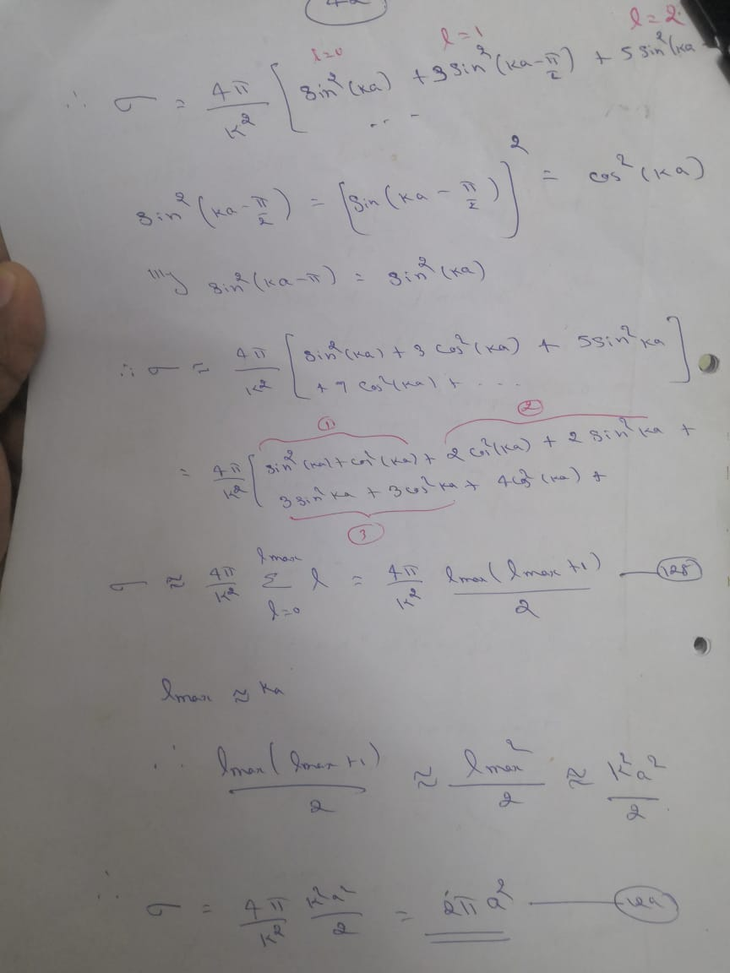

Slide 21
Expression of Phase shift of any general potential in terms of hard sphere part and potential part
$ξ_{l}: \text{independent} \text{of} \text{details} \text{of} \text{potential}$(hard sphere part) $$ρ_{l}: \text{dependent} \text{of} \text{details} \text{of} \text{the} \text{potential}$$

