Slide 1
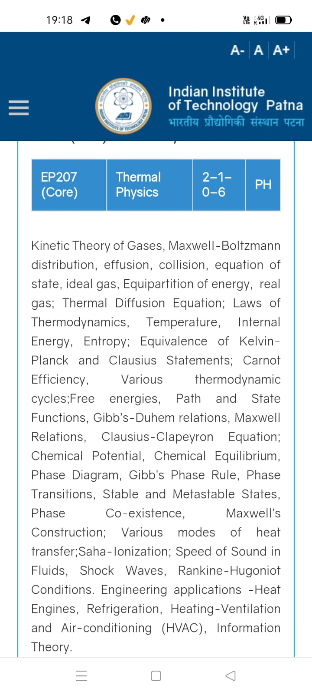
Season 5, Lecture 5 (S5,L5):
EP2104 Thermal physics with engineering applications
3-1-0-4

Slide 2
Time | 11:11:55 | 12-12:55 | 3-3:55 | 4- 4:55 | 02-02:55
Day
Monday |  | R103
Tuesday |  |  | R103
Wednesday |  |  |  | R102
Thursday | R103

Slide 3
 |  | L1 | L2 | L3 | L4 | L5
 | "Anirudh Karthikeyan" <anirudh_2501ph19@iitp.ac.in>; | p | p | p | p | p
2. | "Anshita Meena" <anshita_2501ph08@iitp.ac.in>; | p | p | p | p | p
3. | "Aritro Ghosh" <aritro_2501ph03@iitp.ac.in>; | p | a | p | p | p
4. | "Arunya Guha" <arunya_2501ph28@iitp.ac.in>; | p | p | a | p | p
5. | "Avala Venkata Hemanth" <avala_2501ph37@iitp.ac.in>; | a | a | a | p | p
6. | "Ayush Kumar" <ayush_2501ph24@iitp.ac.in>; | p | p | a | p | p
7. | "Badavath Madhulatha" <badavath_2501ph38@iitp.ac.in>; | p | p | a | p | p
8. | "Banothu Somanna" <banothu_2501ph36@iitp.ac.in>; | p | p | p | p | p
9. | "Chenche Shankara Suman" <chenche_2501ph07@iitp.ac.in>; | p | p | p | p | p
10. | "Davala Bhuvana Karthik" <davala_2501ph25@iitp.ac.in>; | p | p | p | p | p

Slide 4
 |  | L1 | L2 | L3 | L4 | L5
11. | "David Pratap Singh" <david_2501ph26@iitp.ac.in>; | p | p | q | p | p
12. | "Deepak Kumar" <deepak_2503ph03@iitp.ac.in>; | p | p | q | p | p
13. | "Dekka Nivas" <dekka_2501ph29@iitp.ac.in>; | p | p | q | p | p
14. | "Gamit Marlon Maheshbhai" <gamit_2501ph21@iitp.ac.in>; | p | p | q | p | p
15. | "Himesh Katare" <himesh_2501ph33@iitp.ac.in>; | p | p | q | p | p
16. | "Jadhav Vedant Rajesh" <jadhav_2501ph06@iitp.ac.in>; | p | p | q | p | p
17. | "Johaan Peter Thekkan" <johaan_2501ph05@iitp.ac.in>; | p | p | q | p | p
18. | "Karri Akshara" <karri_2501ph13@iitp.ac.in>; | p | p | q | p | p
19. | "Kashvi Mehta" <kashvi_2501ph32@iitp.ac.in>; | p | p | q | p | p
20. | "Kirti Chandra" <kirti_2501ph35@iitp.ac.in>; | p | p | q | a | p

Slide 5
 |  | L1 | L2 | L3 | L4 | L5
21 | "Krishna Mule" <krishna_2501ph04@iitp.ac.in>; | p | p | q | p | p
22. | "Kummetha Sai Darshan Reddy" <kummetha_2501ph17@iitp.ac.in>; | a | a | a | a | a
23. | "Maddirala Bhanu Kiran" <maddirala_2501ph31@iitp.ac.in>; | p | p | q | a | a
24. | "Manish" <manish_2501ph22@iitp.ac.in>; | p | p | q | p | p
25. | "Mohammad Owais Ansari" <mohammad_2501ph18@iitp.ac.in>; | p | p | q | p | p
26. | "Muhammed Rehaan Sharafudheen" <muhammed_2501ph20@iitp.ac.in>; | p | p | q | p | p
27. | "Nikhil" <nikhil_2501ph34@iitp.ac.in>; | p | p | q | p | p
28. | "Poodari Shivani" <poodari_2503ph04@iitp.ac.in>; | p | p | q | p | p
29. | "Rahul Yadav" <rahul_2501ph23@iitp.ac.in>; | p | p | q | p | p
30. | "Rohit David Paul" <rohit_2501ph11@iitp.ac.in>; | p | p | a | p | a

Slide 6
 |  | L1 | L2 | L3 | L4 | L5
31 . | "Ronak Jakhar" <ronak_2501ph10@iitp.ac.in>; | p | p | p | p | p
32. | "Rudraneel Shee" <rudraneel_2501ph15@iitp.ac.in>; | p | p | p | p | p
33. | "S Ragul Raagav" <s_2503ph02@iitp.ac.in>; | p | p | p | p | p
34. | "Sara Khan" <sara_2501ph30@iitp.ac.in>; | p | p | p | p | p
35. | "Shaik Jabeer Sulthan" <shaik_2501ph16@iitp.ac.in>; | p | p | p | p | p
36. | "Shourya Sharma" <shourya_2503ph01@iitp.ac.in>; | p | p | a | a | p
37. | "Shreyas Saraswatiprasad Waikar" <shreyas_2501ph02@iitp.ac.in>; | p | p | p | p | p
38. | "Snehardra Das" <snehardra_2501ph14@iitp.ac.in>; | p | p | p | a | p
39. | "Tejeswin R" <tejeswin_2501ph09@iitp.ac.in>; | p | p | a | p | p
40. | "Varkatam Akshaya" <varkatam_2501ph12@iitp.ac.in>; | p | p | p | p | p

Slide 7
 |  | L1 | L2 | L3 | L4 | L5
41. | "Vivanshu Chauhan" <vivanshu_2501ph01@iitp.ac.in>; | p | p | p | p | p
42. | "Yogesh Kumar" yogesh_2501ph27@iitp.ac.in | p | p | p | p | p
Attendance: 75% mandatory

Slide 8
Derivation of Maxwell speed distribution for a classical gas

Slide 9
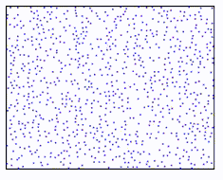
y
N molecules/particles
x
z
Need to find a distribution function of the form f(v)

Slide 10
Position space to Velocity space

Slide 12
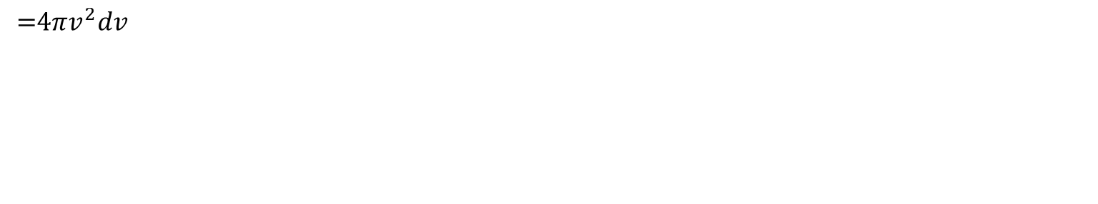

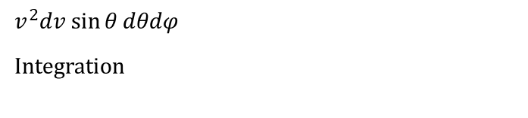
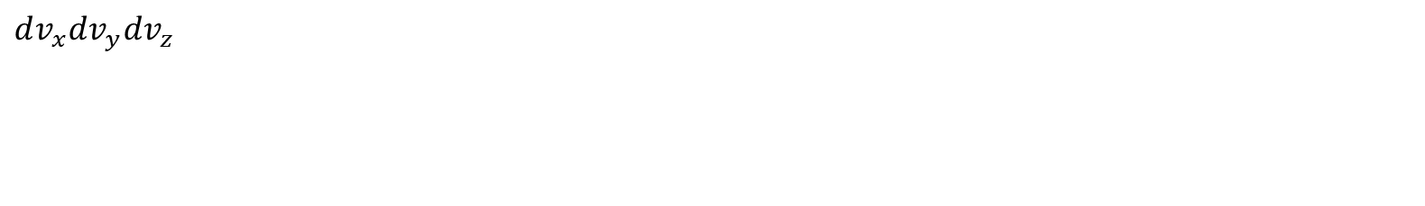


$$= \frac{dN}{N}$$
Probability of molecules which are moving between speeds of v and v + dv?
$$dv$$
Thickness of the spherical shell (Note: this is not tangent)
No of molecules/particles inside this shell of thickness dv
$$dv_{x}dv_{y}dv_{z}$$
$$dv$$
v
$$v^{2}dv\sin{θ}dθdφ$$
Integration
$$\text{ =4}πv^{2}dv$$

Slide 13
Maxwell’s speed distribution function and assumption’s

Slide 14
Maxwell’s velocity distribution function and assumption’s
A

Slide 15
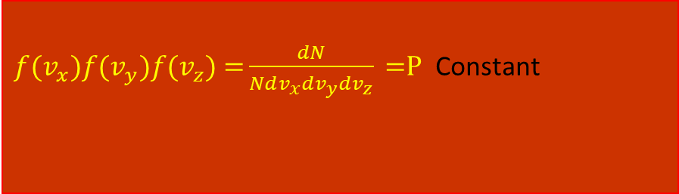
$f(v_{x})f(v_{y})f(v_{z})\text{ =}\frac{dN}{Ndv_{x}dv_{y}dv_{z}}\text{ =}\text{P}$ Constant

Slide 17
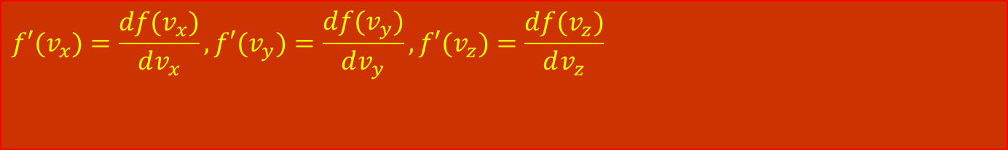
$$f′(v_{x})=\frac{df(v_{x})}{dv_{x}}, f′(v_{y})=\frac{df(v_{y})}{dv_{y}},f′(v_{z})=\frac{df(v_{z})}{dv_{z}}$$
2

Slide 18
Recollect eqn (1)
3

Slide 19
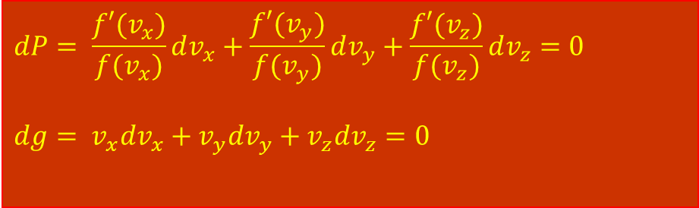
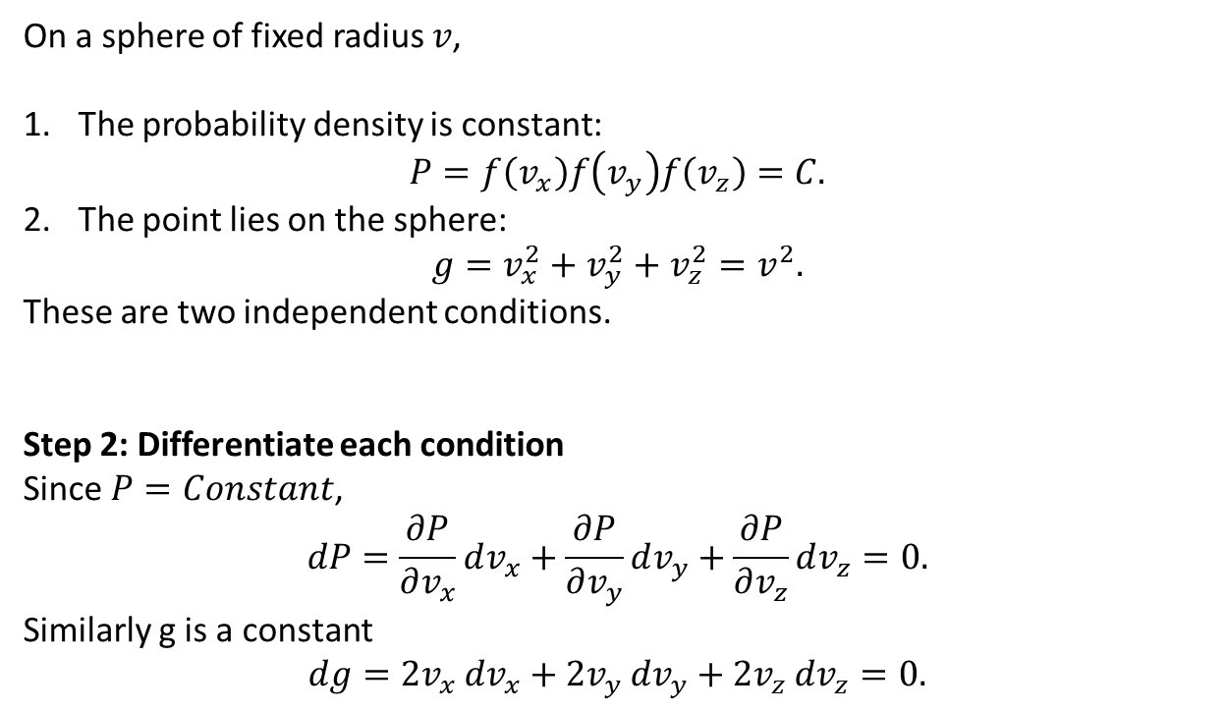
On a sphere of fixed radius $v$,
The probability density is constant:
$$P=f\left(v_{x}\right)f\left(v_{y}\right)f\left(v_{z}\right)=C.$$
The point lies on the sphere:
$$g=v_{x}^{2}+v_{y}^{2}+v_{z}^{2}=v^{2}.$$
These are two independent conditions.
Step 2: Differentiate each condition
Since $P=Constant$,
$$dP=\frac{∂P}{∂v_{x}}dv_{x}+\frac{∂P}{∂v_{y}}dv_{y}+\frac{∂P}{∂v_{z}}dv_{z}=0.$$
Similarly g is a constant
$$dg=2v_{x} dv_{x}+2v_{y} dv_{y}+2v_{z} dv_{z}=0.$$
$$dP= \frac{f′(v_{x})}{f(v_{x})}dv_{x}+\frac{f′(v_{y})}{f(v_{y})}dv_{y}+\frac{f′(v_{z})}{f(v_{z})}dv_{z}=0$$
$${dg= v}_{x}dv_{x}+v_{y}dv_{y}+v_{z}dv_{z}=0$$
dP = ∇P.dv =0 , dg = ∇g⋅dv = 0
Note dv is tangent vector hence ∇P and ∇g must be normal to sphere
∇P = ± β∇g.
dP ± βdg = 0.
∇P.dv = ± β∇g.dv
It could be parallel or antiparallel chose it as per physical correctness

Slide 20
Langrangian method of undetermined multiplier
(Mathematics)

Slide 21
Recollecting (A) and substituting

Slide 22
A
B

Slide 25
Maxwell’s distribution law

Slide 26
Maxwell Boltzmann
distribution law

Slide 27
Tutorial 1

Slide 28
Problem 1

Slide 29
Solution

Slide 31
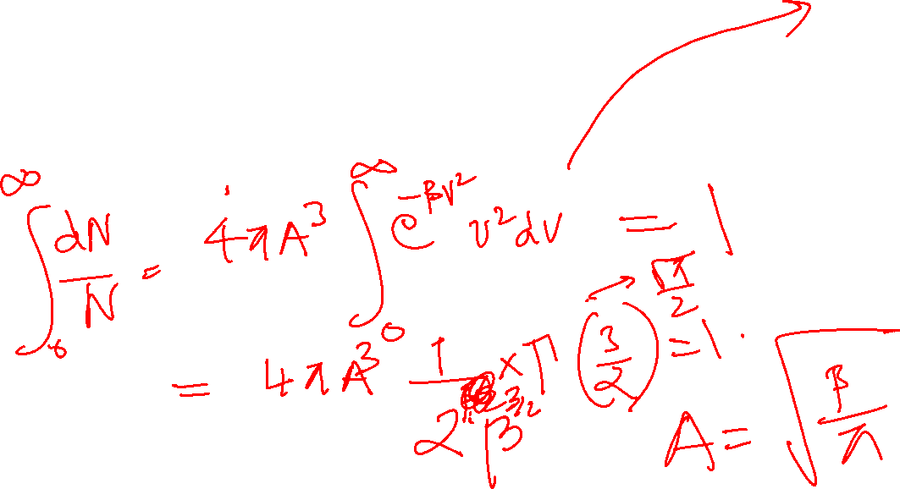
Solution

Slide 38
Using Law of Equipartition of energy

Slide 39
Distribution function
Maxwell Boltzmann speed distribution

Slide 40
Problem 2

Slide 41
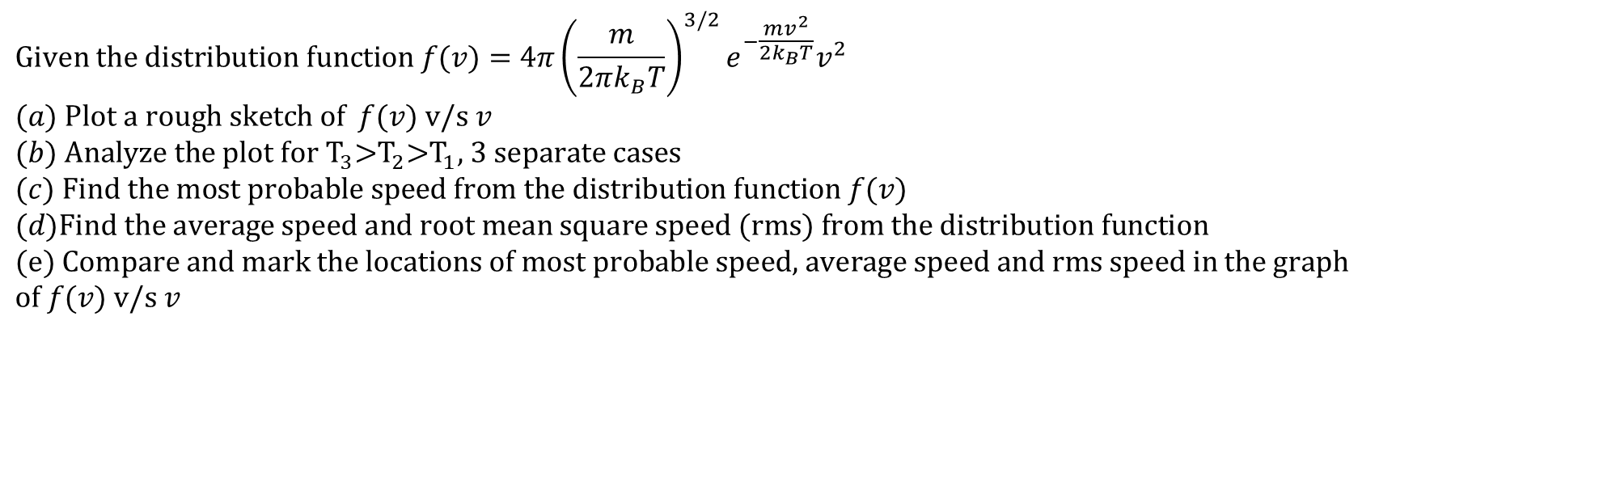

$$\text{Given the distribution function }f(v)=4π{\left(\frac{m}{2πk_{B}T}\right)}^{3/2}e^{−\frac{mv^{2}}{2k_{B}T}}v^{2} \\ (a)\text{ Plot a rough sketch of }f(v)\text{ v/s }v \\ (b)\text{ Analyze the plot for }{\text{T}}_{3}\text{>}{\text{T}}_{2}\text{>}{\text{T}}_{1}\text{, 3 separate cases} \\ (c)\text{ Find the most probable speed from the distribution function }f(v) \\ (d)\text{Find the average speed and root mean square speed }(\text{rms})\text{ from the distribution function} \\ (e)\text{ Compare and mark the locations of most probable speed, average speed and rms speed in the graph} \\ \text{of }f(v)\text{ v/s }v$$
$$\boxed{\int_{0}^{∞}{x^{n}}e^{−ax^{2}} dx=\frac{1}{2}a^{−\left(n+1\right)/2}Γ \left(\frac{n+1}{2}\right), a>0}$$
where
$$\boxed{Γ\left(z\right)=\int_{0}^{∞}{t^{z−1}}e^{−t}dt.}$$
Useful Gamma values are
$$Γ \left(\frac{1}{2}\right)=\sqrt{π}, \\ Γ \left(\frac{3}{2}\right)=\frac{1}{2}\sqrt{π}, \\ Γ \left(\frac{5}{2}\right)=\frac{3}{4}\sqrt{π}, \\ Γ\left(2\right)=1, \\ Γ\left(3\right)=2.$$

Slide 42
Distribution function
Maxwell Boltzmann speed distribution

