Slide 1
Season 2, Lecture 4 (S2,L4):
Tutorial 1 (contd)

Slide 3
Maxwell Boltzmann
distribution law

Slide 4
Name | L1 | L2 | L3 | L4
"2201ph34_dolly" <2201ph34_dolly@iitp.ac.in>; | p
"Adhila Aslam" <2201ph01_adhila@iitp.ac.in>; | p
"Aditi Baghel" <2201ph31_aditi@iitp.ac.in>; | p
"Aditya Kumar" <2201ph02_aditya@iitp.ac.in>; | a
"Aditya Singh" <2201ph03_aditya@iitp.ac.in>; | p
"Anil Ram" <2201ph04_anil@iitp.ac.in>; | a
"Animesh Sharma" <2201ph05_animesh@iitp.ac.in>; | p
"Arun Mishra" <2201ph06_arun@iitp.ac.in>; | p
"Aryan Raj" <2201ph32_aryan@iitp.ac.in>; | p
"Ayush Gautam" <2201ph07_ayush@iitp.ac.in>; | p
"Boda Vishnuwardhan" <2201ph08_boda@iitp.ac.in>; | p
"Chanchal Tolani" <2201ph09_chanchal@iitp.ac.in>; | p
"Devansh Srivastava" <2201ph33_devansh@iitp.ac.in>; | p
"Gaurav Verma" <2201ph10_gaurav@iitp.ac.in>; | p

Slide 5
Name | L1 | L2 | L3 | L4
"Gourav Jha" <2201ph11_gourav@iitp.ac.in>; | a
"Gurinder Dhillon" <2201ph12_gurinder@iitp.ac.in>; | p
"Harsh Joshi" <2201ph13_harsh@iitp.ac.in>; | a
"Himanshu Patel" <2201ph35_himanshu@iitp.ac.in>; | p
"Jigyasa Agrawal" <2201ph36_jigyasa@iitp.ac.in>; | a
"Khushal Yadav" <2201ph14_khushal@iitp.ac.in>; | p
"Krishnakant Chourey" <2201ph15_krishnakant@iitp.ac.in>; | p
"Manas Gupta" <2201ph16_manas@iitp.ac.in>; | a
"Mohit Saini" <2201ph17_mohit@iitp.ac.in>; | p
"Mude Naik" <2201ph18_mude@iitp.ac.in>; | a
"Murari Kumar" <2201ph19_murari@iitp.ac.in>; | a
"Nishant Yadav" <2201ph20_nishant@iitp.ac.in>; | p
"Pranitha Moluguri" <2201ph21_pranitha@iitp.ac.in>; | p

Slide 6
Name | L1 | L2 | L3 | L4
"Premanandh Sigamala" <2201ph22_premanandh@iitp.ac.in>; | a
"Ruchi Thakur" <2201ph23_ruchi@iitp.ac.in>; | a
"Satyam Sahoo" <2201ph25_satyam@iitp.ac.in>; | p
"Satyam Shandilya" <2201ph24_satyam@iitp.ac.in>; | p
"Shyam Hembram" <2201ph26_shyam@iitp.ac.in>; “ | p
Sougata Saha" <2201ph27_sougata@iitp.ac.in>; | p
"Sumit Rajpoot" <2201ph28_sumit@iitp.ac.in>; | p
"Suprajit Dewanji" <2201ph29_suprajit@iitp.ac.in>; | p
"Yepuri Subhash" <2201ph30_yepuri@iitp.ac.in> | a
Attendance: 75% mandatory

Slide 7
S2, L4, Tutorial 1

Slide 8
Distribution function
Maxwell Boltzmann speed distribution

Slide 9
Problem 2

Slide 10
(a) Complete Analysis of distribution function

Slide 11
Complete Analysis of distribution function

Slide 12
(b) With temperature

Slide 13
(c) Most Probable speed
Most probable speed

Slide 14
Complete Analysis of distribution function

Slide 15
Average speed
(d)
Root mean square speed (RMS)

Slide 16
(e) A comparison

Slide 17
Problem 3

Slide 18
Solution:

Slide 19
Solution:

Slide 20
Problem 1

Slide 21
Solution

Slide 23
Problem 2

Slide 24
Solution
1

Slide 25
Solution

Slide 27
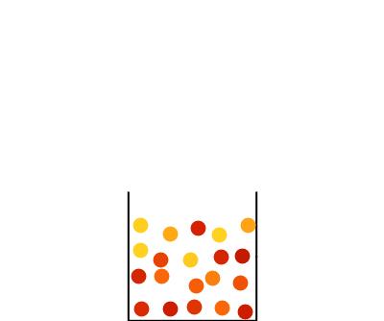

Slide 28
Problem 3

Slide 29
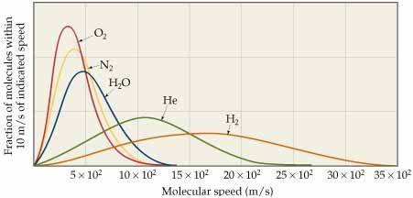
Solution

