Slide 1
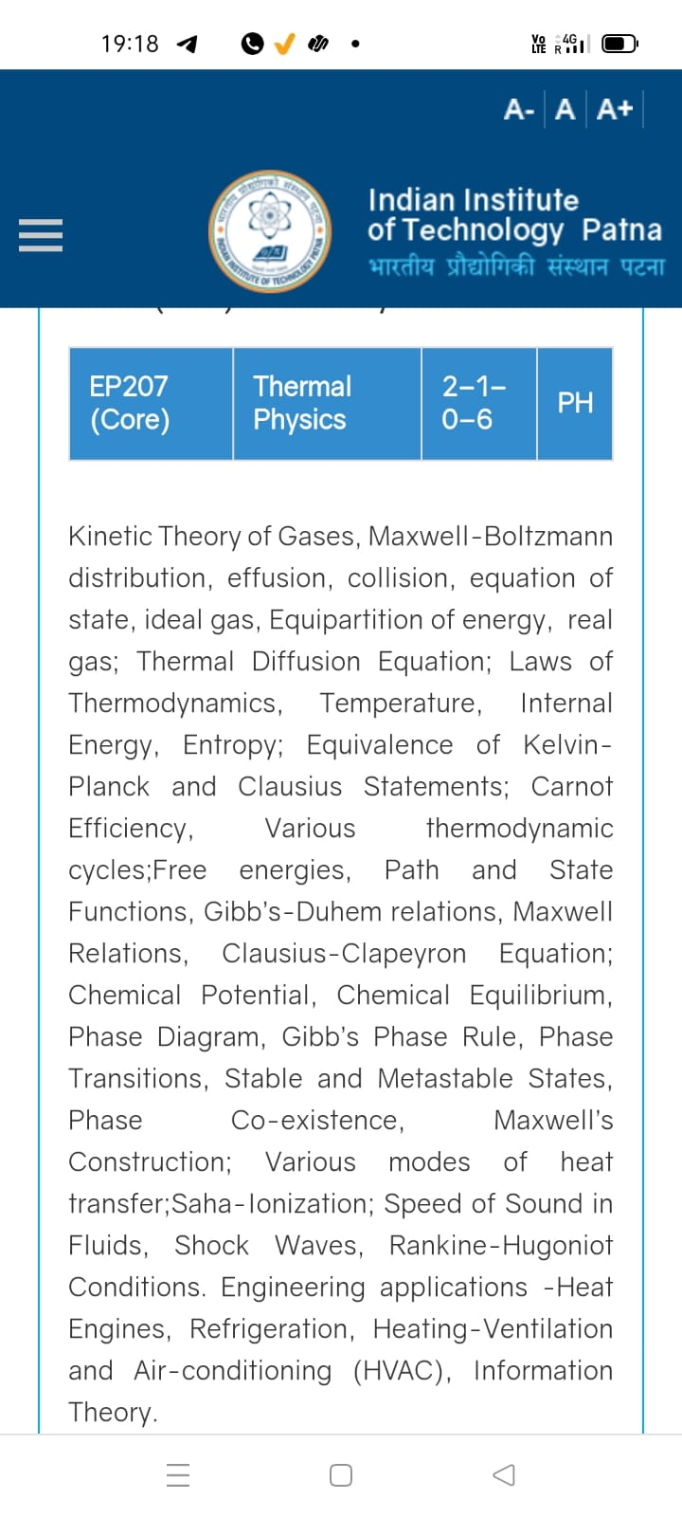
Season 5, Lecture 16 (S5,L16):
EP2104 Thermal physics with engineering applications
3-1-0-4

Slide 2
EP2104 Thermal physics with engineering applications
3-1-0-4
Syllabus
Course Outline Kinetic Theory of Gases, Maxwell-Boltzmann distribution, Mean free path, collision, equation of state, ideal gas, Equipartition of energy, real gas; Thermal Diffusion Equation, effusion; Laws of Thermodynamics, Temperature, Internal Energy, specific heat, Entropy;
Carnot engine, Various thermodynamic cycles; Thermodynamic potentials, Path and State Functions, Gibb’s-Duhem relations, Maxwell Relations; Clausius-Clapeyron Equation; Chemical Potential, Chemical Equilibrium, Phase Diagram, Gibb’s Phase Rule, Phase Transitions, Stable and Metastable States, Phase Co-existence, Maxwell’s Construction; Various modes of heat transfer; Saha-Ionization; Speed of Sound in Fluids, Shock Waves, Rankine-Hugoniot Conditions. Engineering applications -Heat Engines, Joule-Thompson effect and applications to cryogenics, Refrigerators, Heating-Ventilation and Air-conditioning (HVAC), Exergy analysis of engineering systems, Information Theory.
Additional Topics: Thermal Physics and Quantum Memory for Quantum Communication.

Slide 3
Time | 11:11:55 | 12-12:55 | 3-3:55 | 4- 4:55 | 02-02:55
Day
Monday |  | R103
Tuesday |  |  | R103
Wednesday |  |  |  | R103
Thursday | R101

Slide 4
 |  | L1 | L2 | L3 | L4 | L5 | L6 | L7 | L8 | L9 | L10 | L11 | L12 | L13 | L14 | L15 | L16
 | "Anirudh Karthikeyan" <anirudh_2501ph19@iitp.ac.in>; | p | p | p | p | p | p | q | P | a | a | p | p | p | P | p | p
2. | "Anshita Meena" <anshita_2501ph08@iitp.ac.in>; | p | p | p | p | p | p | q | P | p | p | p | p | p | P | p | p
3. | "Aritro Ghosh" <aritro_2501ph03@iitp.ac.in>; | p | a | p | p | p | p | a | P | p | p | p | p | p |  | p
4. | "Arunya Guha" <arunya_2501ph28@iitp.ac.in>; | p | p | a | p | p | p | a | P | p | p | p | p | a |  | p
5. | "Avala Venkata Hemanth" <avala_2501ph37@iitp.ac.in>; | a | a | a | p | p | p | p | P | p | p | p | p | p |  |  | p
6. | "Ayush Kumar" <ayush_2501ph24@iitp.ac.in>; | p | p | a | p | p | p | p | p | p | p | a | p | p |  | p
7. | "Badavath Madhulatha" <badavath_2501ph38@iitp.ac.in>; | p | p | a | p | p | p | q | P | p | p | p | a | p | P | p | p
8. | "Banothu Somanna" <banothu_2501ph36@iitp.ac.in>; | p | p | p | p | p | p | a | A | p | a | p | a | a | P
9. | "Chenche Shankara Suman" <chenche_2501ph07@iitp.ac.in>; | p | p | p | p | p | a | a | P | p | p | p | p | p |  | p | p
10. | "Davala Bhuvana Karthik" <davala_2501ph25@iitp.ac.in>; | p | p | p | p | p | p | a | A | p | p | p | p | p | P | p

Slide 5
 |  | L1 | L2 | L3 | L4 | L5 | L6 | L7 | L8 | L9 | L10 | L11 | L12 | L13 | L14 | L15 | L16
11. | "David Pratap Singh" <david_2501ph26@iitp.ac.in>; | p | p | q | p | p | p | p | P | p | p | p | a | p | P | p | p
12. | "Deepak Kumar" <deepak_2503ph03@iitp.ac.in>; | p | p | q | p | p | p | p | P | p | a | p | p | p | P | p | p
13. | "Dekka Nivas" <dekka_2501ph29@iitp.ac.in>; | p | p | q | p | p | p | p | P | p | p | p | p | p |  | p
14. | "Gamit Marlon Maheshbhai" <gamit_2501ph21@iitp.ac.in>; | p | p | q | p | p | p | p | P | p | a | a | p | p |  | p
15. | "Himesh Katare" <himesh_2501ph33@iitp.ac.in>; | p | p | q | p | p | p | p | P | p | p | p | p | p | P | p
16. | "Jadhav Vedant Rajesh" <jadhav_2501ph06@iitp.ac.in>; | p | p | q | p | p | p | p | P | p | p | p | p | p | P | p | p
17. | "Johaan Peter Thekkan" <johaan_2501ph05@iitp.ac.in>; | p | p | q | p | p | p | p | P | p | p | p | p | p | P | p | p
18. | "Karri Akshara" <karri_2501ph13@iitp.ac.in>; | p | p | q | p | p | p | p | P | p | p | p | p | p | P | p | p
19. | "Kashvi Mehta" <kashvi_2501ph32@iitp.ac.in>; | p | p | q | p | p | p | p | P | p | p | p | p | p | P | p | p
20. | "Kirti Chandra" <kirti_2501ph35@iitp.ac.in>; | p | p | q | a | p | p | p | P | p | p | p | p | p | P | p | p

Slide 6
 |  | L1 | L2 | L3 | L4 | L5 | L6 | L7 | L8 | L9 | L10 | L11 | L12 | L13 | L14 | L15 | L16
21 | "Krishna Mule" <krishna_2501ph04@iitp.ac.in>; | p | p | q | p | p | p | p | P | p | p | p | p | p | P | p | p
22. | "Kummetha Sai Darshan Reddy" <kummetha_2501ph17@iitp.ac.in>; | p | p | p | p | p | p | p | P | p | p | p | p | a | P | p | p
23. | "Maddirala Bhanu Kiran" <maddirala_2501ph31@iitp.ac.in>; | p | p | q | a | a | a | p | P | p | p | p | p | p | P | p | p
24. | "Manish" <manish_2501ph22@iitp.ac.in>; | p | p | q | p | p | p | p | P | p | p | p | p | p | P | p
25. | "Mohammad Owais Ansari" <mohammad_2501ph18@iitp.ac.in>; | p | p | q | p | p | p | p | P | p | p | p | p | p | P | p | p
26. | "Muhammed Rehaan Sharafudheen" <muhammed_2501ph20@iitp.ac.in>; | p | p | q | p | p | p | p | P | p | p | p | p | p | P | p | p
27. | "Nikhil" <nikhil_2501ph34@iitp.ac.in>; | p | p | q | p | p | p | p | P | p | p | p | p | p |  |  | p
28. | "Poodari Shivani" <poodari_2503ph04@iitp.ac.in>; | p | p | q | p | p | p | p | P | p | p | p | p | p |  |  | p
29. | "Rahul Yadav" <rahul_2501ph23@iitp.ac.in>; | p | p | q | p | p | p | p | P | p | p | p | p | p |  | p
30. | "Rohit David Paul" <rohit_2501ph11@iitp.ac.in>; | p | p | a | p | a | a | a | P | p | a | p | a | p

Slide 7
 |  | L1 | L2 | L3 | L4 | L5 | L6 | L7 | L8 | L9 | L10 | L11 | L12 | L13 | L14 | L15 | L16
31 . | "Ronak Jakhar" <ronak_2501ph10@iitp.ac.in>; | p | p | p | p | p | p | P | P | p | p | p | p | p | P | P | p
32. | "Rudraneel Shee" <rudraneel_2501ph15@iitp.ac.in>; | p | p | p | p | p | p | P | P | p | p | a | p | p |  | P | p
33. | "S Ragul Raagav" <s_2503ph02@iitp.ac.in>; | p | p | p | p | p | p | P | P | p | p | p | p | p |  | P
34. | "Sara Khan" <sara_2501ph30@iitp.ac.in>; | p | p | p | p | p | p | P | P | p | p | p | p | p | P | P | p
35. | "Shaik Jabeer Sulthan" <shaik_2501ph16@iitp.ac.in>; | p | p | p | p | p | p | a | A | p | a | p | p | p |  | P | p
36. | "Shourya Sharma" <shourya_2503ph01@iitp.ac.in>; | p | p | a | a | p | P | P | P | P | P | P | a | p |  | P
37. | "Shreyas Saraswatiprasad Waikar" <shreyas_2501ph02@iitp.ac.in>; | p | p | p | p | p | p | p | P | p | p | p | p | p | P | P | p
38. | "Snehardra Das" <snehardra_2501ph14@iitp.ac.in>; | p | p | p | a | p | p | a | P | a | a | a | a | p |  |  | p
39. | "Tejeswin R" <tejeswin_2501ph09@iitp.ac.in>; | p | p | a | p | p | a | p | P | p | p | p | p | p |  | P | p
40. | "Varkatam Akshaya" <varkatam_2501ph12@iitp.ac.in>; | p | p | p | p | p | p | p | P | p | a | p | a | p |  | P | p

Slide 8
 |  | L1 | L2 | L3 | L4 | L5 | L6 | L7 | L8 | L9 | L10 | L11 | L12 | L13 | L14 | L15 | L16
41. | "Vivanshu Chauhan" <vivanshu_2501ph01@iitp.ac.in>; | p | p | p | p | p | p | a | P | p | p | p | p | p | P | P | p
42. | "Yogesh Kumar" yogesh_2501ph27@iitp.ac.in | p | p | p | p | p | p | a | P | p | p | p | p | p |  | P | p
Attendance: 75% mandatory

Slide 9
Introduction to Thermodynamics
A revision

Slide 10
Macroscopic approach
Does not probe system at molecular level
Thermodynamic variables P,V,T etc
System and rest of universe (reservoir: Infinite heat capacity)
System is separated by a wall

Slide 11
Zeroth Law of Thermodynamics
R. H. Fowler :1931

Slide 12
Statement
If two systems are in thermal equilibrium with a third system then those two are in thermal equilibrium with each other
A
B

Slide 13
Statement
If two systems are in thermal equilibrium with a third system then those two are in thermal equilibrium with each other
B
C

Slide 14
Statement
If two systems are in thermal equilibrium with a third system then those two are in thermal equilibrium with each other
A
C

Slide 15

Statement
Same Temperature
A
C

Slide 16
Statement
No Heat Flow
A
C

Slide 17
B
DIATHERMIC (CONDUCTING)
A
ADIABATIC
(NON
CONDUCTING)
C

Slide 18
B
ADIABATIC
A
DIATHERMIC (CONDUCTING)
C
No heat flow

Slide 19
First Law of Thermodynamics
Law of Conservation of Energy

Slide 20
First Law of Thermodynamics
Law of Conservation of Energy

Slide 21
Statement
Energy is conserved and heat and work are both forms of energy.

Slide 22
TUTORIAL 4
“Application engineering” problems
(First Law)

Slide 23
1. “Electric heater + Piston cylinder”

Slide 25
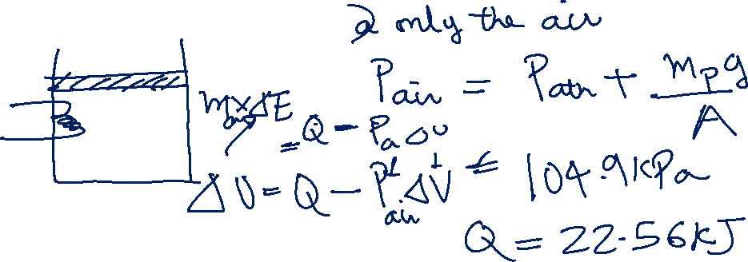

Slide 28
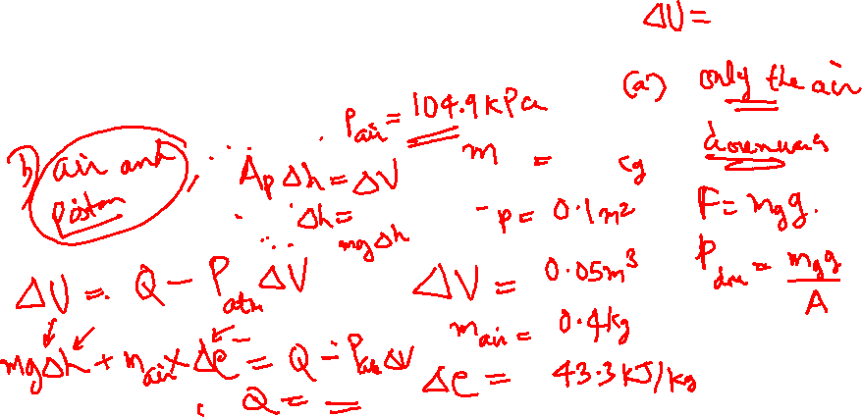

Slide 29
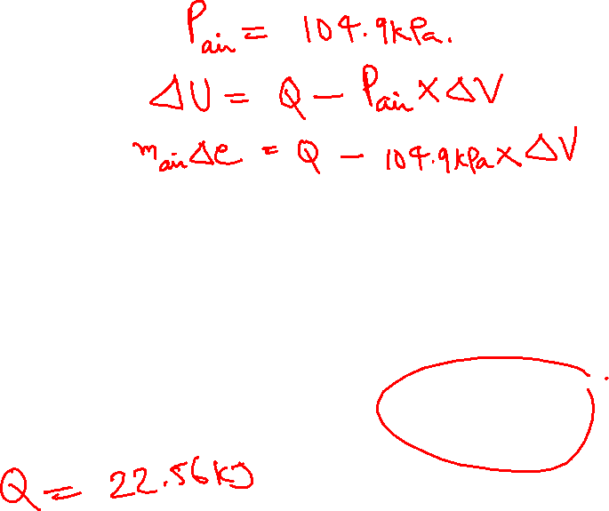
100 kPa

Slide 30
a) Only the air
100 kPa

Slide 31
100 kPa

Slide 32
a) Air and the Piston
100 kPa

Slide 33
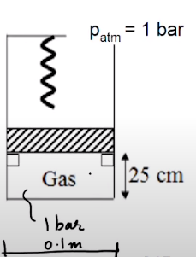
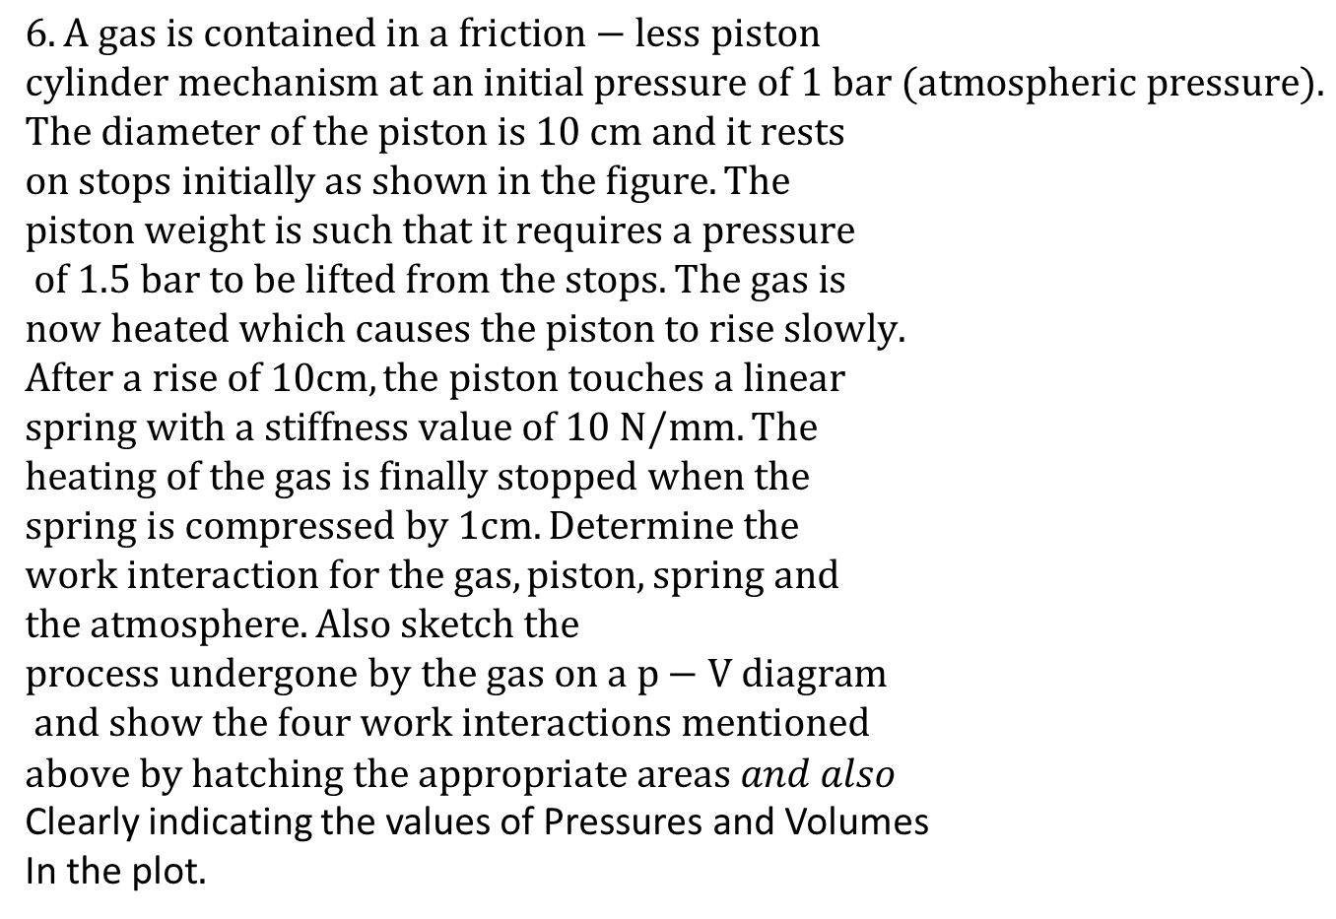
$$6. A gas is contained in a friction−less piston \\ cylinder mechanism at an initial pressure of 1 bar (atmospheric pressure). \\ The diameter of the piston is 10 cm and it rests \\ on stops initially as shown in the figure. The \\ piston weight is such that it requires a pressure \\ of 1.5 bar to be lifted from the stops. The gas is \\ now heated which causes the piston to rise slowly. \\ After a rise of 10cm, the piston touches a linear \\ spring with a stiffness value of 10 N/mm. The \\ heating of the gas is finally stopped when the \\ spring is compressed by 1cm. Determine the \\ work interaction for the gas, piston, spring and \\ the atmosphere. Also sketch the \\ process undergone by the gas on a p−V diagram \\ and show the four work interactions mentioned \\ above by hatching the appropriate areas and also$$
Clearly indicating the values of Pressures and Volumes
In the plot$.$
stops

Slide 39
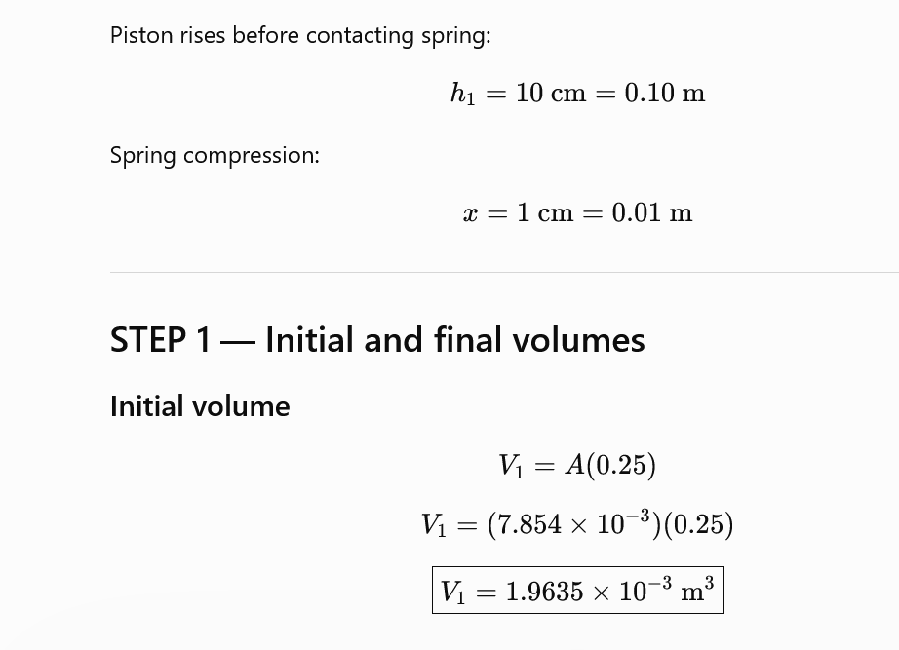
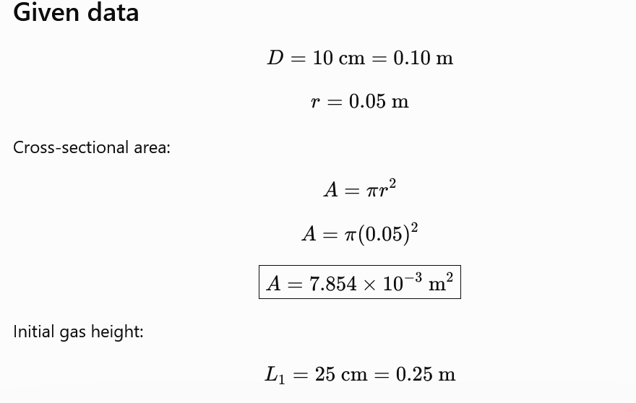

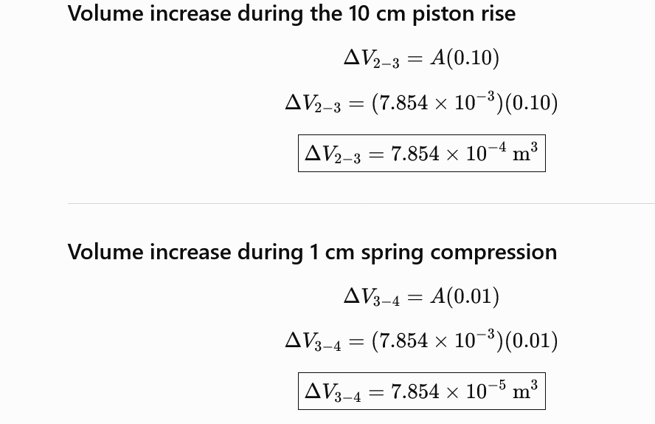
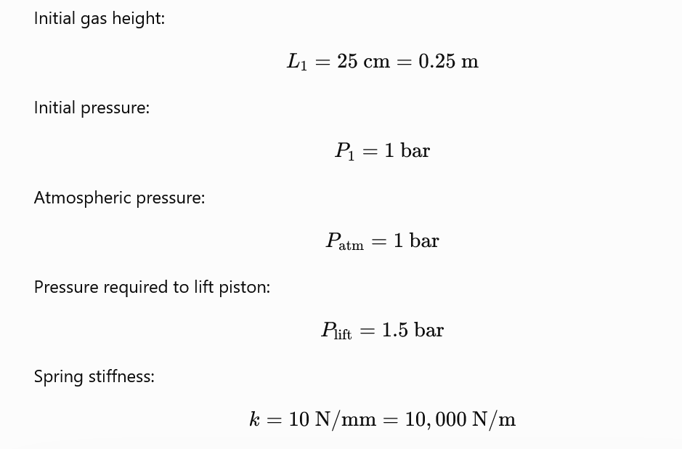
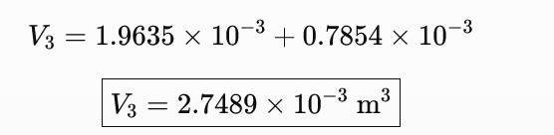
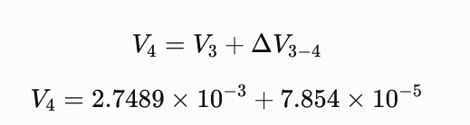
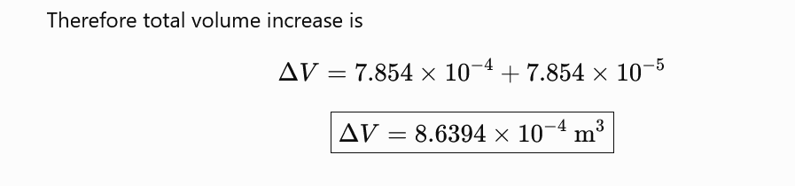


Slide 40
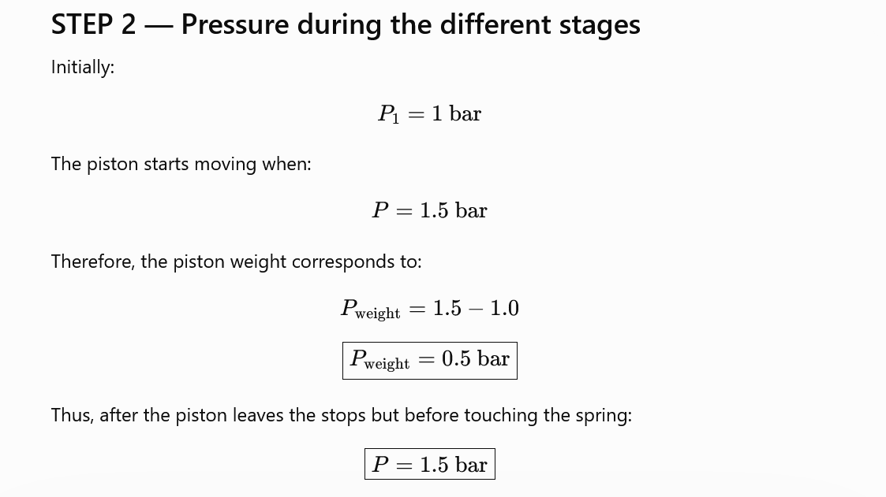
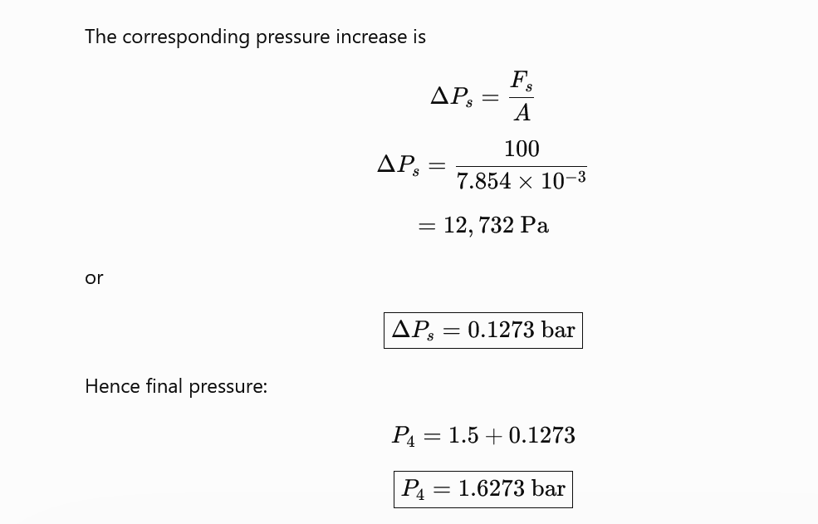
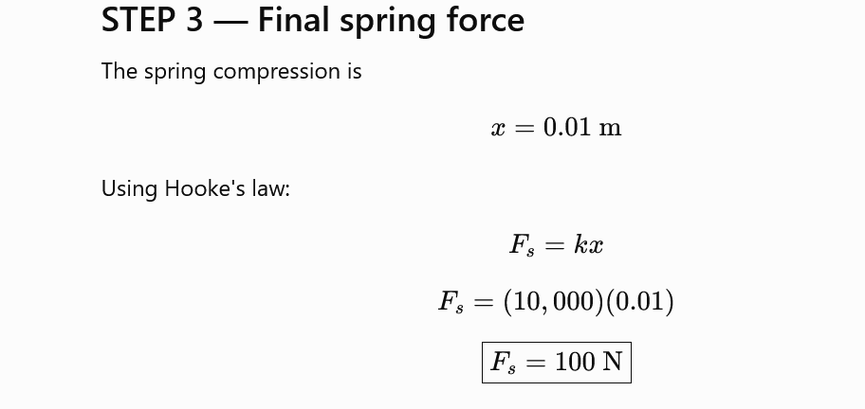
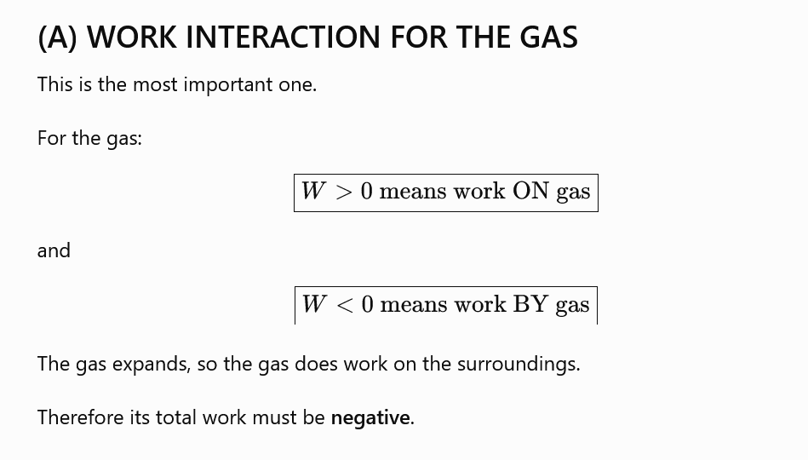

Slide 41
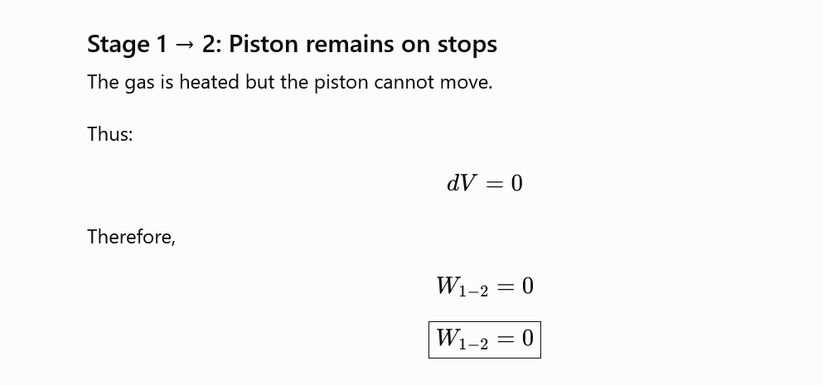
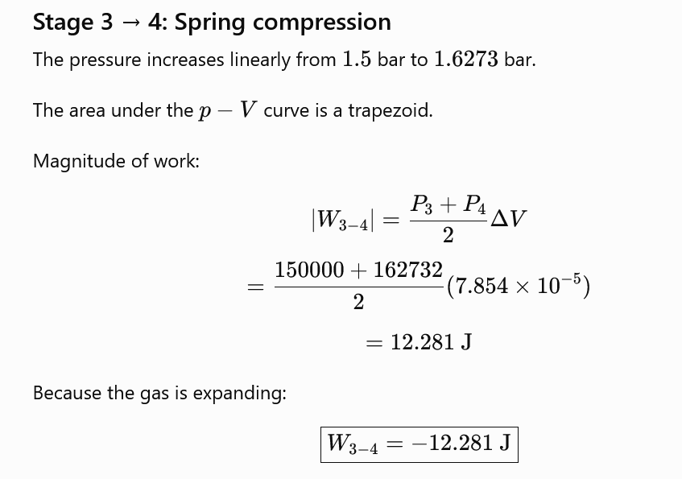
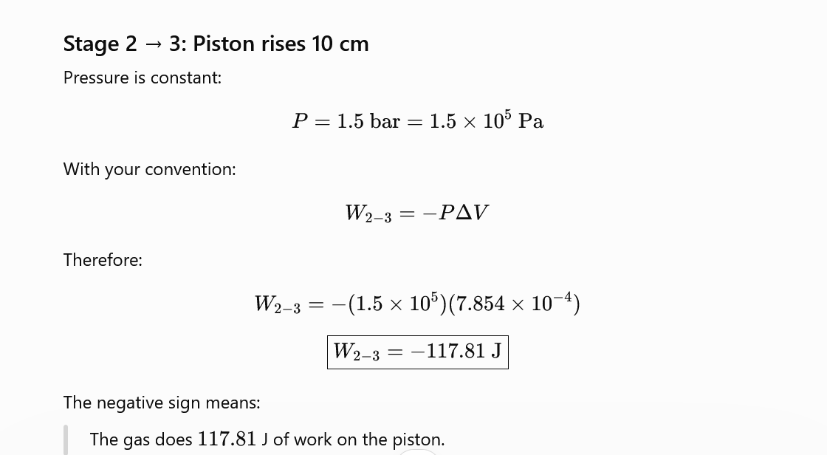
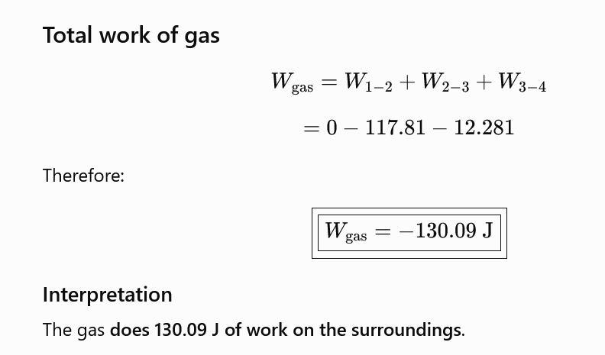

Slide 42
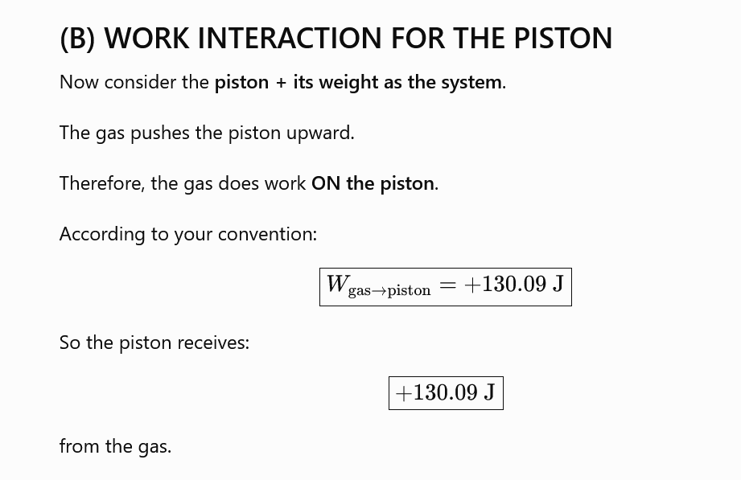
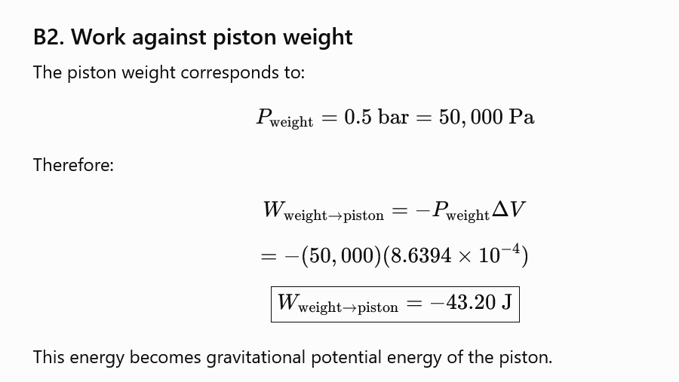
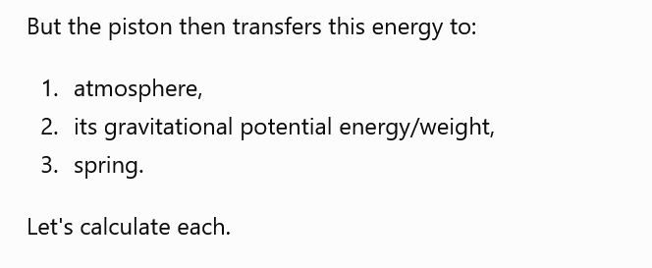
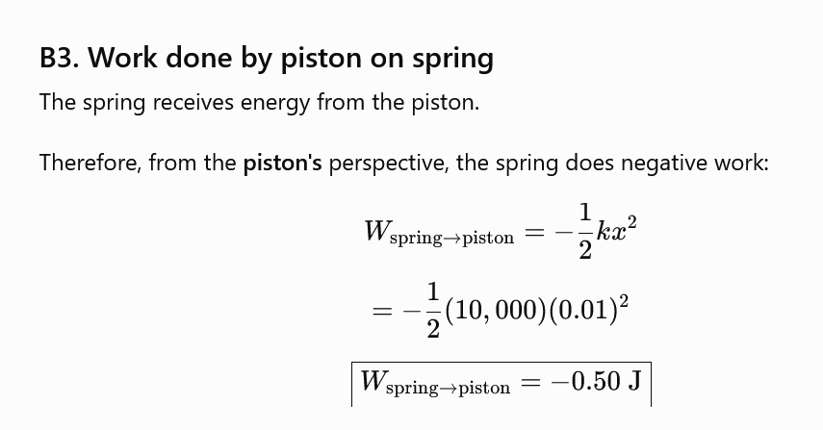
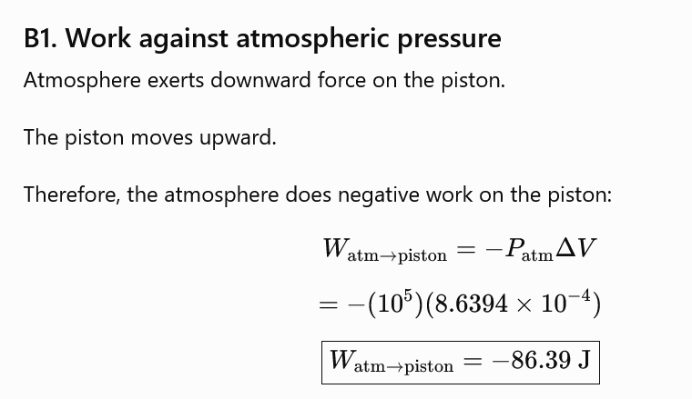

Slide 43
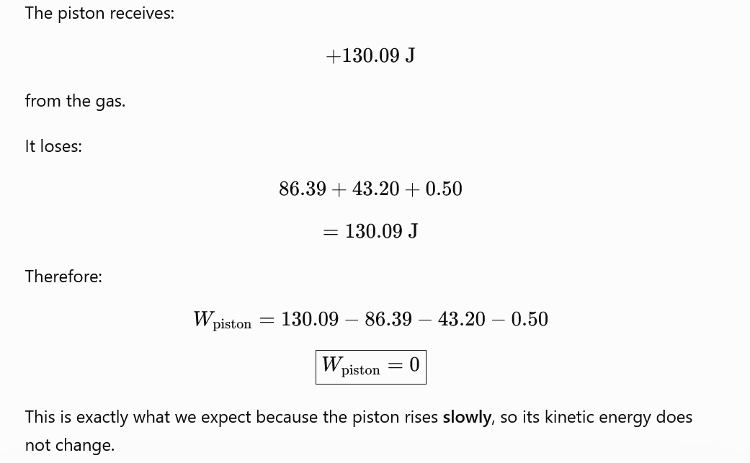
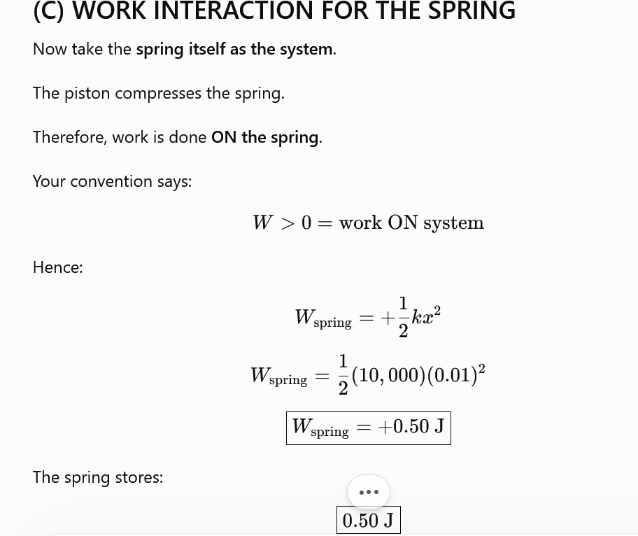
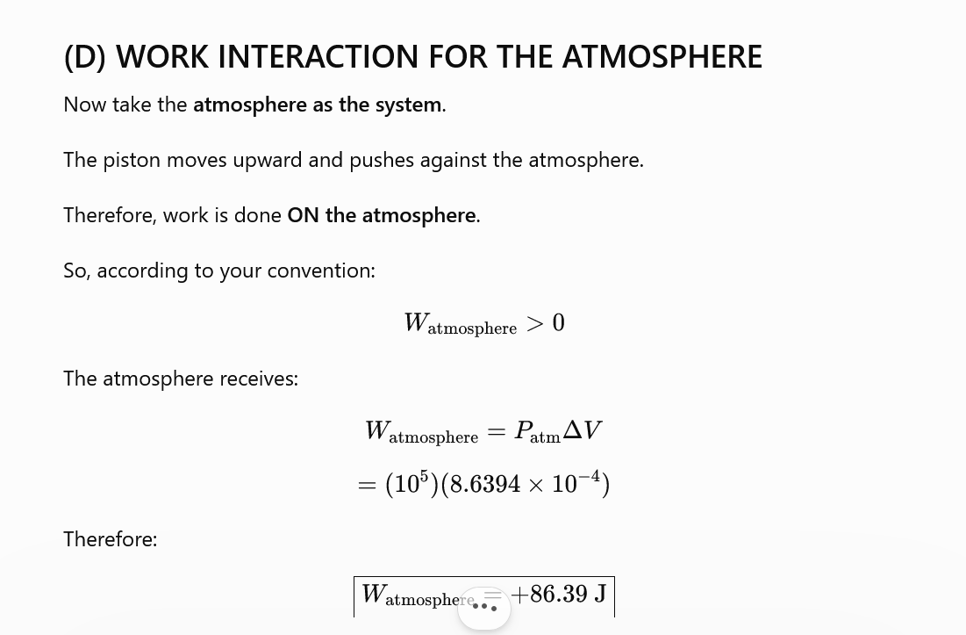
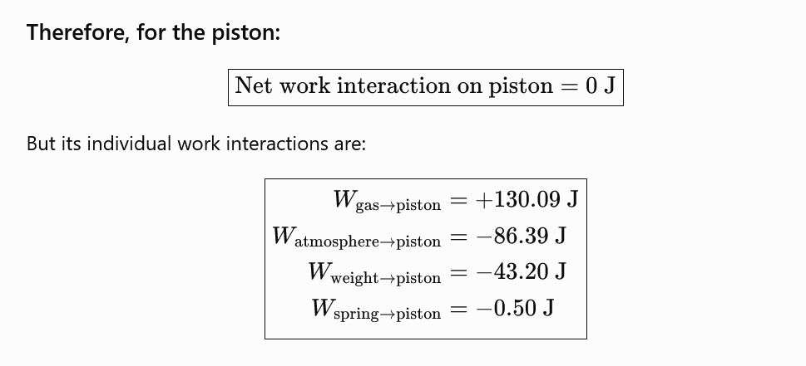

Slide 44
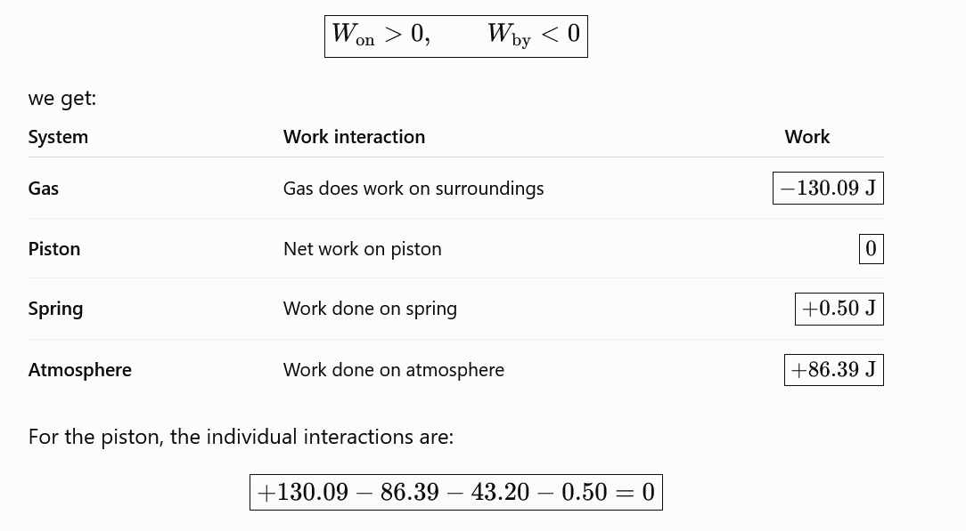

Slide 45
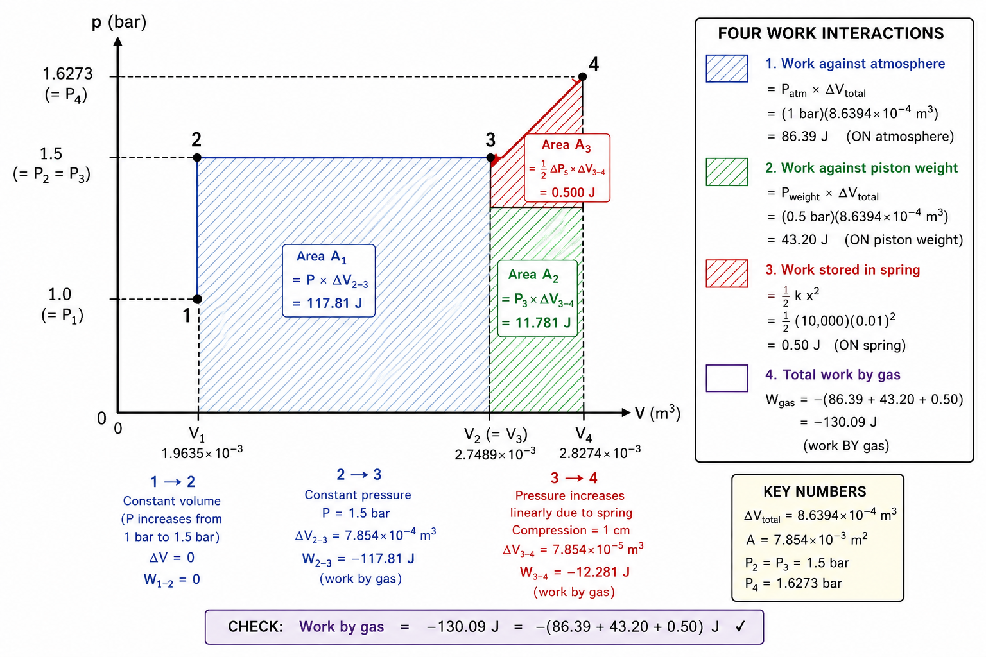

Slide 46
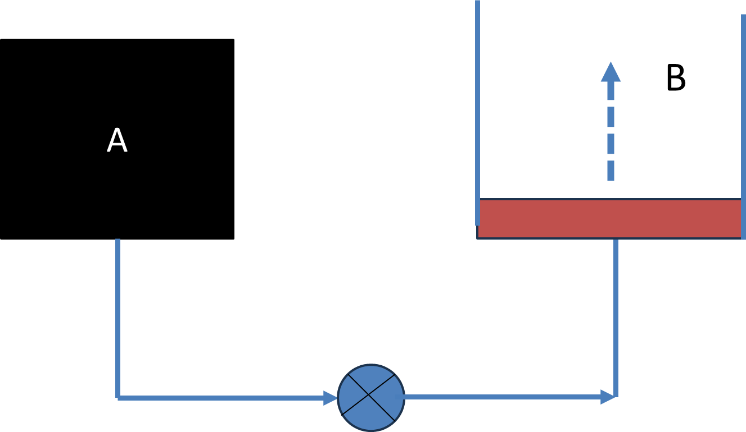
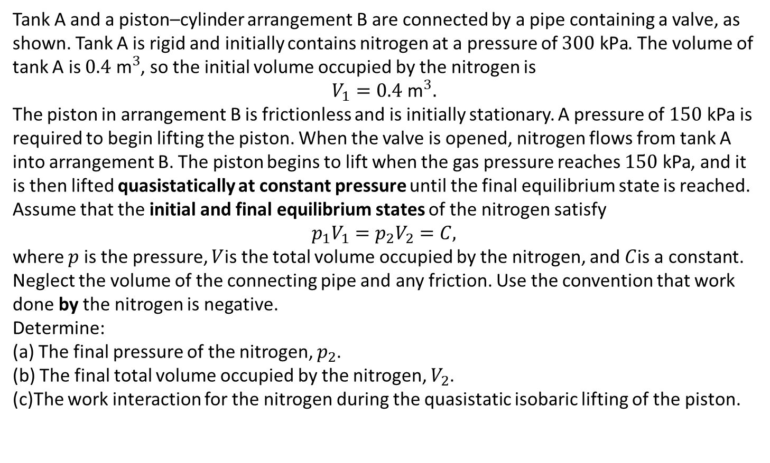
Tank A and a piston–cylinder arrangement B are connected by a pipe containing a valve, as shown. Tank A is rigid and initially contains nitrogen at a pressure of $300\text{ kPa}$. The volume of tank A is $0.4{\text{ m}}^{3}$, so the initial volume occupied by the nitrogen is
$$V_{1}=0.4{\text{ m}}^{3}.$$
The piston in arrangement B is frictionless and is initially stationary. A pressure of $150\text{ kPa}$is required to begin lifting the piston. When the valve is opened, nitrogen flows from tank A into arrangement B. The piston begins to lift when the gas pressure reaches $150\text{ kPa}$, and it is then lifted quasistatically at constant pressure until the final equilibrium state is reached.
Assume that the initial and final equilibrium states of the nitrogen satisfy
$$p_{1}V_{1}=p_{2}V_{2}=C,$$
where $p$is the pressure, $V$is the total volume occupied by the nitrogen, and $C$is a constant. Neglect the volume of the connecting pipe and any friction. Use the convention that work done by the nitrogen is negative.
Determine:
(a) The final pressure of the nitrogen, $p_{2}$.
(b) The final total volume occupied by the nitrogen, $V_{2}$.
(c)The work interaction for the nitrogen during the quasistatic isobaric lifting of the piston.

Slide 48
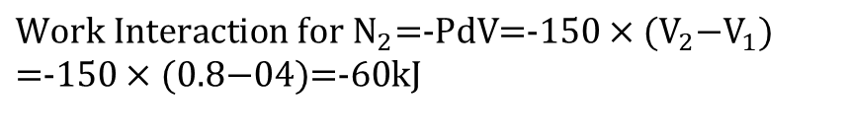
$$\text{Work Interaction for }{\text{N}}_{2}\text{=}\text{−}\text{PdV=}\text{−}\text{150}×(V_{2}\text{−}{\text{V}}_{1}) \\ \text{=}\text{−}\text{150}×(\text{0.8−04})\text{=}\text{−}\text{60kJ}$$

Slide 49
“Cutting tool Lathe”

