Slide 1
RIGID BODY IN MOTION
Chapter 4

Slide 2
How to find principal axis????
For simple geometries it is easy to find by intuition but not for any general case
How to find diagonalized MI matrix??
Mathematical approach!

Slide 3
Square Laminar Problem

Slide 4
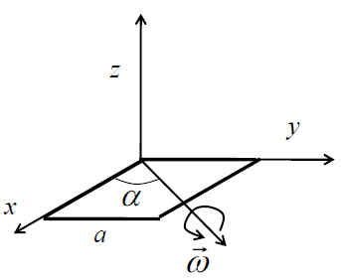
How to find principal axis????
Unknowns
Step: 1
Find the axis of rotation where L and ω are parallel.
WE IMPOSE THE CONDITION, TO MAKE L AND ω PARALLEL
Find the unknowns ω and λ

Slide 5
How to find principal axis????
Unknowns
Insert a unit matrix

Slide 6
How to find principal axis????
Theorem: If [A][x]=0, then [A] is non-invertible. This implies A⁻¹ does not exist
Hence, |A|=0.
Characteristic Equation

Slide 7
How to find principal axis????
Solving characteristic equation result in
λ_{1,} λ₂, λ_{3.}
Substitute
λ_{1,} λ₂, λ₃ separately and solve for ωs

Slide 8
Note!
λ_{1,} λ₂, λ₃ are called the Eigen values which satisfies the equation
[ω]’s are called the Eigen vectors.
For each Eigen values, Eigen vector can be found.

Slide 9
Step2: How to find diagonalized MI matrix??
Whenever ω is parallel to L, choosing the corresponding direction of rotation as co-ordinate axis will be the principal axes
By writing eigen values as diagonal elements chooses Moment of Inertia matrix
corresponding to a co-ordinate axis as its rotation axis

Slide 10
Step2: How to find diagonalized MI matrix??
Following Diagonalization Theorem,
Diagonalization ensures the rotation axis is along the coordinate axis (Principal axis)
Diagonalization Theorem in mathematics rotates the co-ordinate axis to the axis where L and ω are parallel
(Will be taught in MA102)

Slide 12
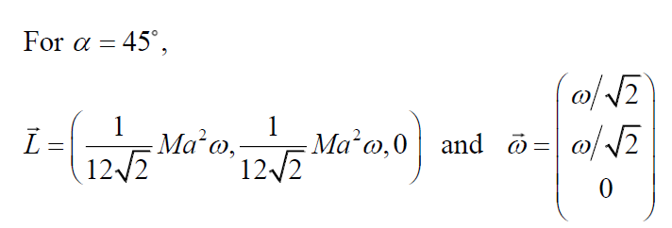
Comparison with Square Laminar Problem
Mathematical approach
Square Laminar Problem
Given an Aribitary [I]
Find the axis of rotation where L and ω are parallel.
[I]=
Step1:
Impose the condition
Z
X
Y
ω
This is one of the λ
Z
Find λ_{1,} λ₂, λ₃
Other 2 axis of rotation’s for which L and are ω are parallel are
For each λ, corresponding [ω]’s can be found
X
[ω]’s also give the corresponding axis of rotations
Step2: By writing eigen values as diagonal elements chooses Moment
of Inertia matrix corresponding to a co-ordinate axis as its rotation axis
MI (Principal axes)
MI (Principal axes)
Will be discussed in Tutorials

Slide 13
Let us try one example

Slide 14
How to find the principal axis of a rigid body?
y
Given a moment of Inertia matrix for some unknown
x
This Co-ordinate axis corresponds which the MI matrix given in the problem
Step 1: Find an axis for which L is parallel to ω for the given [I]

Slide 15
Finding an axis for which L is parallel to ω for the given [I]
IMPOSING THE CONDITION TO THE GIVEN [I]
BY IMPOSING THIS CONDITION AND FINDING THE UNKNOWNS λ AND ω GIVE INFORMATION ABOUT THE AXIS FOR WHICH L AND ω ARE PARALLEL FOR THE UNKNOWN RIGID BODY

Slide 16
Finding an axis for which L is parallel to ω for the given [I]
$$\left[I\right]ω − λω =0$$
$\left[\begin{aligned}2 −λ −1 \\ −1 2−λ\end{aligned}\right]\left[\begin{aligned}ωx \\ ωy\end{aligned}\right]$ = 0
Theorem: If [A][x]=0, then [A] is non-invertible. This implies A⁻¹ does not exist
Hence, |A|=0.
We can find relations btw $ωx$ and $ωy$
Characteristic Equation

Slide 17
Finding an axis for which L is parallel to ω for the given [I]
λ_{1,} λ₂ are called the Eigen values which satisfies the equation
[ω]’s are called the Eigen vectors.
For each Eigen values, Eigen vector can be found.

Slide 18
Eigen vector corresponding to λ ₁ =1
Eigen vector corresponding to λ ₁ =1 is

Slide 19
Eigen vector corresponding to λ ₂ =3
Eigen vector corresponding to λ ₂ =3

Slide 20
Physical meaning of eigenvectors
Eigenvector1
Y
Eigenvector2
ω
X
ω

Slide 21
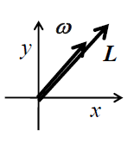
This Situation is similar to……….Rotation at 45 degrees
Z
X
ω
L and ω are parallel!

Slide 22
BUT STILL MI [I] is not diagonal
FINDING THE PRINCIPAL AXIS
BY DIAGONALIZATION OF [I]

Slide 23
Step2: Rotating Co-ordinates axis to the axis where L and ω are parallel
Diagonalization Theorem in mathematics rotates the axis to the axis where L and ω are parallel
Diagonalization ensures the rotation axis is along the coordinate axis (Principal axis)
Such Matrix are obtained by
writing Eigen Values
as diagonal elements
I = D = $\left[\begin{matrix}λ1 & 0 \\ 0 & λ2\end{matrix}\right]$

Slide 24
Step2: Rotating Co-ordinates axis to the axis where L and ω are parallel
Eigenvector1
Y
Y
Eigenvector2
ω
X
X
ω

Slide 25
Moment of Inertia matrix for principal axis
Moment of Inertia Matrix in the principal axes
Eigen Values in the principal axis are
Eigen Vectors in the principal axis are
Angular momentum equations are

