Slide 1
Find out the Single-photon recoil velocity and recoil temperature for Sodium atom [Mass of Na atom is 22.98 a.m.u, Resonant wavelength = 589.3 nm]

Slide 2
An ensemble of two level atoms moving at a room temperature of 300K needs to be laser cooled and trapped in an experiment. Assume average atomic speed inside the Vacuum chamber as 300m/s. Being an experimentalist in Quantum Optics, think of implementing this in a set up
How will you achieve the appropriate detuning for the laser experimentally for cooling process? (a)What will be the experimental parameters you need to set for laser cooling stage and MOT stage given the Magnetic field numerical value changes from +0.5G to -0.5G along the periphery of the laser cooling beam in an anti-Helmholtz configuration. Magnetic field gradient is very small and negligible (Band gap Wavelength for this atom 750 nm)
Sketch the Experimental sequence of laser cooling stage and MOT stage assuming optimum time scales of frequency ramp as 5 ms for laser cooling and 10 ms for MOT stage. {Use F = 0 to F = 1 as ground and excited states, for simplicity choose gf = 1 for F = 1 level of the hypothetical atom}

Slide 10
Potential seen by the atom in different mF states
1/2 kx²
mF = +1
mF = 0
-1/2 kx²
mF = -1

Slide 11
Restoring Force
Hence, restoring force is experienced for atoms having electron in mF =+1 state only (F=-Kx form)
Only those toms will ‘feel’ a trapping potential
This is like a trap for atoms having electron in mF =+1 inside this region
where +1g_{F}µ_{B}B(x) >>> ½ mv_{D}²

Slide 12
Atomic cloud
½ mv_{D}²
mF = +1
+1g_{F}µ_{B}B(x)
+1g_{F}µ_{B}B(x) >>> ½ mv_{D}²
Atoms who has ½ mv²>>> +1g_{F}µ_{B}B(x) will escape the trap leaving
Colder ones behind and they thermalize
Evaporation Process……

Slide 13
Self Evaporation
mF = +1
Overall temperature goes down

Slide 14
Temperature measurement
Trap off
Cloud expands
camera
Atom
cloud
Resonant light is shone on to atoms

Slide 15
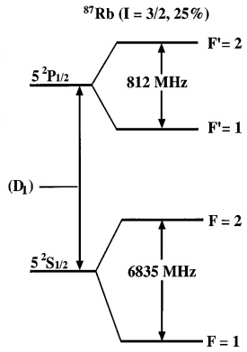
Frequency of detection light?
+2
-2
-2
-1
mF
σ+Light, ΔmF = +1
+1
-1

Slide 16
As seen on Camera: Absorption imaging
Atom
cloud

Slide 17
How it looks in camera?
False
Color
a

Slide 18
Absorption Imaging Sequence
Step 1
Doppler Cooling+ MOT + Magnetic trap
ALL OFF
Expansion
Of atomic cloud
Atomic sample destroyed
t₁ s
Detection light
CCD Camera

Slide 19
Again the sequence starts from beginning! Why? Because atoms are destroyed by detection light
Note: Absorption imaging is a destructive method

Slide 20
Absorption Imaging Sequence
Step 1
Doppler Cooling+ MOT + Magnetic trap
ALL OFF
Expansion
Of atomic cloud
Atomic sample destroyed
It is
Difficult
To get
A ultra short
Light
Pulse
As our laser
Is CW
t₁ s
Detection light
CCD Camera

Slide 21
Absorption Imaging Sequence
Step 2
Doppler Cooling+ MOT + Magnetic trap
ALL OFF
Expansion
Of atomic cloud
Atomic sample destroyed
later
t₂ s
Detection light
CCD Camera

Slide 22
Absorption Imaging Sequence
Step 3
Doppler Cooling+ MOT + Magnetic trap
ALL OFF
Expansion
Of atomic cloud
Atomic sample destroyed
t₃ s
Detection light
CCD Camera

Slide 23
Doppler Cooling+ MOT + Magnetic trap
ALL OFF
Expansion
Of atomic cloud

Slide 24
Steps: RF evaporation
Step 1
Image Analysis
Doppler Cooling+ MOT + Magnetic trap
RF
Evaporation
Frequency f₁
ALL OFF
Expansion
For temperature
Detection light
CCD Camera

Slide 25
Steps: RF evaporation
Step 2
Image Analysis
Doppler Cooling+ MOT + Magnetic trap
RF
Evaporation
Frequency f₁
To f₂
ALL OFF
Expansion
For temperature
Detection light
CCD Camera

Slide 26
Steps: RF evaporation
Step 3
Image Analysis
Doppler Cooling+ MOT + Magnetic trap
RF
Evaporation
Frequency f₁
To f₃
ALL OFF
Expansion
For temperature
Detection light
CCD Camera

Slide 27
Steps: RF evaporation
Distribution
changes
Step 4
Image Analysis
Doppler Cooling+ MOT + Magnetic trap
RF
Evaporation
Frequency f₁
To f₄
ALL OFF
Expansion
For temperature
Detection light
CCD Camera

Slide 28
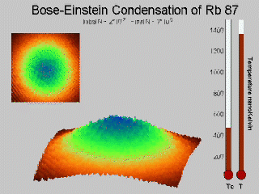
Till how much you do evaporation?

Slide 29
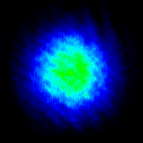
Quantum degeneracy
BEC

