Slide 1

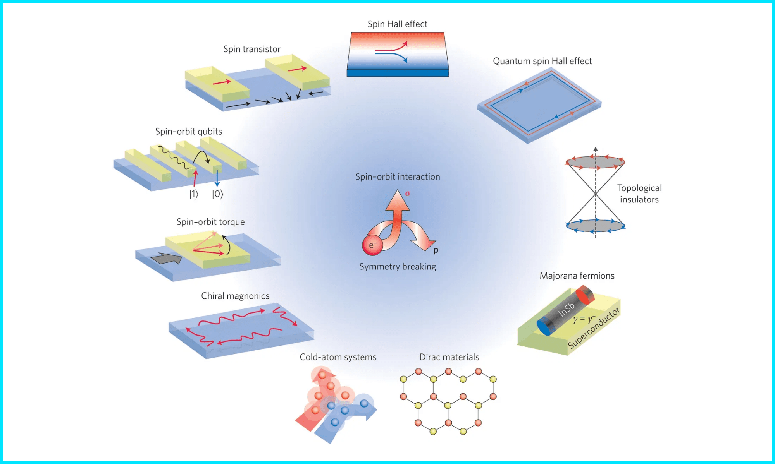
Spin-Orbit Coupling
A Detailed Current Loop Derivation
Relativistic Interaction of Electron Spin and Orbital Motion

Slide 2

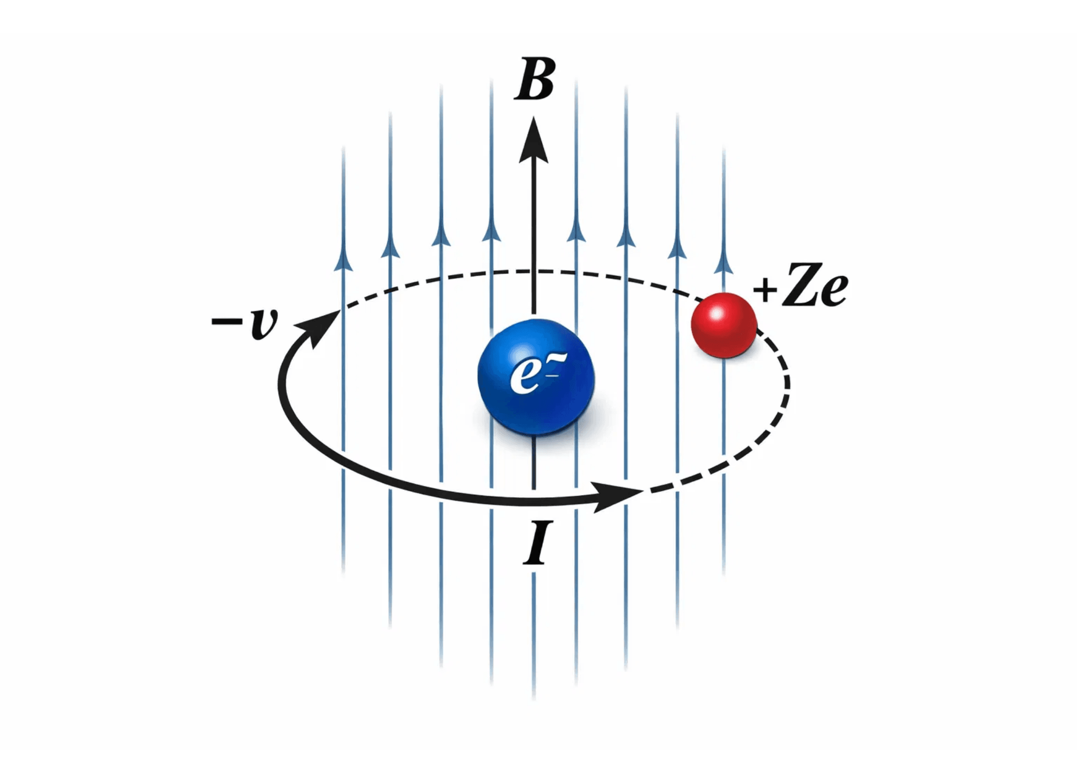
Lab Frame vs. Electron Rest Frame
In the Laboratory Frame, the nucleus is at rest while the electron orbits. The interaction is purely electrostatic.
In the Electron's Rest Frame, the nucleus (charge +Ze) appears to orbit the electron with velocity -v.
This transformation is crucial: it converts the electrostatic field into an electrodynamic interaction. The moving nucleus acts as a current loop, generating the magnetic field that interacts with the electron's spin.

Slide 3

Why Electron Mass (m_{e}) is Used
1. Interaction at the Electron's Position
The magnetic field is calculated at the center of the current loop, which is the electron's position. The interaction is between the field and the electron's intrinsic spin magnetic moment.
2. Kinematic Definition of Angular Momentum
The orbital angular momentum
L = r × p
is defined by the electron's motion. Since
p = m
_{e}
v
,
the electron mass naturally enters the equation.
3. Mass Ratio (M ≫ m_{e})
Because the nucleus is much heavier, it remains nearly stationary in the lab frame. The electron is the primary dynamic component whose mass determines the energy scales of the coupling.

Slide 4

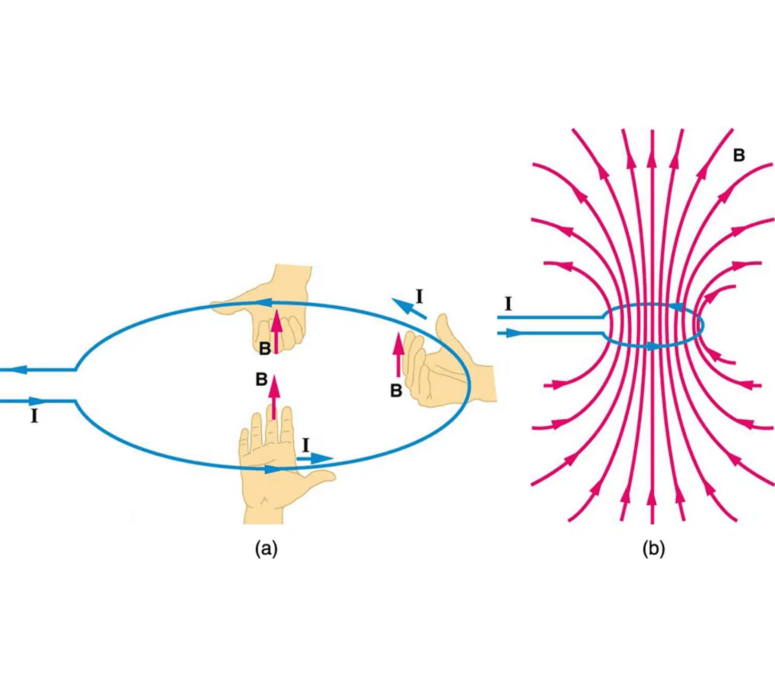
The Nucleus as a Classical Current Loop
1. Define the current I from the orbiting charge:
I = Ze / T = Ze / (2πr / v) = Zev / 2πr
2. Apply Biot-Savart Law for the center of a loop:
B = μ₀I / 2r
3. Substitute I into the B-field equation:
B = μ₀(Zev / 2πr) / 2r = μ₀Zev / 4πr²

Slide 5

The Orbital Current Loop Model
T = 2πr / v
1. Orbital Period
I = Δq / Δt = -e / T
2. Current Definition
I = - (ev / 2πr)
3. Final Orbital Current

Slide 6
Biot-Savart Law at the Nucleus
dB = (μ₀/4π) (I dl × r̂ / r²)
1. Biot-Savart Law
|dl × r̂| = dl (since dl ⊥ r̂)
2. Geometric Simplification
B = (μ₀I / 4πr²) ∫ dl = (μ₀I / 4πr²) (2πr)
3. Integration over Loop
Field at the Center
B = μ₀I / 2r

Slide 7
The Resulting Magnetic Field B
B = μ₀I / (2r)
1. Biot-Savart Result
B = (μ₀ / 2r) · [ -ev / (2πr) ]
2. Substitute Current I
Final Magnetic Field Magnitude
B = - (μ₀ev / 4πr²)

Slide 8
Relating B to Angular Momentum L
L = mvr ⇒ v = L / (mr)
1. Orbital Angular Momentum
B = - (μ₀e / 4πr²) · (L / mr)
2. Substitute v into B-Field
Internal Magnetic Field Vector
B = - [ μ₀e / (4πmr³) ] L

Slide 9
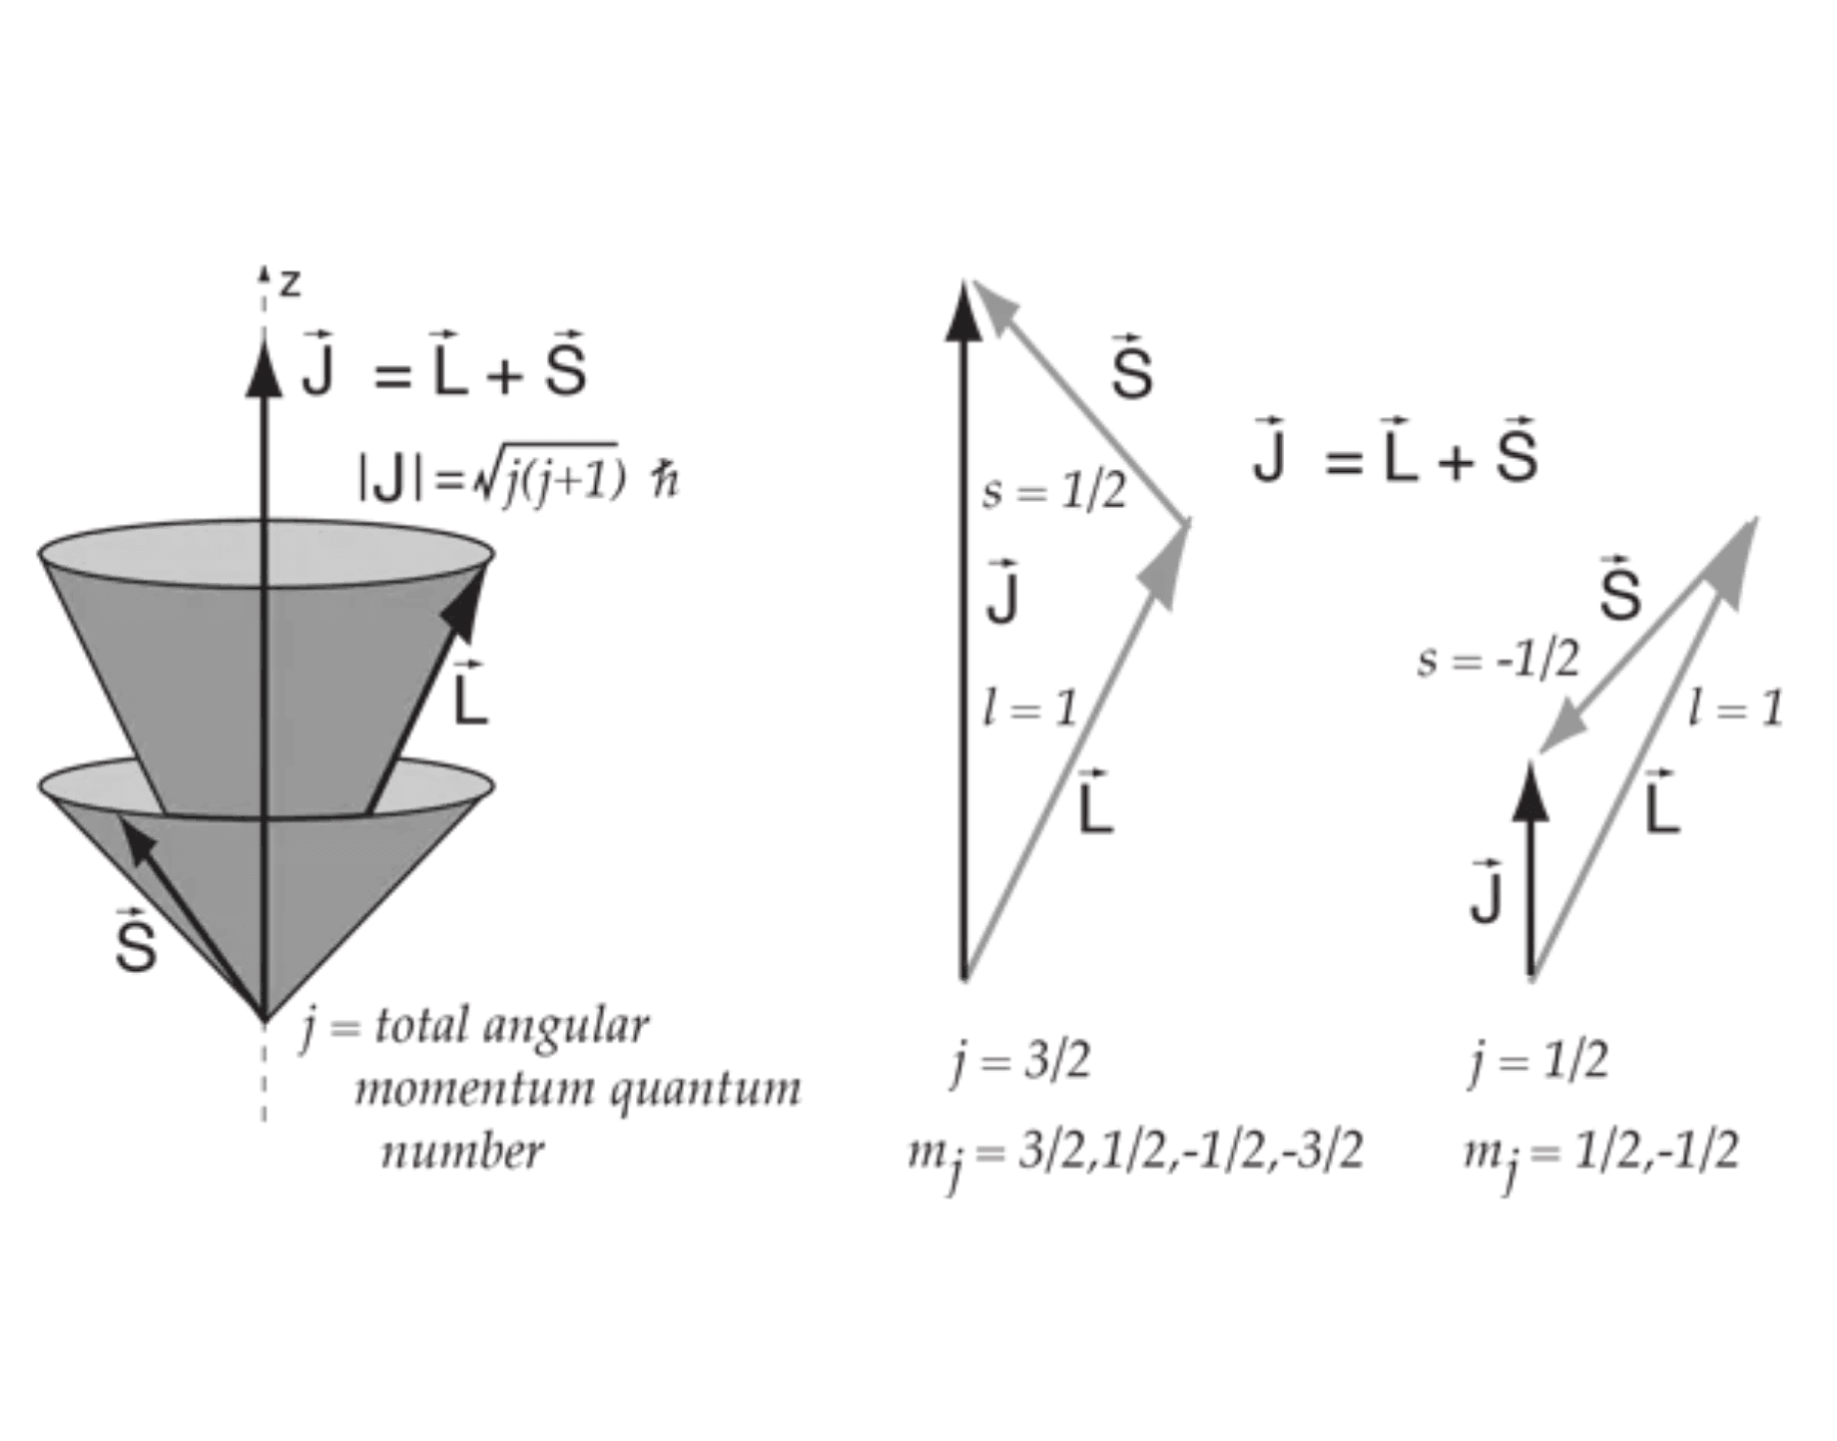
The Spin Magnetic Moment μ_{s}
Intrinsic Property
The electron possesses an intrinsic spin
S
and a
corresponding magnetic moment
μ
_{s}
.
μ_{s} = -g_{s} (e / 2m) S
The g-factor
≈ 2.0023
g
_{s}
.
For an electron, the dimensionless g-factor is
Negative Sign
The negative sign indicates that
μ
is anti-parallel
Vector Coupling of L and S
_{s}
to
S
due to the electron's negative charge.

Slide 10
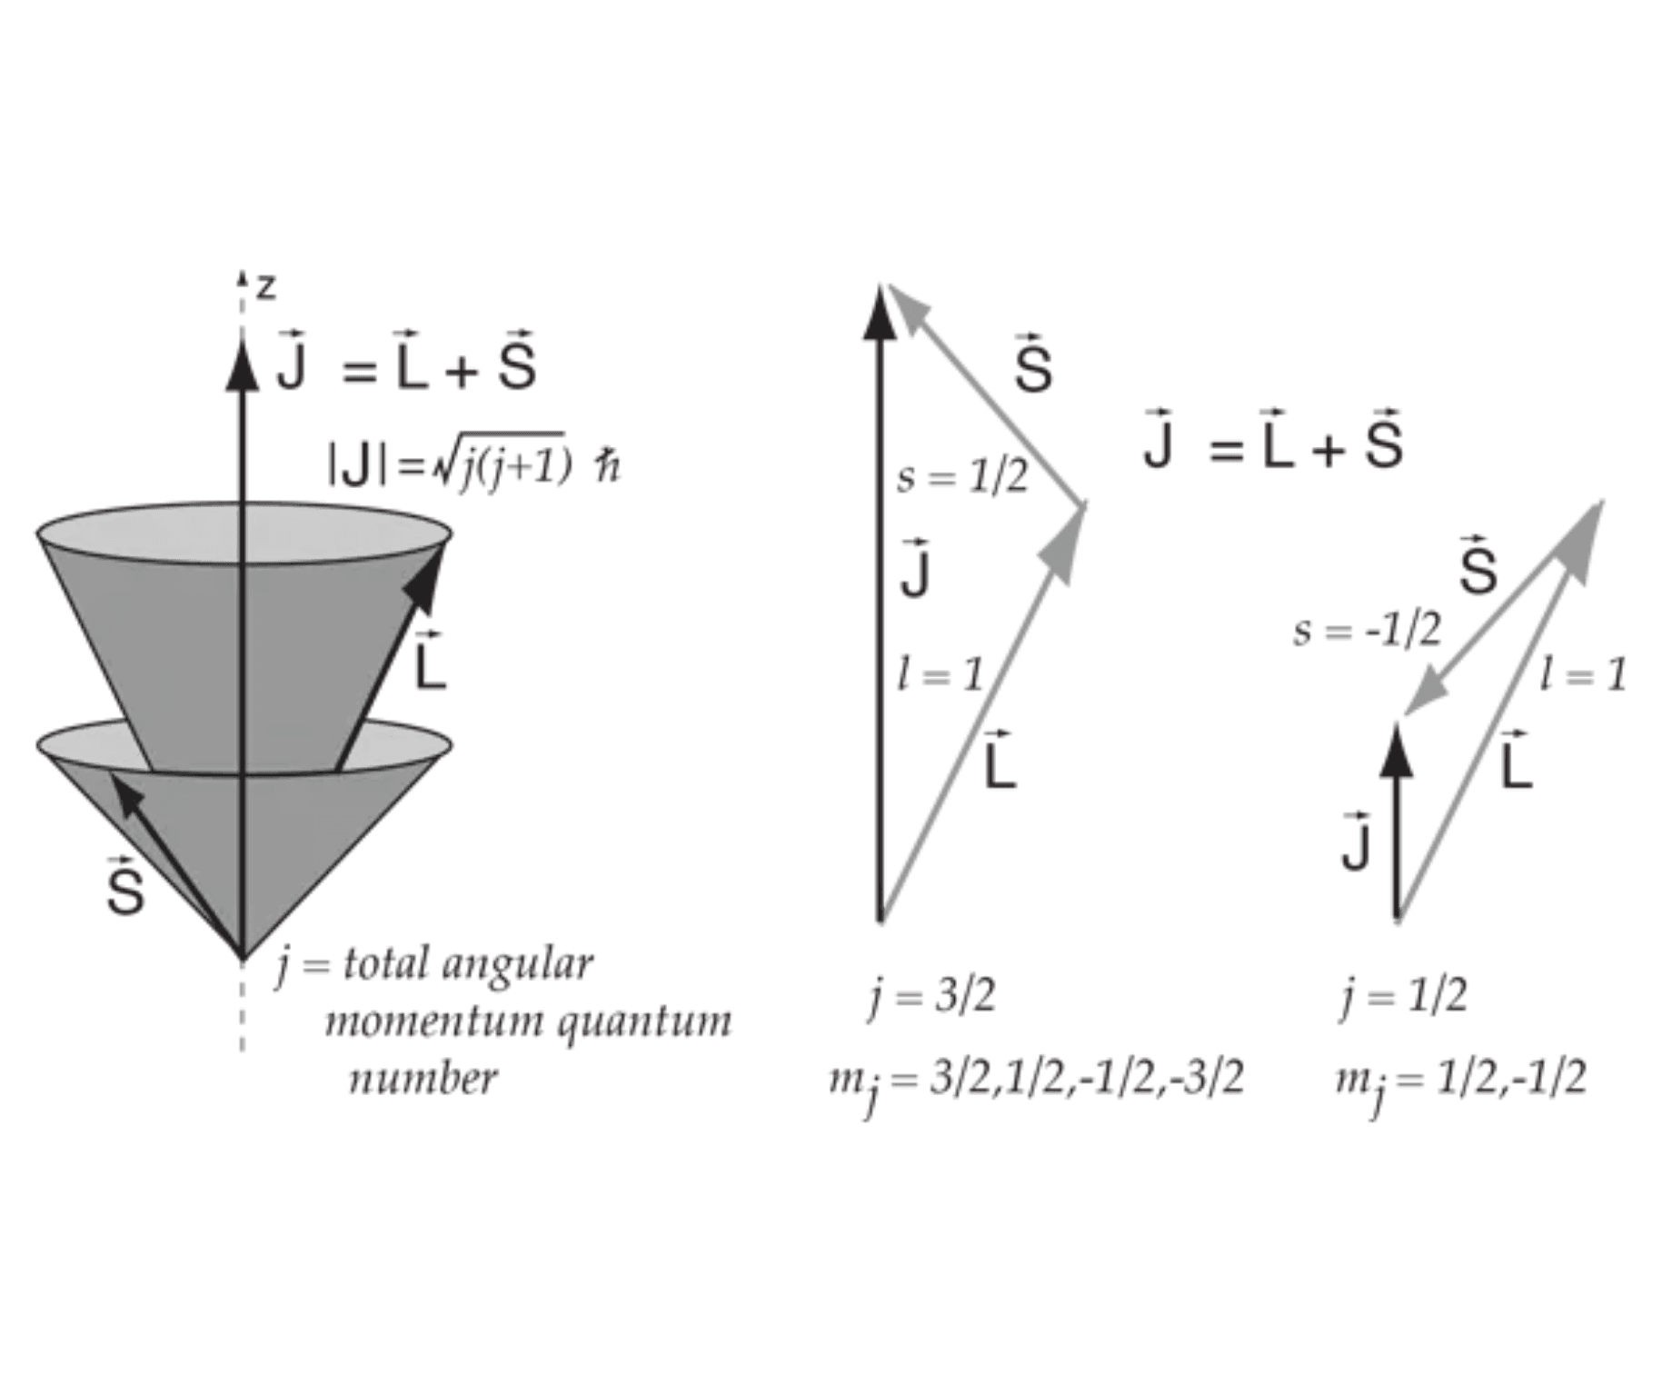
Potential Energy of a Dipole in B
Fundamental Relation
The potential energy
U
of a magnetic dipole
μ
in
an external magnetic field
B
is:
U = - μ · B
Physical Significance
This term represents the work required to orient
the dipole within the field. The negative sign
ensures that the energy is minimized when the
dipole is aligned with the field.
Vector Relationship: L, S, and J

Slide 11

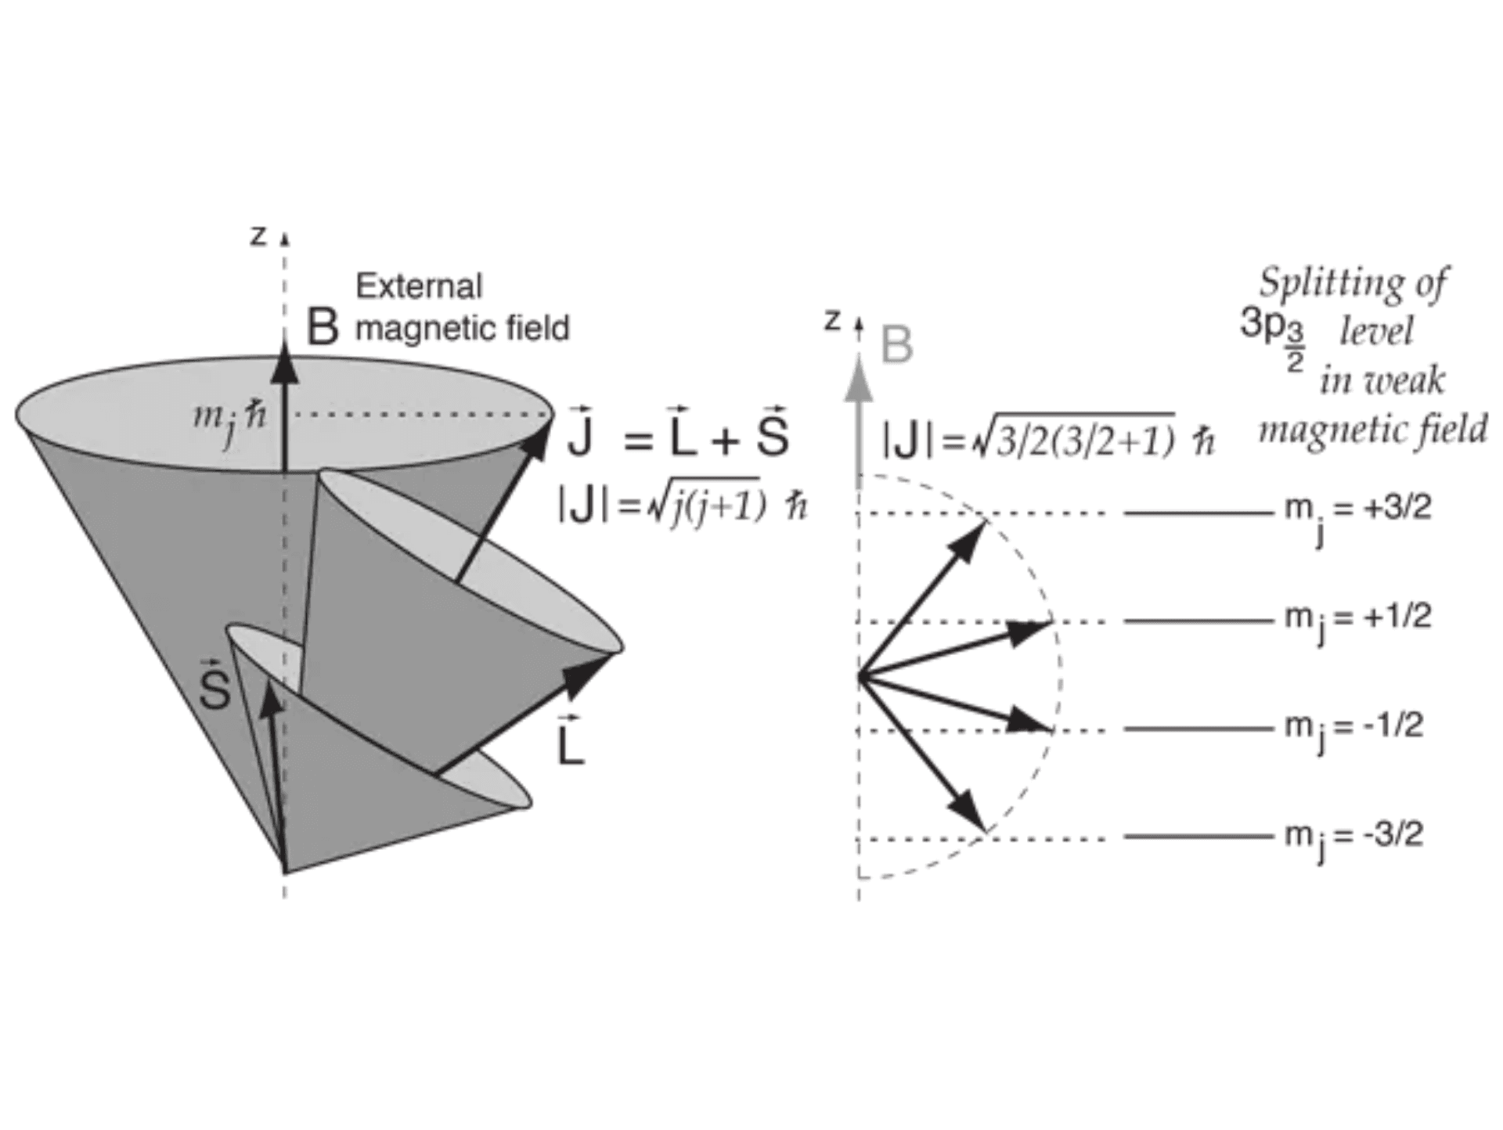
Physical Origin of the Negative Sign
Energy Minimization
Systems move toward states of lower potential
energy.
Alignment Stability
A magnetic dipole
μ
is most stable when aligned
with the field
B
.
θ = 0 ⇒ U = -μB cos(0) = -μB (Min)
Anti-Alignment Instability
Rotating the dipole against the field requires
work.
Splitting as a Result of Energy Shifts
θ = π ⇒ U = -μB cos(π) = +μB (Max)
Conclusion
The negative sign in
U = -
μ
·
B
denotes preference
for alignment.

Slide 12
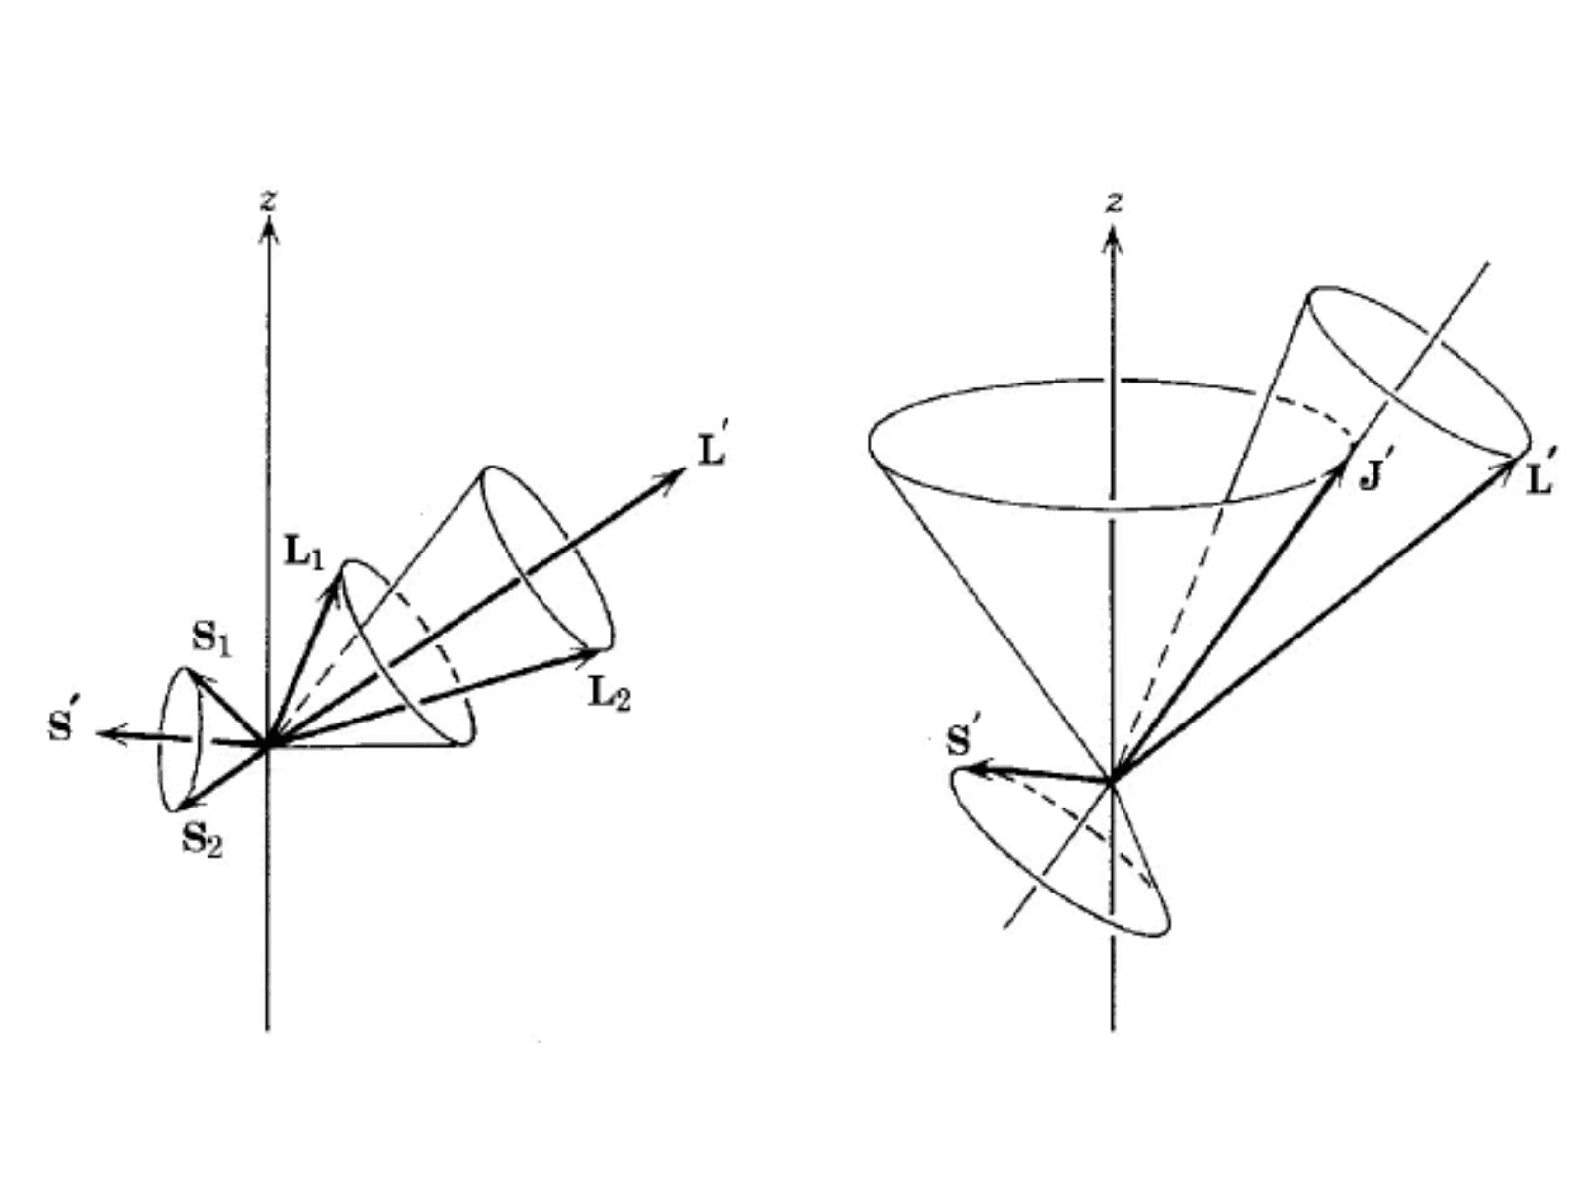
Synthesis: The Naive Hamiltonian
1. Interaction Energy
U = - μ_{s} · B
2. Substitute Components
U = - [ -g_{s}(e/2m)S ] · [ -(μ₀e/4πmr³)L ]
3. Simplify (using g_{s} = 2)
U = - [ e²μ₀ / (4πm²r³) ] (L · S)
Coupling of L and S to form J
The Naive Spin-Orbit Term
U = - [ e² / (4πε₀m²c²r³) ] (L · S)

Slide 13
The Thomas Precession Correction
Non-Inertial Frame
The electron's rest frame is accelerating
due to its orbital motion, making it a
non-inertial reference frame.
Correction Factor
1 / 2
Kinematic Effect
Relativistic rotation of the coordinate
system occurs, known as Thomas
U_{SO} = ½ U_{naive}
Precession, which adds an energy term.
The Correction
Corrected Interaction
H_{SO} ∝ ½ (L · S)
This effect reduces the effective
magnetic field by exactly a factor of 2,
resolving the "factor of 2" discrepancy.

Slide 16

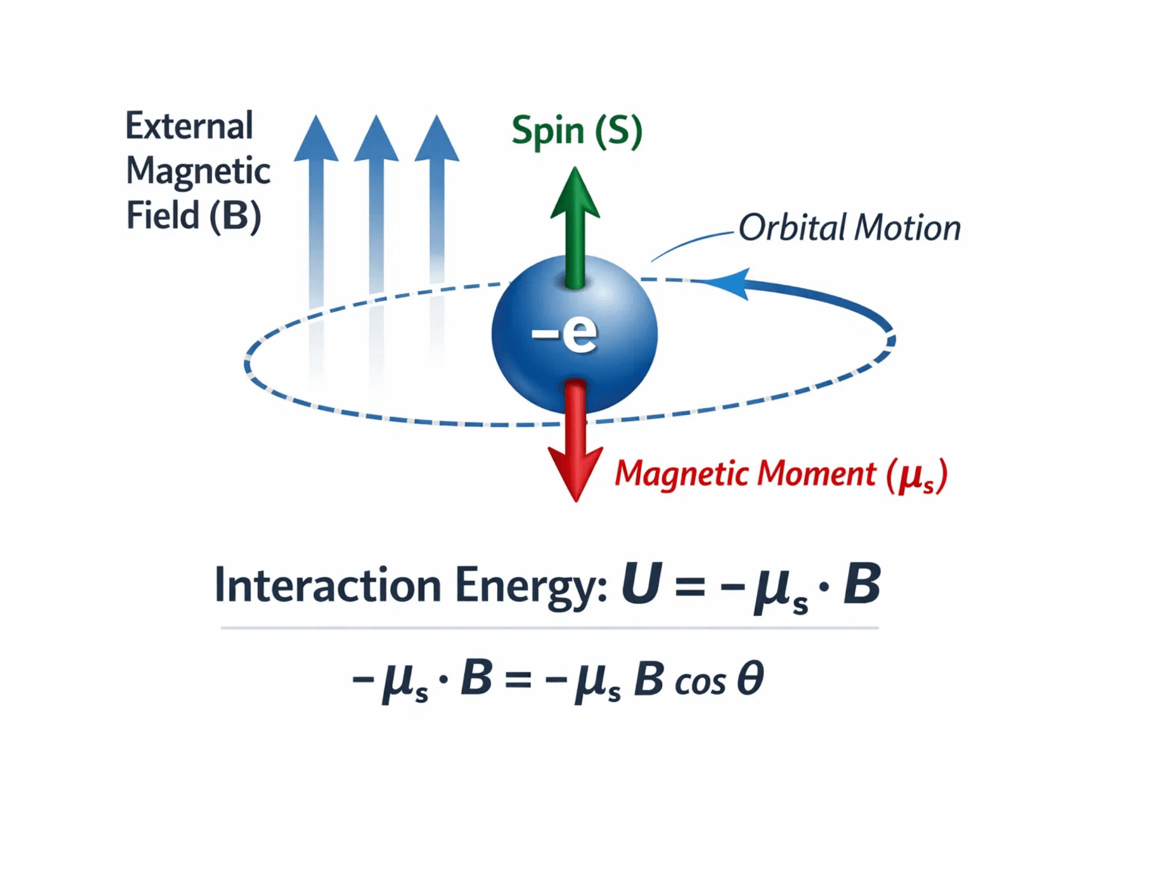
Thomas Precession & The Relativistic Correction
The electron's rest frame is non-inertial because it is constantly accelerating as it orbits the nucleus.
Relativistic kinematics requires an additional rotation term known as Thomas Precession, which arises from the composition of Lorentz boosts.
This effect reduces the interaction energy by exactly half, resolving the "factor of 2" discrepancy in early models.
Corrected Spin-Orbit Hamiltonian:
Interaction of Spin Magnetic Moment with Orbital Field
H_{so} = ½ · U_{magnetic}

Slide 17
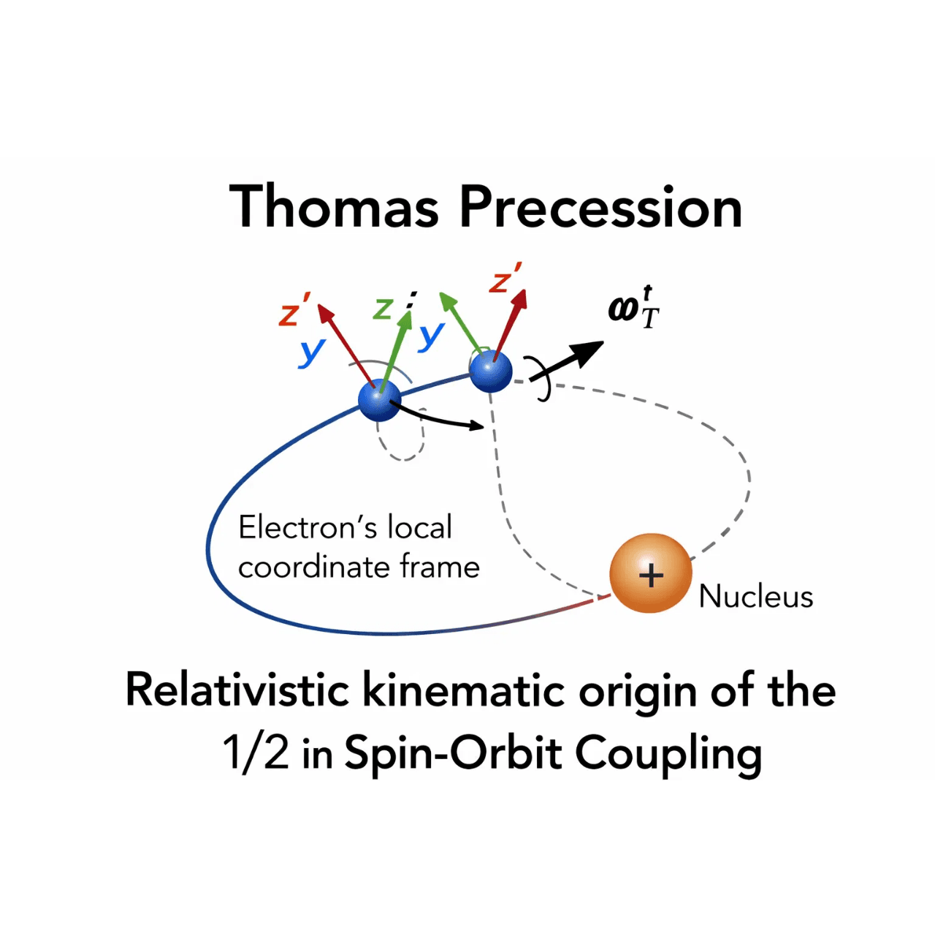
Evaluating the L·S Term
1. Define Total Momentum
J = L + S
2. Square the Operator
J² = L² + S² + 2(L·S)
3. Isolate the Coupling Term
L·S = ½(J² - L² - S²)
The eigenvalues are determined by the quantum numbers j, l, and s:
Relativistic Kinematic Context: Thomas Precession
⟨L·S⟩ = (ħ²/2) [j(j+1) - l(l+1) - s(s+1)]

Slide 18
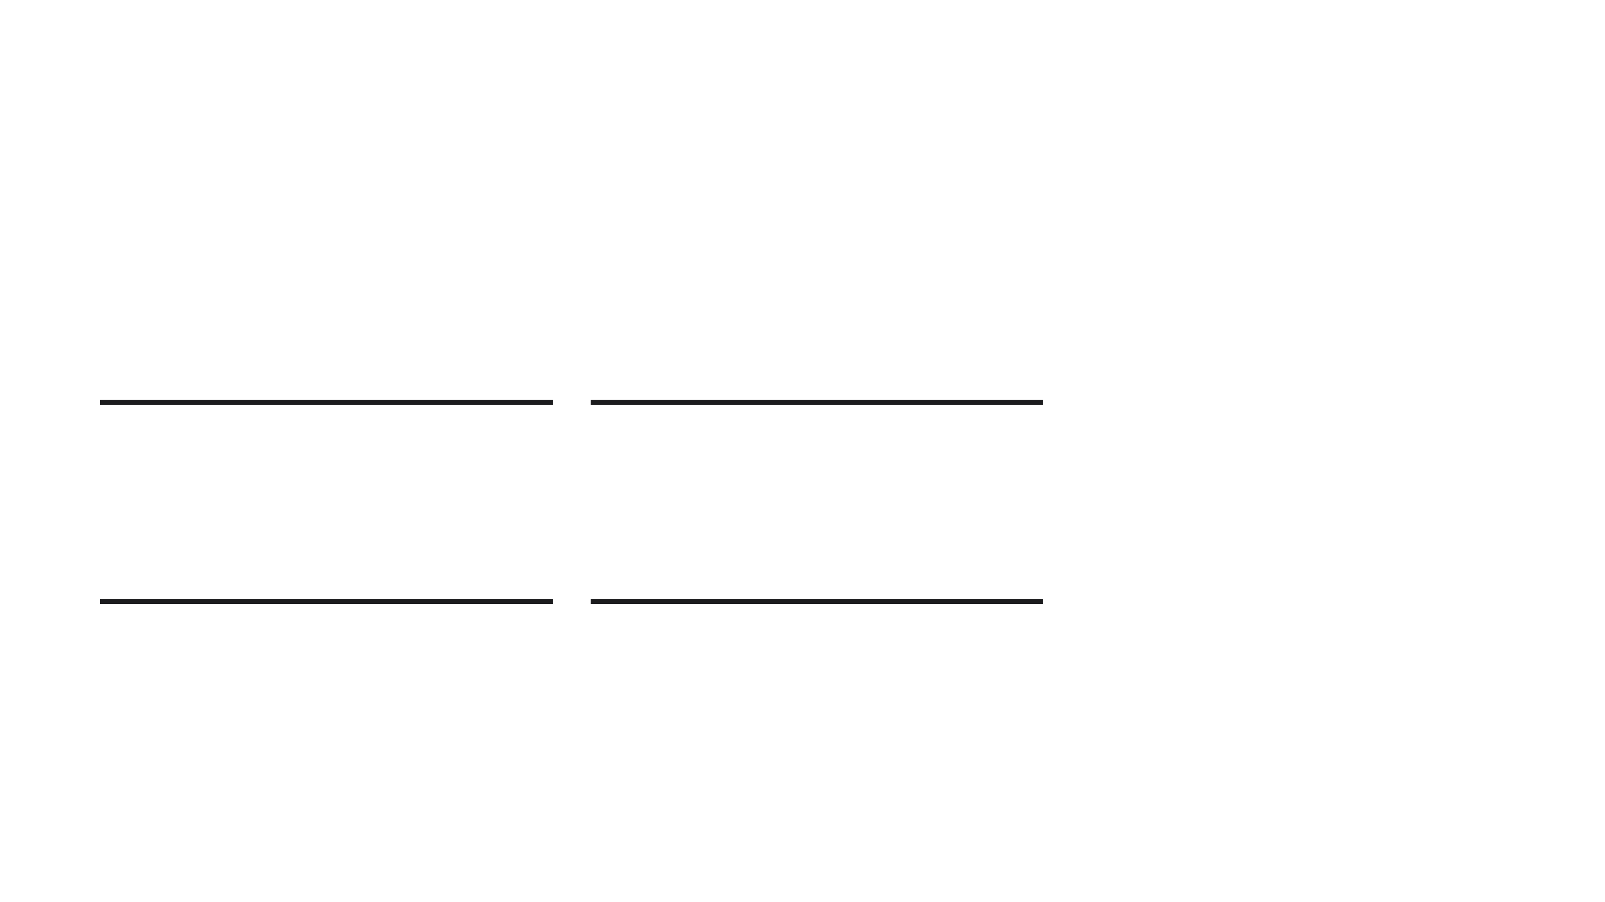
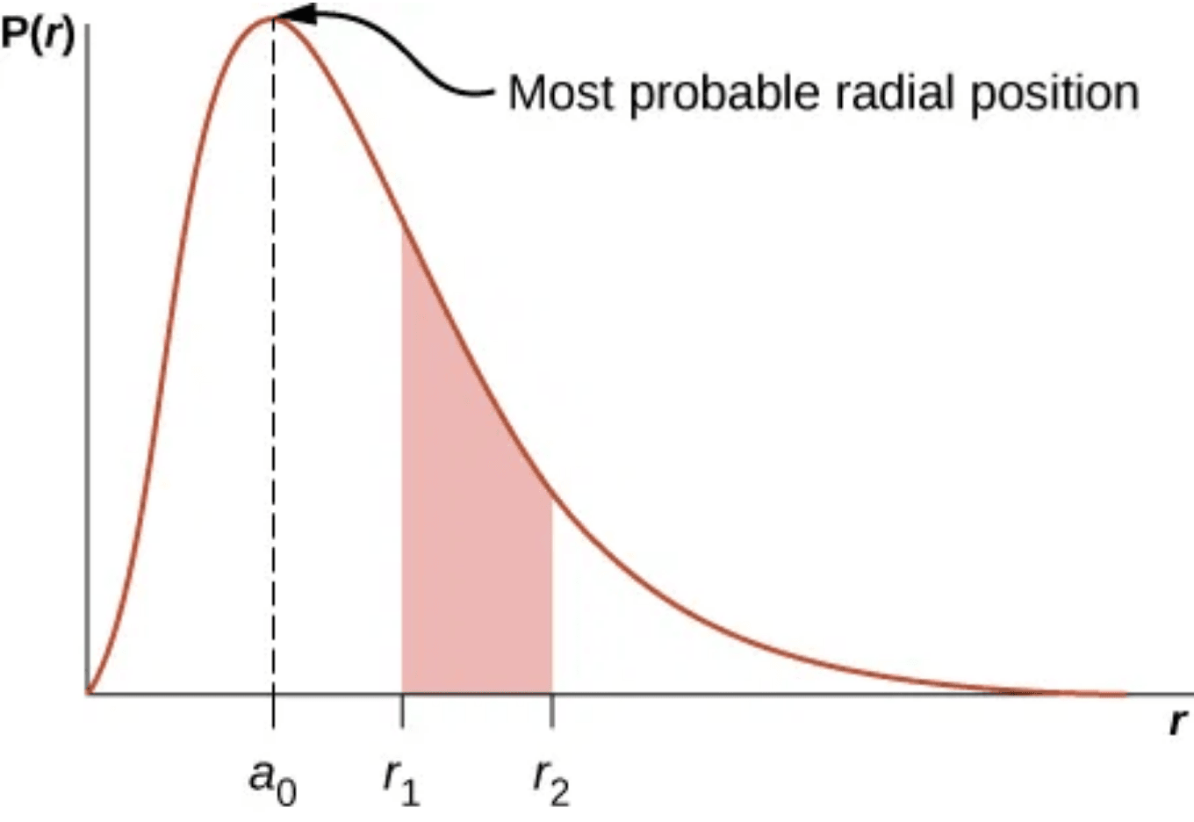
Expectation Value of 1/r³
⟨1/r³⟩ = Z³ / [n³a₀³ l(l+1/2)(l+1)]
Atomic Number (Z³)
Principal Quantum (n⁻³)
The interaction strength increases cubically with Z, making it dominant in heavy elements.
As n increases, the electron is further from the nucleus, rapidly weakening the coupling.
Angular Momentum (l)
Physical Origin
Radial probability distribution P(r) determines the spatial average of the interaction.
The term depends heavily on l. Note that for l=0, the formula formally diverges.
Derived from the radial wave functions R_{nl}(r) of the hydrogen-like atom.

Slide 19
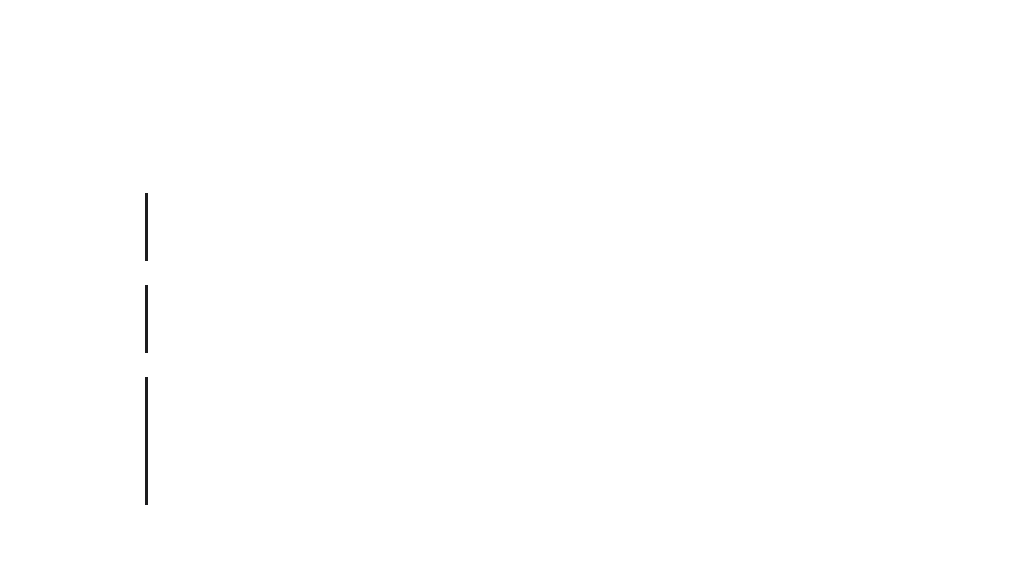
Evaluating the L · S Term
01
J = L + S
Define the Total Angular Momentum as the sum of orbital and spin components.
02
J² = (L + S)² = L² + S² + 2(L · S)
Square the operator to isolate the coupling term.
03
L · S = ½(J² - L² - S²)
The expectation value is determined by the quantum numbers j, l, and s:
⟨L · S⟩ = (ħ²/2) [j(j+1) - l(l+1) - s(s+1)]

Slide 20
Step-by-Step: L·S for j = l ± 1/2
Case 1: j = l + 1/2
⟨L·S⟩ = (ħ²/2) [(l+1/2)(l+3/2) - l(l+1) - 3/4]
⟨L·S⟩ = (ħ²/2) [l² + 2l + 3/4 - l² - l - 3/4]
⟨L·S⟩ = ħ²l / 2
Spin is parallel to orbital angular momentum.
Case 2: j = l - 1/2
⟨L·S⟩ = (ħ²/2) [(l-1/2)(l+1/2) - l(l+1) - 3/4]
⟨L·S⟩ = (ħ²/2) [l² - 1/4 - l² - l - 3/4]
⟨L·S⟩ = -ħ²(l+1) / 2
Spin is anti-parallel to orbital angular momentum.

Slide 21
Calculating the Energy Shift (ΔE_{SO})
General Expression
ΔE_{SO} = ⟨H_{SO}⟩ = [Ze² / (8πε₀m_{e}²c²)] ⟨1/r³⟩ ⟨L · S⟩
Defining Constant C
C = [Ze² / (8πε₀m_{e}²c²)] [Z³ / (n³a₀³l(l+1/2)(l+1))]
We group the radial part and constants into C to simplify the energy level expressions.
The total energy shift is the product of the radial expectation value and the angular momentum coupling term.
Energy Levels
1. E₊ = C · (ħ²l / 2)
2. E₋ = -C · (ħ²(l+1) / 2)
These represent the energy shifts for the j = l + 1/2 and j = l - 1/2 states, respectively.

Slide 22
The Energy Gap Calculation
1
Define the Energy Difference
Calculation Logic
ΔE = E₊ - E₋
The energy gap represents the total splitting between the j = l + 1/2 and j = l - 1/2 states.
2
Factor out the Constant C
ΔE = C · (ħ²/2) [ l - (-(l+1)) ]
By subtracting the lower energy state from the higher one, we isolate the magnitude of the Spin-Orbit interaction.
3
Simplify Angular Terms
ΔE = C · (ħ²/2) (2l + 1)
4
Substitute Constant C
ΔE = [Ze²ħ²(2l+1) / 16πε₀mₑ²c²] ⟨1/r³⟩

Slide 23

Final Energy Gap Formula
Simplification Step
Since (2l + 1) = 2(l + 1/2), the middle term in the denominator cancels out perfectly.
The Resulting Expression
ΔE = [Z⁴e²ħ²] / [8πε₀mₑ²c²n³a₀³l(l+1)]
Energy levels for sodium. The 3p level splitting is a direct application of this Z⁴ scaling formula.
Fine Structure Constant Scaling
ΔE = [Z⁴α⁴mₑc²] / [2n³l(l+1)]
Where α = e² / (4πε₀ħc) ≈ 1/137

Slide 24

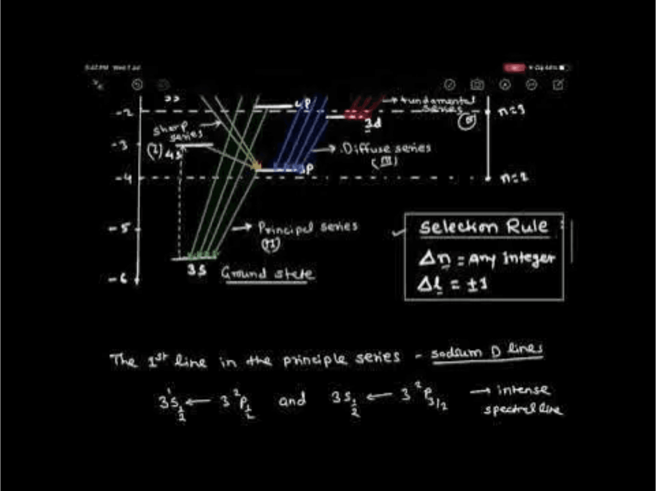
Summary and Physical Implications
Scaling Laws
The energy gap ΔE scales as Z⁴ and n⁻³. This explains why fine structure is prominent in heavy atoms but remains a tiny correction in Hydrogen.
Experimental Proof
The Sodium D-line doublet (589.0 nm and 589.6 nm) is the most famous macroscopic evidence of spin-orbit splitting in the 3p state.
Spin-orbit coupling serves as a fundamental bridge between classical electromagnetism and relativistic quantum mechanics.
Experimental evidence: The Sodium D-line splitting and selection rules.

Slide 25

Scaling Laws of Spin-Orbit Splitting
ΔE_{so} ∝ Z⁴ / [n³ l(l+1/2)(l+1)]
Atomic Number (Z⁴)
Principal Quantum Number (n⁻³)
The splitting magnitude increases with the fourth power of Z. This makes spin-orbit effects dominant in heavy elements while remaining a tiny correction in light atoms.
As the electron moves to higher energy shells (larger n), the average distance from the nucleus increases, rapidly weakening the interaction strength.
Element
Atomic Number (Z)
State
Splitting (ΔE)
Hydrogen
1
2p
~0.000045 eV
Sodium
11
3p
~0.0021 eV
Cesium
55
6p
~0.068 eV

Slide 26

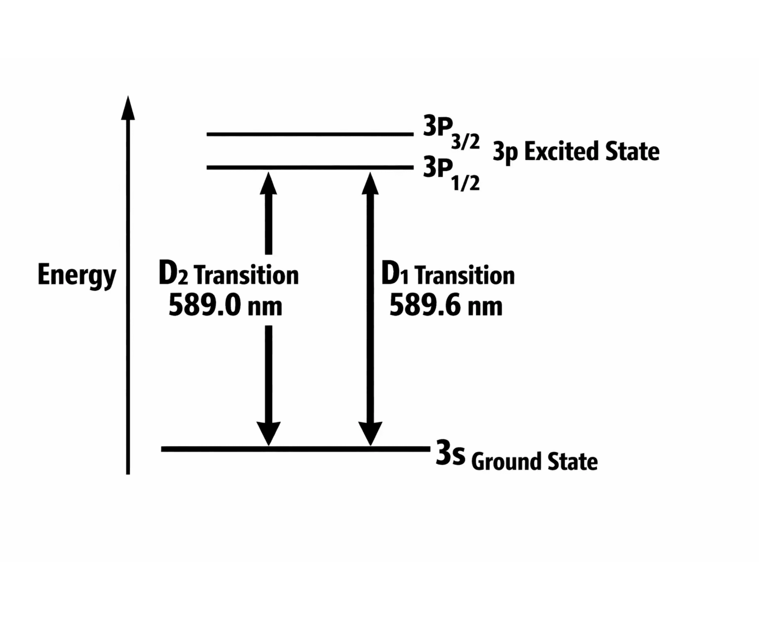
The Sodium D-Line Doublet
The most famous evidence for spin-orbit coupling is the yellow doublet in the sodium spectrum.
When a valence electron drops from the 3p state to the 3s ground state, the l=1 level is split into two distinct energy states by the interaction.
Transition
Wavelength
State
D1 Line
589.6 nm
3P
_{1/2}
→ 3s
D2 Line
589.0 nm
3P
_{3/2}
→ 3s
The energy splitting is approximately 0.0021 eV, a direct macroscopic proof of quantum spin.

