Slide 1
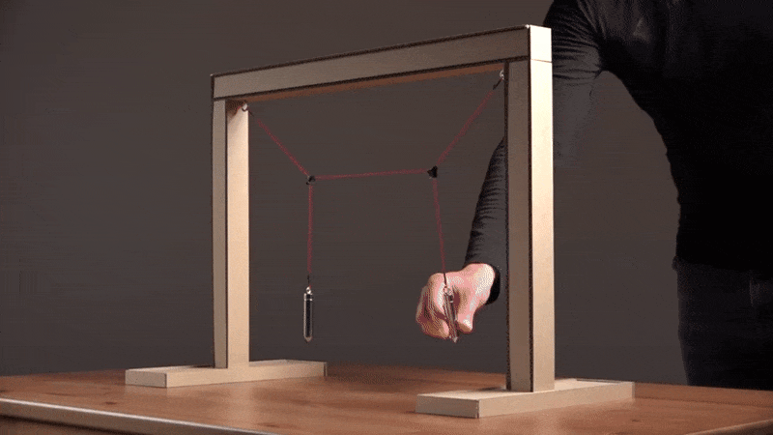
Coupled Oscillations

Slide 2
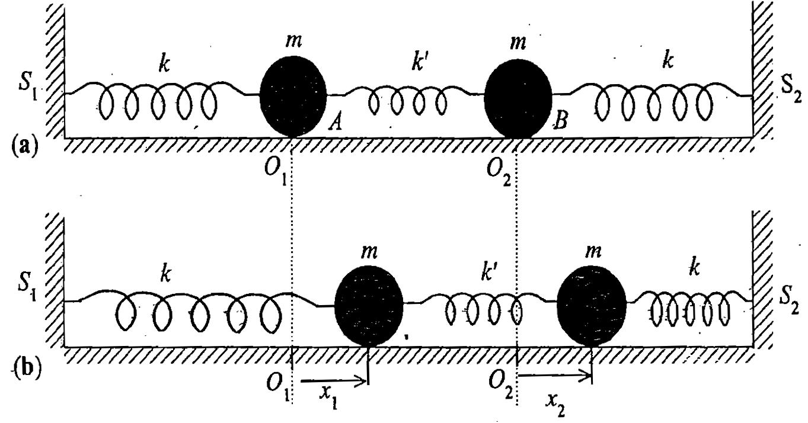
Coupled Oscillators
NON-INTITUTIVE!

Slide 3
Coupled Oscillators
Equations of motion are
Simultaneous coupled differential equation

Slide 4
Matrix equation of coupled oscillator

Slide 5
Trial solution

Slide 6
Following the procedure of getting Eigen values and Eigen vectors

Slide 7
Finding the energy eigen values λ of [A]

Slide 8
Finding Eigen values of [A]

Slide 9
Characteristic equation:
Eigen values of [A]

Slide 10
Eigen values of [A]

Slide 11
Find the eigen vectors of [A]

Slide 12
Finding Eigen vectors of [A]
Substitute each values of α² in the Eigen value equation
Putting α₁² in the Eigen value equation to get first set of
Eigen vectors

Slide 13
Substituting

Slide 14
Substituting

Slide 15
Finding Eigen vectors of [A]
Substitute each values of α₃² in the Eigen value equation
Putting α₃² =-(ω₀²+2ω_{c}² ) in the Eigen value equation

Slide 16
Substituting

Slide 18
S
U
M
M
A
R
Y

Slide 20
Let’s recapitulate……

Slide 22
Physical Interpretation

Slide 24
=
+

Slide 25
Plots: Amplitude v/s time
x₁(t) v/s t
x₂(t) v/s t

Slide 26
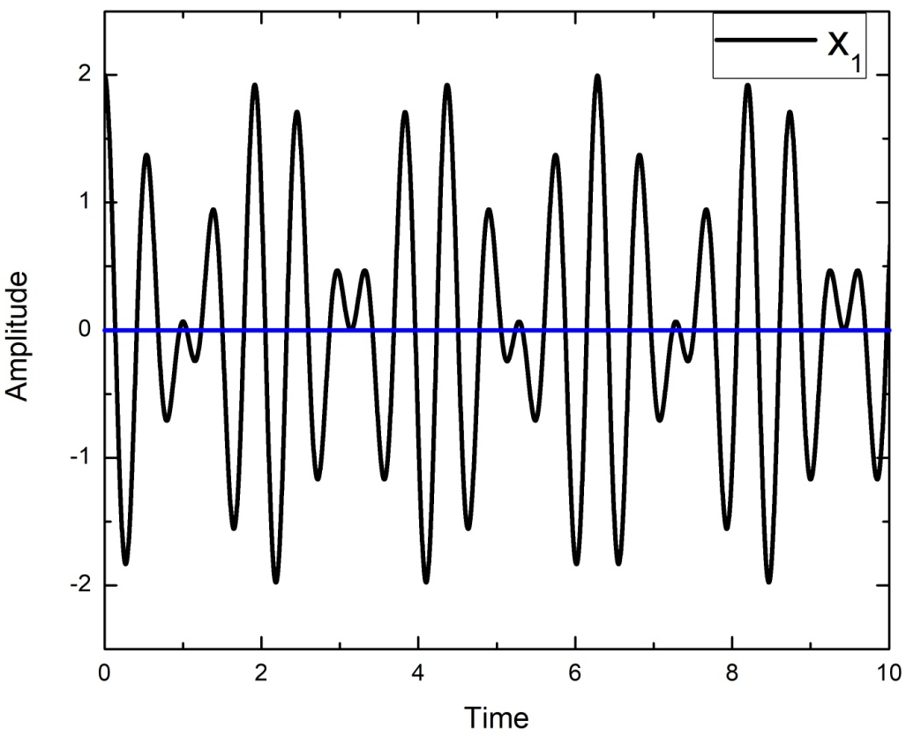
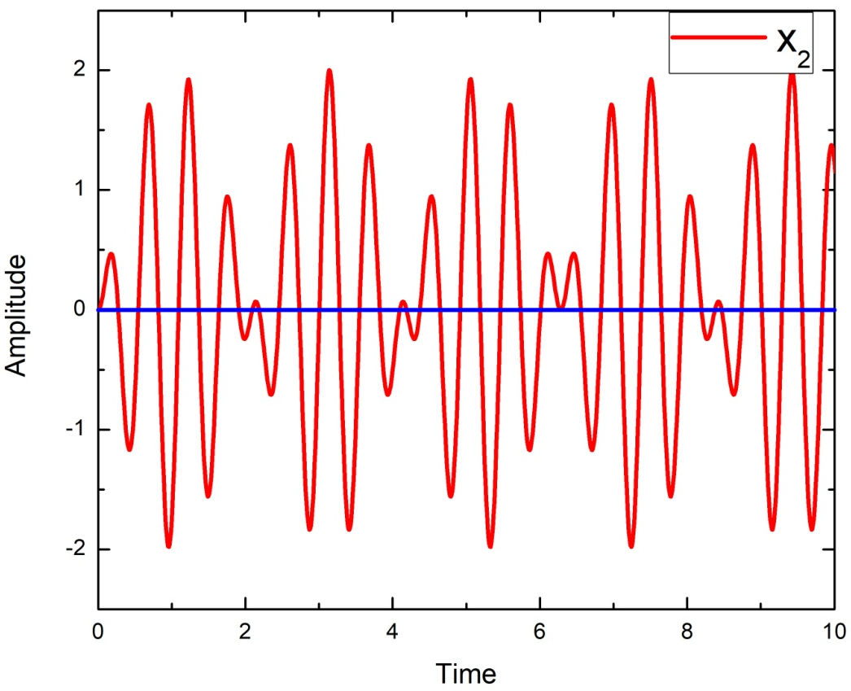

Slide 27
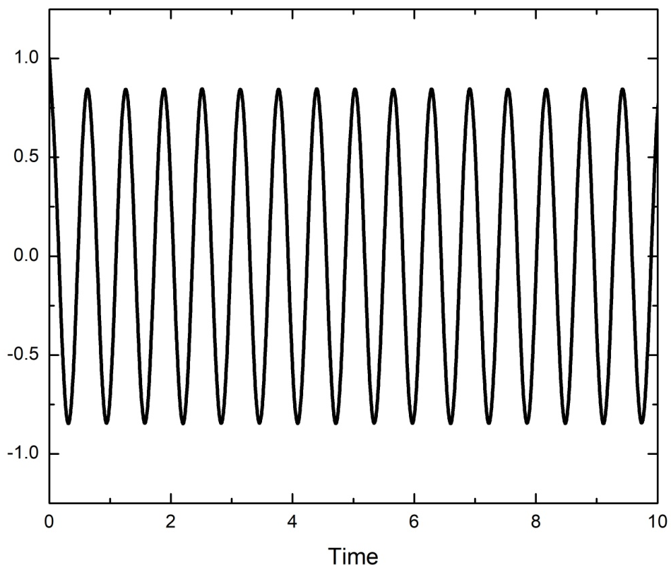
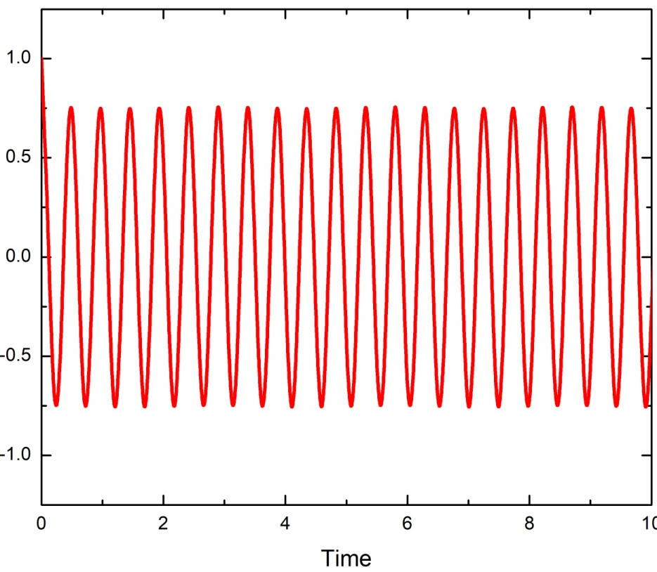

Slide 28
Normal Coordinates
Can we get some co-ordinates which will oscillate with one pure frequency??
Try by just adding x₁ and x₂ and subtracting
x₁ and x₂

Slide 29
Normal Coordinates
Inverse transformation

Slide 30
Why Normal Co-ordinates?
This will help in knowing 2 different frequencies independently
If you plot X₁(t) and X₂(t) v/s time you get nice cosine graph
x₁(t) and x₂(t) v/s time was erratic in nature
Out of phase and in-phase motion cannot get visualized though!

Slide 31
Is there any alternative way of solving the coupled differential equation?

Slide 32
Alternate way of deriving….
Equations of motion are
Simultaneous coupled differential equation

Slide 33
Equations of motion are
…….. (1)
…….. (2)
(1)+(2)
(1)-(2)

Slide 34
…….. (3)
…….. (4)
BACK TO NORMAL CO-ORDINATES AND NORMAL MODES

Slide 35
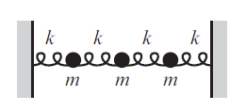
2
D
I
S
C
R
E
T
E
TO
C
O
N
T
I
N
O
U
S
P
L
A
N
3
.
.
.
N
∞

